Slide 1
Brand Valuation
Through Brand Passion Strategy
Zeenat Jabbar

Slide 2
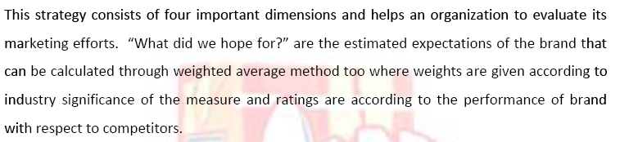
Passion Brand Strategy

Slide 3
Four Dimensions of
Passion Brand Strategy
Brand Performance
Brand Perception
Brand Inside
Brand Currency
OLPERS AS A CASE STUDY

Slide 4
OLPERS FIRST RAMZAAN

Slide 5
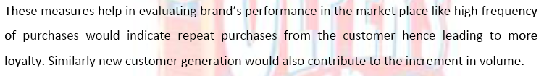
Brand Performance

Slide 6
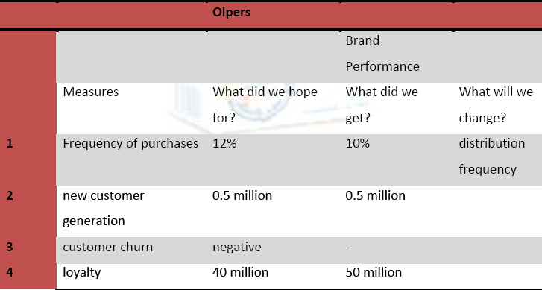
Brand Performance

Slide 7
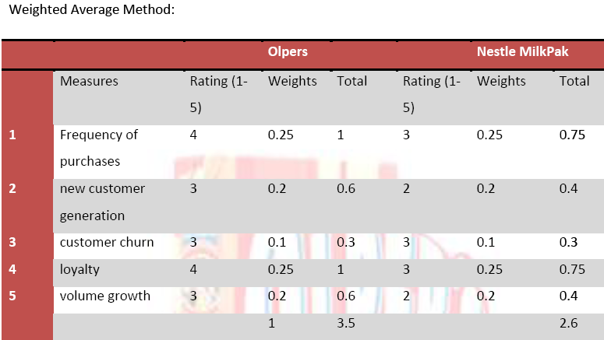
Brand Performance

Slide 8
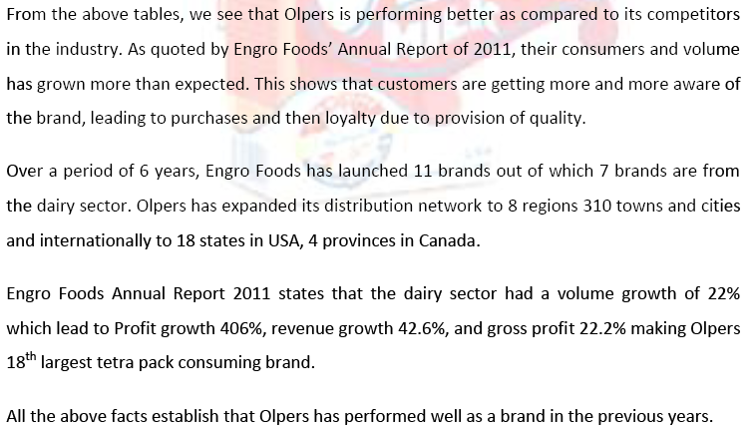
Brand Performance

Slide 9
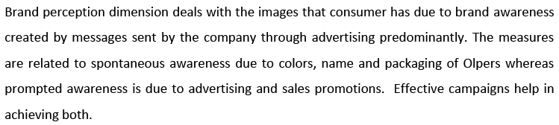
Brand Perception

Slide 10
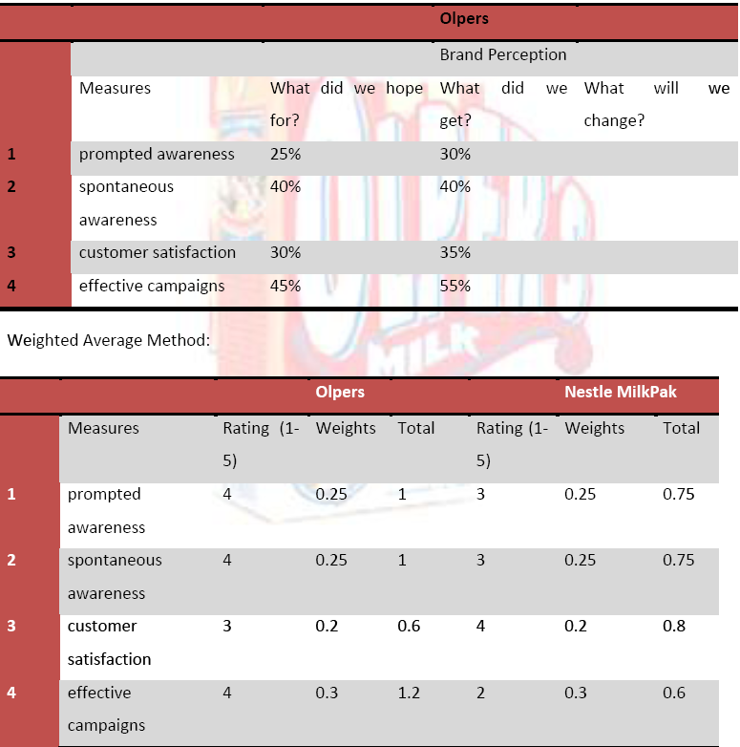
Brand Perception

Slide 11
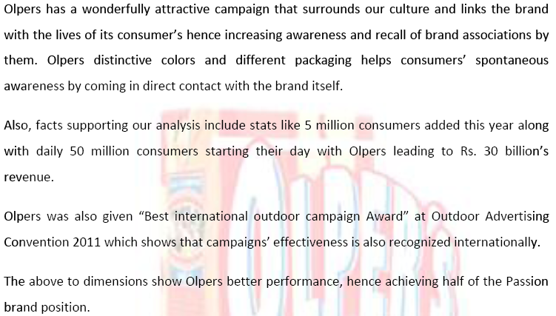
Brand Perception

Slide 12

Brand Inside

Slide 13
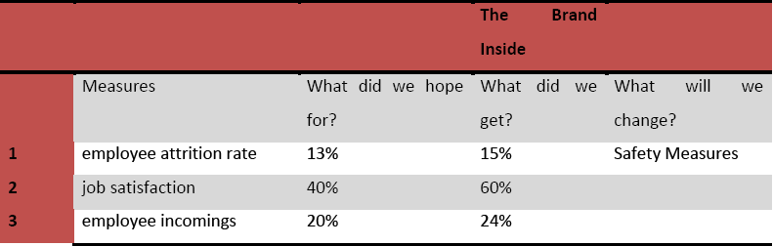
Brand Inside

Slide 14
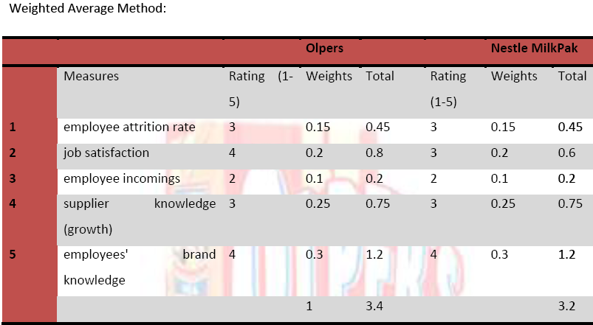
Brand Inside

Slide 15
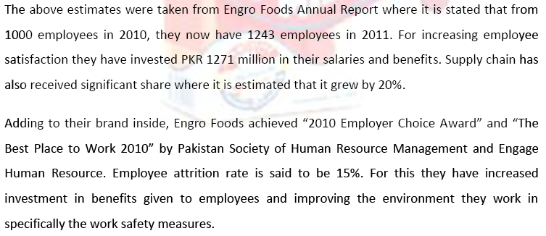
Brand Inside

Slide 16
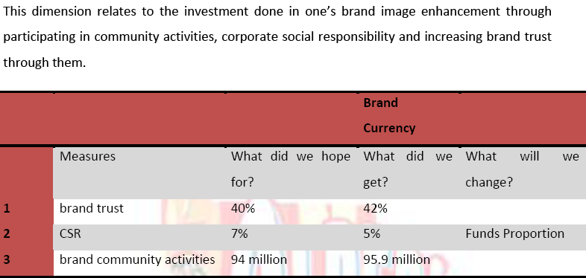
Brand Currency

Slide 17
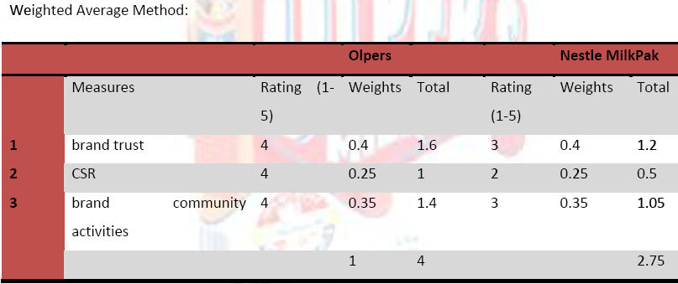
Brand Currency

Slide 18
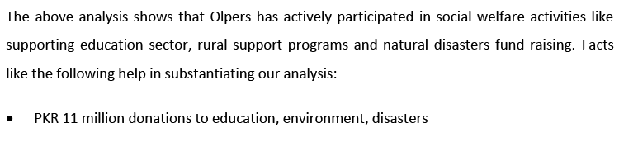
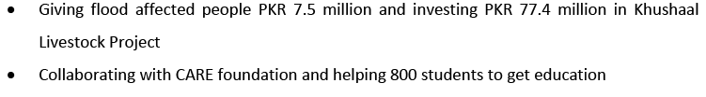
Brand Currency

