Slide 1
BRAND REPORT CARD
Zeenat Jabbar

Slide 2
WORLD’S TOP TEN BRANDS SHARE THE COMMON TRAITS
1. Brand excels at delivering the benefits the customers truly desire
2. Btand stays relevant
3. Pricing strategy is based on consumer’s perception of value
4. Brand is properly positioned
5. Brand is consistent
6. Brand portfolio & hierarchy make sense
7. Brand makes use of & coordinates a full repertoire of marketing activities to build brand equity
8. Brand managers understand what the brand means to consumers
9. Brand is given proper, sustainable support
10. Company manages sources of brand equity

Slide 3
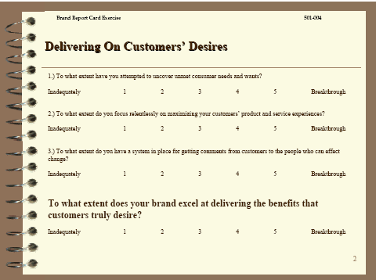

Slide 4
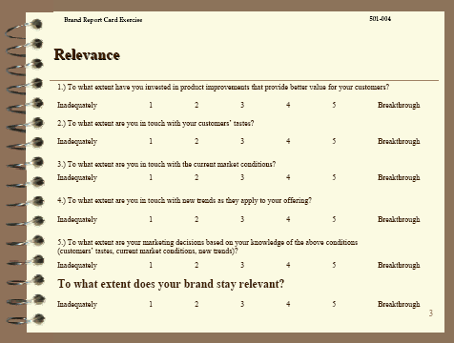

Slide 5
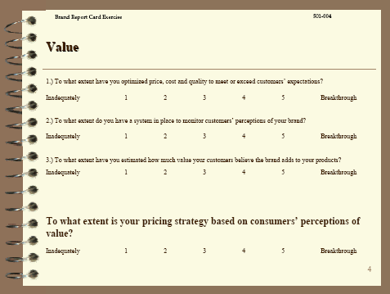

Slide 6
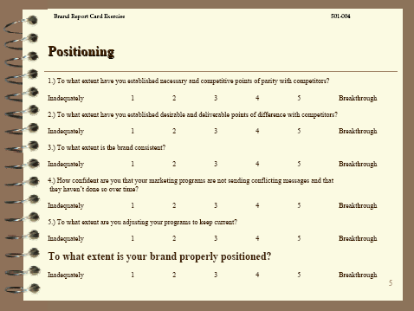

Slide 7
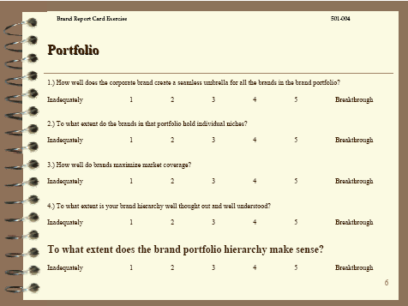

Slide 8
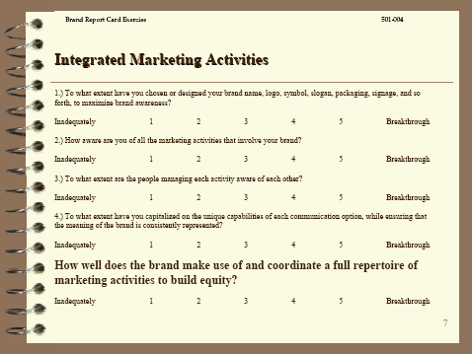

Slide 9
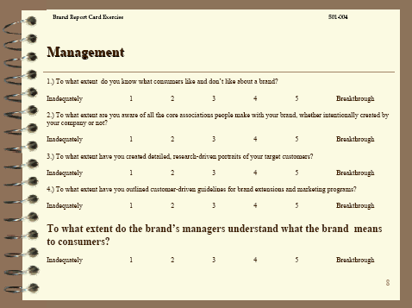

Slide 10
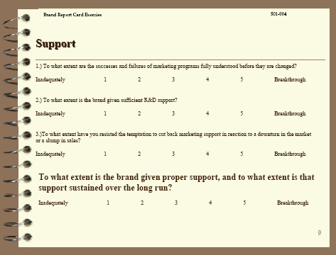

Slide 11
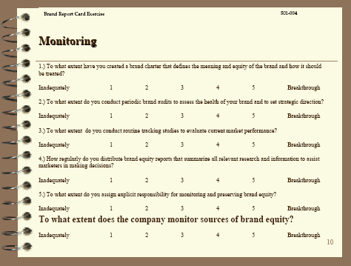

Slide 12
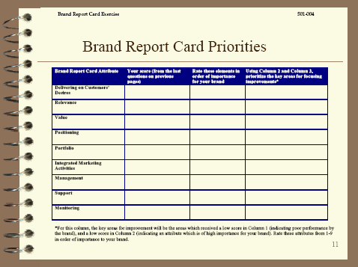

Slide 13


Slide 14
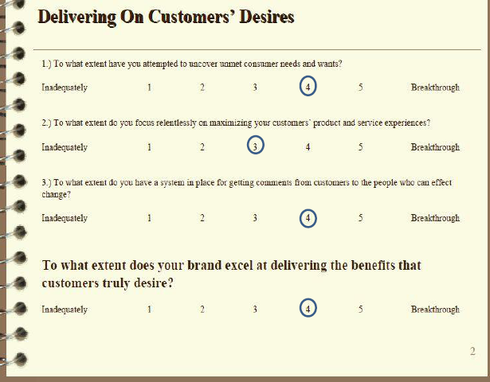

Slide 15
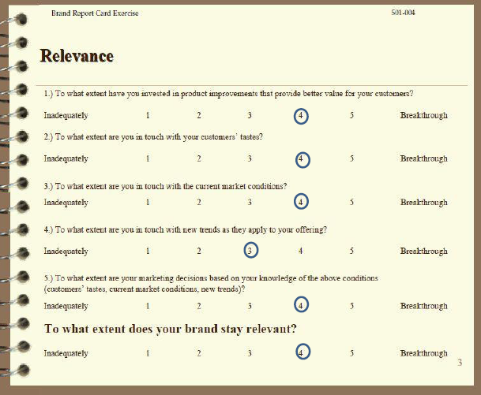

Slide 16
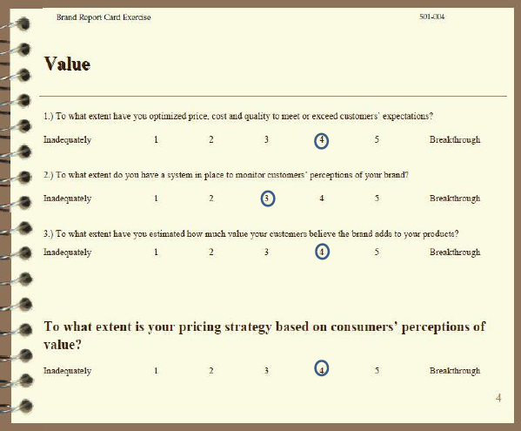

Slide 17
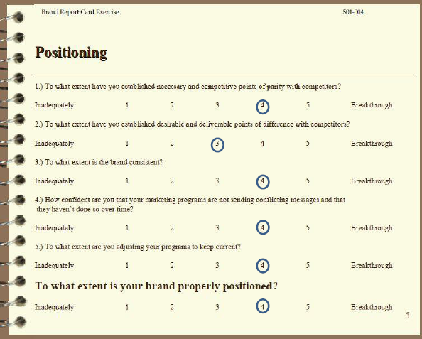

Slide 18
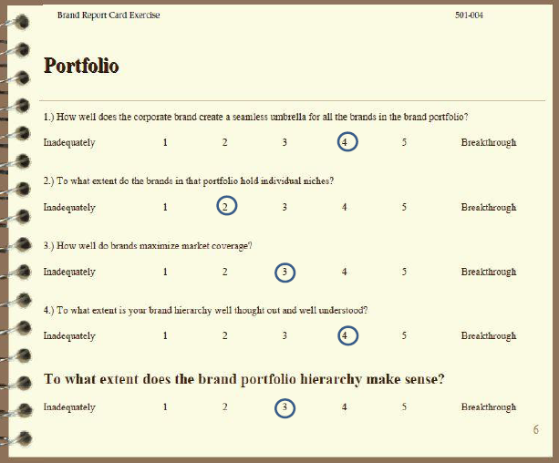

Slide 19
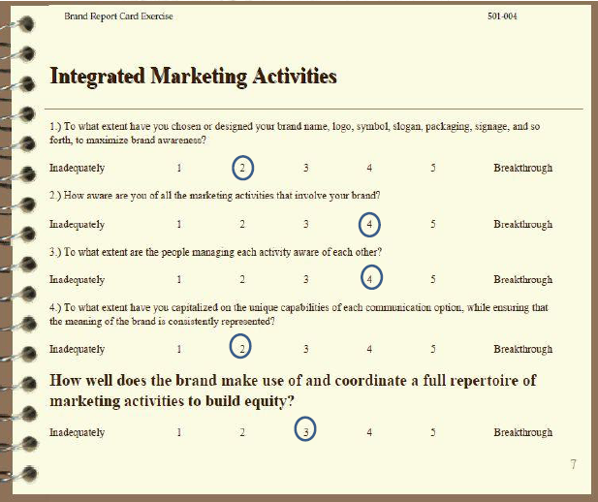

Slide 20
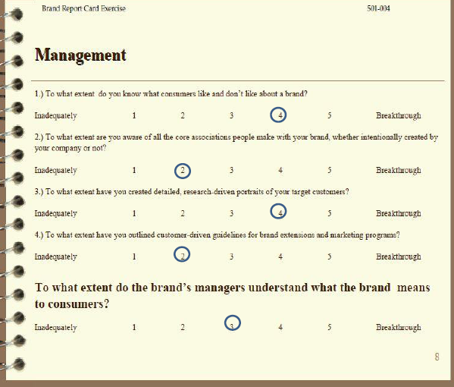

Slide 21
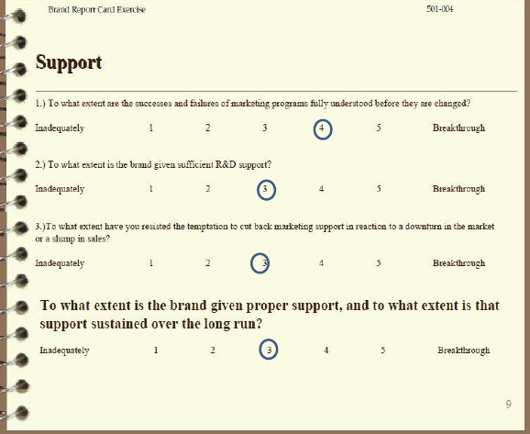

Slide 22
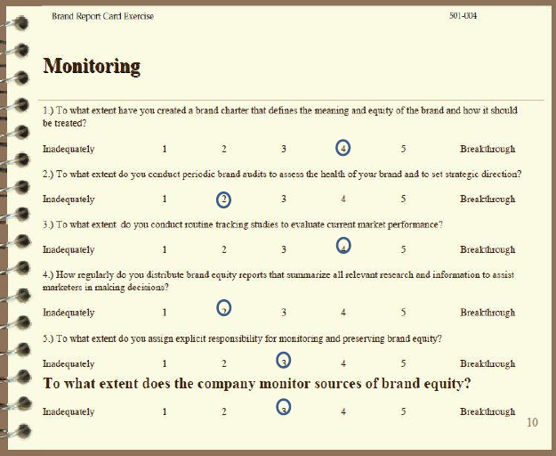

Slide 23
