Slide 1
Advances in Human Resource Development and Management
Course code: MGT 712
Lecture 9

Slide 2
Recap of lecture 8
Selection Interview
Types of selection interviews
Effective Interviewing
Background Investigation
Making the Selection Decision
Making the Job Offer
Placement of Employees

Slide 3
Learning Objectives: Lecture 9
What is Performance Management?
The purposes of Performance Management
Criteria for Effective Performance Management
The link of Performance Management With Organizational Strategy, Outcomes and Results
The Process of Performance Management
  Identifying and Measuring Employee Performance
  Performance Appraisal

Slide 4
Performance Management
Large organizations need sophisticated systems in order to manage their employees’ performance
Well intentioned employees do not always know what is expected or how to improve
How to furnish evidence that dismissal of employee is based on poor performance
Performance Management
The process through which managers ensure that employees’ activities and out puts contribute to the organization’s goals.
  Knowing what activities and outputs are desired
  Clarify organizational performance expectations to employees
  Observing whether they achieve
  Providing feedback to help employees meet expectations
  Identify the development steps that are needed to enhance employee performance
  Provide rewards for achieving performance objectives.
  Document performance for personnel actions.

Slide 5
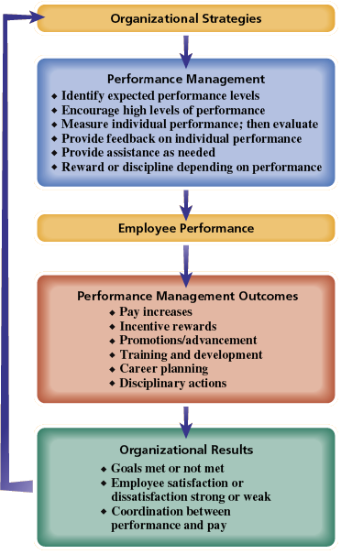
The link of Performance Management With Organizational Strategy, Outcomes and Results

Slide 6
Purposes of Performance Management
Strategic Purpose
By helping the organization achieve its business objectives
  Linking employee behavior with organizational goals
  Communicating to employees their goals and feedback on their performance
Administrative Purpose
By providing information for day-to-day decisions about salary, benefits, and recognition programs
  Supports decision making related to employee retention, termination, hiring or layoffs
Developmental Purpose
By developing employees’ knowledge and skills
  Effective performance feedback makes employees aware of their strengths and areas of improvement
  Employees who achieve their objectives may become more valuable when they hear and discuss their performance feedback

Slide 7
Criteria for Effective Performance Management
Fit with strategy
  Should achieve employee behavior and attitude that
  support organization’s strategy, goals, and culture.
  An organization focuses on customer service
Reliability
Describes the consistency of results that a performance measure will deliver.
  Inter-rater reliability is consistency of results when more than one person measures the performance.
  Test-retest reliability refers to the consistency of results over time

Slide 8
Criteria for Effective Performance Management
Validity
The extent to which a measurement tool actually measures what it is intended to measure.
Whether appraisal measures all the relevant aspects of performance and omits irrelevant aspects of performance
Information that is gathered but irrelevant is contamination
  Measuring the performance of sales people on how many calls they make to customers
Information that is not gathered but is relevant represents the deficiency of a measure
  Measuring employee performance on attendance records but not on whether they work efficiently and effectively
  Performance of an employment interviewer based on the number of applicant hired and not on the quality of those hired

Slide 9
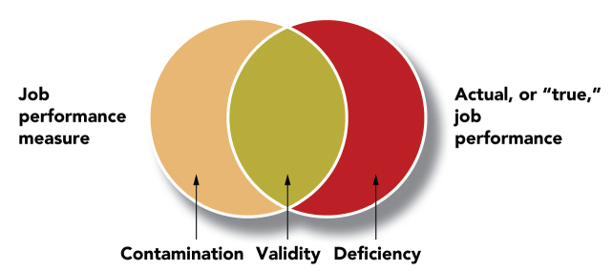
Criteria for Effective Performance Management

Slide 10
Criteria for Effective Performance Management
Acceptability
Measure must meet the practical standard of being acceptable to the people who use it.
  It should not be perceived as time consuming and unfair
Specific feedback
Performance measure should specifically tell employees what is expected of them and how they can meet those expectations
  Will help achieve the goals of supporting strategy and developing employees

Slide 11
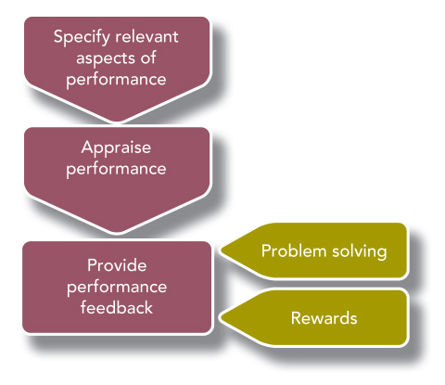
The Process of Performance Management

Slide 12
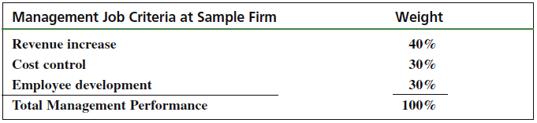
Identifying and Measuring
Employee Performance
Performance
What an employee does and does not do
    Quantity of output • Quality of output
    Timeliness of output • Presence at work
    Cooperativeness
Job Criteria
  Identify the most important elements in a given job
  Define what the organization pays an employee to do
  Weights can be used to show the relative importance of several job criteria

Slide 13
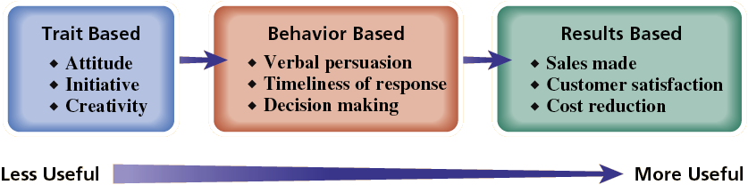
Types of Performance Information

Slide 14
Relevance of Performance Criteria
Performance measures should use relevant criteria that focus on most important aspects of employees’ jobs
Customer service representative in Insurance claims centre
  Attitude vs. no of claims handled properly
  Most important job criteria should be identified and linked to employees job description

Slide 15
Potential Performance Criteria Problems
Objective measures can be directly measured or counted – the number of cars sold or the number of invoices processed
Subjective measures require judgment on the part of evaluator and are more difficult to measure – employee attitude or customer service
  Objectives measures tend to be more narrowly focused – thus being inadequately defined
  Subjective measures may be prone to contamination or biasness
  Both objective and subjective measures should be used carefully

Slide 16
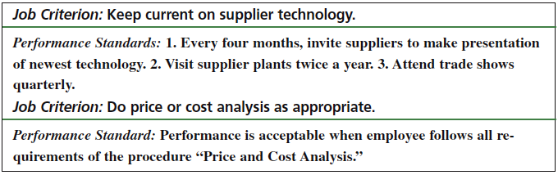
Performance Standards
Define the expected level of performance, and are benchmarks, goals, or targets depending upon the approach taken.
Tell what the satisfactory job performance is?
Need to be established before the work is performed
Set effective performance standards/ goals: SMART
  Specific
  Measurable
  Attainable
  Relevant
  Timely

Slide 17
Performance Standards
Both Numerical and Non-numerical responses can be set to measure performance standards
How well employees meet established standards can be expressed as:
  Numerical rating – 5, 4, 3, 2, 1,
  Verbal rating – Outstanding, Very Good, Satisfactory, Marginal, Unsatisfactory

Slide 18
Performance Appraisal
  The process of evaluating how well employees perform their jobs
  when compared to a set of standards.
  Informal Appraisal
  The day-to-day working relationships between a manager and an employee offers an opportunity for the employee’s performance to be evaluated.
    It is largely undocumented
    Appropriate when time is an issue
  Systematic Appraisal
  Systematic appraisal is used when the contact between manager and employee is formal, and a system is in place to report managerial impressions and observations on employee performance.
    conducted at regular time intervals
    It is usually documented

Slide 19
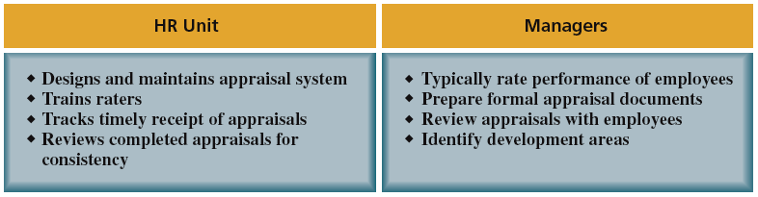
Typical Division of HR Responsibilities: Performance Appraisal

Slide 20
The Benefits of Performance Appraisal
Despite imperfect measurement techniques, individual differences in performance can make a difference to company performance.
Documentation of performance appraisal and feedback may be needed for legal defense.
Appraisal provides a rational basis for constructing a bonus or merit system.
Appraisal dimensions and standards can help to implement strategic goals and clarify performance expectations.
Despite the traditional focus on the individual, appraisal criteria can include teamwork and the teams can be the focus of the appraisal.
Notes:
Though there is generally a lot of dissatisfaction with the way appraisals are conducted, these next two illustrations highlight some of the benefits of performance appraisal; from the perspective of the employer and the employee.

Slide 21
Summary of Lecture 9
Performance Management
The purposes of Performance Management
Criteria for Effective Performance Management
The link of Performance Management With Organizational Strategy, Outcomes and Results
The Process of Performance Management
  Identifying and Measuring Employee Performance
  Performance Appraisal

Slide 22
Reference books
Fundamentals of Human Resource Management Raymond A. Noe, John R. Hollenbeck, Barry Gerhart, & Patrick M. Wright: McGraw-Hill, New York
Human Resource Management (10th Ed.)
Robert L. Mathis and John H. Jackson: Cengage Learning, Delhi

Slide 23
Thank you!

