Slide 1
Advances in Human Resource Development and Management
Course code: MGT 712
Lecture 7

Slide 2
Recap of lecture 6
Labor Market Components
Strategic Recruiting Decisions
Recruiting Human Resources
  Personnel Policies
  Recruiting sources
  Recruiter Traits and Behaviors

Slide 3
Learning Objectives: Lecture 7
Why Careful Selection is Important?
What is employee selection?
Criteria for Measuring the Effectiveness of Selection Tools and Methods
The selection process
Screening Applications and Resumes
Testing and Reviewing Work Samples

Slide 4
Why Careful Selection is Important?
Having a pool of applicants, next step is to select the best person
  Employee productivity may be enhanced through
  Hire hard, manage easy
  Good training will not make up for bad selection
  Organizational performance always depends in part on subordinates having the right skills and attributes.
  Recruiting and hiring employees is costly
  To avoid lawsuits, nondiscriminatory selection procedures is must
  The liability of negligent hiring of workers with questionable backgrounds

Slide 5
Selection
The process through which organizations make decisions about who will or will not be allowed to join the organization.
  Selection begins with the candidates identified through recruitment.
  It attempts to reduce their number to the individuals best qualified to perform available jobs.
  It ends with the selected individuals placed in jobs with the organization.

Slide 6
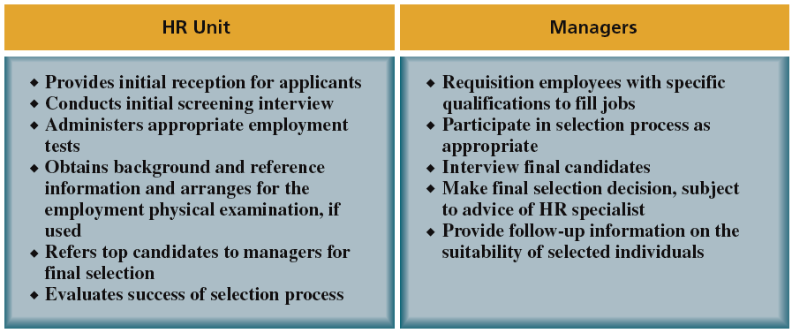
Typical Division of HR Responsibilities: Selection

Slide 7
A Strategic Approach to Personnel Selection
To design a dependable selection process, organizations are to:
  Identify determinants of effective job performance
  What employee specifications are required to achieve that performance
  A selection criterion is a characteristic that a person must have to do the job successfully
An ideal selection process is one that:
  Supports organization’s job descriptions
  Lets the organization to identify people who have the necessary KSAOs
This kind of strategic approach to selection requires ways to measure the effectiveness of the selection tools
Notes:
While the process varies with each organization, there is a strategic approach that should be followed:

Slide 8
Criteria for Measuring the Effectiveness of Selection Tools and Methods
The method provides reliable information
The method provides valid information
The information can be generalized to apply to the candidates
The method offers high utility
The selection criteria are legal

Slide 9
Reliability
The extent to which a measurement is free from random error.
A reliable measurement generates consistent results.
  The consistency of scores obtained by the same person when retested with the identical or equivalent tests.
  Are the test results stable over time?

Slide 10
Validity
The extent to which the performance on a measure (such as a test score) is related to what the measure is designed to assess (such as job performance)- typing speed for data entry jobs
Does the test actually measure what we need for it to measure?

Slide 11
Ability to Generalize
A generalizable selection method applies not only to the conditions in which the method was originally developed – job, organization, people, time period, etc.
It also applies to other organizations, jobs, applicants, etc.
Research supports that intelligence and thinking skills can be generalized in many jobs
Notes:
Along with validity in general, we need to know whether a selection method is valid in the context in which the organization wants to use it.

Slide 12
Practical Value and Utility
An important consideration is the cost of using the selection method
Selection methods should cost significantly less than the benefits of hiring new employees.
Methods that provide economic value greater than the cost of using them are said to have utility.
Selection of sales person for million dollar sales vs staff of a fast food restaurant
Notes:
Not only should selection methods such as tests and interview responses accurately predict how well individuals will perform, they should also produce information that actually benefits the organization.

Slide 13

Steps in the Selection Process
Notes:
The process of selecting employees varies considerably from organization to organization.
At most organizations selection includes the steps illustrated in Figure 6.1.

Slide 14
Screening Applications and Resumes
Individuals show their job interest while organizations seek background information on applicants through:
  Job applications
  Resume
Organizations get reasonably accurate information by combining applications and resumes with background checks and well-designed interviews
There may be some pre-employment screening
  Verify minimum qualifications
  Driving license
Electronic pre-screening
  Scanning resumes and applications
Screening criteria must be job related

Slide 15
Screening Applications and Resumes
Application Form
It has certain standard categories of information: Contact information, Work experience, Educational background, Technical experience, Memberships in professional or trade groups
Purposes:
  Record of applicant’s interest in the job
  Provides a profile of the applicant
  Basic record for applicants who are hired
Application Disclaimers and Notices
  Indicates the right of the employer or employee to terminate the employment relationship without cause or notice
  Obtains applicant’s permission of contact references

Slide 16
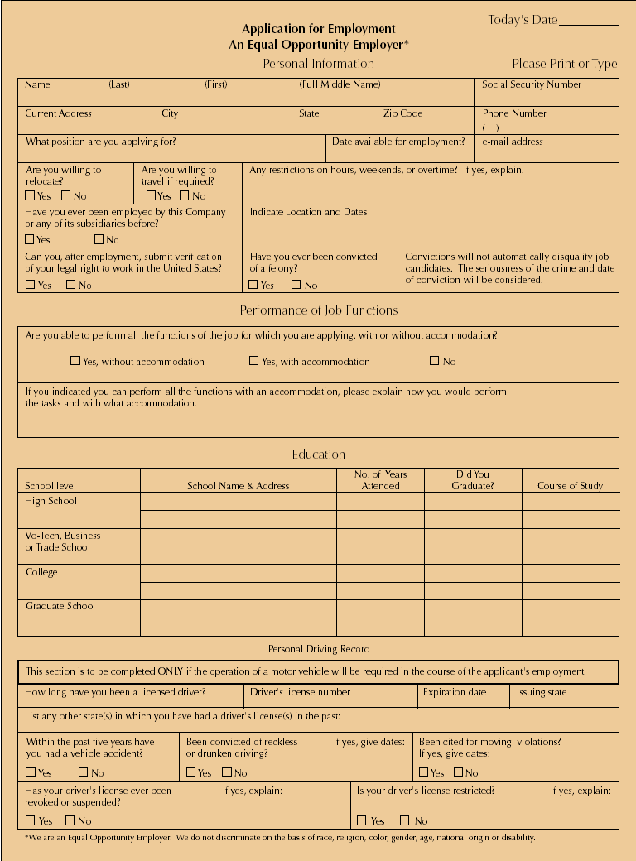
Sample Application Form

Slide 17
Sample Application Form (cont’d)

Slide 18
Screening Applications and Resumes
Resume
A usual way through which applicants introduce themselves to employers
It has certain drawbacks for organizations- the content of the information and the way it is presented
By reviewing application forms and resumes, HR personnel can:
  Identify the candidates with minimum requirement for education background and related work experience
  Rank applicants
Organizations tend to decide against applicants whose resume are unclear or full of mistakes
Applicants can highlight accomplishments that might not show up in application form

Slide 19
Testing and Reviewing Work Samples
Aptitude Tests:
  Assess how well a person can learn or acquire skills and abilities.
Achievement Tests
  Measure a person’s existing knowledge and skills
  used to select civil servants
Cognitive Ability (Intelligence) Tests
  Measure an individual’s thinking, memory, reasoning, and verbal and mathematical abilities.
  Are specially valid for complex jobs and for those requiring adaptability in changing circumstances

Slide 20
Testing and Reviewing Work Samples
Physical Ability Tests
  Measure strength, endurance, and muscular movement
Psychomotor Tests
  Measure dexterity, hand-eye coordination, arm-hand steadiness, and other factors.
Physical ability and psychomotor tests:
  Are essential for effective performance at certain jobs and to avoid injury
  May discriminate women and persons with disabilities
  Abilities tested must be job relevant

Slide 21
Testing and Reviewing Work Samples
Job Performance Tests and Work Samples
Certain jobs require specialized skills- operating a certain machine, handling phone calls, designing ads
Work Sample Tests
  Require an applicant to perform a simulated task- Keyboarding, in-basket tests
  For certain jobs candidates may show existing samples of their work- graphic designers and writers
Assessment Centers
  A series of evaluation exercises and tests used for the selection and development of managerial personnel.
  Multiple raters assess participants in multiple exercises and problems
  These exercises and problems should be related to the jobs for which the individuals are being screened
Job performance tests are:
  Valid because they are job specific
  Highly valid when combined with cognitive ability test and structured interviews

Slide 22
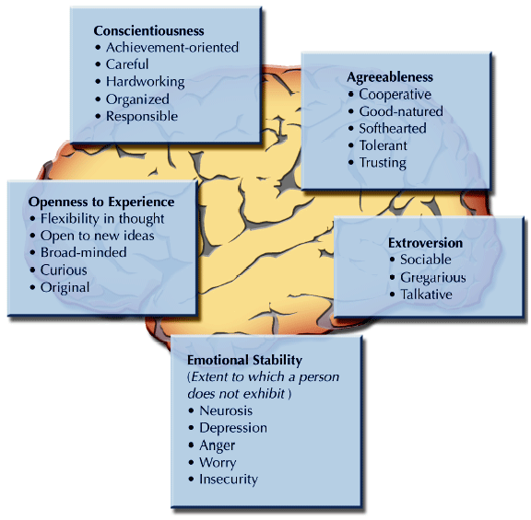
Testing and Reviewing Work Samples
Personality Tests
  Big Five personality traits
  People who score high on conscientiousness tend to excel at work
  For people related jobs like sales and management, extroversion and agreeableness seem to be associated with success

Slide 23
Summary of Lecture 7
Why Careful Selection is Important?
What is employee selection?
Criteria for Measuring the Effectiveness of Selection Tools and Methods
The selection process
Screening Applications and Resumes
Testing and Reviewing Work Samples

Slide 24
Reference books
Human Resource Management (10th Ed.)
Robert L. Mathis and John H. Jackson: Cengage Learning, Delhi
Fundamental of Human Resource Management Raymond A. Noe, John R. Hollenbeck, Barry Gerhart, & Patrick M. Wright: McGraw-Hill, New York
A Framework for Human Resource Management (6th Ed.)
Gary Dessler: Dorling Kindersley, India

Slide 25
Thank you!

