Slide 1
Advances in Human Resource Development and Management
Course code: MGT 712
Lecture 6

Slide 2
Recap of lecture 5
What is Job Design?
Various approaches to job design
  Designing efficient jobs
  Designing jobs that motivate
  Designing ergonomic jobs
  Designing Jobs That Meet Mental Capabilities and Limitations

Slide 3
Learning Objectives: Lecture 6
Labor Market Components
Strategic Recruiting Decisions
Recruiting Human Resources
  Personnel Policies
  Recruiting sources
  Recruiter Traits and Behaviors

Slide 4
Labor Market Components
Recruiting
  The process of generating a pool of qualified applicants for organizational jobs.
Labor Force Population
  All individuals who are available for selection if all possible recruitment strategies are used.
Applicant Population
  A subset of the labor force that is available for selection using a particular recruiting approach.
Applicant Pool
  All persons who are actually evaluated for selection

Slide 5
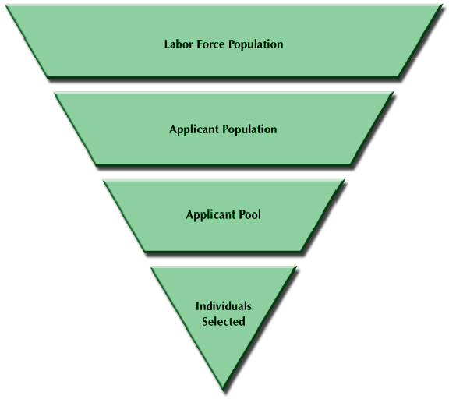
Labor Market Components

Slide 6
Strategic Recruiting Decisions
Organizational based vs. Outsourcing
  Outsourcing- placing ads, initial screening of resumes, initial contacts with applicants
Regular vs. Flexible Staffing
  Flexible staffing makes use of recruiting sources and workers who are not traditional employees.
    Temporary workers
    Independent contractors- workers who perform specific services on contract basis.
Diversity Consideration/Equal Employment Opportunity
Develop flexible work options
Develop flexible benefit options

Slide 7
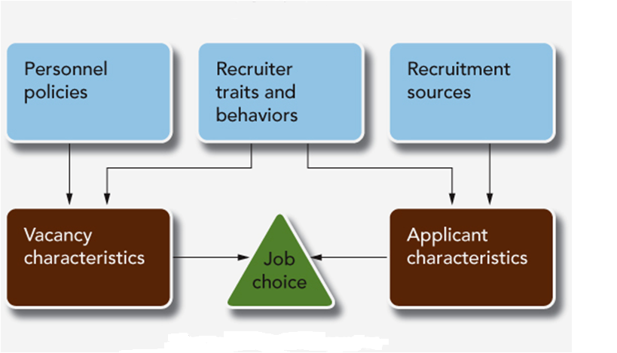
Recruiting Human Resources
Three aspects of recruiting
Notes:
All companies have to make decisions in three areas of recruiting:
Personnel policies
Recruitment sources
Characteristics and behavior of the recruiter
These aspects of recruiting have different effects on whom the organization ultimately hires.
This is shown in Figure 5.2.

Slide 8
Personnel Policies
Personnel Policies
  Decisions about how it will carry out human resource management,
  including how it will fill job vacancies. Affect vacancy characteristics
  Internal vs external recruiting
    Internal recruitment- promoting from within the organization
    External recruitment- hiring from outside the organization
    Affect the attractiveness of position, recruitment sources, and nature of applicants
  Lead-the-market pay strategy
    Can make up for job’s less desirable features- shift differential
  Employment-at-will Policy
  Employment principle that if there is no specific employment contract saying otherwise, the employer or employee may end an employment relationship at any time, regardless of cause.
  Image advertising
  Advertising designed to create a generally favorable impression of the organization
Notes:
An organization’s personnel policies are its decisions about how it will carry out human resource management, including how it will fill job vacancies.

Slide 9

Image advertising promotes a whole profession or organization as opposed to a specific job opening.
This ad is designed to create a positive impression of the profession, which is now facing a shortage of workers.

Slide 10
Recruitment Sources: Internal Sources
Internal Sources
Employees who currently hold other positions in the organization
Organizational Databases
Promotions and Job Transfers
Job Posting: the process of communicating information about a job vacancy - On company bulletin boards, employee publications , corporate intranets, anywhere else the organization communicates with employees
Re-Recruiting Former Employees
  Internal sources affect the kind of people the organization recruits
Notes:
Another critical element of an organization’s recruitment strategy is its decisions about where to look for applicants.
The total labor market is enormous and spread over the entire globe.

Slide 11
Internal Sources
Advantages
Disadvantages
Morale of promotee
Better assessment of abilities
Applicants are relatively knowledgeable about the organization’s vacancies
Lower cost for some jobs
Motivator for good performance
Have to hire only at entry level
Inbreeding
Possible morale problems of those not promoted
Political fighting for promotions
Need for management development program

Slide 12
Recruitment Sources: External Sources
1. Direct Applicants and Referrals
Direct applicants
People who apply for a vacancy without prompting from the organization.
Referrals
People who apply for a vacancy because someone in the organization prompted them to do so.
  The process of self selection/ aided self selection
  Low cost source of recruiting
  Some employers offer financial incentives to employees for referring applicants who are hired and perform acceptably.
  Fresh viewpoints may be restricted
  May lead to nepotism: the practice of hiring relatives
Notes:
Despite the advantages of internal recruitment, organizations often have good reasons to recruit externally. For entry-level positions and perhaps for specialized upper-level positions, the organization has no internal recruits from which to draw. Also, bringing in outsiders may expose the organization to new ideas or new ways of doing business.

Slide 13
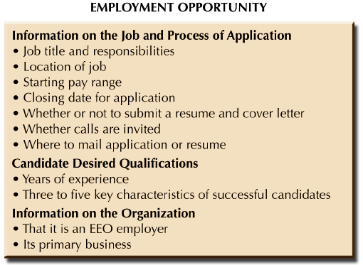
Recruitment Sources: External Sources
2. Advertisements in Newspapers and Magazines
Typically generate less desirable group of applicants
Notes:
Despite the advantages of internal recruitment, organizations often have good reasons to recruit externally. For entry-level positions and perhaps for specialized upper-level positions, the organization has no internal recruits from which to draw. Also, bringing in outsiders may expose the organization to new ideas or new ways of doing business.

Slide 14
Recruitment Sources: External Sources
3. Employment Agencies and Search Firms
For a fee collected form employee/employer, these agencies do some preliminary screening and put the organization in touch with applicants.
  Differ in level of service, cost, policies, type of applicants they provide
  Employment agencies focusing their efforts on executive, managerial, and professional positions are called ‘Executive Search Firms’ or ‘Headhunters’.
    They may charge one-third to one-half of first year salary of the executive
    Convincing a person to change his job requires the employer to offer something more attractive
Notes:
Despite the advantages of internal recruitment, organizations often have good reasons to recruit externally. For entry-level positions and perhaps for specialized upper-level positions, the organization has no internal recruits from which to draw. Also, bringing in outsiders may expose the organization to new ideas or new ways of doing business.

Slide 15
Recruitment Sources: External Sources
4. Colleges and Universities
A significant source for entry level professional
and technical employees
Determinants of employer’s selection of college/university:
  Available job openings
  Reputation of university/college
  Experience with placement office and previous students
  Typical salary offered
Allow employers to attract students in high demand specialties to accept internships or part-time jobs during their studies.
Notes:
Despite the advantages of internal recruitment, organizations often have good reasons to recruit externally. For entry-level positions and perhaps for specialized upper-level positions, the organization has no internal recruits from which to draw. Also, bringing in outsiders may expose the organization to new ideas or new ways of doing business.

Slide 16
Recruitment Sources: External Sources
5. Electronic Recruiting
Employer web-sites
employers have employment and career information on their web-sites. Job seekers email resume or complete online applications
Job Boards
Provide places for employers to post jobs and search for candidates. Job seekers may submit their resumes on these sites. For instance brightspire.com, rozee.com, mustaqbil.com
    Offer an efficient way to find a match
    Big websites may provide too many leads of inferior quality
Niche Boards
Smaller, more tailored websites focus on certain industries, occupations or geographic areas. Professional associations may have employment sections at their web-sites.
Notes:
Despite the advantages of internal recruitment, organizations often have good reasons to recruit externally. For entry-level positions and perhaps for specialized upper-level positions, the organization has no internal recruits from which to draw. Also, bringing in outsiders may expose the organization to new ideas or new ways of doing business.

Slide 17
External Recruiting Sources
Advantages
Disadvantages
New blood brings new perspectives
Cheaper and faster than training professionals
No group of political supporters in organization
May bring new industry insights
May not select someone who will ‘fit’ the job or organization
May cause morale problems for internal candidates not selected
Longer adjustment or orientation time

Slide 18
Evaluating the Quality of a Source
Yield Ratio
Expresses the percentage of applicants who successfully move from one stage of the recruitment and selection process to the next.
Cost per hire
The cost of using a particular recruitment source for a particular type of vacancy.

Slide 19
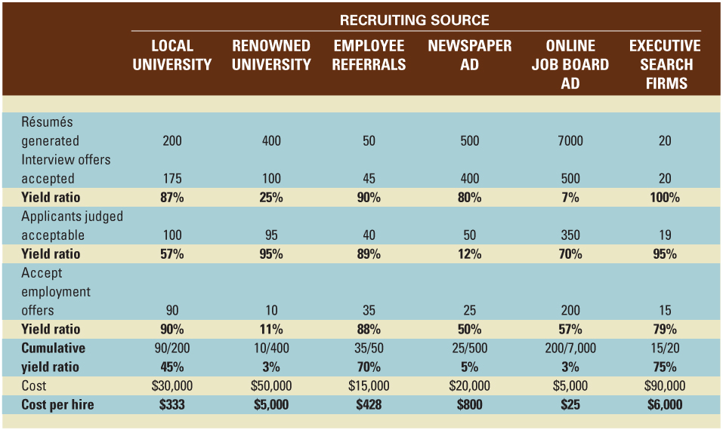
Results of a Hypothetical Recruiting Effort
Notes:
Table 5.3 shows how the yield ratio and cost per hire measures are used by HR professionals.

Slide 20
Recruiter Traits and Behaviors
Recruiters may be HR Specialists or experts at jobs – supervisors or current job holders. Affect the both job vacancy and the applicant generated but become involved late in the process
Characteristics of the recruiter
  Applicants perceive HR specialists as less credible
  Applicants respond positively to recruiters whom they perceive warm and informative
  Effect of recruiter’s age, gender, and race is inconsistent
Behavior of the recruiter
Level of realism in recruiter’s message- recruiter may inflate or deflate qualities of a job
  Employer may be perceived as deceitful
  Turnover may be high
Notes:
The third influence on recruitment outcomes is the recruiter – including this person’s characteristics and the way he or she behaves.
The recruiter affects the nature of both the job vacancy and the applicants generated.

Slide 21
Enhancing the Recruiter’s Impact
Recruiters should provide timely feedback
Recruiters should avoid offensive behavior
They should avoid behaving in ways that might convey the wrong impression about the organization
The organization can recruit with teams rather than individual recruiters
Notes:
Researchers have tried to find the conditions in which recruiters do make a difference. Such research suggests that an organization can take several steps to increase the positive impact that recruiters have on job candidates.
Through such positive behavior, recruiters can give organizations a better chance of competing for talented human resources.

Slide 22
Summary of Lecture 6
Labor Market Components
Strategic Recruiting Decisions
Recruiting Human Resources
  Personnel Policies
  Recruiting sources
  Recruiter Traits and Behaviors

Slide 23
Reference books
Fundamentals of Human Resource Management Raymond A. Noe, John R. Hollenbeck, Barry Gerhart, & Patrick M. Wright: McGraw-Hill, New York
Human Resource Management (10th Ed.)
Robert L. Mathis and John H. Jackson: Cengage Learning, Delhi

Slide 24
Thank you!

