Slide 1
Advances in Human Resource Development and Management
Course code: MGT 712
Lecture 5

Slide 2
Recap of Lecture 4
HRM and Jobs
Work flow in organizations
Job Analysis
Job analysis methods
Behavioral aspects of job analysis
Job description and job specification
Competency approach to job analysis

Slide 3
Learning Objectives: Lecture 5
What is Job Design?
Various approaches to job design
  Designing efficient jobs
  Designing jobs that motivate
  Designing ergonomic jobs
  Designing Jobs That Meet Mental Capabilities and Limitations

Slide 4
Designing Jobs
A job may be motivating to one not to others
Jobs may provide opportunity to satisfy job related needs
Job Design
  Organizing tasks, duties, and responsibilities into a productive unit of work.
  To design jobs effectively, manager must understand:
    The job through job analysis
    Its place in the larger work unit’s work flow process
  Many situations may require redesign of jobs
  Person-job fit involves matching characteristics of people with characteristics of jobs
    Better fit can be achieved by redesigning jobs

Slide 5
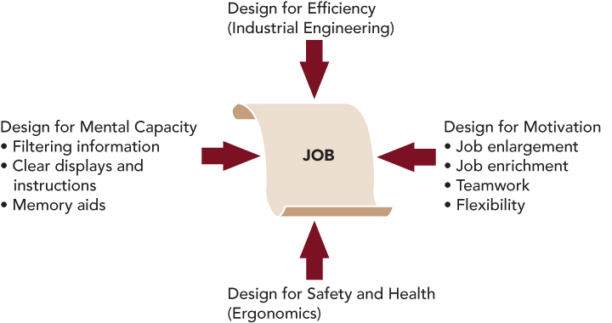
Approaches to Job Design
Notes:
As shown in Figure 4.5, the available approaches to job design emphasize different aspects of the job:
The mechanics of doing a job efficiently.
The job’s impact on motivation.
The use of safe work practices.
The mental demands of the job.

Slide 6
Designing Efficient Jobs
Industrial Engineering
The study of jobs to find the simplest way to structure work in order to maximize efficiency.
  Reduces the complexity of work.
  Allows almost anyone to be trained quickly and easily perform the job.
  Used for highly specialized and repetitive jobs
  With extremely simple and repetitive tasks, workers may get bored
    Organizations combine industrial engineering with other approaches to job design
Notes:
If workers perform tasks as efficiently as possible, not only does the organization benefit from lower costs and greater output per worker, but workers should be less fatigued.
Industrial engineering provides measurable and practical benefits.
However, a focus on efficiency alone can create jobs that are so simple and repetitive that workers get bored.
Industrial engineering is usually combined with other approaches to job design.

Slide 7
Designing Jobs That Motivate
To attract skilled and competent workforce, organizations need to design interesting and satisfying jobs
Important tool to design such jobs is Job Characteristics Model developed by Hackman and Oldham:
Notes:
A model that shows how to make jobs more motivating is the Job Characteristics Model, developed by Richard Hackman and Greg Oldham. This model describes jobs in terms of five characteristics:

Slide 8
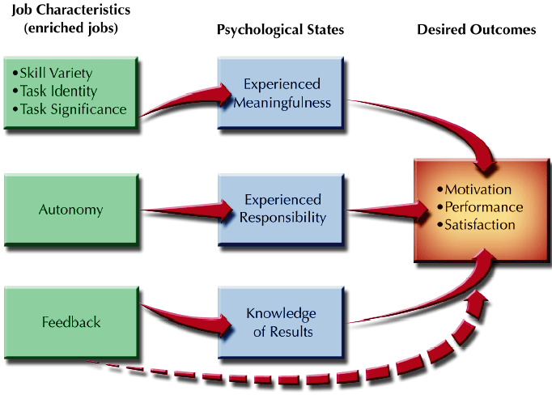
Job Characteristics Model

Slide 9
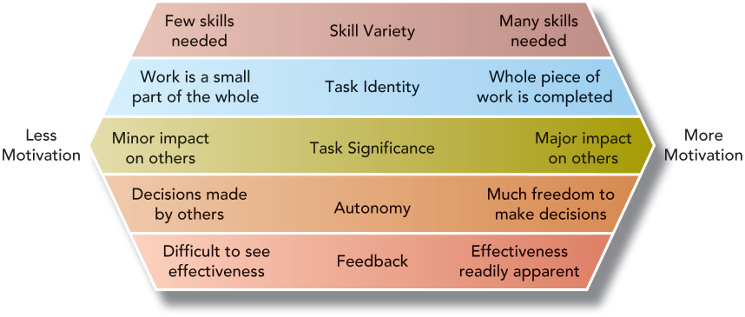
Characteristics of a Motivating Job
Notes:
As shown in Figure 4.6, the more of each of these characteristics a job has, the more motivating the job will be, according to the Job Characteristics Model.

Slide 10
Designing Jobs That Motivate
1. Job Enlargement
Broadening the types of tasks performed in a job.
    Makes jobs less repetitive and more interesting
  Job Extension
  Enlarging jobs by combining several relatively simple jobs to form a job with a wider range of tasks.
  Job Rotation
  Enlarging jobs by moving employees among several different jobs.

Slide 11
Designing Jobs That Motivate
2. Job Enrichment
  Increasing the depth of a job by adding the
  responsibility for planning, organizing , controlling, and
  evaluating the job.
Based on Herzberg’s two factor theory
  Intrinsic motivation: achievement, recognition, growth, responsibility, and performance of job
  Extrinsic motivation: pay, supervision, working conditions, and interpersonal relations

Slide 12
Designing Jobs That Motivate
3. Flexible Work Schedules
  Flextime
  A scheduling policy in which full-time employees may choose starting and ending times within guidelines specified by the organization.
    Employees be at work between certain hours (10:00 am -03:00 pm)
    Enables workers to adjust a particular day’s hours
  Job Sharing
  A work option in which two part time employees may carry out the tasks associated with a single job.
  Compressed Workweek
  In a compressed workweek schedule, full time workers complete their weekly hours in fewer than five days.

Slide 13
Designing Jobs That Motivate
4. Telework
The broad term for doing one’s work away from a centrally located office is telework or telecommuting.
IBM gave each teleworker an IBM ThinkPad, printer, and home phone line; marketing employees were supplied with cell phone, pagers, faxes, and personal copiers
Advantages:
  less need for office space by employer
  greater flexibility to employees with special needs
  Employee productivity is high because of reduced commuting time and avoidance of distractions from coworkers
Easy to implement for managerial, professional, or sales jobs
Difficult to set up for manufacturing workers

Slide 14
Designing Jobs That Motivate
4. Telework
The broad term for doing one’s work away from a centrally located office is telework or telecommuting.
IBM gave each teleworker an IBM ThinkPad, printer, and home phone line; marketing employees were supplied with cell phone, pagers, faxes, and personal copiers
Advantages:
  less need for office space
  greater flexibility to employees with special needs
  Employee productivity is high because of reduced commuting time and avoidance of distractions from coworkers
Easy to implement for managerial, professional, or sales jobs
Difficult to set up for manufacturing workers

Slide 15
Designing Jobs That Motivate
5. Self-Managing Work Team
A self-managing work team is composed of individuals who have authority for an entire work process or segment:
  schedule work
  hire team members
  resolve team performance problems
  perform other duties traditionally handled by management
Team work keeps members motivated by autonomy, skill variety, and task identity.

Slide 16
Designing Ergonomic Jobs
Ergonomics
The study of the interface between individuals’ physiology and the characteristics of the physical work environment.
The goal is to minimize physical strain on the worker by structuring the physical work environment around the way the human body works.
Redesigning work to make it more worker- friendly can lead to increased efficiencies
  Adjusting the height of a computer keyboard
  The design of chairs and desks to fit posture requirements
Notes:
The way people use their bodies when they work affects their physical well-being and may affect how long they can work.

Slide 17
Designing Jobs That Meet Mental Capabilities and Limitations
Work is designed to reduce the information- processing requirements of the job.
  Workers may be less likely to make mistakes or have accidents.
  Organizations can provide easy to understand gauges and displays, simple to operate equipment, and clear instructions
  Employees try to simplify their jobs by creating checklists, charts, or other aids.
  Electronic cash registers have simplified the job of cashier
Simplifying the mental demands of a job may make it less interesting
Technology tools may be distracting employees from their primary task thus resulting in increased mistakes and accidents.
Notes:
Just as the human body has capabilities and limitations, addressed by ergonomics, the mind, too, has capabilities and limitations.

Slide 18
Summary of Lecture 5
Job Design
Designing efficient jobs
Designing jobs that motivate
Designing ergonomic jobs
Designing Jobs That Meet Mental Capabilities and Limitations

Slide 19
Reference books
Fundamentals of Human Resource Management Raymond A. Noe, John R. Hollenbeck, Barry Gerhart, & Patrick M. Wright: McGraw-Hill, New York
Human Resource Management (10th Ed.)
Robert L. Mathis and John H. Jackson: Cengage Learning, Delhi

Slide 20
Thank You!

