Slide 1
Advances in Human Resource Development and Management
Course code: MGT 712
Lecture 4

Slide 2
Recap of Lecture 3
Managing Human Resource Surplus or shortage
Assessing HR effectiveness
HR performance and Benchmarking
Human Resource Information Systems

Slide 3
Contents of Lecture 4
HRM and Jobs
Work flow in organizations
What is Job Analysis?
Job analysis process
Job analysis methods
Behavioral aspects of job analysis
Job description and job specification
Competency approach to job analysis

Slide 4
HR Management and Jobs
Jobs are rarely designed in an organization rather managers redesign and reengineer existing jobs
Dividing Work into Jobs
  Work
    Effort directed toward producing or accomplishing results.
  Job
    A grouping of tasks, duties, and responsibilities that constitutes the total work assignment for an employee.
  Position
    A set of duties performed by one person.

Slide 5
Workflow Analysis
Workflow Analysis
  A study of the way work (inputs, activities, and outputs) moves through an organization.
Inputs
(People
Materials
Equipment)
Activities
(Tasks and Jobs)
Outputs
(Goods and Services)
Evaluation

Slide 6
Work Flow in Organizations
How the work fits within the context of organization’s structure
organization’s structure brings together people who must collaborate to produce outputs efficiently – centralized vs decentralized
Jobs may be grouped:
  Functions: Employees work individually on highly specialized jobs
  Divisions: team work
HR managers must understand this big picture before redesigning jobs

Slide 7
The Nature of Job Analysis
Job Analysis
  A systematic way to gather and analyze information about the content, context, and the human requirements of jobs.
  Job analysis is essential for work redesign, HR planning, staffing, training, performance appraisal, compensating, and other HR activities
  Done by line manager, HR manager or contracted to a third party
  Information on characteristics of a job is collected that differentiate it from other jobs:
    Work activities and behaviors
    Interactions with others
    Performance standards
    Machines and equipment used
    Working conditions
    Supervision given and received
    Knowledge, skills, and abilities needed

Slide 8
Job Analysis
Task
A distinct, identifiable work
activity composed of motions
Duty
A larger work segment
composed of several tasks that
are performed by an individual
Responsibilities
Obligations to perform certain
tasks and duties
Job Analysis
Job Descriptions
Job Specifications

Slide 9
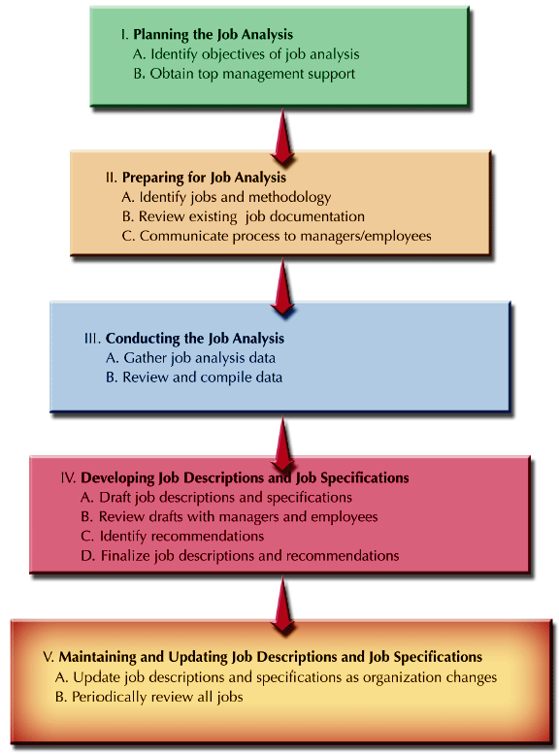
Job Analysis Process

Slide 10
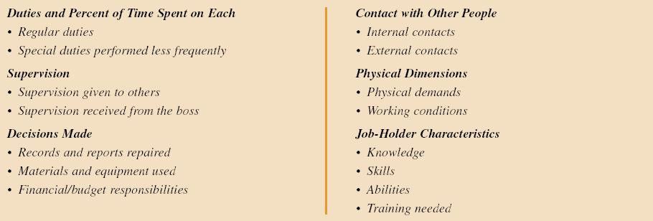
Job Analysis Methods
Job analysis information can be gathered through:
Observation – work sampling, employee diary
Interviewing
Questionnaires - Typical areas covered in a Questionnaire

Slide 11
Behavioral Aspects of Job Analysis
Job inflation
Managerial Straitjacket
Current incumbent emphasis
Employee anxieties

Slide 12
Job Description and Job Specification
Usually, job description and job specifications are combined in a single document that contains several sections:
Job Description
  Identification of the tasks, duties, and responsibilities of a job
Job Specification
  The knowledge, skills, and abilities (KSAs) an individual needs to perform a job satisfactorily.

Slide 13
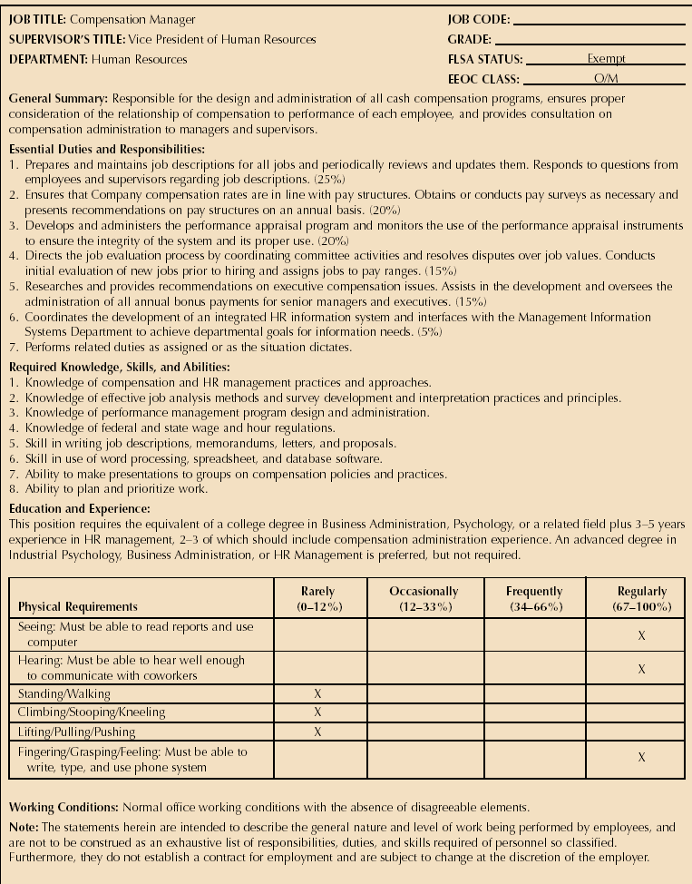
Sample Job Description and Specifications

Slide 14
Sample Job Description and Specifications

Slide 15
Sample Job Description and Specifications

Slide 16
Trends in Job Analysis
Organizations are being viewed as a field of work needing to be done, rather than as a set series of jobs held by individuals.
Over the past few years, job descriptions have become less detailed and restrictive:
Work is being done in cross functional project teams
Less focus on performing specific tasks and duties and more on fulfilling responsibilities and attaining results
So, recruitment, selection, and compensation of such employees should be based on their competence and capabilities

Slide 17
Competency approach to Job Analysis
Describing the job in terms of measurable, observable, and behavioral competencies that an employee doing that job must exhibit to do the job well.
Competencies are basic characteristics that can be linked to enhance performance by individuals or teams.
Leadership, team focus, innovation, adaptability, results orientation etc

Slide 18
Summary of Lecture 4
HRM and Jobs
Work flow in organizations
Job Analysis
Job analysis methods
Job description and job specification
Competency approach to job analysis

Slide 19
Reference books
Human Resource Management (10th Ed.)
Robert L. Mathis and John H. Jackson: Cengage Learning, Delhi
Fundamentals of Human Resource Management Raymond A. Noe, John R. Hollenbeck, Barry Gerhart, & Patrick M. Wright: McGraw-Hill, New York
A Framework for Human Resource Management (6th Ed.)
Gary Dessler: Dorling Kindersley, India

Slide 20
Thank You!

