Slide 1
Advances in Human Resource Development and Management
Course code: MGT 712
Lecture 3

Slide 2
Recap of Lecture 2
How Strategic Planning and Strategic Human Resource Management is linked?
Human resources as a core competency
What is HR planning?
How to develop the HR plan?
Identify factors to forecast supply and demand for human resources in an organization

Slide 3
Contents of Lecture 3
Managing Human Resource Surplus or shortage
Assessing HR effectiveness
HR performance and Benchmarking
Human Resource Information Systems

Slide 4
Managing Human Resource
Surplus or Shortage
HR Strategy and Plans
Focus on problem… by addressing labor surplus or shortage
Plan should include a specific figure indicating what should happen with job category/skill area in a specific time frame

Slide 5
Managing Human Resource
Surplus
  Causes
    Economic—weak product demand, loss of market share to competitors
    Structural—technological change, mergers and acquisitions
    Various options to deal with a surplus differ in their expense, speed, and amount of human suffering

Slide 6
Options for Reducing a Surplus
Downsizing
Pay reductions
Demotions
Transfers
Work sharing
Hiring freeze
Natural attrition
Early retirement
Retraining

Slide 7
Managing Human Resource
Surplus
Downsizing
The planned elimination of large number of employees with the goal of enhancing organization’s effectiveness.
  Positive consequences
    Increased competitiveness
    Increased productivity
  Negative consequences
    Loss of talent, specialized skills, informal knowledge, and experience
    Disrupts social networks through which people are creative and flexible
    Surviving employees fear to take risk
    Negative publicity because of downsizing may hurt company image
  Managing survivors
    Survivors are overburdened and demoralized
    Provide explanations for actions and the future
  Always go through legal requirements before planning, announcing, and implementing downsizing

Slide 8
Managing Human Resource Surplus
Early retirement programs
  Offering incentives that encourage senior employees to leave the organization early.
  Phased retirement program
  organization continue to enjoy the experience of older workers while reducing the number of hours that these employees work, as well as the cost of those employees.
  More humane way to reduce staff
Attrition and hiring freezes
  Attrition occurs when individuals who quit, die or retire are not replaced.
  This strategy woks well if combined with hiring freeze
Layoffs
  Employees are placed on unpaid leave until called back to work when business conditions improve.
  Appropriate strategy during temporary downturn in industry
  How will call backs be made?

Slide 9
Doing Layoffs and Downsizing… Well
Investigate alternatives to downsizing
Involve those people necessary for success in the planning for downsizing
Empower managers to make choices
Develop comprehensive communications plans
Nurture the survivors
Outplacement services

Slide 10
Managing Human Resource Shortage
Options for Avoiding a Shortage
Overtime
Temporary employees
Outsourcing
Retrained transfers
Turnover reductions
New external hires
Technological innovation

Slide 11
Managing Human Resource Shortage
Employing temporary workers
  Flexibility to operate, low cost, requires lesser administration
  Agencies that provide temporary workers
    handle some hiring tasks, have trained them
  Opportunity to test a person before permanent hiring
  Temporary workers bring objective point of view, varied experience
  Tension between permanent and temporary employees

Slide 12
Managing Human Resource Shortage
Outsourcing
  Contracting with another organization to perform a broad set of services - data entry, security, recruiting,
  Outside company can operate at economies of scale
  Outsourcing in manufacturing as well as services occurs to avail cheap labor
Overtime and Expanded Hours
  Non exempt/non managerial employees are paid one and a half times their normal wages
  Preferred when higher level of demand is not sustainable
  Workers appreciate added compensation for short time other wise they may feel stress and frustration

Slide 13
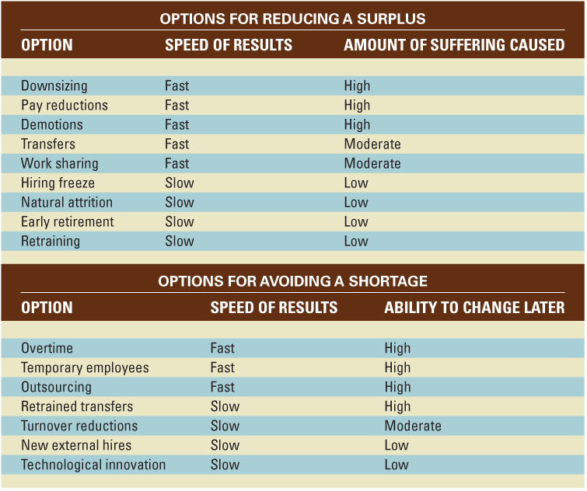
HR Strategies for Addressing a Labor Shortage or Surplus

Slide 14
Assessing HR Effectiveness
Other departments, managers, and employees are the customers of HR department
HR Department is to show the real link between HR activities and organizational performance
  Research shows the relationship of best HR Practices with
    Reduced turnover
    Increased productivity
    Enhanced profitability and market value
    High quality and highly motivated workforce
Measures of HR Effectiveness
  HR expense per employee
  Compensation as a percent of expenses
  HR department expense as a percent of total expenses
  Cost of hires
  Turnover rates
  Absenteeism rates

Slide 15
The HR Scorecard Approach
HR scorecard
  Measures the HR function’s effectiveness and efficiency in producing employee behaviors needed to achieve the company’s strategic goals.
Creating an HR scorecard
  Must know what the company’s strategy is
  Must understand the causal links between HR activities, employee behaviors, organizational outcomes, and the organization’s performance
  Must have quantitative standards or metrics to measure all the activities and results involved

Slide 16
HR Performance and Benchmarking
Benchmarking
  Comparing specific measures of performance against data on those measures in other “best practice” organizations
Common Benchmarks
  Total compensation as a percentage of net income
  Percent of management positions filled internally
  Dollar sales per employee
  Benefits as a percentage of payroll cost

Slide 17
Human Resource Information Systems
Human resource information systems (HRIS)
  An integrated system of hardware, software, and databases designed to provide information used in HR decision making.
    Automation of payroll and benefit activities
  Benefits of HRIS
    Administrative and operational efficiency in compiling HR data
    Availability of data for effective HR strategic planning

Slide 18
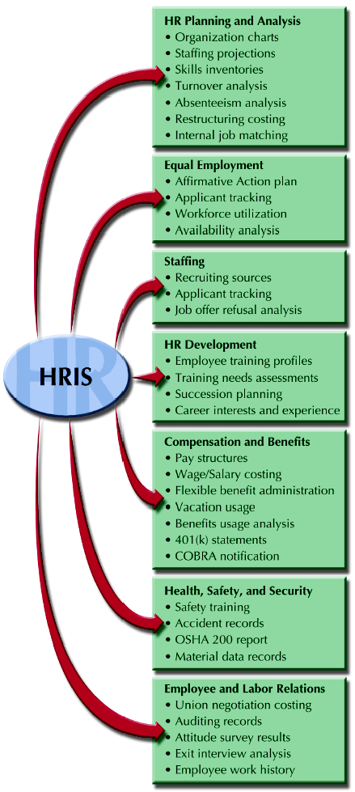
Uses of an HR Information System (HRIS)

Slide 19
Summary of Lecture 3
Plans to manage Human Resource Surplus or shortage
Assessing HR effectiveness
HR performance and Benchmarking
Human Resource Information Systems

Slide 20
Reference books
Human Resource Management (10th Ed.)
Robert L. Mathis and John H. Jackson: Cengage Learning, Delhi
Fundamentals of Human Resource Management Raymond A. Noe, John R. Hollenbeck, Barry Gerhart, & Patrick M. Wright: McGraw-Hill, New York
A Framework for Human Resource Management (6th Ed.)
Gary Dessler: Dorling Kindersley, India

Slide 21
Thank You!

