Slide 1
Advances in Human Resource Development and Management
Course code: MGT 712
Lecture 21

Slide 2
Recap of Lecture 20
Understanding Learning
Social Learning Theory
Motivation to Learn
  Environmental Factors and Resistance
  Individual Factors and Resistance
Training that Motivates Adults to Learn

Slide 3
Learning Objectives: Lecture 20
Training Needs Assessment/Analysis (TNA)
Why to conduct TNA?
What is a Training/HRD Need?
The TNA Model
  Organizational Analysis
  Data Sources for Organizational Analysis
  What Do You Ask and from Whom?

Slide 4
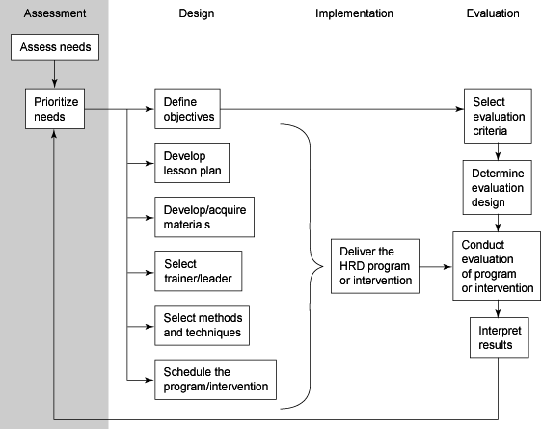
The HRD Process

Slide 5
“Remember, training is not what is ultimately important… performance is.”
Marc Rosenberg

Slide 6
Training Needs Assessment/Analysis (TNA)
It is a systematic process by which an organization’s HRD needs are identified and articulated.
  Needs assessment can identify:
  Organization’s goals and its effectiveness in reaching these goals
  Gaps between employees’ skills and the skills required for effective current job performance
  Gaps between current skills and skills needed to perform the job successfully in future
  The employees to be sent on training
  The conditions under which the HRD activity will occur

Slide 7
Why to conduct TNA?
Although organizational effectiveness may be improved without TNA but it is not guaranteed. So TNA:
  Increases the chances that time, money, and effort spent on training is spent wisely
  Determines the benchmark for evaluation of training
  Increases the motivation of participants
  Aligns training activities with strategic objectives
Why TNA is not Conducted?
  Can be a difficult and time-consuming process
  Action is valued over research
  Unnecessary because available information already specifies organization needs
  Lack of support
TNA is not needed:
  If organization is trying to communicate a new vision or address legal concerns
  If a team requires team building skills

Slide 8
What is a Training/ HRD Need?
Need
A discrepancy or gap between what an organization expects to happen and what actually occurs
Identified needs focus on correcting substandard performance
  HRD intervention my be the solution
  Compensation practices or employee selection may solve the problem
  Another management action like replacing machinery or negotiating work rules may be more appropriate solution

Slide 9
What is a Training/ HRD Need?
Focusing only on performance deficiency is restrictive
Diagnostic needs
Focus on factors that lead to effective performance and prevent performance problems rather than emphasizing existing problems.
Analytic needs
Identify new or better ways to do things
Compliance
Mandated by law or regulation
  Reactive TNA – performance and compliance needs
  Proactive TNA – diagnostic and analytic needs

Slide 10
Traps to avoid in Needs Assessment
Focusing only on individual performance deficiencies
Starting with a “Training Needs Assessment”
Using Questionnaires asking people what they need
Using subjective data only
Using objective data only
  Easily measured data is provided, but critical, hard-to-measure data is missing

Slide 11
The TNA Model
Input
Process
Output
Organizational
Analysis
Objectives
Resources
Environment
Training
Needs
TRIGGER
Actual Organizational
Performance
(AOP) < Expected
Organizational
Performance (EOP)
Operational/Task
Identify Performance Discrepancy (PD)
PD = EP < AP
And Causes of PD
Analysis
Expected
Performance
(EP)
Non
Person Analysis
Training
Actual
Needs
Performance
(AP)

Slide 12
Training Needs Analysis
1. Inputs
Strategic/ Organizational Analysis
Examination of an organization’s strategy, goals, and objectives; and the systems and practices in place to determine how they affect employee performance.
  Where in the organization training is needed and under what conditions it will occur?
Task Analysis
The examination of specific jobs to determine the requirements, in terms of the tasks required to be done, and the KSAs required to get the job done.
Person Analysis
The examination of employees in the jobs to determine whether they have the required KSAs to perform at the expected level.
  Who needs to be trained and what kind of training they need?
2. Processes
In the process process phase:
Task analysis provides information on expected performance
Person analysis provides information on actual performance
3. Outputs
Training needs
Non-Training needs

Slide 13
Organizational Analysis
Ties HRD programs to organizational goals and Strengthens corporate support for HRD
Organizational analysis requires a ‘whole system’ view of the organization and what it is trying to achieve?
Components of an organizational analysis
  Organizational goals and strategy
  Organizational resources (Capital and Human)
  Organizational culture/climate
  Environmental constraints

Slide 14
Data Sources for Organizational Analysis
Data Source Recommended | Training Need Implications | Example
Organizational Goals, Objectives and Budget | Where training emphasis can and should be placed. | To maintain a quality standard of no more than 1 reject per thousand Goal is to become ISO certified and 90,000 dollars has been allocated to this effort
Labor Inventory | Where training is needed to fill gaps caused by retirement, turnover, age, etc. | Thirty percent of our truck drivers will retire over the next four years

Slide 15
Data Sources for Organizational Analysis
Data Source Recommended | Training Need Implications | Example
Organizational Climate Indices | These may help focus on problems that have training components
Grievances | Items related to productivity are useful in determining performance deficiencies | Seventy percent of grievances are related to behaviors of 6 supervisors
Absenteeism |  | High absences in clerical staff
Accidents |  | Accident rate for line workers increasing

Slide 16
Data Sources for Organizational Analysis
Data Source Recommended | Training Need Implications | Example
Analysis of Efficiency Indices Cost of labor | Can help document difference between actual performance and desired performance | Labor costs have increased 8 percent in the last year
Changes in System or Subsystem | New or changed equipment may present training problem | The line has been shut down about once per day since the new machinery was installed. Waste has doubled since using the new cutting tool

Slide 17
What Do You Ask and from Whom?
What to Ask About Who to Ask
Mission Goals and Objectives
What are the goals and objectives of the organization?
How much money has been allocated to any new initiatives?
Is there general understanding of these objectives?
Top management
Relevant department managers, supervisors and incumbents
Social Influences
What is the general feeling in the organization regarding meeting goals and objectives?
What is the social pressure in your department regarding these goals and productivity?
Top management
Relevant department managers, supervisors and incumbents

Slide 18
What Do You Ask and from Whom?
What to Ask About Who to Ask
Reward Systems
What are the rewards and how are they distributed?
Are there incentives, are they tied to the goals and objectives?
What specifically do high performers get as rewards?
Top management
Relevant department managers, supervisors and incumbents
Job Design
How are the jobs organized?
Where does their work/material/ information come from, where does it go when done?
Does the design of the job inhibit workers from being high performers?
Relevant supervisors and incumbents, perhaps relevant department managers

Slide 19
What Do You Ask and from Whom?
What to Ask About Who to Ask
Job Performance
How do employees know what level of performance is acceptable?
How do they find out if their level of performance is acceptable?
Is there a formal feedback process?
Are there opportunities for help if required?
Relevant supervisors and incumbents
Methods and Practices
What are the policies/ procedures/rules in the organization?
Which if any inhibit performance?
Relevant department managers supervisors and incumbents

Slide 20
Summary of Lecture 21
Training Needs Assessment/Analysis (TNA)
Why to conduct TNA?
What is a Training/HRD Need?
The TNA Model
  Organizational Analysis
  Data Sources for Organizational Analysis
  What Do You Ask and from Whom?

Slide 21
Reference books
Effective Training: Systems, Strategies, and Practice (3rd Ed.)
P. Nick Blanchard and James W. Thacker: Dorling Kindersley, Delhi
Human Resource Development: Foundation, Framework and Application
Jon M. Werner and Randy L. DeSimone: Cengage Learning, New Delhi

Slide 22
Thank you!

