Slide 1
Advances in Human Resource Development and Management
Course code: MGT 712
Lecture 2

Slide 2
Recap of Lecture 1
What is HRM?
Why is HRM important for all managers?
HRM and company performance
Objectives of the HRM function
Activities/Responsibilities of HRM
Skills of HRM Professionals

Slide 3
Lecture 2
How Strategic Planning and Strategic Human Resource Management is linked?
What is strategic human resource management?
Human resources as a core competency
What is HR planning?
How to develop the HR plan?
Identify factors to forecast supply and demand for human resources in an organization

Slide 4
Strategic Planning and Strategic HRM
There are three levels of strategic planning
Corporate strategy
Identifies the portfolio of businesses that, in total, comprises the company and the ways in which these businesses relate to each other.
Business/Competitive strategy
Identifies how to build and strengthen the business’s long term competitive position in the marketplace.
Functional strategy
identifies the basic courses of action that each of the business’s departments will pursue to help the business attain its competitive goals.

Slide 5
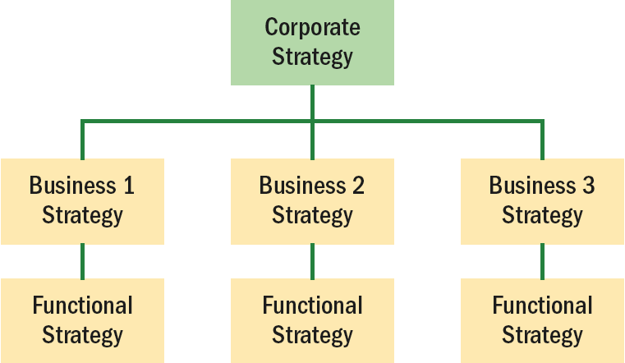

Slide 6
Strategic Human Resource Management
Organizational use of employees to gain or keep a competitive advantage against competitors.
Core Competency
  A unique capability in the organization that creates high value and that differentiates the organization from its competition.
  Today, most companies have easy access to same technologies, so technology itself is rarely enough to set a firm apart. Its usually the employees and the management system that make the difference.

Slide 7
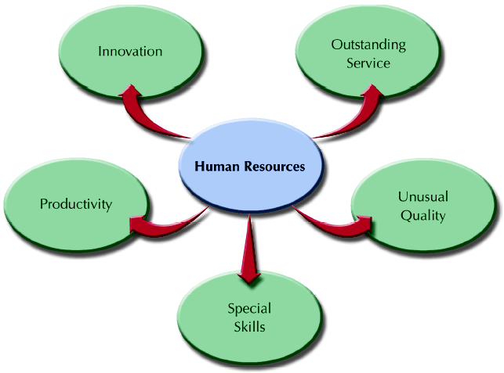
Human Resources as a Core Competency
When employees have special
capabilities and be innovative
that competitors cannot
imitate ….. This needs HRM
Organizational Culture
The shared values and beliefs of the
workforce that distinguishes the
organization form other organizations.
Excellent strategies may fail because of incompatible culture
Culture affect attraction and retention of competent employees
Culture affects the way external forces are viewed

Slide 8
HR-Based Core Competencies
Productivity
  Output of goods and services per unit of input of resources used in a production process.
  Ways to increase productivity through
  Common approaches: Computers, machinery, equipment, outsourcing,
  HRM: Selection, job design, training and development, motivation, compensation
Quality Products and Services
  High quality products and services are the results of HR-enhancements to organizational performance.

Slide 9
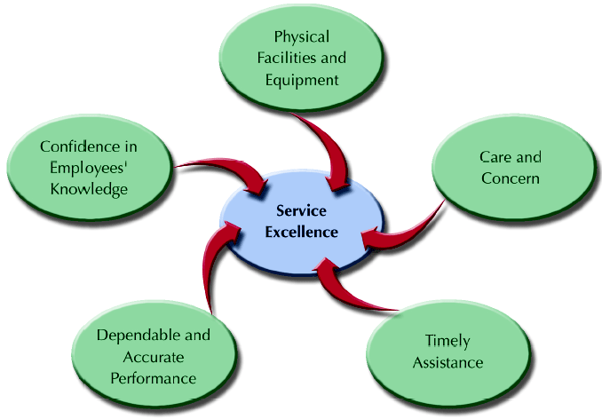
HR-Based Core Competencies cont..
Excellent customer service
Special skills
Disney
Innovation
Apple, Micorsoft, Intel

Slide 10
Human Resource Planning
  The process of analyzing and identifying the need
  for and availability of human resources so that the
  organization can meet its objectives.

Slide 11
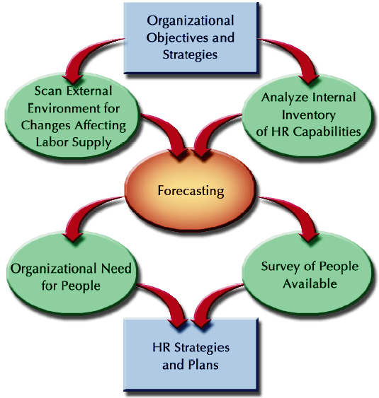
HR Planning Process

Slide 12
Scanning the External Environment
  The process of studying the environment of the organization
  to pinpoint opportunities and threats.
  Governmental regulations
  Minimum wages, length of work week, hiring and firing rules
  Economic conditions
  Economic growth, unemployment rate, interest rate, inflation,
  Geographic and competitive concerns
  Competitors, direct competition, international competition, employee resistance to relocate
  Workforce composition
  Flexible staffing- temporary workers, independent contractors, job sharing, part timers and outsourcing

Slide 13
Internal Assessment of the
Organizational Workforce
Auditing Jobs and Skills
  What jobs exist now?
  How many individuals are performing each job?
  How essential is each job?
  What jobs will be needed to implement future organizational strategies?
  What are the characteristics of anticipated jobs?

Slide 14
Internal Assessment of the
Organizational Workforce
Organizational Capabilities Inventory
  Human Resource Information Systems (HRIS)
  Sources of information about employees’ knowledge, skills, and abilities (KSAs)
  Long range need for recruitment, selection, HR development
  Additional capabilities needed in future
  Components of an organizational capabilities inventory
    Workforce and individual demographics
    Individual employee career progression
    Individual job performance data
  Using organizational data inventory
    Absence of specialized skills, retirement of key persons, internal hiring

Slide 15
Forecasting HR Supply and Demand
Forecasting
The use of information from the past and present to identify expected future conditions.
Forecasting Methods
  Judgmental
    Estimates—asking managers’ opinions, top-down or bottom-up
    Rules of thumb—using general guidelines, one operations manager per five reporting supervisors
  Mathematical/ Statistical
    Statistical regression analysis — gross sales and number of employees
    Productivity ratios—units produced per employee
Forecasting Periods
  Short-term—less than one year
  Intermediate—up to five years
  Long-range—more than five years

Slide 16
Forecasting HR Supply and Demand
Forecasting the Demand for Human Resources
  Organization-wide estimate for total demand
  Unit breakdown for specific skill needs by number and type of employee
    Develop decision rules (“fill rates”) for positions to be filled internally and externally.
    Develop additional decision rules for positions impacted by the chain effects of internal promotions and transfers.

Slide 17
Forecasting HR Supply and Demand
Forecasting the Supply for Human Resources
Forecasting External HR Supply
  Factors affecting external supply
    Net migration for an area
    Individuals entering and leaving the workforce
    Individuals graduating from schools and colleges
    Changing workforce composition and patterns
    Economic forecasts
    Technological developments and shifts
    Actions of competing employers
    Government regulations and pressures

Slide 18
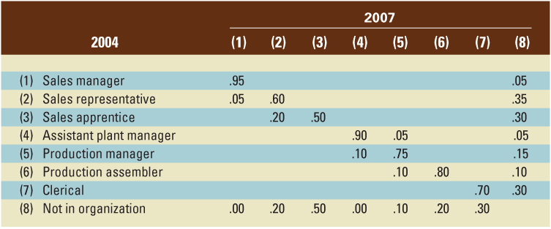
Forecasting HR Supply and Demand
Forecasting Internal HR Supply
  Effects of promotions, lateral moves, retirements, voluntary turnover, and terminations
  Transition Matrix for internal flows

Slide 19
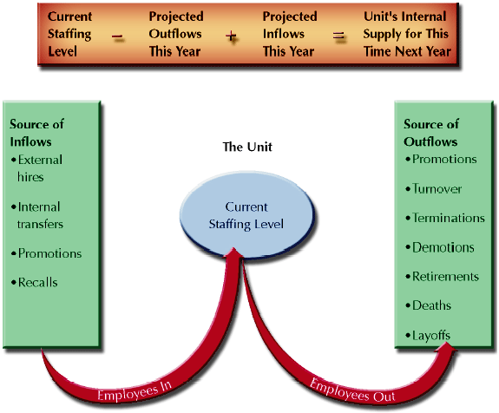
Estimating Internal Labor Supply for a Given Unit
Figure 2–9

Slide 20
HR Strategies and Plans
  HR Strategies
  The means used to anticipate and manage the supply of and demand for human resources.
  HR Plans
  Provide more specific direction for the management of HR activities
      Shifting employees within an organization
      Laying off or downsizing
      Retraining present employees
      Increasing number of employees in certain areas

Slide 21
Summary of lecture 2
The link of Strategic Planning and Strategic with Human Resource Management
Strategic human resource management
Human resources as a core competency
Human Resource Planning
Human Resource Planning Process
Factors to forecast supply and demand for HR

Slide 22
Reference books
Human Resource Management (10th Ed.)
Rober L. Mathis and John H. Jackson: Cengage Learning, Delhi
Fundamental of Human Resource Management Raymond A. Noe, John R. Hollenbeck, Barry Gerhart, & Patrick M. Wright: McGraw-Hill, New York
A Framework for Human Resource Management (6th Ed.)
Gary Dessler: Dorling Kindersley, India

