Slide 1
Advances in Human Resource Development and Management
Course code: MGT 712
Lecture 18

Slide 2
Recap of Lecture 17
Rights and Responsibilities Issues
Legislation in Pakistan
HR Policies, Procedures, and Rules
Employee Handbooks
Communicating HR Information
Employee Discipline
Approaches to Discipline

Slide 3
Learning Objectives: Lecture 18
Why HRD?
What is HRD?
Relationship between HRM and HRD
Functions of HRM
Functions of Human Resource Development
Training and Development
Organization Development
Career Development
The new learning and performance wheel
Strategic Management and HRD

Slide 4
Have you ever:
  Trained a new employee to do his or her job?
  Taught another person how to use a new technology?
  Attended an orientation session for new employees?
  Taken part in a company sponsored training program?
  Completed some type of career planning project?
  Participated in an organization wide change effort?

Slide 5
Why Human Resource Development?
‘An organization is as good as its people’
  All organizations must employ competent and motivated workers
  Need is intense for organizations competing in dynamic, competitive, and global markets
  HR managers in large organizations ranked ‘training and development’ as the most important functional area they had to deal with
  Even, the knowledge required to run an economy is both deeper and broader

Slide 6
Human Resource Development
A set of systematic and planned activities designed by an organization to provide its members with the necessary skills to meet current and future job demands.
  Learning is at the core of all HRD efforts
  HRD activities should begin
  HRD activities should focus all employees
  HRD program must respond to job changes and integrate the long-term plans and strategies

Slide 7
Learning
  Learning is a relatively permanent change in behavior, cognition, or affect that occurs as a result of one’s interaction with the environment.
  Learning involves;
      Change
      Change must be long lasting
      Focus of learning include – behavior, cognition, affect, or any combination of these
      Learning results from an individual’s interaction with the environment

Slide 8
Relationship between HRM and HRD
Human resource management (HRM) encompasses many functions
Human resource development ( HRD) is just one of the functions within HRM

Slide 9
Functions of HRM
Human resource planning
Analyzing and designing jobs
Recruiting in labor markets
Selecting and placing human resources
Performance management and appraisal
Compensation and benefits
Health, safety, and security
Employee rights and discipline
Human resource development

Slide 10
Functions of Human Resource Development
Training and development (T&D)
Organization development
Career development

Slide 11
Training and Development
Training
Improving the knowledge, skills and attitudes of employees for the short
term, particular to a specific job or task.
  Employee orientation
  The process by which new employees learn important organizational values and norms, establish working relationships, and learn how to function within their jobs.
  Skills & technical training
  Programs aim to teach the new employee a particular skill or area of knowledge.
  Coaching
  In this process, individuals are encouraged to accept responsibility for their actions, to address any work-related problems, and to achieve and sustain superior levels of performance.
  Counseling
  Counseling techniques help employees deal with personal problems that may interfere with the achievement of organizational goals.

Slide 12
Training and Development
Development
Preparing for future responsibilities, while increasing the capacity to perform at a current job
  Management training
  Supervisor development
  College and university courses

Slide 13
Organization Development
The process of improving an organization’s effectiveness and member’s well-being through planned interventions that apply behavioral science concepts.
  Focuses on both:
    Macro changes are intended to ultimately improve the effectiveness of the organization
    Micro changes are directed at individuals, small groups, and teams
  HRD plays the role of a change agent

Slide 14
Career Development
Ongoing process by which individuals progress through series of changes until they achieve their personal level of maximum achievement.
  Career planning
  Involves activities performed by an individual, often with the assistance of counselors, to assess his/her skills and abilities to establish a realistic career plan.
  Career management
  Involves taking the necessary steps to achieve that plan, and generally focuses more on what the organization can do to foster employee career development.

Slide 15
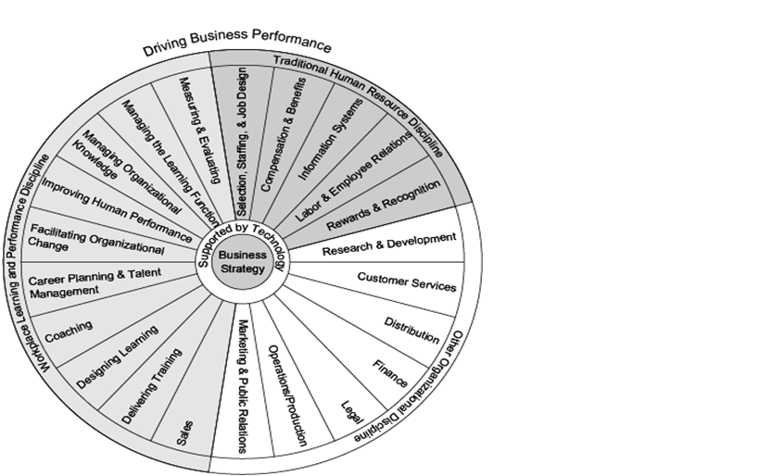
The New Learning and Performance Wheel

Slide 16
Strategic Management and HRD
Strategic management intends to provide a competitively superior fit with the external environment and enhance the long run performance of the organization.
HRD department should demonstrate its strategic capability through:
  Directly participating in organization’s strategic management process
  Providing education and training to line managers in the concepts and methods of strategic management and planning
  Providing training to all employees that is aligned with the goals and strategies of the organization

Slide 17
The supervisor’s role in HRD
  Implements HRD programs and procedures
  On-the-job training (OJT)
  Coaching/mentoring/counseling
  Career and employee development
  A “front-line participant” in HRD

Slide 18
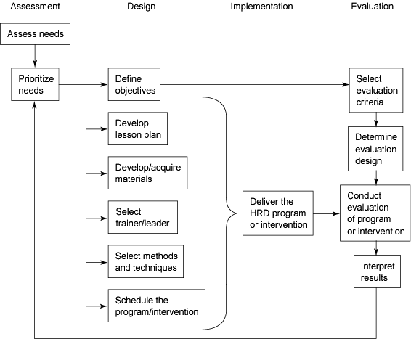
A Framework for the HRD Process

Slide 19
Summary of Lecture 18
Why HRD?
What is HRD?
Relationship between HRM and HRD
Functions of HRM
Functions of Human Resource Development
Training and Development
Organization Development
Career Development
The new learning and performance wheel
Strategic Management and HRD

Slide 20
Reference books
Human Resource Development: Foundation, Framework and Application
Jon M. Werner and Randy L. DeSimone: Cengage Learning, New Delhi

Slide 21
Thank you!

