Slide 1
Advances in Human Resource Development and Management
Course code: MGT 712
Lecture 17

Slide 2
Recap of lecture 16
Why Health, Safety, and Security?
Defining Health, Safety, and Security
Safety Management
Health
Security
Workplace Violence
Security Management

Slide 3
Learning Objectives: Lecture 17
Rights and Responsibilities Issues
Legislation in Pakistan
HR Policies, Procedures, and Rules
Employee Handbooks
Communicating HR Information
Employee Discipline
Approaches to Discipline

Slide 4
Rights and Responsibilities Issues
Rights
  Belong to a person by law, nature, or tradition.
  Legal rights may or may not correspond to moral rights.
Responsibilities
  Obligations to be accountable for actions.
  Employment is a reciprocal relationship – both sides have rights and responsibilities.
  If an employee has the right to a safe working condition, then employer must have an obligation to provide a safe workplace
  If the employer has the right to expect uninterrupted high- quality work from employees, then the worker has the responsibility to be on the job and meet performance standards.
Statutory Rights
  Rights based on specific laws and statutes passed by federal, provincial, and local governments.

Slide 5
Legislation in Pakistan
Industrial and Commercial Employment Ordinance 1968
  The workmen should be provided the contract in writing, showing the terms and conditions of his service, at the time of hiring, promotion and transfer.
  The wage rates paid to different categories of workers/work should be posted on the notice boards.
Articles 25 and 27 of the Constitution
  Prohibit discrimination on the basis of race, religion, caste, sex, residence or place of birth.
Article 37(e) of the Constitution
  The state shall make provision for securing just and humane conditions of work, ensuring that children and women are not employed in vocations unsuited to their age or sex, and for maternity benefits for women in employment.
Article 38 of the Constitution
  The state shall secure the well-being of the people, irrespective of sex, caste, creed or race, by ensuring equitable adjustment of rights between employers and employees.

Slide 6
HR Policies, Procedures, and Rules
Policies
  General guidelines that focus organizational actions.
  “Why we do it”
  Are general in nature
  Be viewed regularly
Procedures
  Provide for customary methods of handling activities
  “How we do it”
  Specific to the situation
Rules
  Specific guidelines that regulate and restrict the behavior of individuals.
  “The limits on what we do”
  Similar to procedures as they guide action and typically allow no discretion in their application
  Rules reflect a management decision that action be taken – or not taken in a given situation

Slide 7
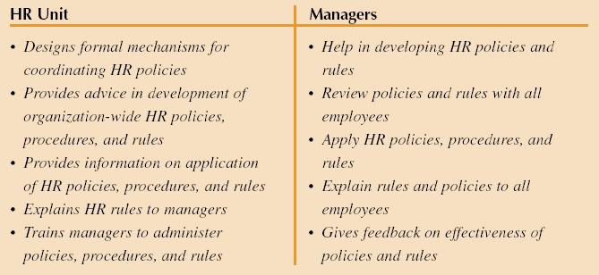
Typical Division of HR Responsibilities:
Policies and Rules

Slide 8
Employee Handbooks
Any conflict between the two entities be resolved so that employees receive appropriate treatment.
Well designed HR policies should be:
  Consistent, necessary, applicable, understandable, reasonable, distributed, and clearly communicated
Employee Handbooks
  Give employees a reference source for company policies and rules
  Can be a positive tool for effective management of human resources
  Can be prepared very easily by using available computer software

Slide 9
Employee Handbooks
  First, develop sound HR policies and employee handbooks to communicate them and then:
  Legal Review of Language
    Eliminate controversial phrases in wording
    Use disclaimers and show them prominently in the handbook
    Disclaimers should not be overused
    Keep handbook contents current
  Readability
    Adjust reading level of handbook for intended audience of employees
    Test the readability of the handbook on a sample of employees before it is published
  Use
    Communicate and discuss handbook
    Distribute employee handbook electronically
    Notify all employees of changes in the handbook

Slide 10
Communicating HR Information
It focuses on receipts and dissemination of HR data and information throughout the organization
  Downward communication
    Informing employees about what is and will be happening in the organization
    What top management expectations and goals are
  Upward communication
    Enables managers to know about the ideas, concerns, and information needs of employees

Slide 11
Communicating HR Information
HR publications and media
Communication through newspapers, company magazines, organizational newsletters, videotapes, and internet postings
  Manager should make an honest effort to communicate information employee need to know
  It should not be solely a public relations tool rather bad news as well as good news should be reported objectively in readable style
    A question and answer section in newsletter
    Video or audio tapes to explain benefit programs

Slide 12
Communicating HR Information
Electronic communication
Communication to employees through E-mail, teleconferencing, and message boards on company’ web site
  Replies can be returned at once
  E-males can bypass organizational structure and channels
  Videoconferencing can deliver same message at various audience at various locations
  Message boards allow communication among management, employees and executives on issue of concern

Slide 13
Communicating HR Information
Suggestion system
A formal method of obtaining employee input and upward communication
  Give opportunity to employees to suggest changes to improve the operations – may encourage loyalty and commitment
  Employees are in good position to tell management
  Financial rewards of such suggestions may be given to the employee
  In a period of seven years, Toyota Japan received on average 2 million suggestions from its workforce

Slide 14
Employee Discipline
Employee rights often are a key issue in disciplinary cases
Discipline
  A form of training that enforces organizational rules.
  Used for problem employees:
    Absenteeism, tardiness, productivity deficiencies, and insubordination
    If organizations fail to deal with the small number of problem employees, negative effect on other employees or work groups may result

Slide 15
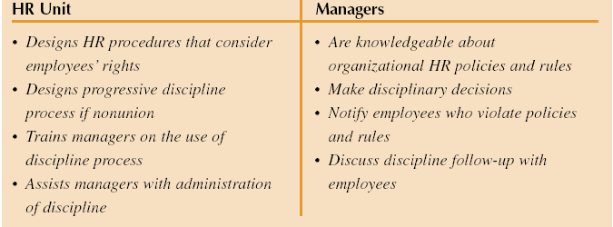
Typical Division of HR Responsibilities: Discipline

Slide 16
Approaches to Discipline
  Disciplinary system can be viewed as an application of behavior
  modification
  Self discipline: when most people understand what is required at work,
  they can be counted on to do their jobs effectively
  External discipline helps their self-discipline
Positive discipline approach
Violations are actions that usually can be constructively
corrected without penalty
Managers focus on fact finding and guidance to encourage
desirable behaviors rather than using penalties
Counseling
Heightens employee awareness of organizational rules and policies; and knowledge of disciplinary action

Slide 17
Approaches to Discipline
2. Written documentation
If employee fails to correct his behavior, then a second
conference becomes necessary
  This stage is documented in written form
  Employee and supervisor develop written solutions to prevent such problems
3. Final warning
When employee does not follow the written solutions, a final warning
conference is held.
  The supervisor emphasizes the importance of correcting the inappropriate actions.
4. Discharge
If the employee fails to follow the action plan, that was developed and
further problems exist, then the supervisor discharges the employee
This approach needs extensive training
It takes supervisory time

Slide 18
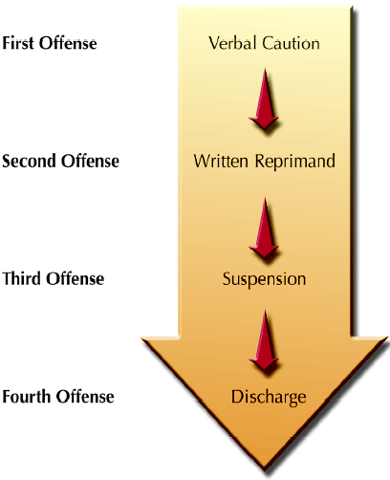
Approaches to Discipline
Progressive discipline approach
It is a sequence of steps each of which
becomes progressively more stringent
and are designed to change the
employee’s inappropriate behavior.
  Third offense in a year may lead to a
  suspension.
  It sends a strong message to the
  employee that undesirable job behavior
  must change or termination is likely to
  follow.
  This approach provides opportunities to
  correct deficiencies
  It ensures that both the nature and
  seriousness of the problem are clearly
  communicated to the employee.

Slide 19
Reasons Why Discipline Might Not Be Used
Organizational culture regarding discipline
  Organizational norm is to avoid penalizing and even dismissal of problem employees
Lack of support by higher management
Guilt
Loss of friendship
Time loss
Fear of lawsuits

Slide 20

The Hot Stove Rule
Good discipline (or a rule) is like a hot stove in that:
  It provides a warning (feels hot)
  It is consistent (burns every time)
  It is immediate (burns now)
  It is impersonal (burns all alike)

Slide 21
Effective Discipline
Should be aimed at the behavior not the employee
Discipline can be positively related to performance
If the manager tolerates unacceptable behavior, the group may resent the unfairness
Training supervisors and managers on when and how discipline is crucial
Training managers on counseling and communication skills may enable them to deal with employee performance problems

Slide 22
Discharge: The Final Disciplinary Step
Handling Discharges
  Provide discharge warning at last disciplinary step before termination.
  Provide the employee with written notice of the discharge that clearly states the reason(s) for the discharge decision, do not try to “sugarcoat” the reason(s).
  Have an HR representative attend the termination meeting as a witness.
  Inform the employee of HR or benefits issues.

Slide 23
Summary of Lecture 17
Rights and Responsibilities Issues
Legislation in Pakistan
HR Policies, Procedures, and Rules
Employee Handbooks
Communicating HR Information
Employee Discipline
Approaches to Discipline

Slide 24
Reference books
Human Resource Management (10th Ed.)
Robert L. Mathis and John H. Jackson: Cengage Learning, Delhi
Labour and Employment Law: A Profile on Pakistan
Iftekhar Ahmed

Slide 25
Thank you!

