Slide 1
Advances in Human Resource Development and Management
Course code: MGT 712
Lecture 16

Slide 2
Recap of lecture 15
Benefits
Strategic Perspectives on Benefits
Funding Benefits
Types of Benefits
Benefits Administration

Slide 3
Learning Objectives: Lecture 16
Why Health, Safety, and Security?
Defining Health, Safety, and Security
Safety Management
Health
Security
Workplace Violence
Security Management

Slide 4
Why Health, Safety, and Security
Employees expect their employers to provide work environments that are safe, secure, and healthy
People once viewed accidents and occupational diseases as unavoidable by-products of work – prevention and control measures may be take to minimize or eliminate these risks
Organizations are required to pay enormous amounts against worker compensation
Employers cannot have healthy, motivated, satisfied and committed work force without their addressing Health, Safety, and Security issues

Slide 5
Health, Safety, and Security
Health
  A general state of physical, mental, and emotional well-being.
Safety
  A condition in which the physical well-being of people is protected.
Security
  The protection of employees and organizational facilities.

Slide 6
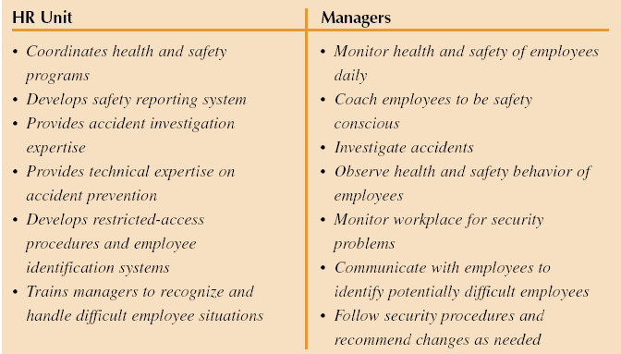
Typical Division of Responsibilities:
Health, Safety, and Security

Slide 7
Safety Management
It requires organizational commitment to provide safe working conditions
This effort should be coordinated from top management to include all the members of the organization
This should be reflected in management actions
Such efforts give rise to a safety culture that prevails in the organization
It pays out in terms of:
  Reduced workplace accidents and injuries
  Reduced costs associated with worker compensation and fines
There are three different approaches

Slide 8
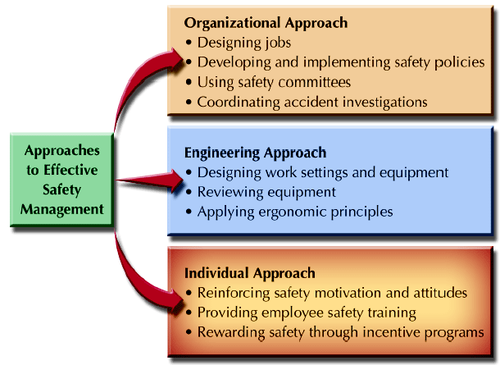
Approaches to Effective Safety Management

Slide 9
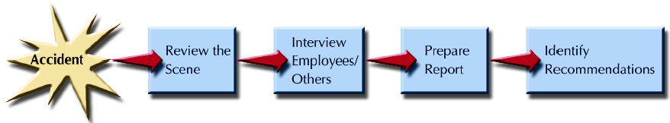
Phases of Accident Investigation

Slide 10
Health
1. Workplace Health Issues
Emotional and mental health concerns
  Employees face work, family, and personal life pressures
  Specific events – death of a relative, divorce, medical problems – may affect individuals in terms of depression and stress
  This may result into work related consequences – that should be dealt properly
  HR staff should intervene and refer affected employees to outside resources through employee assistance programs

Slide 11
Health
Workplace air quality
Within certain manufacturing facilities air quality can be a health issue
  textile unit, fertilizer or cement plant
  Sealed buildings, inadequate ventilation
  Airborne contamination from carpet, copy machines, adhesives, and fungi
Smoking at work
  Many employers have no smoking policies
  Some employers offer smoking cessation workshops

Slide 12
Health
2. Health Promotion
Health promotion is a supportive approach to facilitate and encourage employees to enhance healthy actions and lifestyles.
  Level 1. Information and awareness
  Employer provide information on – weight control, stress management, nutrition, exercises and smoking cessation
  Has some impact on individuals
  Level 2. Lifestyle wellness
  Individuals are required to follow those initiatives and make changes in attitudes and behaviors.
  Wellness programs are designed to maintain or improve employee health before problems arise.
    For instance reducing cholesterol, heart disease risk, individualized exercise programs
    Encourage self-directed lifestyle changes

Slide 13
Health
  Employee assistance programs
  Provide counseling and other help to employees having emotional, physical, or other personal problems – depression and anxiety, legal difficulties, substance abuse, financial counseling, and career advice
  Level 3. Organizational health culture
  Employers believe that an organizational culture that emphasizes and supports health efforts is beneficial
  They indulge in an integrated and broad based effort supported both financially and managerially
  They development of procedures and policies that support health efforts – on site exercise facilities, fitness centre

Slide 14
Security
Top Eight Security Concerns at Work:
  Workplace violence
  Internet/intranet security
  Business interruption/disaster recovery
  Fraud/white collar crime
  Employee selection/screening concerns
  General employee theft
  Unethical business conduct
  Computer hardware/software theft

Slide 15
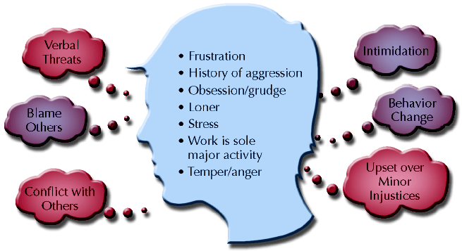
Profile of a Potentially Violent Employee

Slide 16
Workplace Violence
Management of Workplace Violence
Employers should develop workplace violence prevention and response policies and practices
Employers must initiate disciplinary actions and referrals to employee assistance programs
Violence response team should function like a safety committee
Post violence response should sound reasonable – referrals to EAP resources, allowing employee time to meet with HR staff, arranging for trained counselors

Slide 17
Workplace Violence
Domestic causes of workplace violence
Violence that begins at home with family can spill over to workplace
Training on workplace violence
Managers, HR staff, supervisors and employees must be trained on how to recognize a potential violent employee and what to do when violence occurs:
  Notice verbal and non-verbal reactions of individuals that indicate hostility
  Ask questions that require longer answers and explanations
  Respond calmly and non-threatingly to individual’s emotions and acknowledge those emotions/feelings
  Get assistance from HR or another neutral party
  Notify security personnel

Slide 18
Security Management
An overall approach to security management is needed to deal with a wide range of issues
Security audit / vulnerability analysis
A comprehensive review of organizational security – through internal managers and outsiders. It includes:
  Survey of the area around facility
  Review of the security available
  Review of the disaster management plans
Controlled access
  Controlling access to the physical facilities of the organization
  Most vulnerable employees must be provide with secure areas

Slide 19
Security
Security Management
Computer security
it controls access to computer systems
  Internet, Email, and e-commerce
  Important when individuals are terminated or leave the organization
Employee screening and selection
  A key facet of providing security is to screen job applicants
Security personnel
  Another critical part of security system is adequately trained security staff in sufficient numbers

Slide 20
Legislation in Pakistan
Regarding Occupational Safety and Health, following legislation exists in Pakistan:
The Factories Act 1934
The main law containing OSH provisions is applicable to manufacturing enterprises employing 10 or more workers.
Mines Act 1923
It covers the mining sectors
Dock Laborers Act 1934
Workmen’s Compensation Act 1923
The OSH law in Pakistan mainly cover the formal sector manufacturing industry

Slide 21
Summary of Lecture 16
Why Health, Safety, and Security?
Defining Health, Safety, and Security
Safety Management
Health
Security
Workplace Violence
Security Management

Slide 22
Reference books
Human Resource Management (10th Ed.)
Robert L. Mathis and John H. Jackson: Cengage Learning, Delhi
Labour and Employment Law: A Profile on Pakistan
Iftekhar Ahmed

Slide 23
Thank you!

