Slide 1
Advances in Human Resource Development and Management
Course code: MGT 712
Lecture 14

Slide 2
Recap of lecture 13
Variable Pay
Assumptions of Variable Pay System
Types of Variable Pay
Factors Affecting Variable Pay Plans
Individual Incentives
  Piece-Rate Systems
  Bonuses
  Special Incentive Programs
Sales Compensation and Incentives
Advantages and Disadvantages of Individual Incentive Plans

Slide 3
Learning Objectives: Lecture 14
Why Team Incentives
Defining Group/Team Incentives
Distributing Team Incentives
Problems with Team-Based Incentives
Types of Group Incentives
Organizational Incentives
Executive Compensation

Slide 4
Why Team Incentives
Growing use of teams in organizations to achieve objectives and to be competitive
In certain organizations, cooperation within and between teams is needed
Team based job designs promote innovation
Team based organization structures encourage team members to learn new skills and assume broader responsibility
Individual incentives may limit team effectiveness
Companies are forced to change individual based compensation to team based compensation plans

Slide 5
Defining Group/Team Incentives
A group of employees is not necessarily a team but either one can be the basis for variable compensation
Group incentive programs reward employees for their collective rather than for individual performance
More effective:
  when all group member have some impact on achieving the goal
  Where group size is small
  where interdependence is high
Well designed team incentives plans:
  Reinforce team work
  Cultivate loyalty
  Increase productivity
  Improves quality
  Boosts up employee morale
  Ties earnings to team performance

Slide 6
Distributing Team Incentives
Allocating Rewards
  Same size reward
  Different size rewards
Decision Making about Team Incentive Amounts
  Decide how to divide
  Vote
  Team leader decide
  Equally
  Unwilling to handle pay decisions for coworkers
Timing of Team Incentives
  Monthly, quarterly, semiannually, annually

Slide 7
Problems with Team-Based Incentives
Rewarding team member equally or equitably
Poorly performing individual influence team results negatively
Still employees expect to be paid on individual performance

Slide 8
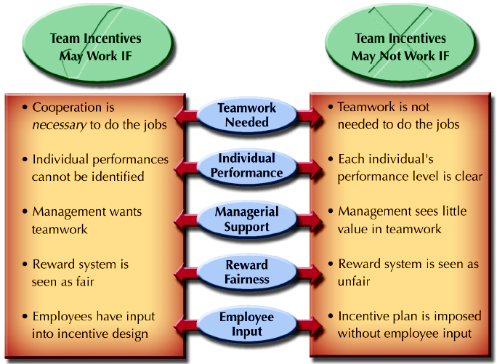
Conditions for Successful Team Incentives

Slide 9
Types of Group Incentives
Work Team Results
  May reward equally on the basis of group output – cost savings, quality improvement, increased sales revenue
  1 % improvement over baseline in the shipping groups’ rate of on-time delivery each month

Slide 10
Types of Group Incentives
  Most of the group incentives are designed on self-funding principle
Gainsharing
The sharing with employees of greater-than-expected gains in productivity.
  It attempts to increase discretionary effort
  Usually, workers are not paid for discretionary effort
  Management must identify the ways in which increased productivity, quality, and financial performance can occur
  Decide how to share gains with employees
    A flat amount for all employees
    Same percentage of base salary for all employees
    Percentage of the gains by category of employees
    A percentage based on individual performance against measures

Slide 11
Advantages and Disadvantages of Group Incentives
Advantages
Disadvantages
Performance measures for group incentives can be developed more easily
Judging the quality of final product makes the sense
Greater group cohesion
High turnover because of free rider effect
Employees who make the greater contributions are likely to leave
Group members are uncomfortable because other members’ performance influence their compensation

Slide 12
Organizational Incentives
An organizational incentive system compensates all employees in the organization based on how well the organization as a whole performs during the year.
  Overall results depend on organizational or plant-wide cooperation
  Conflicts between marketing and production can be overcome
  Such plans should include every one from non-exempt employees to managers and executives
  Organizational incentives include:
    Profit sharing
    Employee stock options
    Employee stock ownership plans

Slide 13
Profit Sharing
Profit Sharing
A system to distribute a portion of the profits of the organization to employees.
  Typically percentage of profits to be distributed is agreed on by the end of the year before distribution
  Profits may be distributed at year end or deferred and made available at retirement
  Primary objectives are to:
    Improve productivity
    Recruit or retain employees
    Improve product/service quality
    Improve employee morale
  Drawbacks
    Disclosure of financial information
    Variability of profits from year to year
    Profit results not strongly tied to employee efforts

Slide 14
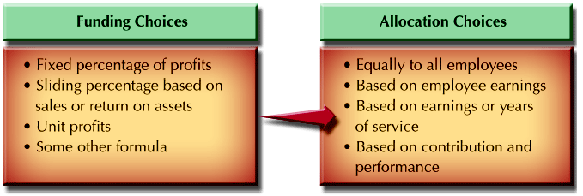
Profit-Sharing Plan Framework Choices

Slide 15
Employee Stock Options
Give employees the right to purchase a fixed number of shares of company stock at a specified price for a limited period of time.
  Purchasing and holding the company stock is thought to give employees a vested ownership in seeing the company do well
  Provides incentive to work productively

Slide 16
Employee Stock Ownership Plans (ESOPs)
Employees gain stock ownership in the organization for which they work.
Place company stock in trust accounts for employees.
  These trust are set aside as a source of retirement income
  It is similar to deferred profit sharing
  Retirement benefit is tied to the firm’s performance

Slide 17
Executive Compensation
CEOs receive millions of dollars
CEOs fall in high tax brackets
Want compensation in ways that offer tax advantages
Total compensation packages are more significant than base pay

Slide 18
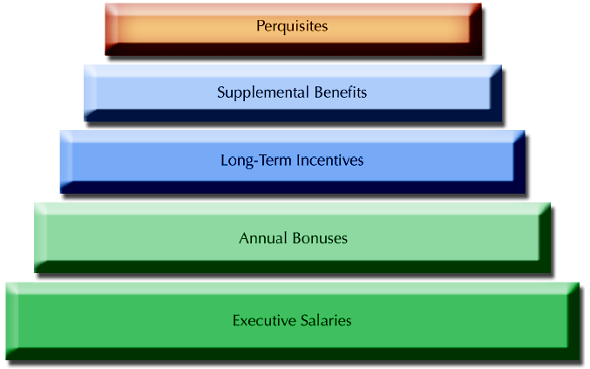
Executive Compensation Components

Slide 19
Executive Compensation
Executive Salaries
  Salaries vary by type of job, size of organization, and industry
Executive Bonus Plans
  Bonus compensation must reflect some performance measures
  Bonuses may be decided by board of directors or tied to earning per share, return of investment or net profit
Long term incentives
  Stock option, share appreciation rights
Benefits for Executives
  Health insurance, vacation, retirement
Executive perquisites
  Special benefits – usually noncash items – for executives.
  Perks help tie executives with organizations and demonstrate their importance to their companies.
  Can offer tax savings

Slide 20
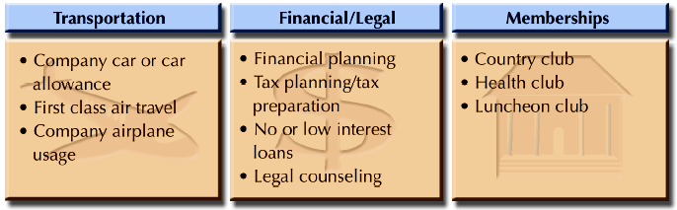
Common Executive Perks

Slide 21
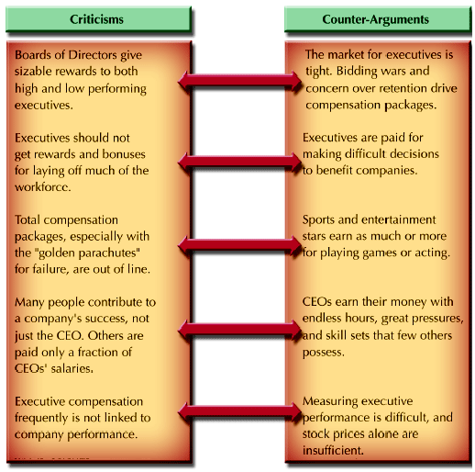
Arguments in the Executive Pay Debate

Slide 22
Summary of Lecture 14
Why Team Incentives
Defining Group/Team Incentives
Distributing Team Incentives
Problems with Team-Based Incentives
Types of Group Incentives
Organizational Incentives
Executive Compensation

Slide 23
Reference books
Human Resource Management (10th Ed.)
Robert L. Mathis and John H. Jackson: Cengage Learning, Delhi
Fundamentals of Human Resource Management Raymond A. Noe, John R. Hollenbeck, Barry Gerhart, & Patrick M. Wright: McGraw-Hill, New York

Slide 24
Thank you!

