Slide 1
Advances in Human Resource Development and Management
Course code: MGT 712
Lecture 13

Slide 2
Recap of Lecture 12
Development of a Base Pay System
Job Evaluation
Pay Survey
Pay Structures
Individual Pay
Issues Involving Pay Increases

Slide 3
Learning Objectives: Lecture 13
Why Variable Pay?
What is Variable Pay?
Assumptions of Variable Pay System
Types of Variable Pay
Factors Affecting Variable Pay Plans
Individual Incentives
  Piece-Rate Systems
  Bonuses
  Special Incentive Programs
Sales Compensation and Incentives
Advantages and Disadvantages of Individual Incentive Plans

Slide 4
Why Variable Pay?
Do employees work harder if pay is tied to performance?
  Employees can control their salaries
Employers apparently believe it too – by adopting variable pay systems:
  To link individual performance to business goals
  To motivate employees
  To retain employees
  To Control cost

Slide 5
Variable (Incentive) Pay
Rewards employees for partially or completely attaining a predetermined work objective.
Compensation other than base wages or salaries, that fluctuates according to employees’ attainment of some standard, such as a pre-established formula, individual or group goals, company earnings.
  It adds to basic pay
  It appears as one time payments

Slide 6
Assumptions of Variable Pay System
Individual employees and work teams differ in how much they contribute – what they do, how well they do
Company’s overall performance depends on the performance of individuals and groups
To attract, retain, and motivate high performers, and to be fair to all employees, a company needs to reward employees on performance

Slide 7
Contrasting Variable Pay with Service Pay System?

Slide 8
Types of Variable Pay
Individual Incentives
Team or Group Incentives
Organization wide Incentives

Slide 9
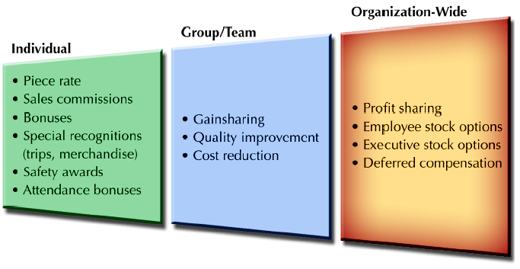
Types of Variable Pay Plans

Slide 10
Typical Performance Measures
Individual Incentive Plans
  Quantity of work output
  Quality of work output
  Work safety record
  Work attendance
Group Incentive Plans
  Customer satisfaction
  Labor cost savings
  Material cost savings
  Reduction in accidents
Companywide Incentive Plans
  Company profits
  Market share
  Cost containment
  Sales revenue

Slide 11
Factors Affecting Variable Pay Plans
Does the plan fit the organization?
  One plan does not work for all organizations
  Plan must be linked to organizational objectives
  Ensure that cost saving or additional revenue justify the incentives
  Plan must be consistent with the organizational culture
Does the plan encourage the desired behavior?
  Employees tend to produce what is measured and rewarded
  Employees must see a direct link
  Organizations must make sure that what is being rewarded leads to achieving organizational objectives
  Employee performance must render itself measurable
  Use of multiple measures helps assure that various performance dimensions are not omitted
Is the plan being administered properly?
  Communication of a variable pay plan to employees is vital
  The more complicated a plan is, the more difficult it will be to communicate
  Clearly reflect that how much is paid to employees separate from their base pay
  Plan should consistently reflect technological and organizational conditions

Slide 12
Individual Incentives
Identification of individual performance
Independent work
Individual competitiveness is desired
Individualism is stressed in organizational culture
Types of Individual Incentives
  Piece-Rate Systems
  Bonuses
  Special Incentive Programs

Slide 13
Piece-Rate Systems
Straight Piece-Rate Systems
  Wages are determined by multiplying the number of pieces produced by the piece rate for one unit.
Differential Piece-Rate Systems
  Employees are paid one piece-rate for units produced up to a standard output and a higher piece-rate wage for units produced over the standard.

Slide 14
Bonuses
Bonus
  A one-time payment that does not become part of the employee’s base pay.
  Can be used to compensate for contributing new ideas, developing skills, or obtaining professional certifications
  A bonus can recognize performance by an employee, a team, or entire organization.
  Bonus plans must be described in writing

Slide 15
Special Incentive Programs
Usually focus on rewarding only high performing individuals
Awards
  Cash or merchandise used as an incentive reward.
Recognition Awards
  Recognition of individuals for their performance or
  service to customers in areas targeted by the firm.
  Work best when they recognize specific efforts and activities targeted by the organization as important
  Objective criteria used to select award winners are more likely to be seen as rewarding performance than favoritism
Service Awards
  Rewards to employees for lengthy service with an
  organization.

Slide 16
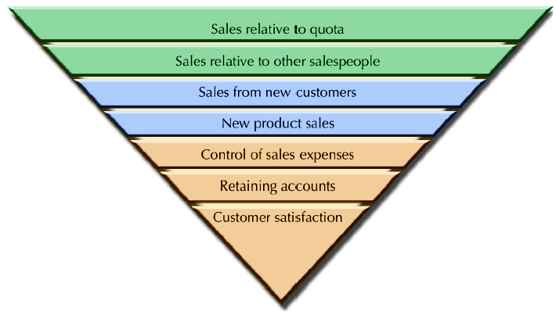
Sales Compensation and Incentives
Measuring Sales Performance
  Establish clear performance criteria

Slide 17
Sales Compensation and Incentives
Sales Compensation Plans
Salary Only
  All compensation is paid as a base wage with no incentives.
  Organization emphasizes serving and retaining existing accounts
  Is used to protect the salary of new sales representatives
  Salespersons who want extrinsic rewards function less effectively in salary only plan
Salary Plus Bonus
Offers a set salary coupled with a bonus
Salary Plus Commission
It combines the stability of a salary with the performance aspect of a commission.

Slide 18
Sales Compensation and Incentives
Commission Plus Draw Plans
Award sales professionals with subsistence pay or draws – money to cover basic living expenses – yet provide them with a strong incentive to excel.
      Draw system make advance payments against future commissions to salesperson.
Commission Only Plans
Salespeople derive their entire income from commissions.
  Straight Commission
  Graduated Commission

Slide 19
Advantages and Disadvantages of Individual Incentive Plans
Advantages
Disadvantages
Can promote relationship between pay and performance
Promote an equitable distribution of compensation in an organization
Compatible with individualistic cultures
Posses a potential to promote inflexibility
Comprehensive performance measures must be developed to award incentives – improved work methods or equipment
Lead to undesirable workplace behavior – reward only quantity of output
Lead to unhealthy competition

Slide 20
Summary of Lecture 13
Variable Pay
Assumptions of Variable Pay System
Types of Variable Pay
Factors Affecting Variable Pay Plans
Individual Incentives
  Piece-Rate Systems
  Bonuses
  Special Incentive Programs
Sales Compensation and Incentives
Advantages and Disadvantages of Individual Incentive Plans

Slide 21
Reference books
Human Resource Management (10th Ed.)
Robert L. Mathis and John H. Jackson: Cengage Learning, Delhi
Strategic Compensation: A Human Resource
Management Approach (3rd Ed.)
Joseph J. Martocchio: Pearson Education

Slide 22
Thank you!

