Slide 1
Advances in Human Resource Development and Management
Course code: MGT 712
Lecture 12

Slide 2
Recap of lecture 11
Importance of Pay System
Objectives of an Effective Compensation System
Nature of Compensation
  Components of a Compensation System
  Types of Compensation
Compensation System Design Issues
Perceptions of Pay Fairness

Slide 3
Learning Objectives: Lecture 12
Development of a Base Pay System
Job Evaluation
Job evaluation Methods
Pay Survey
Pay Structures
Pay Ranges
Individual Pay
Issues Involving Pay Increases

Slide 4
Development of a Base Pay System
Accurate job descriptions and job specifications are available, and used in:
  Job Evaluation – Pay system is internally equitable
  Pays Surveys – Pay system is externally competitive
Both job evaluation and pay surveys are used to designed pay structures – pay grades and minimum and maximum pay ranges
Individual jobs must be placed in appropriate pay grades
Employees’ pay adjusted based on length of service and performance
Pay system must be monitored and updated

Slide 5
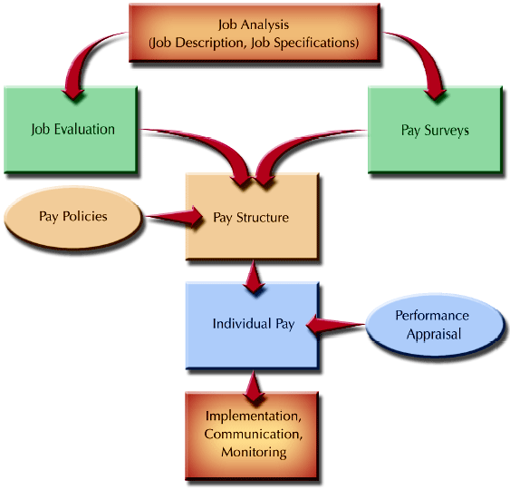
Development of a Base Pay System

Slide 6
Job Evaluation
Job Evaluation
The systematic determination of the relative worth of jobs within an organization.
Here, every job in an organization is examined and priced on:
  Relative importance of the job
  Knowledge, skills, and abilities needed to perform the job
  Difficulty of the job
Benchmark Job
  A job found in many organizations and performed by several individuals who have similar duties that are relatively stable and require similar KSAs - Receptionist, accountant, cashier
  Used as anchors against with unique job can be evaluated

Slide 7
Job evaluation Methods
Ranking Method
Places jobs in order, ranging from highest to lowest in value to the organization. Entire job is considered rather than individual components.
  It is a subjective method
  For a large number of jobs to be ranked, the method becomes awkward
  More appropriate for small organizations

Slide 8
Job evaluation Methods
Classification Method
Descriptions of each class of jobs are written, and then each job in the organization is put into a grade according to the class description it best matches.
  Subjective judgment is needed to develop class descriptions and to place jobs accurately in them.
  Because of generally written class descriptions, some jobs could fall in more than one job grades
  It relies on job titles and duties

Slide 9
Job evaluation Methods
Point Method
It breaks down jobs into various compensable factors and places weights or points on them. After point totals have been determined for all jobs, the jobs are grouped together into pay grades.
  Compensable factor identifies a job value commonly present throughout a group of jobs
  An easy and comprehensive method - It considers the components of a job rather than the total job
  It quantifies job elements by assigning weights to components of a job
  It is a time consuming method
  It reinforces traditional organizational structures and ob rigidity

Slide 10
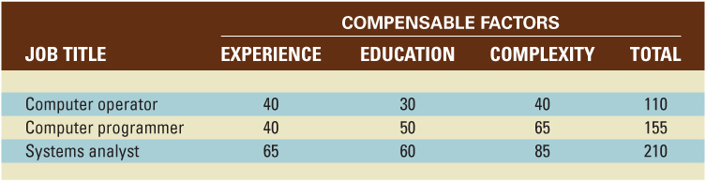
Job Evaluation of Three Jobs with Three Compensable Factors

Slide 11
Job evaluation Methods
Factor Comparison
It involves determining the benchmark jobs in an organization, selecting compensable factors, and ranking all benchmark jobs factor by factor.
A comparison of jobs to market rates for benchmark jobs results in the assignment of monetary values for each factor.
The final step is to evaluate all other jobs in the organization by comparing them with benchmark jobs.
  It is tailored specifically to one organization
  It is a time consuming to establish and develop

Slide 12
Pay Survey
A collection of data on compensation rates for workers performing similar jobs in other organizations.
An organization may
  Use a survey already conducted
  Develop a pay survey

Slide 13
Using Prepared Pay Surveys
Participants
Broad based
Timeliness
Methodology
Job matches

Slide 14
Developing a Pay Survey
Employers with comparable jobs should be selected
Jobs to be surveyed must be determined
Those jobs should be selected that can be compared and that represent a broad range of jobs – key or benchmark jobs
Brief job descriptions for jobs surveyed should be provided
Managers decide what information is needed – starting pay, base pay, overtime rate,
Survey should specify confidentiality, and data are summarized to assure anonymity

Slide 15
Pay Structures
Pay Survey data and job evaluation results are plotted on a graph
Market Line
  The line on a graph showing the relationship between the job value, as determined by job evaluation points, and pay survey rates.
Different Pay Structures
  Hourly and salaried
  Office, plant, technical, professional, managerial
  Clerical, information technology, professional, supervisory, management, and executive

Slide 16
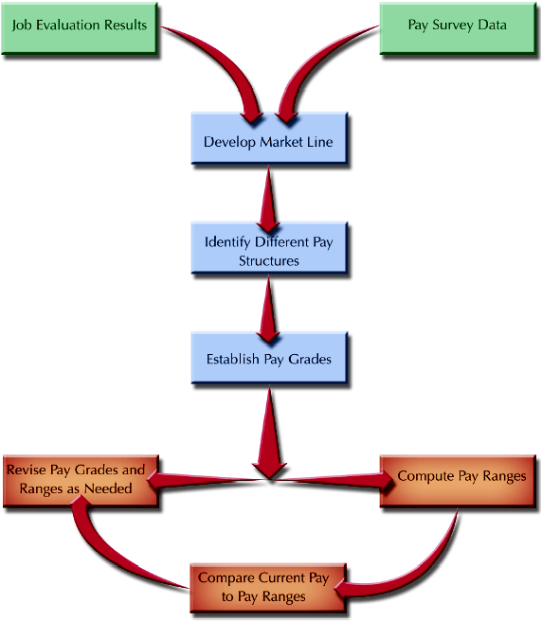
Establishing Pay Structures

Slide 17
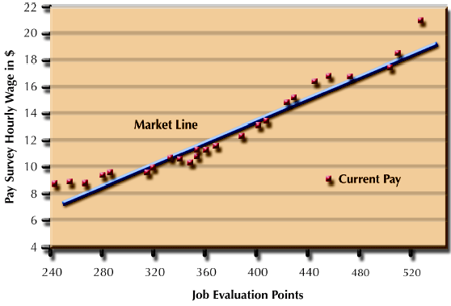
Pay Scattergram

Slide 18
Pay Structures
Pay Grades
  A grouping of individual jobs having approximately the same job worth.
Broad-banding
  The practice of using fewer pay grades having broader pay ranges that in traditional systems.
  Benefits
    Encourages horizontal movement of employees
    Is consistent with trend towards flatter organizations
    Creates a more flexible organization
    Encourages competency development
    Emphasizes career development
  Not appropriate for organizations operating in structured manner
  Employees see promotion accompanied by a pay raise and movement to a new grade

Slide 19
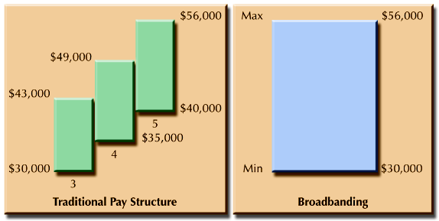
Traditional Pay Structure vs. Broadbanding

Slide 20
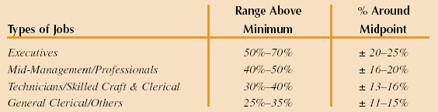
Pay Ranges
Minimum and maximum pay levels for each pay grade may be determined by using the market line as a starting point
Make the market line the midpoint of the new pay structure
In a typical pay grade, maximum value may be 20% above midpoint and the minimum value 20% below it
A smaller minimum to maximum range should be used for lower level jobs than for higher level jobs
There may be overlaps between grades

Slide 21
Individual Pay
Pay ranges for grades give flexibility by allowing individuals to progress within a grade
It allows managers to reward better performing employees while maintaining the integrity of pay system
Rates Out of Range
  Red-Circled Employees
  An incumbent (current jobholder) who is paid above the range set for the job.
    Pay may be frozen
    Give a lump-sum payment but no pay raises
  Green-Circled Employees
  An incumbent who is paid below the range set for the job.
    Handsome pay increases or frequent pay increases may be used

Slide 22
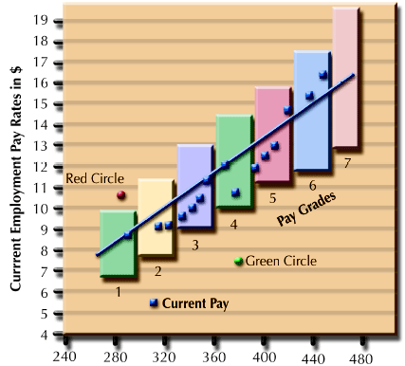
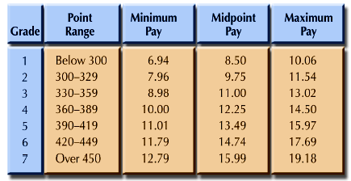
Example of Pay Grades and Pay Ranges

Slide 23
Pay Compression
  A situation in which pay differences among
  individuals with different levels of experience
  and performance in the organization becomes
  small.
  Happens because, labor market pay levels increase more rapidly than current employees’ pay adjustment – IT

Slide 24
Issues Involving Pay Increases
Seniority
Time spent in an organization or on a particular job.
  Used to determine eligibility for organizational rewards and benefits.
  Seniority based pay adjustments are set as automatic steps
Cost-of-Living Adjustments (COLA)
A percentage increase in wages that allows employees to maintain the same real wages in a period of economic inflation.
Lump-Sum Increases (LSI)
  A one-time payment of all or part of a yearly pay increase.
  Lump-sum payments do not increase base pay

Slide 25
Summery of Lecture 12
Development of a Base Pay System
Job Evaluation
Job evaluation Methods
Pay Survey
Pay Structures
Pay Ranges
Individual Pay
Issues Involving Pay Increases

Slide 26
Reference books
Human Resource Management (10th Ed.)
Robert L. Mathis and John H. Jackson: Cengage Learning, Delhi
Fundamentals of Human Resource Management Raymond A. Noe, John R. Hollenbeck, Barry Gerhart, & Patrick M. Wright: McGraw-Hill, New York

Slide 27
Thank you!

