Slide 1
Advances in Human Resource Development and Management
Course code: MGT 712
Lecture 11

Slide 2
Recap of lecture 10
The Process of Performance Management
Methods for Appraising Performance
Sources of Performance Information
Errors in Performance Measurement
Giving Performance Feedback
Finding Solutions to Performance Problems

Slide 3
Learning Objectives: Lecture 11
Importance of Pay System
Objectives of an Effective Compensation System
Nature of Compensation
  Components of a Compensation System
  Types of Compensation
Compensation System Design Issues
Perceptions of Pay Fairness

Slide 4
Importance of Pay System
Pay is a powerful tool for meeting the organization’s goals.
Pay has a large impact on employee attitudes and behaviors.
It influences the kinds of people who are attracted to (or remain with) the organization.
Employees evaluate their relationship with the employer based on their pay

Slide 5
Objectives of an Effective Compensation System
  linked to organizational objectives
  Legal compliance with all appropriate laws and regulations
  Cost effectiveness for the organization
  Internal, external, and individual equity for employees
  Performance enhancement for the organization

Slide 6
Nature of Compensation
Types of Rewards
  Intrinsic
    Intangible, psychological and social effects of compensation
    Praise for competing a project
  Extrinsic
    Tangible, monetary and nonmonetary effects of compensation

Slide 7
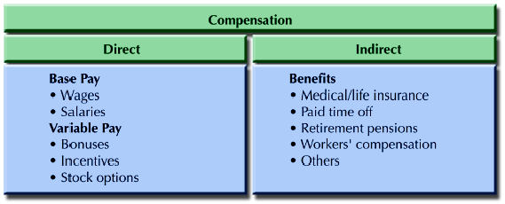
Nature of Compensation
Components of a Compensation Program

Slide 8
Nature of Compensation

Slide 9
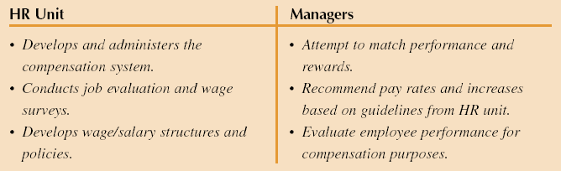
Typical Division of HR Responsibilities: Compensation

Slide 10
Compensation System Design Issues
Compensation decisions must be viewed strategically and be linked to organizational strategy
  Compensation practices of a new organization are different than those of a mature and bureaucratic organization
  A firm that wishes to create an innovative, entrepreneurial culture, it may offer bonus and stock options but sets it base pay and benefits at a modest level
  A firm that sees brand identification as a major objective may want a stable workforce for continuity, so employee retention is important
  A high-tech firm that needs ideas for new product development, would favor recruiting and selecting successful candidates over retention

Slide 11
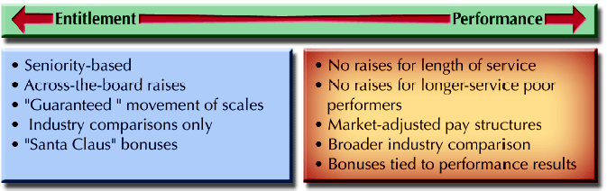
Compensation Philosophies

Slide 12
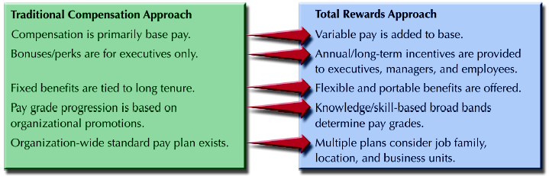
Compensation Approaches
Focus on jobs, More legally defensible, less complex, viewed as more fair,
Focus on individuals, help retain top performers, more flexible to economic conditions, favored by top performers

Slide 13
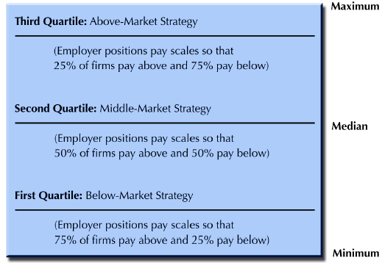
Compensation Levels

Slide 14
Competency Based Pay
Most of the compensation programs reward:
Tasks, duties and responsibilities
Employees receive more for doing jobs that require:
greater variety of tasks, more knowledge and skills, greater physical effort or more demanding working conditions
Now organizations are paying employees for the competencies they demonstrate rather than just for the specific tasks performed
This encourages employees to exhibit more versatility and continue to develop their competencies
Knowledge-based pay or skill-based pay system employed by printing firms
It focuses on training of supervisors and employees
The structure and policies of firm should allow employees for training programs

Slide 15
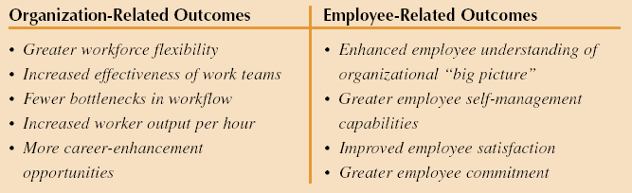
Outcomes of Competency Based Pay

Slide 16
Individual vs Team Rewards
Shift of Individual work to team work
Now how to develop compensation program
  Use skill based pay to determine base pay
  Use variable pay based on company performance
  Distribute variable rewards at the team level
  Maintain a high degree of employee involvement
  Make the system simple and understandable

Slide 17
Perceptions of Pay Fairness

Slide 18
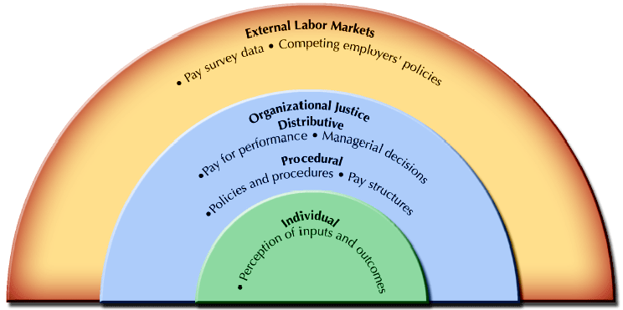
Equity Considerations in Compensation

Slide 19
Summary of Lecture 11
Importance of Pay System
Objectives of an Effective Compensation System
Nature of Compensation
  Components of a Compensation System
  Types of Compensation
Compensation System Design Issues
Perceptions of Pay Fairness

Slide 20
Reference books
Fundamentals of Human Resource Management Raymond A. Noe, John R. Hollenbeck, Barry Gerhart, & Patrick M. Wright: McGraw-Hill, New York
Human Resource Management (10th Ed.)
Robert L. Mathis and John H. Jackson: Cengage Learning, Delhi

Slide 21
Thank you!

