Slide 1
Advances in Human Resource Development and Management
Course code: MGT 712
Lecture 10

Slide 2
Recap of lecture 9
Performance Management
The purposes of Performance Management
Criteria for Effective Performance Management
The Process of Performance Management
  Identifying and Measuring Employee Performance
  Performance Appraisal

Slide 3
Learning Objectives: Lecture 10
The Process of Performance Management
Methods for Appraising Performance
Sources of Performance Information
Errors in Performance Measurement
Giving Performance Feedback
Finding Solutions to Performance Problems

Slide 4
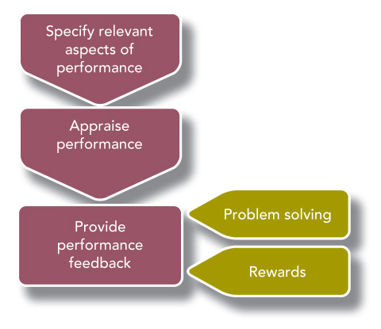
The Process of Performance Management

Slide 5
Methods for Appraising Performance:
Making comparisons
Simple Ranking
Requires managers to rank employees in their group from the highest performer to the poorest performer.
Forced Distribution
Assigns a certain percentage of employees to each category in a set of categories.
Paired Comparison
Compares each employee with each other employee to establish rankings.

Slide 6
Methods for Appraising Performance:
Rating individuals
Rating individuals
It looks at each employee’s performance relative to a uniform set of standards.
Rating individuals: Attributes
Graphic rating scale
Lists traits and provides a rating scale for each trait.
  The employer uses the scale to indicate the extent to which an employee displays each trait.

Slide 7
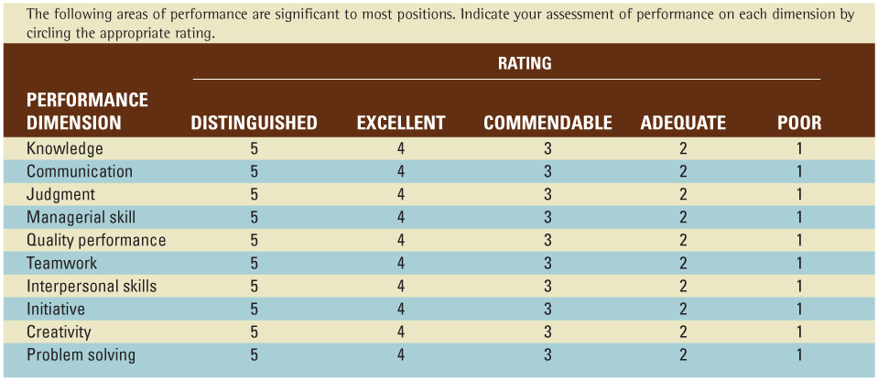
Methods for Appraising Performance:
Rating individuals
Rating Attributes: Example of a Graphic Rating Scale

Slide 8
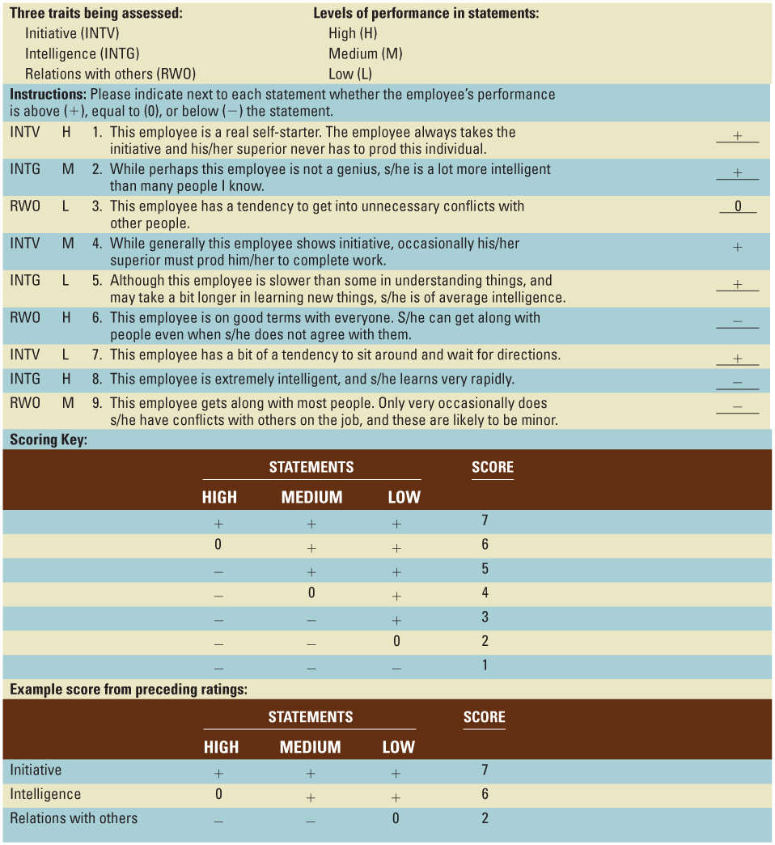
Methods for Appraising Performance:
Rating individuals
Rating Attributes:
Mixed standard scale
Uses several statements
describing each trait to
produce a final score for
that trait.

Slide 9
Methods for Appraising Performance:
Rating individuals
Rating behaviors
Critical incident method
  Based on managers’ records of specific examples of the employee acting in ways that are either effective or ineffective.
  Employees receive feedback about what they do well and what they do poorly and how they are helping the organization achieve its goals.

Slide 10
Methods for Appraising Performance:
Rating individuals
Rating behaviors
Organizational behavior modification
A plan for managing the behavior of employees through a formal system of feedback and reinforcement.
  Define a set of key behaviors necessary for job performance
  Use a measurement system to assess those key behaviors
  Inform employees in terms of goals for how often to exhibit the behaviors
  Provide feedback and reinforcement based on employees’ behavior

Slide 11
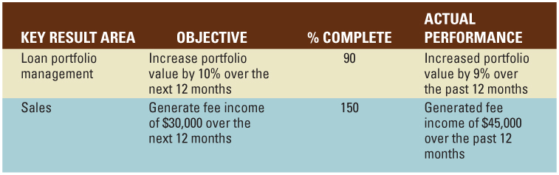
Methods for Appraising Performance: Measuring Results
Management by objectives
people at each level of the organization set goals in a process that flows from top to bottom, so that all levels are contributing to the organization’s overall goals.
These goals become the standards for evaluating each employee’s performance.
  Goals are specific, difficult, and objective
  Managers and subordinates work together to set the goals
  The manager gives objective feedback through the rating period to monitor progress toward the goals

Slide 12
Methods for Appraising Performance: Measuring Results
lt involves employees in setting goals- effectively links the individual employee performance with organization’s overall performance
Evaluation of results is less subjective – easy to accept for management and employees
A result oriented approach is easy to link to organization’s goals
Problems with the validity of MBO:
  Results may adversely be affected by the circumstances beyond each employee’s performance
  If organization measures only final results, may fail to measure significant aspects of performance
  Employees may significant aspects of performance that are not being measured- may result in high efficiency with low effectiveness
  Focus on results only does not guide on how to improve it

Slide 13
Methods for Appraising Performance: Total Quality Management
The principles of total quality management (TQM), provide methods for performance measurement and management.
It assesses both performance of individual and the system within which the individual works
Employees and their customers work together to set standards and measure performance, with the overall goal being to improve customer satisfaction.
This continuous focus on improving customer satisfaction intends to avoid the pitfall of rating individuals on outcomes
With TQM, performance measurement combines measurements on:
  Subjective feedback on employee’s personal qualities
  Objective feedback based on work processes through statistical quality control methods
Now employees are responsible to tracking these measures to identify areas where they can avoid or correct problems
Because of the focus on systems, feedback may result in changes to work process rather than employee areas
TQM does not support decisions about work assignments, training or compensation.

Slide 14
Sources of Performance Information
Who will collect and analyze performance information
  Person have understanding of job requirements and opportunity to see the employee doing the job
Supervisors who rate their subordinates
Employees who rate their supervisors
Employees’ self-appraisal
Outside sources rating employees
Multisource (360° feedback) appraisal
Performance measurement that combines information from the employees, Managers, Peers, Subordinates, Self, and Customers.

Slide 15
Sources of Performance Information:
Managers/ Supervisors
Advantages
Disadvantages
The most used source of information
Extensive knowledge of job requirements
Opportunity to observe
Have an incentive to provide accurate and helpful feedback
Less chance to observe for certain jobs
Subjectivity may be there

Slide 16
Sources of Performance Information:
Peers
Advantages
Disadvantages
Supervisor is unable to observe – law enforcing agencies
Expert knowledge of job requirements
Bring different perspectives
Friendship may lead to biased rating
Can be used for developmental purpose and not for administrative

Slide 17
Sources of Performance Information:
Subordinates
Advantages
Disadvantages
Best chance to see how well manager performs
Potential problems because of power relationships involved
Reluctant to give negative feedback- they prefer to be anonymous
Managers may tend to emphasize employee satisfaction
Can be used for developmental purpose and not for administrative

Slide 18
Sources of Performance Information:
Self
Advantages
Disadvantages
Know their performance to the best
Induces employees to think about their performance
Extensive knowledge of job requirements
Tendency to inflate their performance – if used for administrative purpose
People tend to blame others for failures while take credit for success

Slide 19
Sources of Performance Information:
Customers
Advantages
Disadvantages
Applicable for service firms – customer service cards
Employee job requires direct service to the customer
Helps to determine what products and services customer wants
It is an expensive approach

Slide 20
Errors in Performance Measurement:
Types of Rating Errors
Contrast errors
The rater compares an individual, not against an objective standard, but against other employees.
Distributional errors
The rater tends to use only one part of a rating scale – leniency, strictness, and central tendency
  Difficult to differentiate among performance of employees rated by same person
  Difficult to compare the performance of employees rated by different persons
Rater bias
Raters often fail to distinguish among different aspects of performance
  Halo error: when the bias is in a favorable direction. This can mistakenly tell employees they don’t need to improve in any area.
  Horns error: when the bias involves negative ratings. This can cause employees to feel frustrated and defensive.
Similar to me
Rating error of giving a higher evaluation to people who seem similar to oneself.
Notes:
Several kinds of errors and biases commonly influence performance measurements.

Slide 21
Political Behavior in Performance Appraisals
Distorting a performance evaluation on purpose to advance one’s personal goals
  High performing employees rated lower may feel frustrated
  Low performing employees rated higher will be rewarded but will not focus on performance improvement
Notes:
Sometime raters intentional distort their ratings for personal gain. One technique to minimize appraisal politics is to hold calibration meetings.

Slide 22
Giving Performance Feedback
Once performance is measured, it must be given to the employee - It is difficult to pass on negative feedback
Scheduling Performance Feedback
  Performance feedback should be a regular, and expected management activity
  Annual feedback is not enough - Managers are responsible for correcting performance deficiencies as they occur
  Feedback is most effective when it does not surprise the person - they know what the manager will say
Preparing for a Feedback Session
  Managers should be prepared for each formal feedback session.
  Right context of the meeting is needed – neutral location, free of distractions.
  Should be a chance to discuss the roles of manager and subordinate in an open dialogue
  Enable employees to be well prepared
  Self assessment can help identify areas for discussion - areas for improvement/development
Notes:
Once the manager and others have measured an employee’s performance, this information must be given to the employee.
Only after the employee has received feedback can he or she begin to plan how to correct any shortcomings.

Slide 23
Giving Performance Feedback
Conducting the Feedback Session
  “Tell-and-Sell” – managers tell employees their ratings and then justify those ratings.
  “Tell-and-Listen” – managers tell employees their ratings and then let the employees explain their side of the story.
  “Problem-Solving” – managers and employees work together to solve performance problems in an atmosphere of respect and encouragement

Slide 24
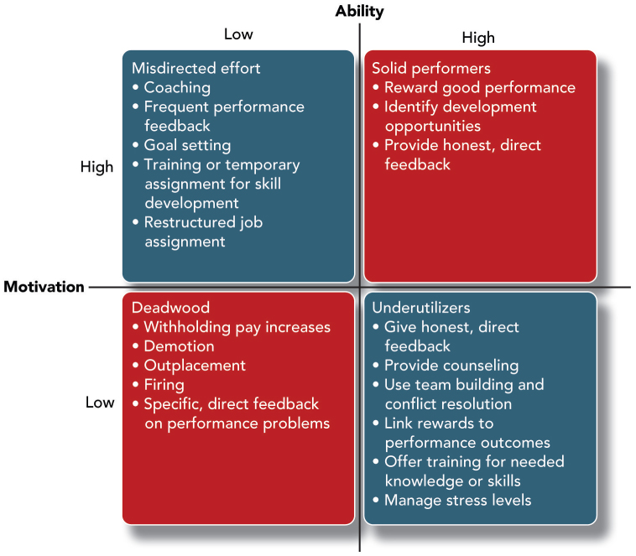
Finding Solutions to Performance Problems
If employee performance is below – feedback session should launch an effort to correct the problem
Even when employee is meeting the current standards – feedback session may identify the areas for improvement

Slide 25
Summary of Lecture 10
The Process of Performance Management
Methods for Appraising Performance
Sources of Performance Information
Errors in Performance Measurement
Giving Performance Feedback
Finding Solutions to Performance Problems

Slide 26
Reference books
Fundamentals of Human Resource Management Raymond A. Noe, John R. Hollenbeck, Barry Gerhart, & Patrick M. Wright: McGraw-Hill, New York
Human Resource Management (10th Ed.)
Robert L. Mathis and John H. Jackson: Cengage Learning, Delhi

Slide 27
Thank you!

