Slide 1
Advances in Human Resource Development and Management
Course code: MGT 712

Slide 2
Lesson 1
What is HRM?
Why is HRM important for all managers?
HRM and company performance
Objectives of the HRM function
Activities/Responsibilities of HRM
Skills of HRM Professionals

Slide 3
Human Resource Management
The design of formal systems in an organization to ensure the effective and efficient use of human talent to accomplish the organizational and individual goals.
Or
  The policies, practices, and systems that influence employees’ behavior, attitudes, and performance to achieve organizational objectives.

Slide 4
HRM is
  Action oriented
  People oriented
  Future oriented

Slide 5
HRM is important for all managers
Managers need to avoid personnel mistakes
All managers are involved in recruiting, interviewing, selecting, training, and appraising employees
Managers may move from line to staff positions and vice versa

Slide 6
Human Resources and Company Performance
HR as an expense or a source of value
Human Capital
  An organization’s employees described in terms of their training, experience, judgment, intelligence, relationships, and insight.
Employees are not interchangeable or easily replaced parts of a system
Who works for an organization and how those people work

Slide 7
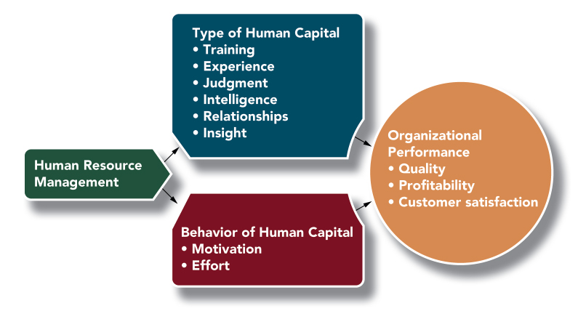

Slide 8
A ‘sustainable competitive advantage’ is necessary for an organization---
HRM is critical because ‘human resources’ has certain unique qualities:
  Valuable
  Rare
  Cannot be imitated
  No good substitutes

Slide 9
Effective HRM may lead to ‘high performance work system’
  An organization in which technology, organizational structure, people, and processes all work together to give an organization an advantage in the competitive environment.

Slide 10
Objectives of the HRM Function
Helping the organization reach its goals
Efficiently employing skills and abilities of the workforce
Providing well-trained and well-motivated employees
Increasing employees’ job satisfaction
Achieving quality of work life

Slide 11
Communicating HRM policies to all employees
Maintaining ethical policies and socially responsible behavior
Managing change
Managing increased urgency and faster cycle time

Slide 12
Activities/Responsibilities of HRM
Analysis and design of work
Recruitment and selection
Training and development
Performance management
Compensation and benefits
Employee relations
Personnel policies
Compliance with laws
Support for strategy

Slide 13
Roles of HRM
Administrative role of HRM
Operational role of HRM
Strategic role of HRM

Slide 14
Skills of HRM Professionals
Human relations skills
Decision making skills
Leadership skills
Technical skills

Slide 15
Summary of Lecture 1
Definition of HRM
Importance of HRM
HRM and company performance
Objectives of HRM function
Responsibilities of HRM
Roles of HRM
Skills of HRM professionals

