Slide 1
Lecture 28
Exploratory Design and Techniques
By
Aziza Munir

Slide 2
Learning Objectives
Exploratory study
Methodology
Types and applications

Slide 3
Exploratory Research
The discovery of ideas and insights. Exploratory research usually results when someone says, "We're not meeting our objectives. What's wrong?" Exploratory research will be used to find the most likely explanations regarding some observed problem. This type of research is often used for:
    Formulating a problems for more precise investigation
    Discovering new ideas
    Developing hypotheses
    Establishing priorities for further research
    Screening of alternatives
    Increasing the analyst's familiarity with the problem area
    Clarifying concepts

Slide 4
Types of Exploratory Research
Case studies
Literature search
Pilot studies
Experience interviews
In-Depth Interviews
Focus Groups

Slide 5
An Exploratory Research Tool: Projective Techniques
Projective techniques are unstructured and indirect forms of questioning that encourage respondents to project their underlying motivations, beliefs, attitudes, or feelings regarding the issues of concern.

Slide 6
Types of Projective Techniques
Association Techniques
  Word Association: Subjects are read a list of words or phrases and asked to respond with the first thing that comes to mind in order to look for hidden meanings and associations
Word Ms. M Ms. C
washday everyday ironing
fresh and sweet clean
pure air soiled
scrub don't; husband does clean
filth this neighborhood dirt
bubbles bath soap and water
family squabbles children
towels dirty wash

Slide 7
Types of Projective Techniques
Completion techniques
  Sentence completion: Respondents given incomplete sentences and asked to complete in their own words in the hopes that hidden thoughts/feelings will be revealed
If Wal-Mart were a car it would be a _____________________
Wal-Mart shoppers are ________________________________
If I asked my friend to go shopping at Wal-Mart, they would say ________________________________
Compared to Target, Wal-Mart is __________________________

Slide 8
Types of Projective Techniques
Completion techniques
  Story completion: Respondents are provided a scenario and askd to complete it.
It has been a very long day. Between classes and meetings, I did not have time to take a break at all. It is now 5:30 and I have just arrived home at my apartment. I just realized that I haven’t eaten all day and am starving. I found a package of Chicken & Mushroom flavored Ramen Noodles and decide to heat it up in the microwave. The noodles are ready to go. As I sit down at the kitchen table and pick up a fork to eat what is in front of me……………

Slide 9
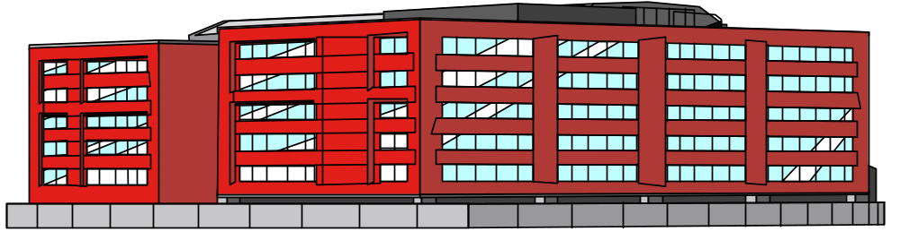
Types of Projective Techniques
Construction Techniques
  Cartoon (or balloon) Tests: Subjects are given a cartoon drawing (typically presented in a vague manner) and asked to suggest the dialogue in an attempt to identify a person’s latent feelings about what is being portrayed.
Let’s see if we can pick up some home décor items at Sears
Sears

Slide 10

Types of Projective Techniques
Construction Techniques
  Picture Tests: Subjects are given a picture and instructed to describe their reactions by writing a short narrative story about the picture.

Slide 11


Types of Projective Techniques
Construction Techniques
  Thematic Apperception Tests (TAT): Subjects are presented with a series of pictures and asked to provide a description of or a story about the pictures.
  A twist on the TAT:
    Ask subjects to draw cartoons and write about the subject of interest
    Example: Roach Killer...

Slide 12
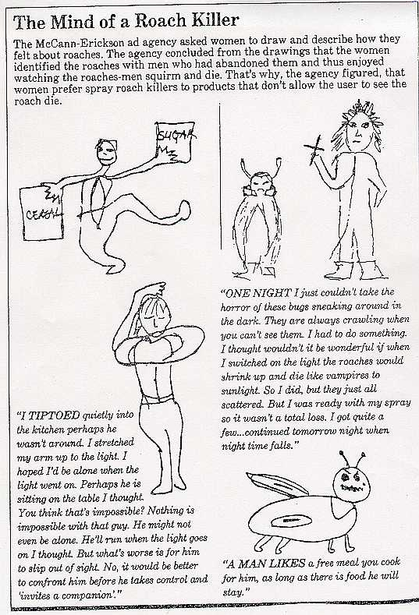

Slide 13
Types of Projective Techniques
Expressive Techniques
  Role Playing: Subject is asked to act out someone else’s behavior in a specified setting.
A customer is trying to return an item and does not have a receipt. The customer insists on a cash refund but store policy clearly states that all returns must be accompanied by a receipt. The store manager is only permitted to allow store credit in these circumstances. The customer is irate. What would you do if you were the store manager in this situation?

Slide 14
Types of Projective Techniques
Expressive Techniques
  Third-Person Technique: Subject is asked to verbalize how a third person (such as a neighbor or friend) would react to a specific question.
What Will the Neighbors Say?
A study was performed for a commercial airline to understand why some people do not fly. When the respondents were asked, "Are you afraid to fly?" very few people said yes. The major reasons given for not flying were cost, inconvenience, and delays caused by bad weather. However, it was suspected that the answers were heavily influenced by the need to give socially desirable responses. Therefore, a follow-up study was done. In the second study, the respondents were asked, "Do you think your neighbor is afraid to fly?" The answers indicated that most of the neighbors who traveled by some other means of transportation were afraid to fly.

Slide 15
Types of Projective Techniques
Another twist - Shopping Lists -- Ask respondents about the type of person who would buy a particular group of products
  An example: Instant Coffee in the 50s. Two women are depicted with having identical shopping lists with the exception that 1 had instant coffee on her list and the other had regular brew coffee. Can you guess how the woman who purchased the instant coffee was viewed as compared to the one who bought the coffee that had to be percolated?

Slide 16
Projective Techniques
Advantages
  They help probe consumer motivations by enabling a subject to project their own psychological material in a non-threatening way
  May stimulate greater creativity
  Greater elicitation of responses
Disadvantages
  Subjectivity/Interpretation bias
  Rely on analytical expertise/background of researcher (need highly trained interviewers
  Unusual behavior may not be reflective of a person’s normal personality or motivations
  the psychological material uncovered may or may not be related to the topic or to the person

Slide 17
In-Depth Interviews (IDIs)
Depth interviews, also known as Individual Depth Interviews (IDIs) or One-on-Ones, is an unstructured, direct personal interview in which a single respondent is probed by a highly skilled interviewer to uncover underlying motivations, beliefs, attitudes, and feelings on a topic.
General Characteristics
  Individual Interviews
  Intended to provide depth of understanding to uncover motivations, beliefs, attitudes, feelings, etc.
  Typically 30 minutes to 1 hour in length
  Unstructured format dependent on response
  Probing is critical

Slide 18
IDIs
Traditional
Symbolic Analysis
  The symbolic meaning of an object is analyzed by comparing them to their opposites. The logical opposites of a product that are investigated are: non-usage of the product, attributes of an imaginary “non-product,” and opposite types of products.
  “What would it be like if you could no longer use airplanes?”
  “Without planes, I would have to rely on letters and long distance calls.”
  Airlines sell to the managers face-to-face communication.
  Advertising theme: The airline will do the same thing for a manager as Federal Express does for a package.

Slide 19
IDIs
Hidden Issue Questioning: the focus is not on socially shared values but rather on “sore spots”; not on general lifestyles but on deeply felt personal concerns.
fantasies, work lives, and social lives
historic, elite, “masculine-camaraderie,” competitive activities
Advertising theme: communicate aggressiveness, high status, and competitive heritage of the airline.

Slide 20
IDIs
Laddering: the line of questioning proceeds from product characteristics to user characteristics. This technique allows the researcher to tap into the consumer's network of meanings.
  Wide body aircrafts (product characteristic)
  I can get more work done
  I accomplish more
  I feel good about myself (user characteristic)
  Advertising theme: You will feel good about yourself when flying
  our airline. “You're The Boss.”

Slide 21
Another Laddering Example
Here is a typical chain or ladder obtained from a secretary discussing why she would prefer to use an overnight package delivery service that has drop boxes available:
    Drop Box
    Convenient
    Save Time
    Can Do More
    Personal Satisfaction
    Accomplishment
    Self-Esteem

Slide 22
IDI’s
Advantages
  Increased depth
  Fewer inhibitions
  Eliminates peer pressure
  Specific competitive situations
Disadvantages
  Cost
  Time
  Less client involvement
  Interviewer errors
  Lack of generalizability

Slide 23
Focus Groups
General Characteristics
  Multiple Respondents
  Group Interaction
  Group Moderation/Facilitation
  Discussion Guide Rather than a Questionnaire
  Homogeneous group composition of prescreened respondents
  Group Size of 6 to 12 participants
  Typically 1 to 2 hours in length

Slide 24
Uses of Focus Groups
To generate hypotheses that can be further tested quantitatively
To generate information helpful in structuring questionnaires
To provide overall background information on a product category
To get impressions on new product concepts for which there is little information available
To stimulate new ideas about older products
To generate ideas for new creative concepts
To interpret previously obtained quantitative results

Slide 25
Types of Focus Groups http://www.marketingpower.com/webcast347.php
Traditional group
Dual-moderator group: two moderators (traditional or dueling moderators)
Two-way group: one focus group watches another focus group and discusses what is learned (e.g. a focus group of physicians viewed a focus group of arthritis patients discussing the treatment they desired )
Client-participant group: one or more client representatives participate in the discussion
Respondent-moderator group: moderator asks selected participants to play the role of moderator temporarily to improve group[ dynamics
Mini group
Videoconference group
Telesession/telephone group
Online group

Slide 26
Focus Group Advantages
Synergism: The combined effect of the group will product a wider range of information, insight, and ideas than if the participants had been interviewed separately.
Snowballing: A bandwagon effect often operates in a group interview situation - a comment by one individual often triggers a chain of responses from otherss.
Stimulation: Usually after a brief introductory period the respondents get "turned on" in that they want to express their ideas and expose their feelings.
Security: The participants can usually find comfort in the group in that their feelings are not greatly different from the other participants.
Spontaneity: Since individuals aren't required to answer any given question in a group interview, their responses can be more spontaneous and less conventional, and should provide a more accurate picture of their position on some issues.
Serendipity: It is more often the case in a group rather than individual interview that some idea will "drop out of the blue."
Specialization: The group interview allows the use of a more highly trained interviewer since a number of individuals are being "interviewed" simultaneously.
Scientific scrutiny: The group interview allows several observers to witness the session and it can be recorded for later playback and analysis.
Structure: The group interview affords more flexibility than the individual interview with regard to the topics covered and depth with which they are treated.
Speed: Since a number of individuals are being interviewed at the same time, the group interview speeds up the data collection and analysis process.

Slide 27
Focus Group Disadvantages
Misuse: Focus groups can be misused and abused by considering the results as conclusive rather than exploratory.
Misjudge: Focus group results can be more easily misjudged than the results of other data collection techniques. Focus groups are particularly susceptible to client and researcher biases.
Moderation: Focus groups are difficult to moderate. Moderators with all of the desirable skills are rare. The quality of the results depends heavily on the skills of the moderator.
Messy: The unstructured nature of the responses makes coding, analysis and interpretation difficult. Focus group data tend to be messy.
Misinterpretation: Focus group results are not necessarily representative of the general population and are not statistically projectable. Consequently, focus group results should not be the sole basis for decision making.
Money: Focus groups can be expensive on a per participant basis

Slide 28
The Focus Group Process
Defining the Parameters – the Planning Phase
  How many groups?
  How many participants per group?
  Where will/should the groups be held?
  What should be the composition of each group (screening requirements)?
  What stimuli (if any) should be used to elicit responses?
  What incentives should be offered?

Slide 29
The Focus Group Process
Conducting the Focus Groups
  The moderator is key
  The moderator’s guide that outlines the topics, questions and prompts must be developed
  The session itself
    Warm-Uo
    Main Topics
    Close
    Behind the Mirror
    Issues During the Group

Slide 30
The Moderator’s Role
To "elicit" inputs
To work with the "assembled group"
To "achieve the objectives of the client"
To keep the session "on track"
To handle situations where participants are only giving "yes" "no" responses
To change directions when the subject is "dead"
To wrap-up effectively

Slide 31
Moderator Qualifications
Kindness with firmness: In order to elicit the necessary interaction, the moderator must combine a disciplined detachment with an empathic understanding.
Permissiveness: While an atmosphere of permissiveness is desirable, the moderator must be at all times alert to indications that the group atmosphere of cordiality is disintegrating.
Involvement: Since a principal reason for the group interview is to expose feelings and to obtain reactions indicative of deeper feelings, the moderator must encourage and stimulate intensive personal involvement.
Incomplete Understanding: A most useful skill of the moderator is his or her ability to convey a lack of complete understanding of the information being presented.
Encouragement: Although the dynamics of the group situation facilitate the participation of all members in the interaction, there may be individuals who resist contributing.
Flexibility: The moderator should be equipped, prior to the session, with a topic outline of the subject matter to be covered. By committing the topics to memory before the interview, the moderator may use the outline only as a reminder of content areas omitted or covered incompletely.
Sensitivity: The moderator must be able to identify, as the group interview progresses, the information level on which it is being conducted, and determine if it is appropriate for the subject under discussion. Sensitive areas will frequently produce superficial rather than depth responses. Indication of depth are provided when participants begin to indicate how they feel about the subject, rather than what they think about it.

Slide 32
Moderator Problems
Leading rather than guiding
Being too knowledgeable
Trying to be a comedian/becoming the focus of the group
Being a poor listener
Being too rigid with the moderator guide
Not relating well to the people in the group
Being too naive about the subject of the focus group
Focusing on individuals rather than the group
Alienating a group member

Slide 33
The Moderator’s Guide
Importance of the Moderator’s Guide
  Allows moderator & client to agree on the content of the focus groups
  Specifies what data will be collected
  Provides an outline of the report
Length & Content
  Typically 3-5 pages
  Outline of introductory remarks
  Outline of questions and probes

Slide 34
Issues During the Groups
Facility Problems
  Noise
  Audio/Video recording
Content Problems
  Confusing concept
  Dead subject
  Lively subject
Participant Problems
  Talkative participant
  Opinionated member
  Silent member
  Improperly screened participant
Problems with Group Dynamics
  Perceived experts
  Having only one participant with a specific point of view
  Offering negative as well as positive feedback

Slide 35
The Focus Group Process
Analyzing and Reporting the Results
  The debriefing session
  Transcripts
  Review of video recordings
  Analyzing the patterns
  Writing the report

Slide 36
Final Thoughts: Focus Groups
Focus groups can be one valuable part of a research program when used correctly
Focus groups are often used inappropriately
Focus groups should not be used to make major decisions but only as one step in the process
Focus groups are not an inexpensive way to answer research questions
Clients must prepare for focus groups to obtain valuable results
The moderator is the most important element in gathering good useful data
There is no substitute for client attendance at focus group sessions
Focus groups with children require different moderator skills
The demand for focus groups is increasing and the quality of focus groups is improving

