Slide 1
Lecture 26
Operational Definition, measurement and attitude scale
By
Aziza Munir

Slide 2
Learning Objectives
Define operational definition
Types of scales and degree of validity in it
Validity and ways to check validity in a testing instrument
Reliability and ways to check reliability in instrument

Slide 3
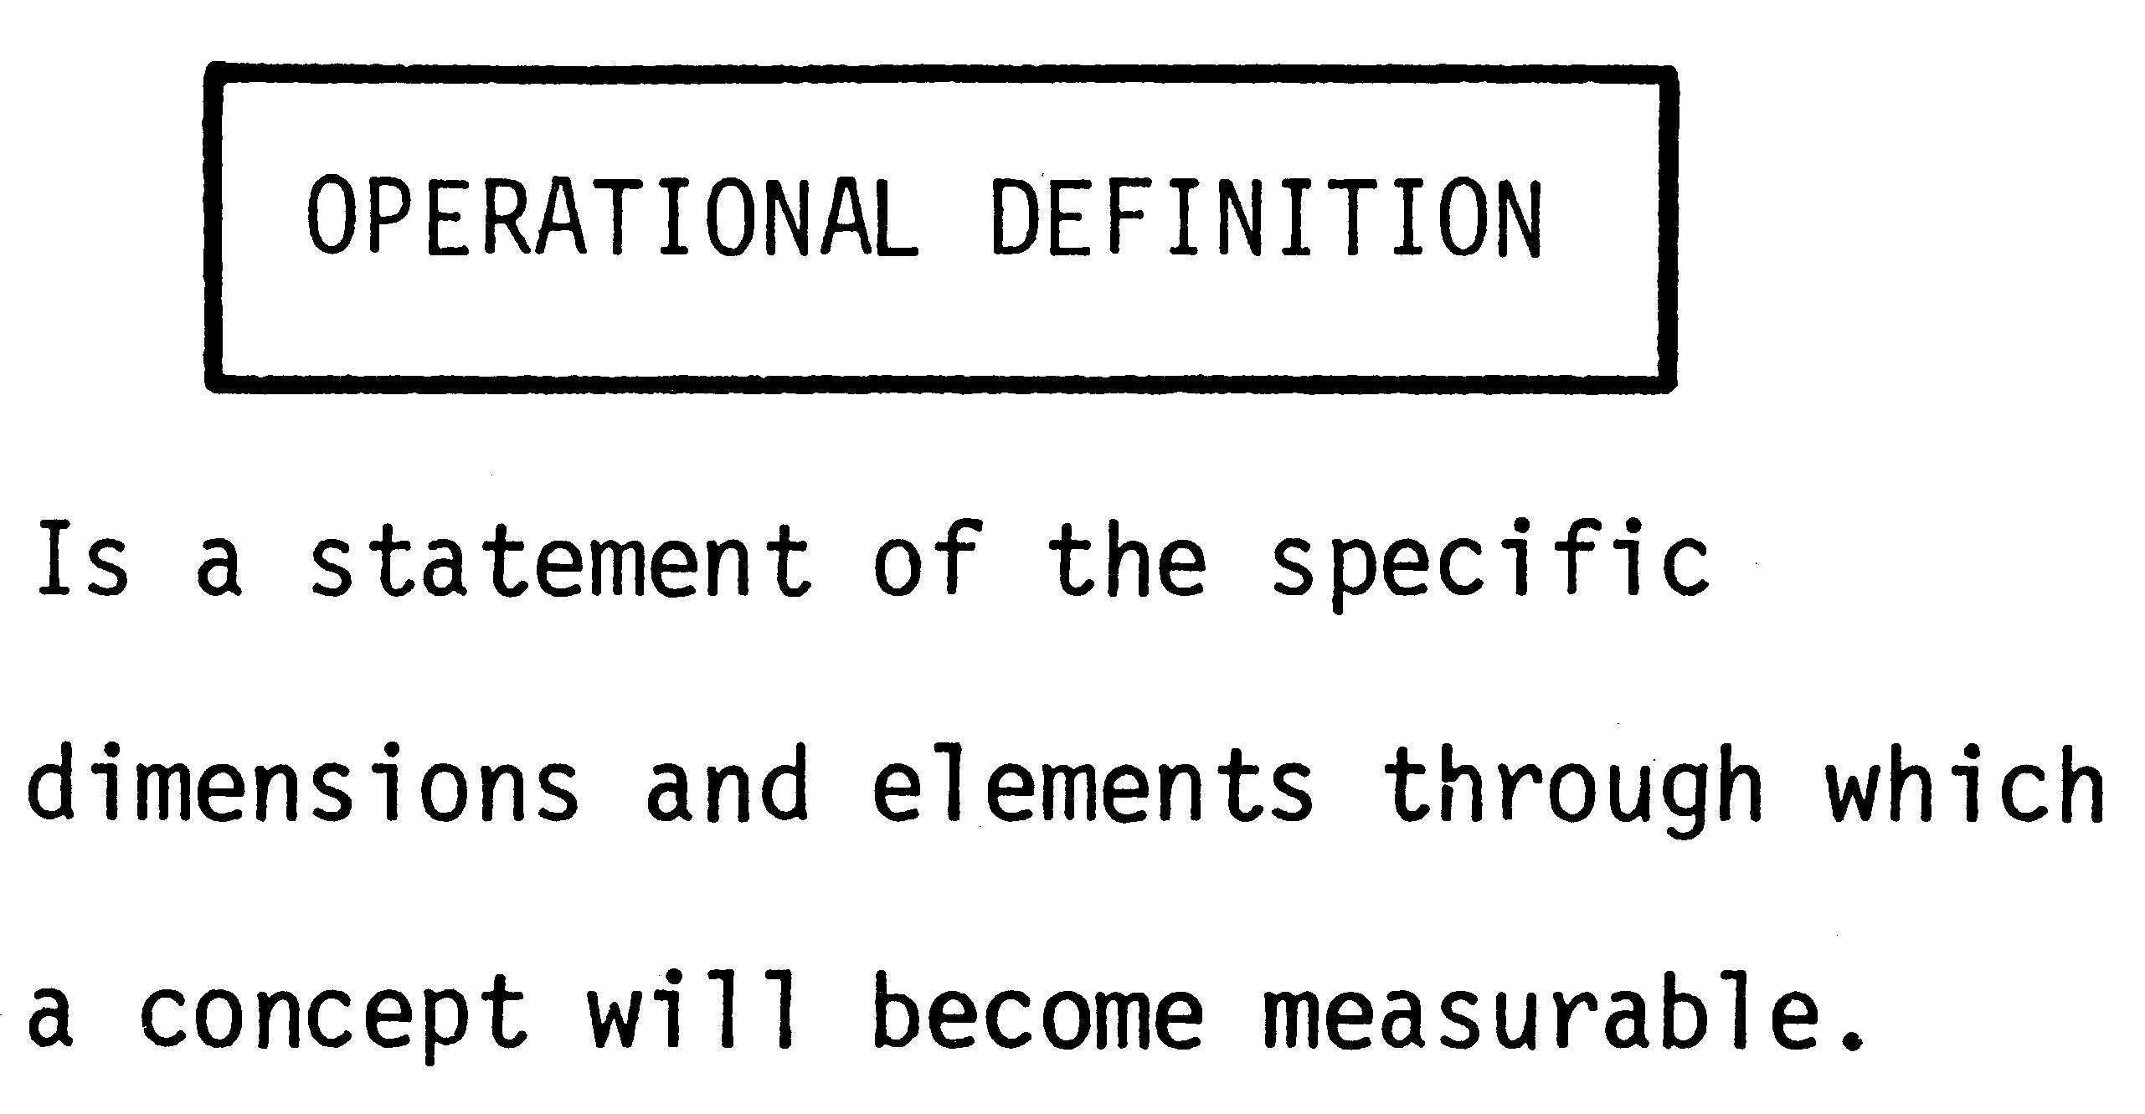

Slide 4
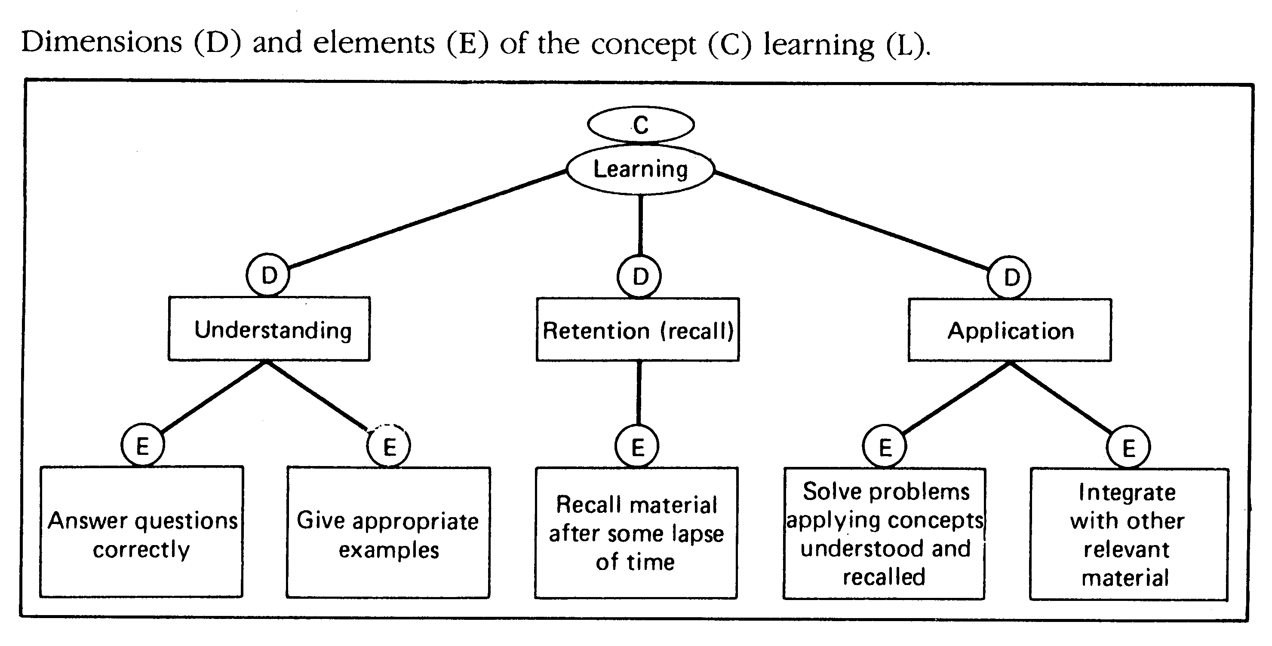

Slide 5
Difference between Factors and Operationalzed variables

Slide 6
Measurement
Is the process of assigning numbers or labels to objects, persons, states of nature, or events.
Done according to set of rules that reflect qualities or quantities of what is being measured.
Measurement means that scales are used. Scales are a set of symbols or numbers, assigned by rule to individuals, their behaviors, or attributes associated with them.
Four types of scales are used in research, each with specific applications and properties. The scales are nominal, ordinal, interval, and ratio.

Slide 7
Scales
Simply the Nominal scale is count of the objects belonging to different catageories.
The ordinal scale positions objects in some order( such as it indicates that pinapples are jucies then apples and oranges are even more jucies than pinapples) The problem is it does not gies us information as to what extent one is jucier than the other. How much better is the pineapple than the apple and orange is better than the pine apple.Is pine apple onely marinally better than the apple .
The interval scale indicates the distance between objects since it measured in units of equal interval.( the difference between temprature of 20degree and 25 degree is the same as the difference between 40 and 45 degree.

Slide 8
Nominal Scales
Nominal scales are used to classify objects, individuals, groups, or even phenomena.
Examples of nominal variables:
  Gender
  State of residence
  Country
  Ethnicity
Nominal scales are mutually exclusive (meaning that those items being classified will fit into one classification).
These scales are also collectively exhaustive, meaning that every element being classified can fit into the scale.

Slide 9
Nominal Scales
As it might appear on a questionnaire, examples of nominally scaled questions included:
  What is your class rank at KSU?
  1. Freshman 3. Junior
  2. Sophomore 4. Senior
  The numbers themselves do not have meaning (we could have used letters, too), they are used just to identify the possible responses to the question.
  Thus, in evaluating responses to this you cannot use the mean.
  Permitted statistics; frequencies (% and counts), modes

Slide 10
Use of the Nominal Scale
Nominal scale is always used for obtaining personal data
such as gender or department in which one works, where
grouping of individuals or objects is useful, as shown below.
1. Your gender 2. Your department
___Male ___Production
___Female ___Sales
___Accounting
___Finance
___Personnel
___R & D ___Other (specify)

Slide 11
Ordinal Scales
These scales allow for labeling (or categorization) as in nominal scales, but they allow for ranking.
Example: Rate these vacation destinations in terms of how much you would like to visit from one to five with one your most preferred and five your least preferred.
  Bermuda
  Florida
  Hawaii
  Aspen
  London

Slide 12
Ordinal Scales
This type of scale can provide information about some item having more or less of an attribute than others, but no information on the degree of this.
Permitted statistics: Frequencies, median, mode

Slide 13
Use of Ordinal Scale
Ordinal scale is used to rank the preferences or usage of
various brands of a product by the individuals and to ranks
order individuals, objects, or events as per the examples
below.
Rank the following personnel computers with respect their
usage in your office, assigning the number 1 to the most
used system, 2 to the next most used, and so on. If a
particular system is not used at all, in your office, put a 0
next to it.
____Apple ____Hewlett Packard
____Compaq ____IBM
____Comp USA ____Packard Bell
____Dell Computer ____Sony
____Gateway ____Toshiba

Slide 14
Interval Scales
Contains the information available in ordinal scales (ranking) but with the added benefit of magnitude of ranking. Interval scales have equal distances between the points of a scale.
These scales can contain a zero point, but they are arbitrary and are not meaningful (0° C = 32° F). Temperature is an example of a interval scale
Permitted statistics; mean, median, mode, as well as more advanced tests.

Slide 15
Interval Scale - Example
On a scale of one to five, with five meaning you strongly agree, and one meaning you strongly disagree consider this statement ‘I believe my college education has prepared me well to begin my career’.
1
2
3
4
5
Strongly disagree
Somewhat disagree
Somewhat agree
Strongly agree
Neither

Slide 16
Ratio Scale
The most comprehensive scale
Has all of the characteristics of the other three with the additional benefit of an absolute, meaningful zero point.
Examples include:
  Weight
  Sales volume
  Income
  Age
Permitted statistics same as with interval data.

Slide 17
Use of Ratio Scale
Ratio scales are usually used in organization
research when exact numbers on objective (as
opposed to subjective) factors are called for, as in
the following question:
How many other organizations did you work for before joining this system?
Please indicate the number of children you have in each of the following categories?
---- below 3 years
---- between 3 and 6
---- over 6 years but under 12
---- 12 years and over
How many retail outlets do you operate?

Slide 18
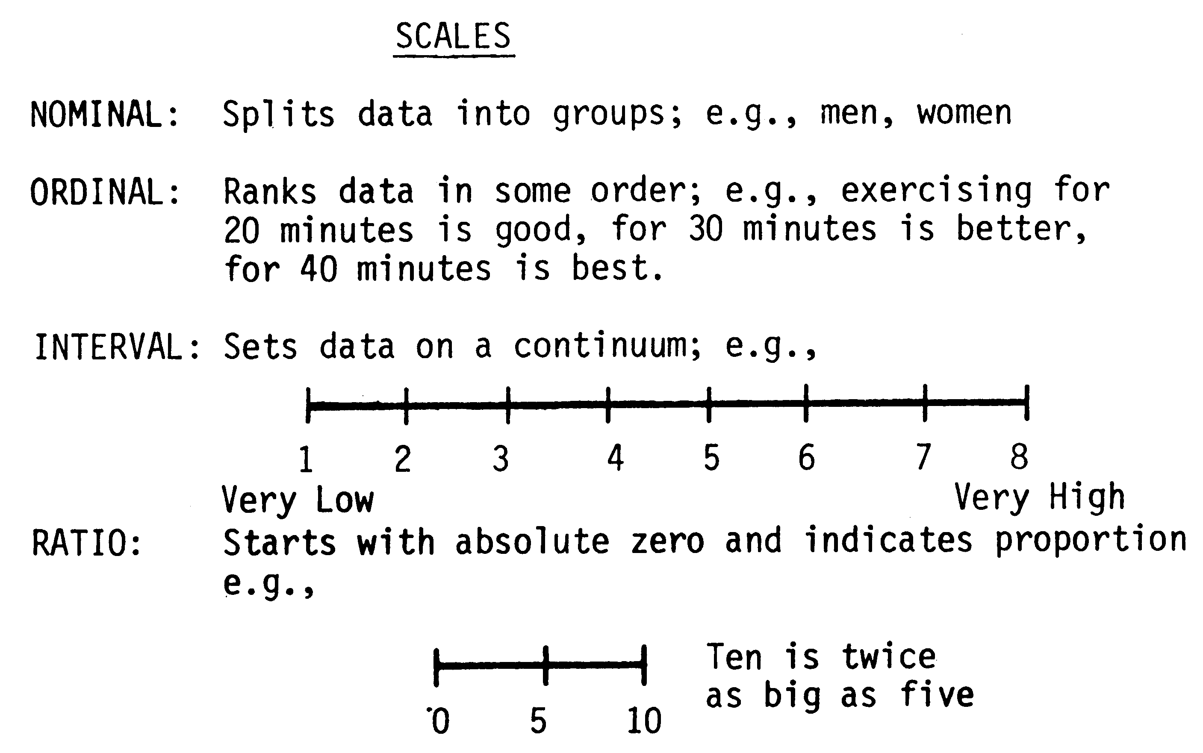

Slide 19
E.g
The researcher would like to know what is the percentage of people who like Pepsi, 7up, Coke, Miranda
The researcher would like to know among the 4 soft dinks which they prefer the most , second most…
The researcher would like to know what extent the 4 drinks are liked
The researcher would like to know how many Pepsi , Mrindia , etc you consume in a month

Slide 20
Sources of Measurement Differences
Why do ‘scores’ vary? Among the reasons legitimate differences, are differences due to error (systematic or random)
1. That there is a true difference in what is being measured.
2. That there are differences in stable characteristics of individual respondents
  On satisfaction measures, there are systematic differences in response based on the age of the respondent.

Slide 21
Sources of Measurement Differences
3. Differences due to short term personal factors – mood swings, fatigue, time constraints, or other transistory factors. Example – telephone survey of same person, difference may be due to these factors (tired versus refreshed) may cause differences in measurement.
4. Differences due to situational factors – calling when someone may be distracted by something versus full attention.
5. Differences resulting from variations in administering the survey – voice inflection, non verbal communication, etc.

Slide 22
Sources of Measurement Differences
6. Differences due to the sampling of items included in the questionnaire.
7. Differences due to a lack of clarity in measurement instrument (measurement instrument error). Example; unclear or ambiguous questions.
8. Differences due to mechanical or instrument factors – blurred questionnaires, bad phone connections.

Slide 23
Goodness of Measure
Measure what is suppose to be measured
Measure as well as possible
Validity : checks as to how well an instrument that is developed measured the concept
Reliability: checks how consistently an instrument measures

Slide 24
Reliability
Key question for researchers to address is ‘Will this measurement instrument provide consistent results over time?’ For scales used in questionnaires that means will we get the same results using these scales over time?

Slide 25
Ways to Check for Reliability
How to check for reliability of measurement instruments or the stability of measures and internal consistency of measures? Two methods are discussed to check the stability .
Stability
  Test – Retest
  Use the same instrument, administer the test shortly after the first time, taking measurement in as close to the original conditions as possible, to the same participants. If there are few differences in scores between the two tests, then the instrument is stable. The instrument has shown test-retest reliability.
  There are problems with this approach.
    Difficult to get cooperation a second time
    Respondents may have learned from the first test, and thus responses are altered
    Other factors may be present to alter results (environment, etc.)

Slide 26
Ways to Check for Reliability
2 Equivalent Form Reliability
  This approach attempts to overcome some of the problems associated with the test-retest measurement of reliability.
  Two questionnaires, designed to measure the same thing, are administered to the same group on two separate occasions (recommended interval is two weeks).
  If the scores obtained from these tests are correlated, then the instruments have equivalent form reliability.
  Tough to create two distinct forms that are equivalent.
  An impractical method (as with test-retest) and not used often in applied research.

Slide 27
Ways to Check for Reliability
Internal Consistency Reliability
This is a test of the consistency of respondents response to all the items in a measure i.e. the items are independent measures of the same concept, they will correlated with one another

Slide 28
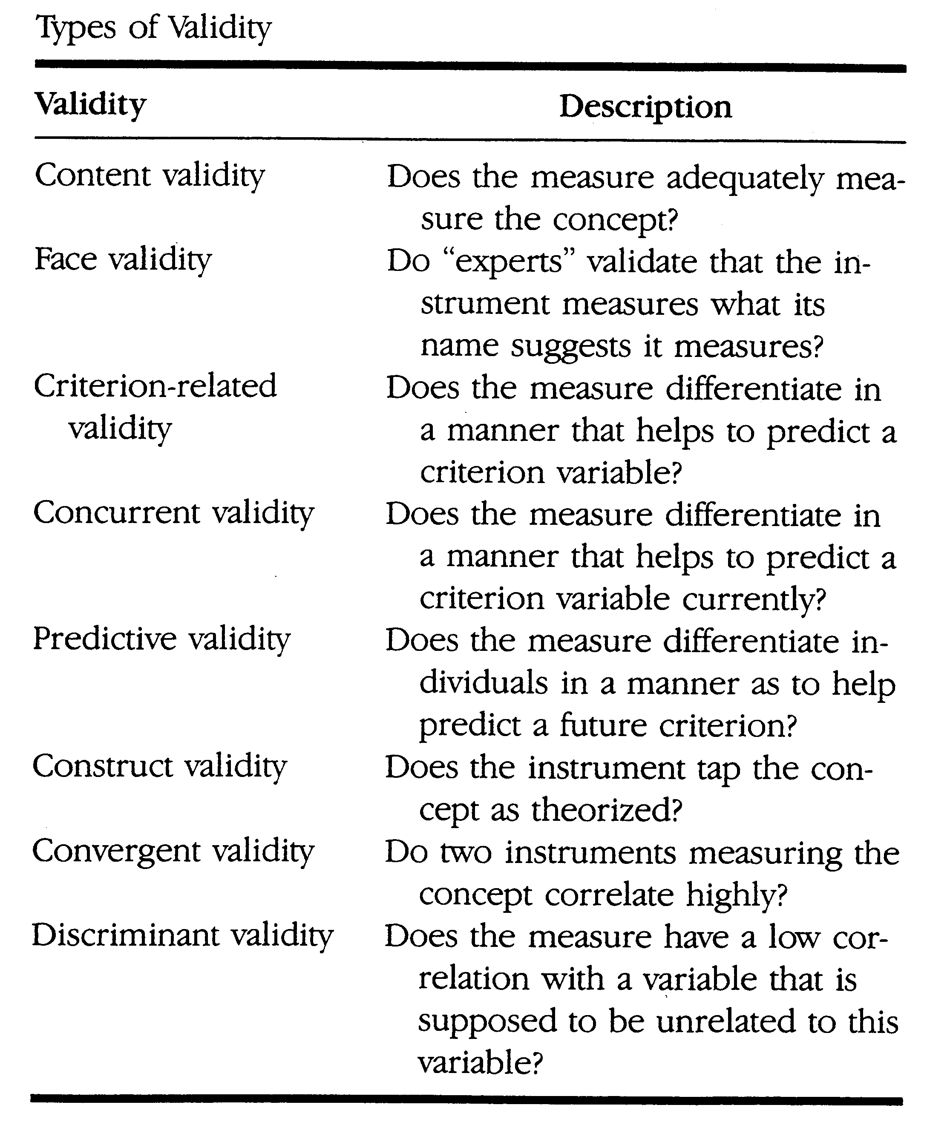
Validity
Definition: Whether what was intended to be measured was actually measured?

Slide 29
Forms of Validity
Face Validity
The weakest form of validity
Researcher simply looks at the measurement instrument and concludes that it will measure what is intended.
Thus it is by definition subjective.

Slide 30
Forms of Validity
Content Validity
The degree to which the instrument items represent the universe of the concepts under study.
In English: did the measurement instrument cover all aspects of the topic at hand?
Example: Let’s say that Amazon wanted to measure customer satisfaction and they asked questions about the following:
  Did the merchandise arrive on time?
  Was it in good condition?
This measure may lack content validity because it assumes that satisfaction is a function of product delivery rather than incorporating questions about the shopping experience.

Slide 31
Forms of Validity
Criterion Related Validity
The degree to which the measurement instrument can predict a variable known as the criterion variable.
Two subcategories of criterion related validity
Predictive Validity
  Is the ability of the test or measure to differentiate among individuals as to a suture criterion
Concurrent Validity
  Is established when the scale discriminates individuals who are known to be different that is they should score differently on the test.

Slide 32
Forms of Validity
Construct Validity
Does the measurement conform to some underlying theoretical expectations. If so then the measure has construct validity. If we are measuring consumer attitudes about product purchases then do the measure adhere to the constructs of consumer behavior theory.
This is the territory of academic researchers

Slide 33
Construct Validity Continued
Two approaches are used to measure construct validity
Convergent Validity
  A high degree of correlation among different measures intended to measure same construct
  Example: Voter behavior the construct, all of the polls surrounding Presidential elections.
Discriminant Validity
  The degree of correlation among constructs that are assumed to be different.

Slide 34

Validity and Reliability Illustrated
Measure is reliable and valid

Slide 35
Conclusion
Types of scales
Applicative examples
Validity its forms and reliability with its multiple forms

