Slide 1
Lecture 25
Experimental Design
By
Aziza Munir

Slide 2
Learning Objectives
1. Basics of Experiment & Causality
2. Advantages and disadvantages of the experimental method
3. Steps of a well-planned experiment
4. Validity in experiments

Slide 3
1.Basics of Experiment & Causality
1.1. Definition of Experiment:
An experiment is a study involving intervention by the researcher beyond that required for measurement.
The usual intervention is to manipulate some variable in a setting and observe how it affects the participants or subjects being studied.
There is at least one independent variable and one dependent variable in a causal relationship.

Slide 4
1.2. Causal Evidence
There are three types of evidence necessary to support causality.
Agreement between
Independent and Dependent Variables
Time order of occurrence
Extraneous variables
did not influence Dependent Variables

Slide 5
1.2.1. Agreement between
Independent and Dependent Variables
First, there must be an agreement between independent and dependent variables.
The presence or absence of one is associated with the presence or absence of the other.

Slide 6
1.2.2. Time order of occurrence
Second, beyond the correlation of independent and dependent variables, we consider the time order of the occurrence of the variables.
The effect on the dependent variable should not precede the manipulation of the independent variable.
The effect and manipulation may occur simultaneously or the manipulation may occur before the effect.

Slide 7
1.2.3. Extraneous variables did not influence Dependent Variables
The third source of support comes when researchers are confident that other extraneous variables did not influence the dependent variable.
To ensure that these other variables are not the source of influence, researchers control their ability to confound the planned comparison.

Slide 8
2. Advantages and disadvantages of the experimental method
Advantages
Ability to manipulate Independent Variable
Use of control group
Control of extraneous variables
Replication possible
Field experiments possible
Disadvantages
Artificiality of labs
Non-representative sample
Expensive
Focus on present and immediate future
Ethical limitations

Slide 9
2.1.Explanation of Some Advantages of Experiments
Replication: is the process of repeating an experiment with different participant groups and conditions to determine the average effect of the Independent Variables across people, situations, and times.
A field experiment: is a study of the dependent variable in actual environmental conditions.

Slide 10
2.2.Explanation of Some Disadvantages of Experiments
The artificiality of a lab is possibly the greatest disadvantage of experiments.
Also, experiments typically use small convenience samples which cannot be generalized to a larger population.
Compared to surveys, they are expensive.
They also cannot deal with past events or predict events in the far-off future.
Finally, marketing research is often concerned with the study of people and there are limits to the types of manipulation and controls that are ethical.

Slide 11
3. Steps of a well-planned experiment
Specify treatment variables
Specify treatment levels
Control environment
Choose experimental design
Select and assign participants
Pilot-test, revise, and test
Collect data
Analyze data

Slide 12
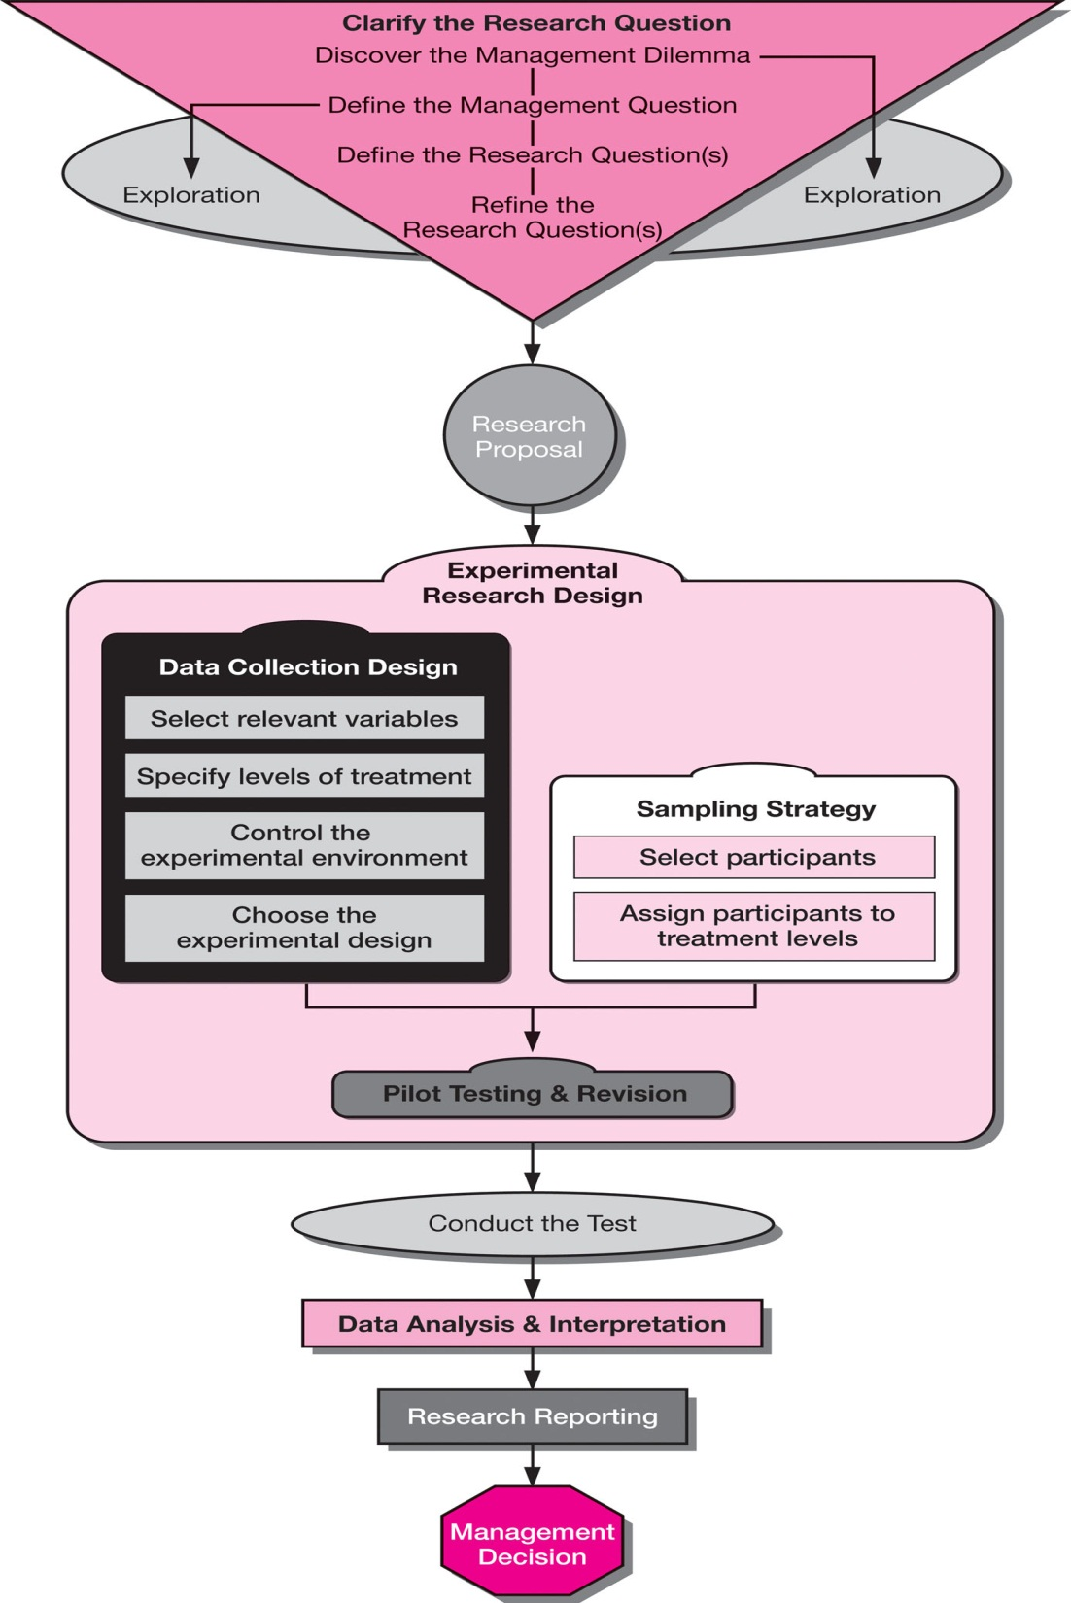

Slide 13
Steps of a well-planned experiment
The activities the researcher must accomplish to make an experiment a success:
3.1. Specify treatment variables:
a) select variables that are the best operational definitions of the original concepts,
b) determine how many variables to test,
c) select or design appropriate measures for the chosen variables.
The selection of measures for testing requires a thorough review of the available literature and instruments.

Slide 14
3.2. Specify treatment levels:
In an experiment, participants experience a manipulation of the independent variable, called the experimental treatment.
The treatment levels are the arbitrary or natural groups the researcher makes within the independent variable.
A control group is a group of participants that is measured but not exposed the independent variable being studied.
A control group can provide a base level for comparison.

Slide 15
3.3. Control environment:
Environmental control means holding the physical environment of the experiment constant. When participants do not know if they are receiving the experimental treatment, they are said to be blind.
When neither the participant nor the researcher knows, the experiment is said to be double-blind.
3.4. Choose experimental design:
The design is then selected. Several designs are discussed on the next several slides.

Slide 16
3.5. Select and assign participants:
The participants selected for the experiment should be representative of the population to which the researcher wishes to generalize the study’s results.
Random assignment is required to make the groups as comparable as possible.
Random assignment uses a randomized sample frame for assigning participants to experimental and control groups.
Matching is an equalizing process for assigning participants to experimental and control groups.

Slide 17
3.5.1. Random assignment :
The sampling frame is often small for experiments and the participants may be self-selected.
However, if randomization is used, those assigned to the experimental group are likely to be similar to those assigned to the control group.
Random assignment allows one to make the groups as comparable as possible.
It means that participants have an equal and known chance of being assigned to any of the groups in the experiment.

Slide 18
3.5.2. Matching :
Matching is a control procedure to ensure that experimental and control groups are equated on one or more variables before the experiment.
The object of matching is to have each experimental and control participant matched on every characteristic used in the research. Matching employs a nonprobability quota sampling approach.
Quota matrix is a means of visualizing the matching process. If matching does not alleviate assignment problems, a combination of matching, randomization, and increasing the sample size may be useful.

Slide 19
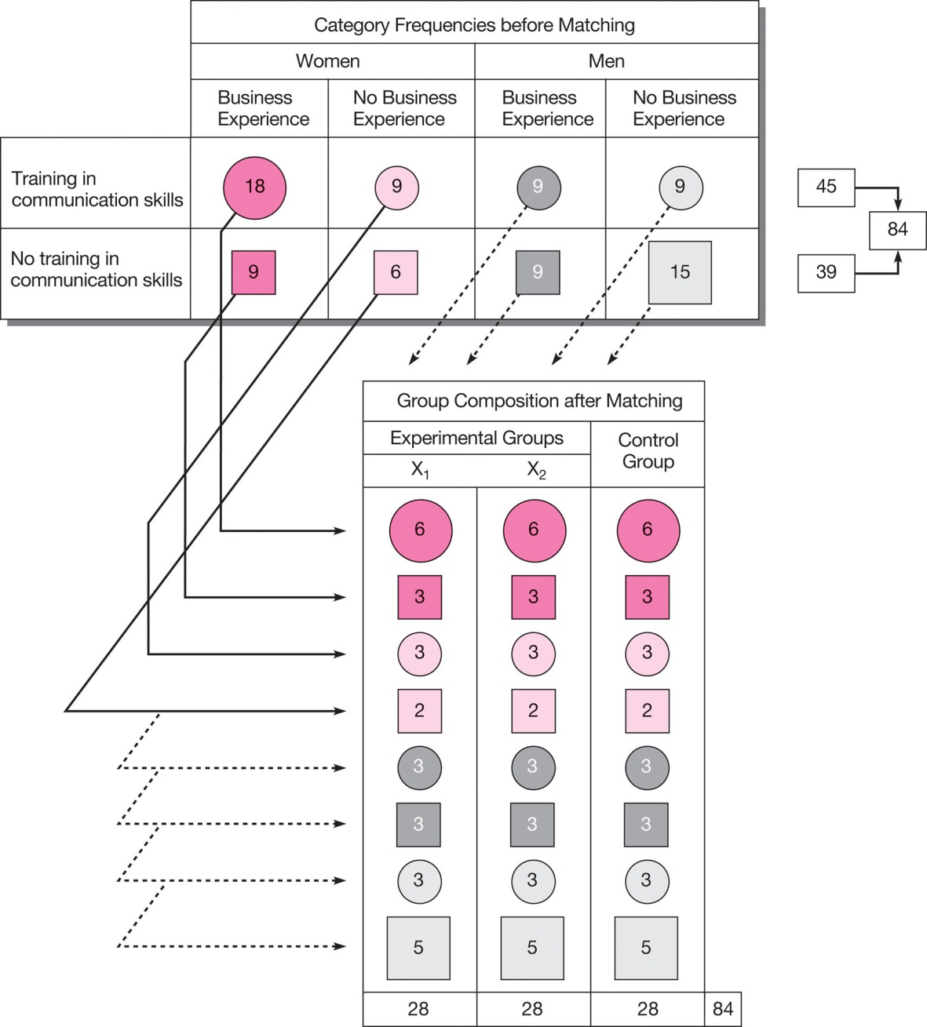
Quota Matrix Example
Exhibit 10-3 presents an example of a quota matrix.
One-third of the participants from each cell of the matrix would be assigned to each of the tree groups.

Slide 20
4. Validity in Experimentation
Internal validity exists when the conclusions drawn about a demonstrated experimental relationship truly implies cause.
External validity exists when an observed causal relationship can be generalized across persons, settings, and times.

Slide 21
Experimental Design
Experimental designs are set up to examine possible cause and effect relationship among variables, in contrast to correlational studies, which examine the relationship among variable without necessarily trying to establish if one variable causes another.
To establish that variable X causes variable Y, all three of the following conditions should met:
1. Both X and Y should covary i.e., when one goes up, the other should
also simultaneously go up (or down).
2. X (the presumed causal factor) should precede Y. In other words,
there must be a time sequence in which the two occur.
3. No other factor should possibly cause the change in the dependent
variable Y.

Slide 22
To establish causal relationship between two variables in an organizational setting, several variables that might covary with the dependent variable have to be controlled. This would then allow us to say that variable X alone causes the dependent variable.
Experimental designs fall into two categories:
Experiment done in an artificial or contrived environment, known as lab experiments,
And those done in the natural environment in which activities regularly take place, known as field experiment.

Slide 23
The Lab Experiment
When a cause and effect relationship between an independent and a dependent variable of interest is to be clearly established, then all other variables that might contaminate or confound the relationship have to be tightly controlled. It is also necessary to manipulate the independent variable so that the extent of its causal effects can be established.
The controls and manipulations are best done in an artificial setting - the laboratory - where the causal effects can be tested. When controls and manipulations are introduced to establish cause and effect relationships in an artificial setting, we have laboratory experimental designs, also known as lab experiments.

Slide 24
Control
When we postulate cause and effect relationships between two variables X and Y, it is possible that some other factor, say Z, might also influence the dependent variable. In such a case, it will not possible to determine the extent Y occurred only because of X, and to what extent Y was additionally influenced by the presence of the other factor.
Example:
HRD Manager arrange for special training in creating web pages to the set of newly recruited secretaries that such training would cause them to function more effectively.
Some of the new secretaries might function more effectively than others ------possibly because they have had previous experience of creating web pages. Here in this example previous experience is the variable that needs to be controlled. This can done by excluding those secretaries from training who have already some experience of it.

Slide 25
Manipulation of Independent Variable
In order to examine the causal effects of an independent on a dependent variable, certain manipulation need to be tried. Manipulation simply means that we create different levels of the independent variable to assess the impact on the dependent variable.
Example: If we want to test the theory that depth of knowledge of various manufacturing technologies is caused by rotating the employees on all the jobs on the production line and in the design department, over a four- week period.
Then we can manipulate the independent variable, “rotation of employees” by rotating one group of production workers and exposing them to all the systems during the four-week period, rotating the other group only partially during the four weeks (i.e., exposing them to only half of the manufacturing technologies), and leaving the third group to do what they are currently doing, without any special rotation.

Slide 26
Controlling the Contaminating Exogenous or “Nuisance” Variables
Matching Groups
One way of controlling the contaminating or “nuisance” variable is to match various group by taking the confounding characteristics and deliberately spreading them across groups.
Example: If there are 20 women among the 60 members, then each group will be assigned 5 women, so that the effects of gender are distributed across the four groups. Similarly, age and experience factors can be matched across the four groups such that each group has a similar mix of individuals in terms of gender, age and experience. Because the suspected contaminating factors are matched across the groups, we may take comfort in saying that variable X alone cause variable Y.

Slide 27
Randomization
Another way of controlling the contaminating variables is to assign the 60 members randomly to the four groups that is every member would have known and equal chance of being assigned to any of these four groups.
For instance we might throw the names of the 60 members into hat and draw their names. The first 15 names may be assigned to the first group, the second 15 to the second group, and so on or the first person drawn might be assigned to the first group, the second person to the second group, and so on. Thus, in randomization, both the process by which individuals drawn is random (i.e, everyone has known and equal chance of being drawn) and the assignment of the individual to any particular group is random ( each individual could be assigned to any one of the groups set up). By thus randomly assigning members to the group we would be distributing the confounding variables among the groups equally.

Slide 28
That is, the variable of age, sex, and previous experience - the controlled variables - will have equal probability of being distributed among the groups. Thus randomization would ensure that if these variables do indeed have a contributory or confounding effect, we would have controlled their confounding effect (along-with those of other unknown factors) by distributing them across the groups.
Advantages of Randomization
The difference between matching and randomization is that in the former case individuals are deliberately and consciously matched to control the differences among group members, whereas in the latter we expect that the process of randomization will distribute the inequalities among the groups, based on the law of normal distribution.

Slide 29
Comparison to randomization, matching might be less effective, because we may not know all the factors that could possibly contaminate the cause and effect relationship in any given situation, and hence fail to match some critical factors across all groups while conducting an experiment. Randomization, however, will take care of this, since all the known and unknown contaminating factors will be spread across all groups.
Internal Validity
Internal validity refers to the confidence we place in the cause and effect relationship. It other words, it address the question, “To what extent does the research design permit us to say that the independent variable A causes a change in the dependent variable B.”
High Internal Validity: In the research with high internal validity, we are relatively better able to argue that the relationship is causal.

Slide 30
Low Internal Validity: In studies with low internal validity causal relationship cannot be inferred at all.
In lab experiments where cause and effect relationship are substantiated, internal validity can be said to be high.
The Field Experiment
A field experiment, as the name implies, is an experiment done in the natural environment in which work goes on as usual, but treatments are given to one or more groups. Thus in the field experience, even though it may not be possible to control all the nuisance variables because members cannot be assigned either randomly assigned to groups, or matched, the treatment can still be manipulated. Control groups could also be set up in field experiments.

Slide 31
External Validity
External Validity refers to the extent of generalizability of the result of a causal study to other setting, people or events, and Internal Validity refers to the degree of our confidence in the causal effects ( i.e., that variable X cause variable Y).
Field Experiments have more external validity (i.e., the result are more generalizable to other similar organizational settings) but less internal validity.
In the Lab Experiments, the reverse is true. The internal validity is high but the external validity is rather low. In other words, in lab experiments we can be sure that variable X causes variable Y because we have been able to keep the other confounding exogenous variables under control.

Slide 32
Factors Affecting Internal Validity
Even the best designed lab studies could be could be influenced by factors that might affect the internal validity of the lab experiment. These possible confounding threats pose a threat to internal validity. The seven major threats to internal validity are:
History Effects
Maturation Effects
Testing Effects
Instrumentation Effects
Selection Effects
Statistical Regression Effects
Mortality Effects

Slide 33
History Effects
Certain events or factors that would have an impact on the independent variable - dependent variable relationship might unexpectedly occur while the experiment is in progress, and this history of events would confound the cause and effect relationship between the two variables, thus affecting the internal validity.
Example
Independent variable Dependent variable
Sales
Sales Promotion
Dairy
farmer’s
advertisement
Uncontrolled
variable

Slide 34
Maturation Effects
Cause and effect inferences can also be contaminated by the effects of the passage of time - another uncontrollable variable. Such contamination is called maturation effects. Examples of maturation effects processes could include growing older, getting retired, feeling hungry, and getting bored.
Example
Independent variable Dependent variable
Efficiency increase
Enhanced technology
Gaining experience
and doing the job faster
Maturation
effects

Slide 35
Testing Effects
Frequently, to test the effects of a treatment, subjects are given pretest (e.g., a short questionnaire eliciting their feelings and attitudes). That is, first a measure of the dependent variable is taken (the pretest), then the treatment is given, and after that a second test, called the posttest, is administered. The difference between the posttest and pretest is then attributed to the treatment. However, the very fact that respondents were exposed to the pretest might influence their response on the posttest, which would adversely impact on internal validity.

Slide 36
Example:
A challenging job is expected to cause increase in job satisfaction, and a pretest on job satisfaction is administered asking for employees level of satisfaction with their current jobs, it might sensitize people to the issue of job satisfaction.
When a challenging a job is introduced and a further job satisfaction questionnaire is administered, the respondent might now react and respond to the posttest with a different frame of reference than if they had not originally been sensitized to the issue of job satisfaction through the pretest.

Slide 37
Instrumentation Effects
Instrumentation effects are another source of threat to internal validity. These effects might arise because of a change in the measurement instrument between pretest and posttest, and not because of the treatment’s differential impact at the end.
Selection Bias Effects
The threat to internal validity could also come from improper or unmatched selection of subjects for the experimental and control groups.
Statistical Regression Effects
Statistical regression occurs when members chosen for the experimental group have extreme scores on the dependent variable to begin with.

Slide 38
Mortality
Another confounding factor on the cause and effect relationship is the mortality or attrition of the members in the experimental or control group or both, as the experiment progresses. When the group composition changes overtime across the groups, comparison between the groups become difficult, because those who dropped out of the experiment may confound the result.
Types of Experimental Design and Internal Validity
The shorter the time span of the experiments, the less the chances of encountering the history, maturation, and mortality effects.
Experiments lasting an hour or two do not usually encounter many of these problems. It is only when experiments take place over an extended period (e.g., several months) that the possibility of encountering more of the confounding factors increases.

Slide 39
Quasi-Experimental Designs
Some studies expose an experimental group to a treatment and measure its effects. Such an experimental design is weakest of all designs, and it does not measure the true cause and effect relationship.
This is because there is no comparison between groups nor any recording of the status of the dependent variable as it was prior to the experimental treatment and how it changed after the treatment.
In the absence of such control, the study is of no scientific value in determining the cause and effect relationship. Hence such a design is referred to as a quasi-experimental design.

Slide 40
Pretest and Posttest Experimental Group Design
An experiment group (without a control group) may be given a pretest, expose to a treatment, and then given a posttest to measure the effects of the treatment.
Pretest and posttest experimental group design
Treatment effect = (O₂₋ O₁)
Group Pretest Treatment Posttest
Experimental group O₁ X O₂

Slide 41
Posttests only with Experimental and Control Groups
Some experimental designs are set up with an experimental and control group, the former alone being exposed to a treatment and not the later. The effects of the treatment are studied by assessing the difference in the outcomes - that is, the posttest scores of the experimental and control groups.
Group Treatment Outcome
Experimental group X O₁
Control group O₂
Treatment effect = (O₁ ₋ O₂)

Slide 42
True Experimental Designs
Experimental designs, which include both the treatment and control groups and record information both before and after the experimental group is exposed to the treatment, are known as the post facto experimental designs.
Pretest and Posttest Experimental and Control Groups Designs
Treatment effect =[ (O₂₋ O₁) - (O₄₋O₃)]
Group Pretest Treatment Posttest
Experimental group O₁ X O₂
Control group O₃ O₄

Slide 43
Simulation
An alternative to lab and field experimentation currently being used in business research is simulation.
Simulation uses model-building technique to determine the effects of changes, and computer based simulation are becoming popular in business research.
A simulation can be thought of as an experiment conducted in a specially created setting that resembles the natural environment in which activities are usually carried on. In that, the sense simulation lies somewhere between a lab and a field experiment, insofar as the environment is artificially created but not far different from “reality”.
Participants are exposed to real world experiences over a period of time, lasting anywhere from several hours to several weeks, and they can be randomly assigned to different treatment groups.

Slide 44
Managerial Implications
Though many managers many not be interested in cause and effect relationship, however, a good knowledge of experimental designs could foster some pilot studies to be undertaken to determine whether factors like bonus system, piece rate and such, lead to positive outcomes such as better motivation, job performance, and other favorable results at the workplace.
Marketing managers would be able to use experimental designs to study the effects on sales of advertisements, sales promotions, pricing, and the like.

Slide 45
Managerial Implications
Decisions points for embarking on an experimental design
Is tracing causal effects necessary
Yes; and if
No
I V is more important
than E V
Generalizibility is more
important than I V
Both I V & E V
are important
Engage in a lab
experiment
Engage in a filed
experiment
First do a lab experiment
then, a filed experiment
Are there cost
constaints?
Yes
No
Engage in a simpler
experimental design
Engage in a more
sophisticated design

Slide 46
Conclusion
Experimental design
Techniques and methodlogies

