Slide 1
Lecture 23
Collecting Primary data through Questionnare
By
Aziza Munir

Slide 2
What to Learn?
What are questionnaires?
Why it is considered a modern and easy approach of data collection
Why a questionnaire?
Types of data collection through questionnaire?
Validity and reliability in questionnaires?

Slide 3
Use of questionnaires (1)
Definition of Questionnaires
Techniques of data collection in which each person is asked to respond to the same set of questions in a predetermined order
Adapted from deVaus (2002)

Slide 4
Use of questionnaires (2)
When to use questionnaires
For explanatory or descriptive research
Linked with other methods in a multiple-methods research design
To collect responses from a large sample prior to quantitative analysis

Slide 5
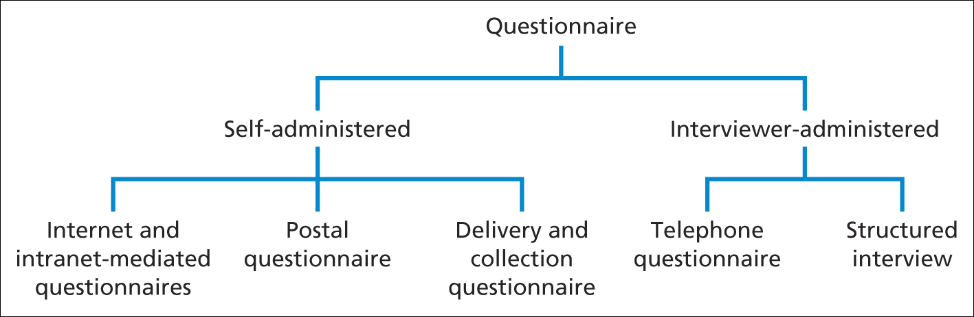
Use of questionnaires (3)
Types of questionnaire
Saunders et al. (2009)
Figure 11.1 Types of questionnaire

Slide 6
Types of questionnaire
The design of a questionnaire differs according to how it is administered and in particular, the amount of contact you have with respondents [Figure 11.1]. Self-administered questionnaires are usually completed by respondents. Such questionnaires are administered electronically using the internet [Internet-mediated questionnaires] or intranet [intranet-mediated questionnaires], posted to respondents who return them by post after completion [postal or mail questionnaire], or delivered by hand to each respondent and collected later [delivery and collection questionnaire].

Slide 7
Continued
Responses to interviewer-administered questionnaires are recorded by the interviewer on the basis of each respondent’s answers. Questionnaires administered using the telephone are known as telephone questionnaires. The final category, structured interviews [sometimes known as interview schedules], refers to those questionnaires where interviewers physically meet respondents and ask the question face to face. These differ from semi-structured and unstructured [in-depth] interviews [Section 10.2], as there is a defined schedule of questions, from which interviewers should not deviate.

Slide 8
Choice of questionnaire
Related factors
Characteristics of the respondents and access
Respondents answers not being contaminated or distorted
Size of sample required for analysis
Type and number of questions required
Available resources including use of computer software

Slide 9
Data collection
Key factors
Precisely defined questions
Representative and accurate sampling
An understanding of the organisational context
Relationships between variables – dependent, independent and extraneous
Types of variable

Slide 10
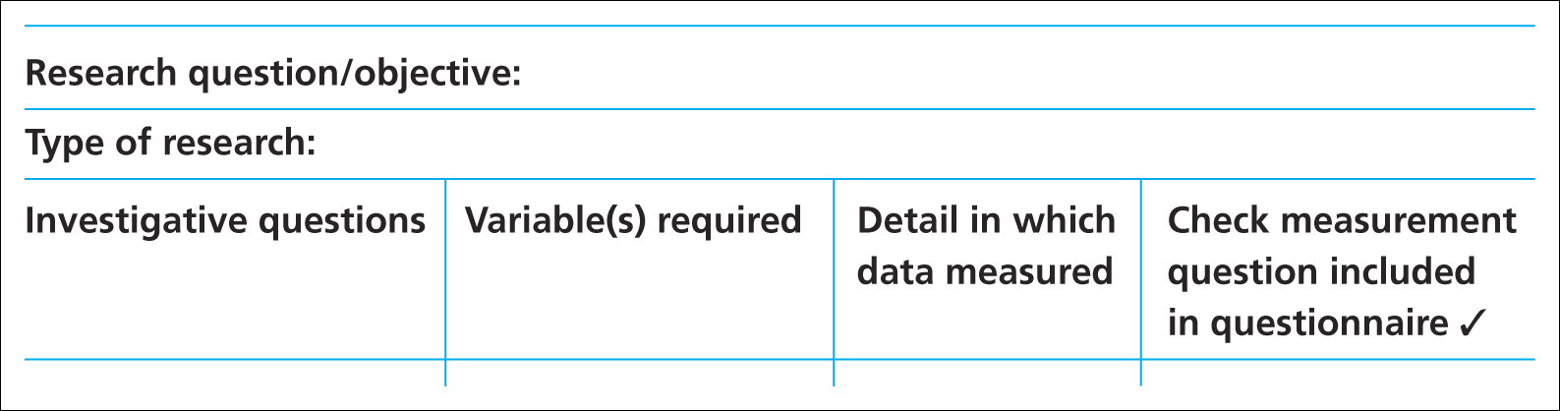
Ensuring essential data are collected
Data requirements table
Saunders et al. (2009)
Table 11.2 Data requirements table

Slide 11
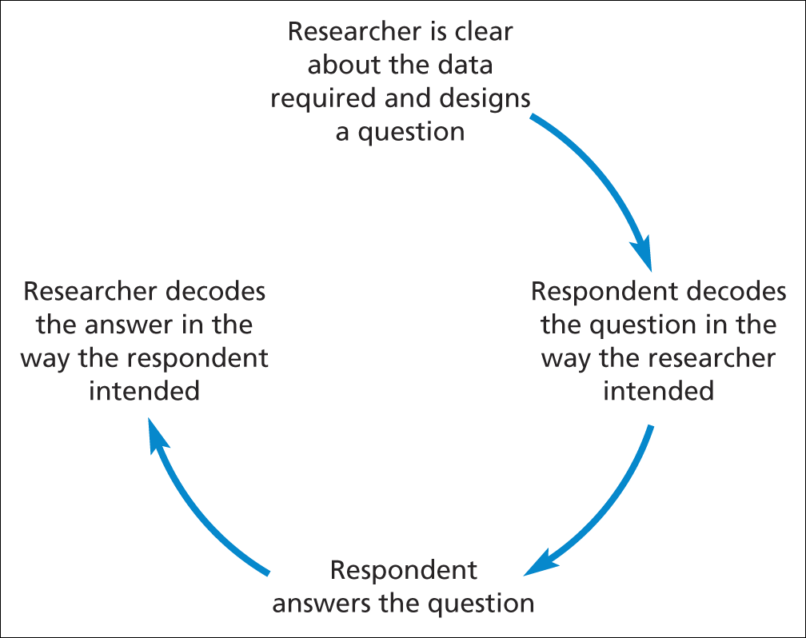
Designing the questionnaire (1)
Stages that must occur if a question is to be valid and reliable
Source: developed from Foddy (1994)
Figure 11.2 Stages that must occur if a question is to be valid and reliable

Slide 12
Designing the questionnaire (2)
Assessing validity
Internal
Content
Criterion – related (predictive)
Construct

Slide 13
Designing the questionnaire (3)
Testing for reliability- the 3 stage process
Test re-test
Internal consistency
Alternative form
Mitchell (1996)

Slide 14
Examples of question types (1)
Open questions
Please list up to three things you like about your job
1…………………………………………
2…………………………………………
3…………………………………………
Saunders et al. (2009)

Slide 15
Examples of question types (2)
List questions
What is your religion?
Please tick ✓ the appropriate box
Buddhist  None 
Christian  Other 
Hindu 
Jewish 
Muslim 
Sikh 
Saunders et al. (2009)

Slide 16
Examples of question types (3)
Category questions
8 How often do you visit the shopping centre?
Interviewer: listen to the respondent’s answer and tick ✓ as appropriate
 First visit
 Once a week
 Less than fortnightly to once a month
 2 or more times a week
Less than once a week to fortnightly
Less often
Saunders et al. (2009)

Slide 17
Examples of question types (4)
Ranking questions
Please number each of the factors listed below in order of importance to you in choosing a new car. Number the most important 1, the next 2 and so on. If a factor has no importance at all, please leave blank.
Factor Importance
Carbon dioxide emissions [ ]
Boot size [ ]
Depreciation [ ]
Price [ ]
Adapted from Saunders et al. (2009)

Slide 18
Examples of question types (5)
Rating questions
10 For the following statement please tick the box that matches your view most closely
Agree Tend to agree Tend to disagree Disagree
I feel employees’    
views have
influenced the
decisions taken
by management
Saunders et al. (2009)

Slide 19
Examples of question types (6)
Quantity questions
What is your year of birth?
(For example, for 1988 write: )
Saunders et al. (2009)
1
9
1
9
8
8

Slide 20
Designing individual questions (1)
Other considerations
Adopting or adapting existing questions – remember to check copyright
Question wording
Translating questions into other languages
Question coding

Slide 21
Designing individual questions (2)
Checklist Box 11.11
Complete the Checklist in Box 11.11
to help you with the wording of your questions
Saunders et al. (2009)

Slide 22
Constructing the questionnaire
Main considerations
Order and flow of questions
Questionnaire layout

Slide 23
Explaining the purpose and testing
Key points
The covering letter
Introducing and closing the questionnaire
Pilot testing and assessing validity

Slide 24
Administering the questionnaire
Points to consider
Internet and intranet-mediated responses
Postal questionnaires
Delivery and Collection
Telephone questionnaires
Structured interviews

Slide 25
Summary:
Questionnaires are often used to collect descriptive and explanatory data
Five main types of questionnaire are Internet- or intra-net mediated, postal, delivery and collection, telephone and interview schedule
Precise data that meet the research objectives can be produced by using a data requirements table

Slide 26
Summary:
Data validity and reliability and response rate depend on design, structure and rigorous pilot testing
Wording and order of questions and question types are important considerations
Closed questions should be pre-coded to facilitate data input and analysis

Slide 27
Summary:
Important design features are a clear layout, a logical order and flow of questions and easily completed responses
Questionnaires should be carefully introduced and pilot tested prior to administration
Administration needs to be appropriate to the type of questionnaire

