Slide 1
Lecture 22
Basics of Primary data Collection
Survey Research
By
Aziza Munir

Slide 2
Learning Objectives
At the end of this chapter you should be able to:
define a survey and identify the key characteristics of surveys
give examples of the use of surveys in applied marketing research
list the advantages and disadvantages of surveys
list and explain different categories of surveys
list and explain the sources of potential errors in survey research

Slide 3
Definition of Survey Research
Survey:
A method of primary data collection based on communication with a representative sample of individuals (called respondents).
Key Concepts in the Definition
Primary data
Communication
Sample
Representative

Slide 4
Selecting a Sample
Sample:
Subset of a larger population
SAMPLE
Sampling:
Who is to be sampled?
How large a sample?
How will sample units be selected?
POPULATION

Slide 5
Basic Definitions for sampling)
Target population: the group about which the researcher wishes to draw conclusions and make generalizations
Random sampling: selecting a sample from a larger target population where each respondent is chosen entirely by chance and each member of the population has a known, but possibly non-equal, chance of being included in the sample.

Slide 6
Basic Definitions for data collection
Surveys ask respondents (who are the subjects of the research) questions by use of a questionnaire.
Respondent: The person who provides information (primary data) by answering a questionnaire or an interviewer’s questions.
Questionnaire: a list of structured questions designed by the researchers for the purpose of codifying and analyzing the respondents’ answers scientifically.
Advantages of Surveys: Quick, Inexpensive, Efficient, Accurate, Flexible way of gathering information.

Slide 7
3. Classification of Survey Methods
3.1. Structure of the questionnaire:
* whether standardized questions with a limited number of allowable answer -multiple choices
* or unstandardized open ended questions with the possibility of being answered in numerious ways.
3.2. Level of Directness of the questions:
* whether direct/undisguised questions
* or indirect/disguised questions to hide the real purpose of the survey

Slide 8
Uses of Surveys in Applied Marketing Research
Description of marketing phenomena. For example:
General Purpose of the Survey
Type of Data Gathered
New Product Testing
Trial Purchase
Repeat Purchase
Market Tracking
Brand Awareness
Product Category Usage
Brand Preference
Market Segmentation
Demographics
Psychographics
Lifestyle
Customer Satisfaction
Satisfaction
Image Studies
Attitude Ratings
Likes / Dislikes

Slide 9
General Purpose of the Survey
Type of Data Gathered
Product Evaluation Studies
Likes / Dislikes
Perceived Benefits
Advertising Testing
Awareness
Believability
Recall
Recognition
Positioning Studies
Identifying unmet market needs
Examining current brand perceptions
Media Exposure Studies
TV Audience Studies
Magazine Readership
Shopping And Consumption Behavior
Shopping Behavior
Reasons For Buying

Slide 10
Advantages & Disadvantages of Surveys
Advantages:
Speed – Faster data collection than other methods
Cost - Relatively inexpensive data collection
Accuracy – Survey data can be very accurate if sampling is properly done
Efficiency – Measured as a ration of accuracy to cost, surveys are generally very efficient data collection methods
Disadvantages:
Survey error – Potentially large sources of error in surveys
Communication Problems - Each of the different communication survey methods has its own unique problems.

Slide 11
Classifying Survey Research Methods
By method of communication.
    Personal Interviews
    Telephone interviews
    Self-administered interviews
By degree of structure and disguise.
    Structured disguised
    Structured undisguised
    Unstructured disguised
    Unstructured undisguised
By time frame (Temporal classification).
    Cross-sectional surveys
    Longitudinal surveys

Slide 12
Classifying Surveys by Degree of Structure and Disguise
Structured
Unstructured
Undisguised (Direct)
Example: Typical descriptive survey with straightforward, structured questions.
Example: survey with open-ended questions to discover “new” answers.
Disguised (Indirect)
Example: survey interview to measure brand A’s image versus competitive brand’s or brand recall (unaided recall).
Example: projection techniques used mostly for exploratory research.

Slide 13
Temporal Classification of Survey Research
Cross-sectional studies: studies in which various segments of a population are sampled and data collected at a single point in time.
Longitudinal studies: studies in which data are collected at different points in time using:
  successive (different) samples in a tracking study or cohort study.
  the same sample in a panel study (consumer panels, retailer panels, etc).

Slide 14
Usefulness of Longitudinal Surveys: Examining Brand Switching (Number of families in panel purchasing each brand)
Brand Purchase
During first time period, t₁
During second time period, t₂
A
200
250
B
300
270
C
350
330
D
150
150
Total
1,000
1,000

Slide 15
2. Errors in Surveys
2.1. Random Sampling Error
2.2. Systematic Error (sample bias)
  2.2.1. Respondent error
  * Nonresponse bias
  * Response bias
  2.2.2. Administrative error
  * Data processing error
  * Sample selection error
  * Interviewer error
  * Interviewer cheating

Slide 16
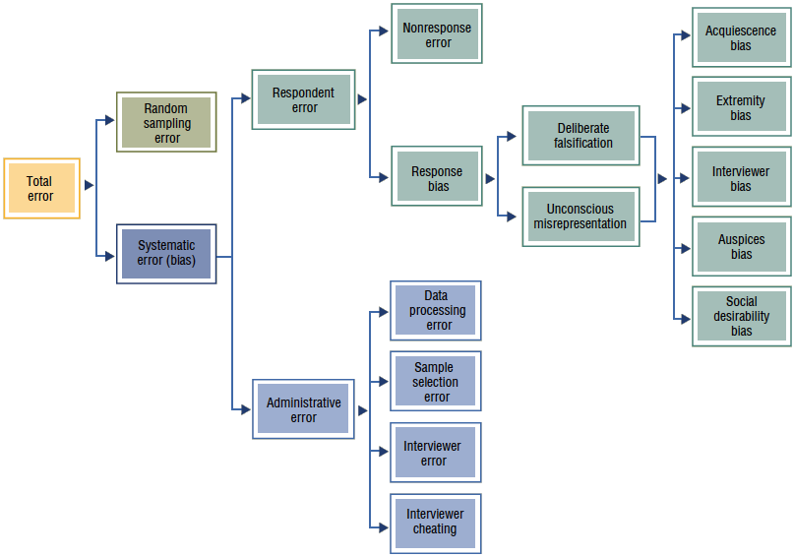
Categories of Survey Errors

Slide 17
2.1. Random Sampling Error
Even if randomly selected, samples may possess different characteristics than the target population (the likelihood of bias is reduced but still exists)
This is a statistical fluctuation due to chance variation.
Then, an important difference occurs between the findings obtained from this sample and the findings obtained from a possible census of the whole target population.

Slide 18
Categories of Survey Error
Random Sampling Error – Statistical fluctuation due to chance variations in elements selected for the sample.
Systematic (Non-Sampling) Error – Error resulting from:
  imperfections in the research design that leads to respondent error, or
  mistakes in executing the research.
Often leads to sample bias – the tendency of sample results to deviate in one particular direction
Respondent Error – Sample biases that result from the respondent action (response bias) or inaction (non-response bias)
Administrative Error – Error caused by improper administration (execution) of the research tasks

Slide 19
Categories of Respondent Error
Nonresponse Error – The statistical difference between the results of a survey in which the sample includes only those who responded (answered the questions) and a survey that would include those who failed to respond. Reasons include: (a) not-at-home, (b) refusal, or c) self-selection
Response bias – Bias that occurs when those who respond tend to answer questions in a way that misrepresents the truth consciously (deliberate falsification) or unconsciously (unconscious misrepresentation)
  Reasons for Deliberate falsification Reasons for unconscious misrepre.
  1. To appear intelligent 1. Question format or content
  2. To conceal personal information 2. Interview situation
  3. To avoid embarrassment 3. Misunderstanding the question
  4. To get rid of the interviewer 4. Forgetting exact details
  5. To please the interviewer 5. Unexpected question
      6. Inability to express feelings

Slide 20
Categories of Response Bias
Acquiescence bias – tendency to agree with everything the interviewer says
Extremity bias – tendency to use extremes when responding to questions
Interviewer bias – tendency of interviewer’s presence to affect respondent’s answers
Auspices bias – tendency for knowledge of who is sponsoring the research to affect respondents’ answers
Social desirability bias – tendency for respondents to give socially acceptable answers rather than the truth

Slide 21
Categories of Administrative Error
Sample Selection Error – Error caused by improper sample design or sampling procedure
Interviewer Error – Errors caused by interviewers making mistakes when performing their tasks
Interviewer Cheating – Errors caused by interviewers filling in fake answers to questions or falsifying entire questionnaires
Data Processing Error – Errors caused by incorrect data entry, computer programming, or other procedural errors during data analysis

Slide 22
3. Classification of Survey Methods
3.1. Structure of the questionnaire:
* whether standardized questions with a limited number of allowable answer -multiple choices
* or unstandardized open ended questions with the possibility of being answered in numerious ways.
3.2. Level of Directness of the questions:
* whether direct/undisguised questions
* or indirect/disguised questions to hide the real purpose of the survey

Slide 23
Survey Research: Basic Communication Methods
* Comparison of Basic Communication Methods in Surveys:
    * Questionnaires administered by an interviewer
    1. Door-to door interviews
    2. Mall intercepts
    3. Telephone interviews
    * Self-administered questionnaires
    4. Questionnaires sent by mail, fax, or e-mail
    5. Internet questionnaires

Slide 24
1. Door-to-Door Personal Interview
Speed of data collection
  Moderate to fast
Geographical flexibility
  Limited to moderate
Respondent cooperation
  Excellent
Versatility of questioning
  Quite versatile
Questionnaire length
  Long
Item non-response
  Low
Possibility of respondent misunderstanding
  Lowest

Slide 25
Door-to-Door Personal Interview
Degree of interviewer influence of answer: High
Supervision of interviewers: Moderate
Anonymity of respondent: Low
Ease of call back or follow-up: Difficult
Cost: Highest
Special features: Visual materials may be shown or demonstrated; extended probing possible

Slide 26
1. Mall Intercept Personal Interview
Speed of data collection: Fast
Geographical flexibility: Confined, urban bias
Respondent cooperation: Moderate to low
Versatility of questioning: Extremely versatile
Questionnaire length: Moderate to long
Item non-response: Medium
Possibility of respondent misunderstanding: Lowest

Slide 27
Mall Intercept Personal Interview
Degree of interviewer influence of answers: Highest
Supervision of interviewers: Moderate to high
Anonymity of respondent: Low
Ease of call back or follow-up: Difficult
Cost: Moderate to high
Special features: Taste test, viewing of TV commercials possible

Slide 28
3. Telephone Surveys
Speed of Data Collection: Very fast
Geographical Flexibility: High
Respondent Cooperation: Good
Versatility of Questioning: Moderate
Questionnaire Length: Moderate
Item Non-response: Medium
Possibility of Respondent Misunderstanding: Average
Degree of Interviewer Influence of Answer: Moderate

Slide 29
Telephone Surveys
Supervision of interviewers: High, especially with central location WATS (Wide Area Telecommunications Service) interviewing
Anonymity of respondent: Moderate
Ease of call back or follow-up: Easy
Cost: Low to moderate
Special features: Fieldwork and supervision of data collection are simplified; quite adaptable to computer technology (e.g. Central location interviewing, Computer-assisted telephone interviewing, Computerized voice-activated interviews)

Slide 30
Self-Administered Questionnaires

Slide 31
4. Mail Surveys
Speed of data collection: Researcher has no control over return of questionnaire; slow
Geographical flexibility: High
Respondent cooperation: Moderate – but, poorly designed questionnaire will have low response rate
Versatility of questioning: Highly standardized format
Questionnaire length: Varies depending on incentive
Item non-response: High

Slide 32
Mail Surveys
Possibility of respondent misunderstanding: Highest--no interviewer present for clarification
Degree of interviewer influence of answer: None - interviewer absent
Supervision of interviewers: Not applicable
Anonymity of respondent: High
Ease of call back or follow-up: Easy, but takes time
Cost: Lowest

Slide 33
5. E-Mail Questionnaire Surveys
Speed of data collection: Instantaneous
Geographic flexibility: worldwide
Cheaper distribution and processing costs
Flexible, but
  Extensive differences in the capabilities of respondents’ computers and e-mail software limit the types of questions and the layout
E-mails are not secure and “eavesdropping” can possibly occur
Respondent cooperation
  Varies depending if e-mail is seen as “spam”

Slide 34
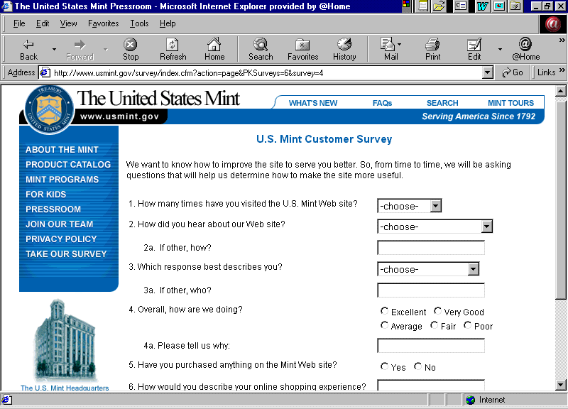
6. Internet Surveys
A self-administered questionnaire posted on a Web site.
Respondents provide answers to questions displayed online by highlighting a phrase, clicking an icon, or keying in an answer.

Slide 35
Internet Surveys
Speed of data collection: Instantaneous
Geographic flexibility: worldwide
Cost effective, visual and interactive
Respondent cooperation
  Varies depending on web site
  Varies depending on type of sample
  When user does not opt-in or expect a voluntary survey cooperation is low.
  Self-selection problems in web site visitation surveys - participants tend to be more deeply involved than the average person.

Slide 36
Internet Surveys
Versatility of questioning: Extremely versatile
Questionnaire length: varying according to the answers of each respondent
Item non-response: Software can assure none
Possibility for respondent misunderstanding: High
Interviewer influence of answers: None
Supervision of interviewers: not required
Anonymity of Respondent: Respondent can be anonymous or known
Ease of Callback or Follow-up: difficult unless e-mail address is known
Special Features: allows graphics and streaming media

Slide 37
Conclusion
Survey Research, its definition and application
Need and use of survey
Advantages and disadvantages
Types and categories of survey errors

