Slide 1
Lecture 19
Research Methods
Developing Theoretical Frame work
By
Aziza Munir

Slide 2
Learning Objectives
Research Process
Identify Key Areas
Variables Discussion
Theoretical Frame work
Need for Literature in developing Theoretical Frame work
Model development

Slide 3
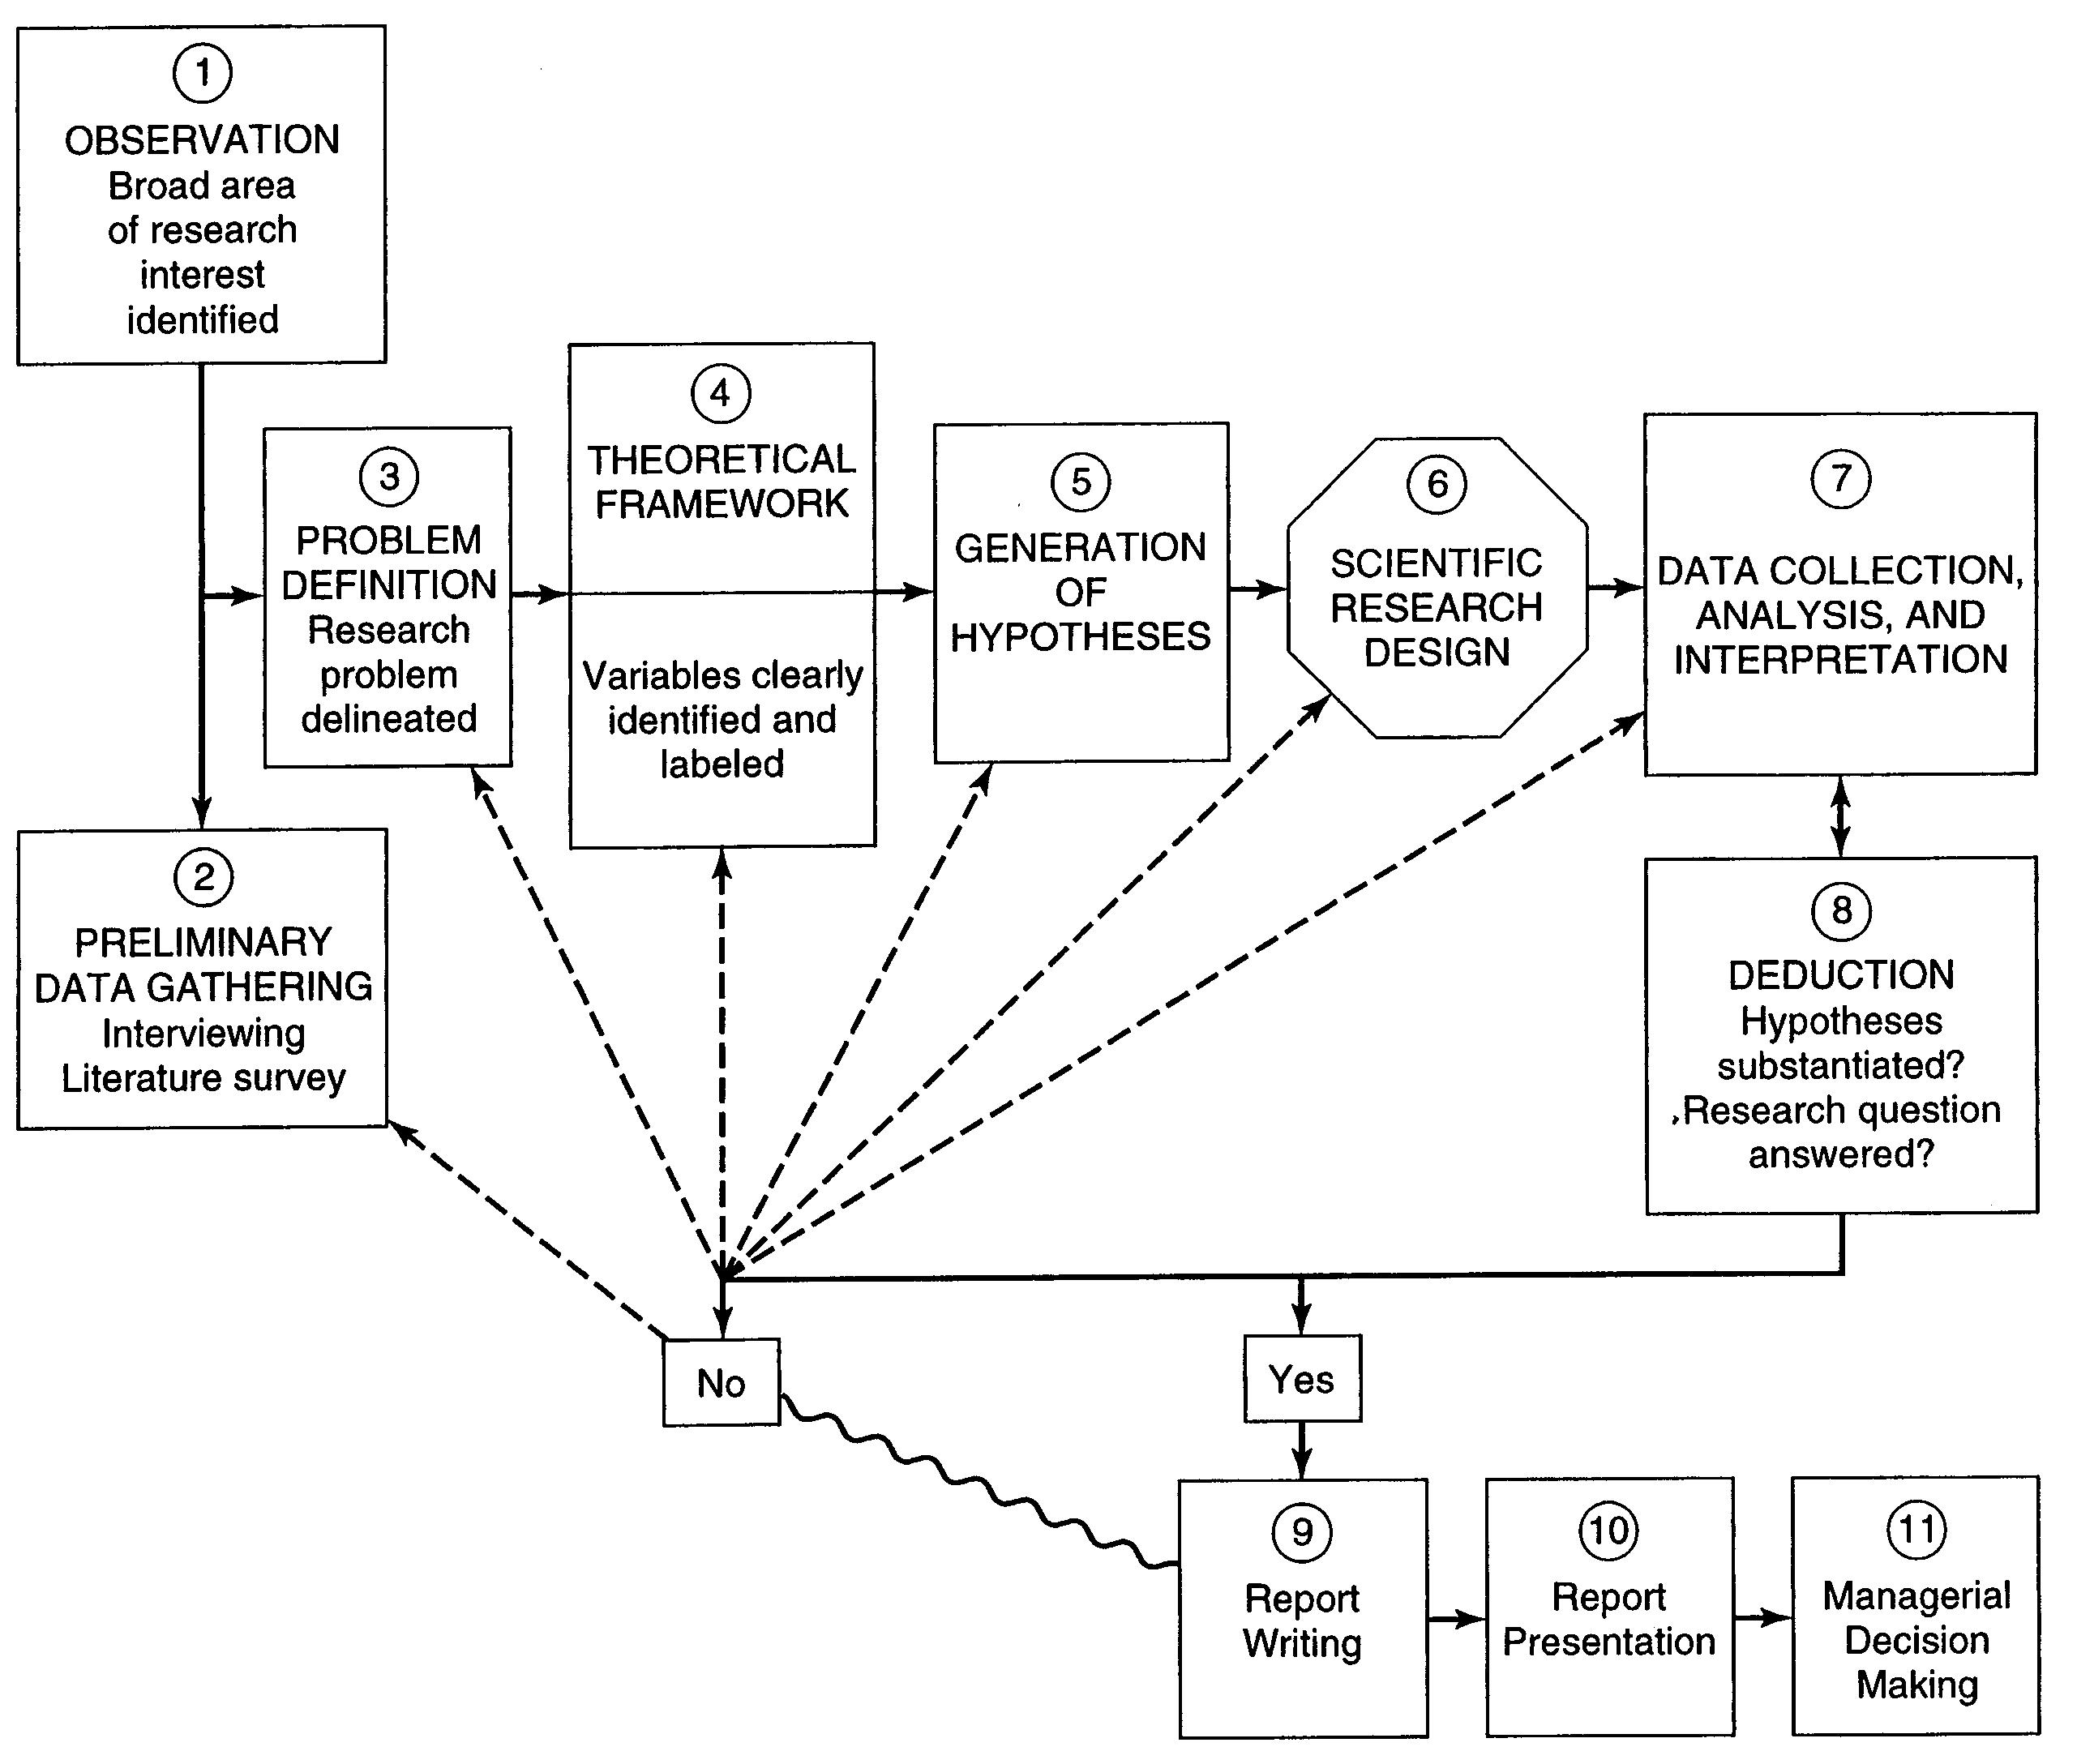
The Research Process

Slide 4
Extracting the Relevant Information
From the articles extract these following information
  Problem
  Variables
  Sample
  Data collection
  Data analysis
  Results
  Conclusion

Slide 5
Nature of the Problem:
Current exiting problem where a manager is looking for a solution
    Performance is low.
Require Improvement is situation that may not be posing any problem at the present.
    People do not come on time
Conceptual Issue where better definition , better theory building is needed
    Defining performance. (performance vs outcomes)
Empirical where researcher is trying to answer a research question empirically
    Attendance and performance related.

Slide 6
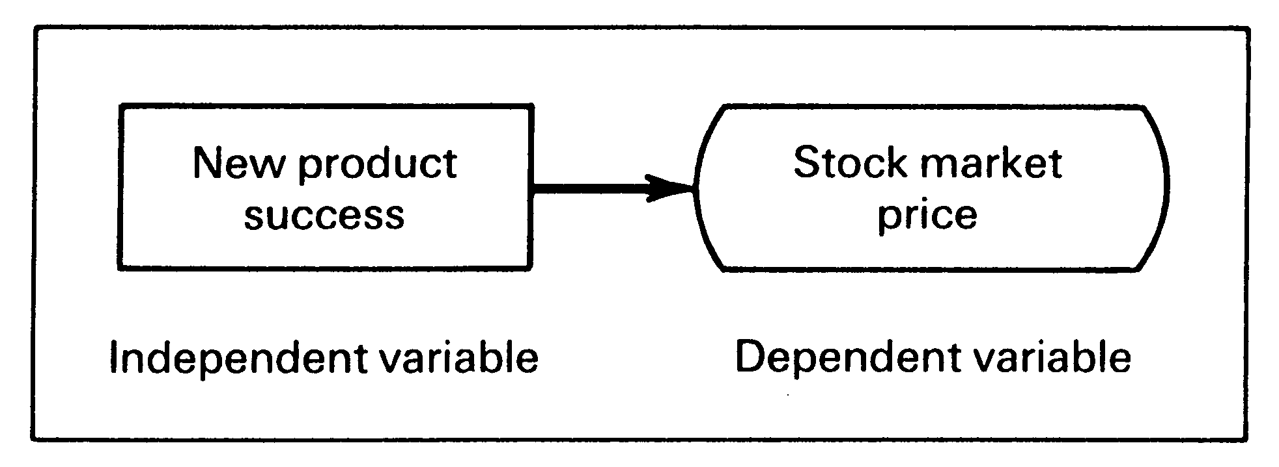
Theoretical Framework
Is conceptual Model of how one theorizes the relationship among the several factors that have been identified as important to the problem.

Slide 7
Variables
A variable is anything that can take on different values. The values can differ at various times for the same object or person or the values can differ at the same time for different objects or persons e.g (scores, temperature, motivation)
Types of variables
  Dependent variable
  Independent variable
  Moderating variable
  The intervening variable

Slide 8
Dependent
The dependent variable is the variable which of primary interest to the researcher. The researcher’s goal is to explain or predict the variability in the dependent variable.
E.g. The sales of new product is not as high as expected. The dependent variable is sales c=f(y)
Where c=consumption & y=income
C is the dependent

Slide 9
Independent
An independent variable is one that influences the dependent variable in either a positive or negative way. When the independent variable is present, the dependent variables is also present and with each unit increase in the independent variable, there is increase or decrease in the dependent variable.
C=f(y) here y is independent
New product success -→Stock market price

Slide 10
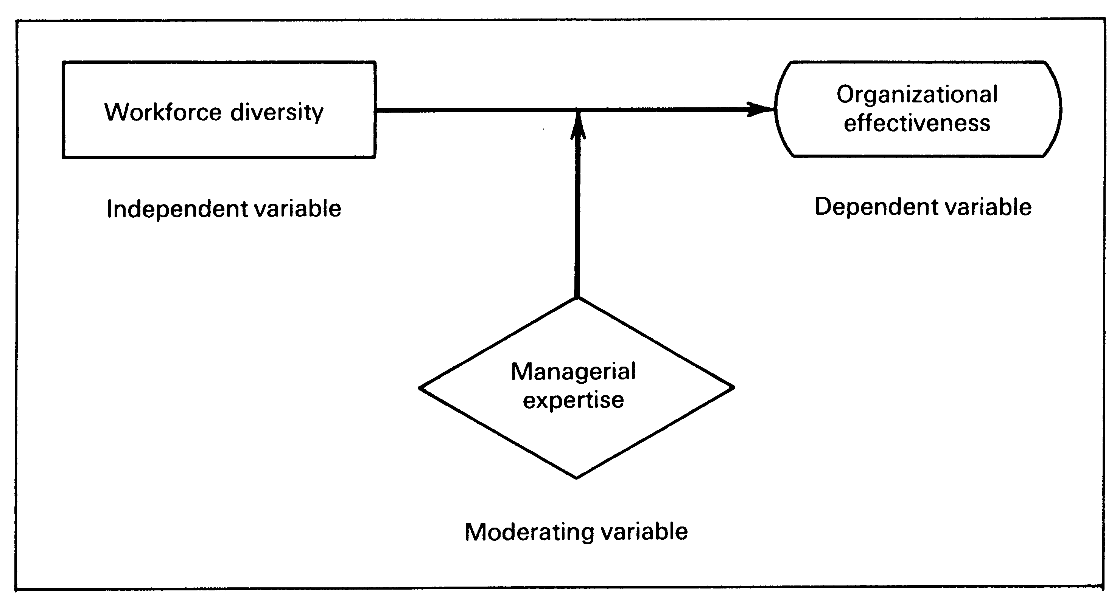
Moderating
Is a variable that has a strong contingent effect on the independent –dependent variable relationship
Does the workforce diversity influence organization effectiveness ?
Does the managerial expertise moderate the relationship?

Slide 11
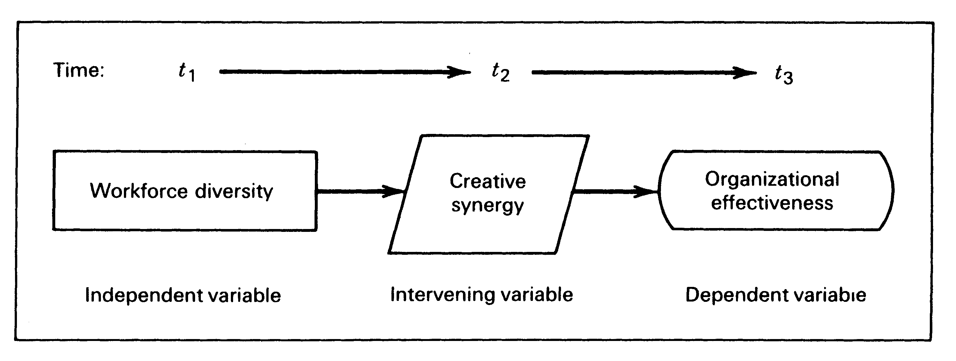
Intervening ( Mediating)
Is a variable that surfaces between the time the independent variable operate to influence the dependent variable and their impact on the dependent variable
Does the workforce creative synergy mediates the relationship?

Slide 12
5 Features of Theoretical Framework
Identifying and labeling the variables
Stating the relationship between the variables
Theorizing nature and direction of the relationship
Logically explain why and how these relationship exists
Developing a schematic diagram

Slide 13
Exercise : List the independent variable
Cross culture research indicates the managerial values govern the power distance between supervisor and subordinates.
A manager believes that good supervision and training would increase the production level of the workers.

Slide 14
Exercises Cont
A manager finds that off the job class room training has a great impact on the productivity of the employee in his department. However ha also observes that employees over fifty years of age do not seem to derive much benefit and do not improve from such training

Slide 15
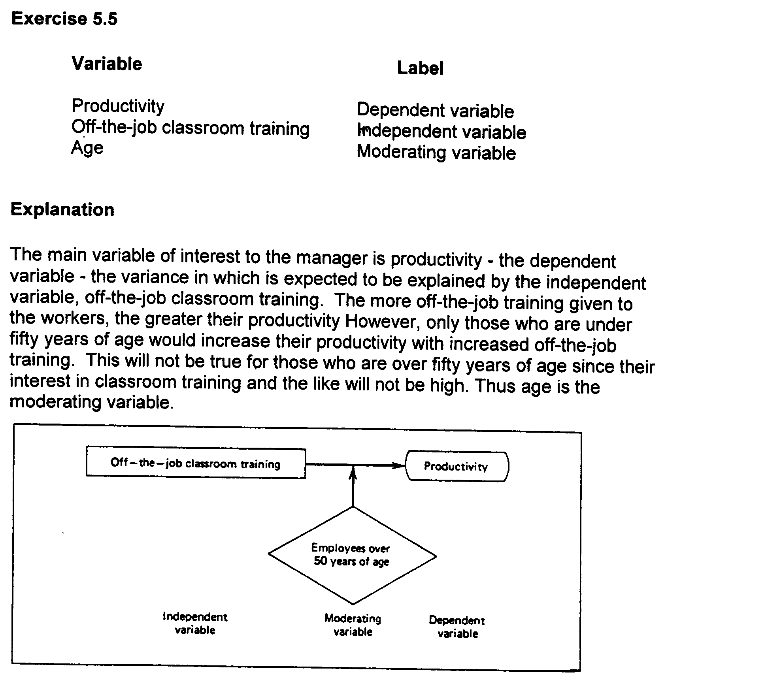

Slide 16
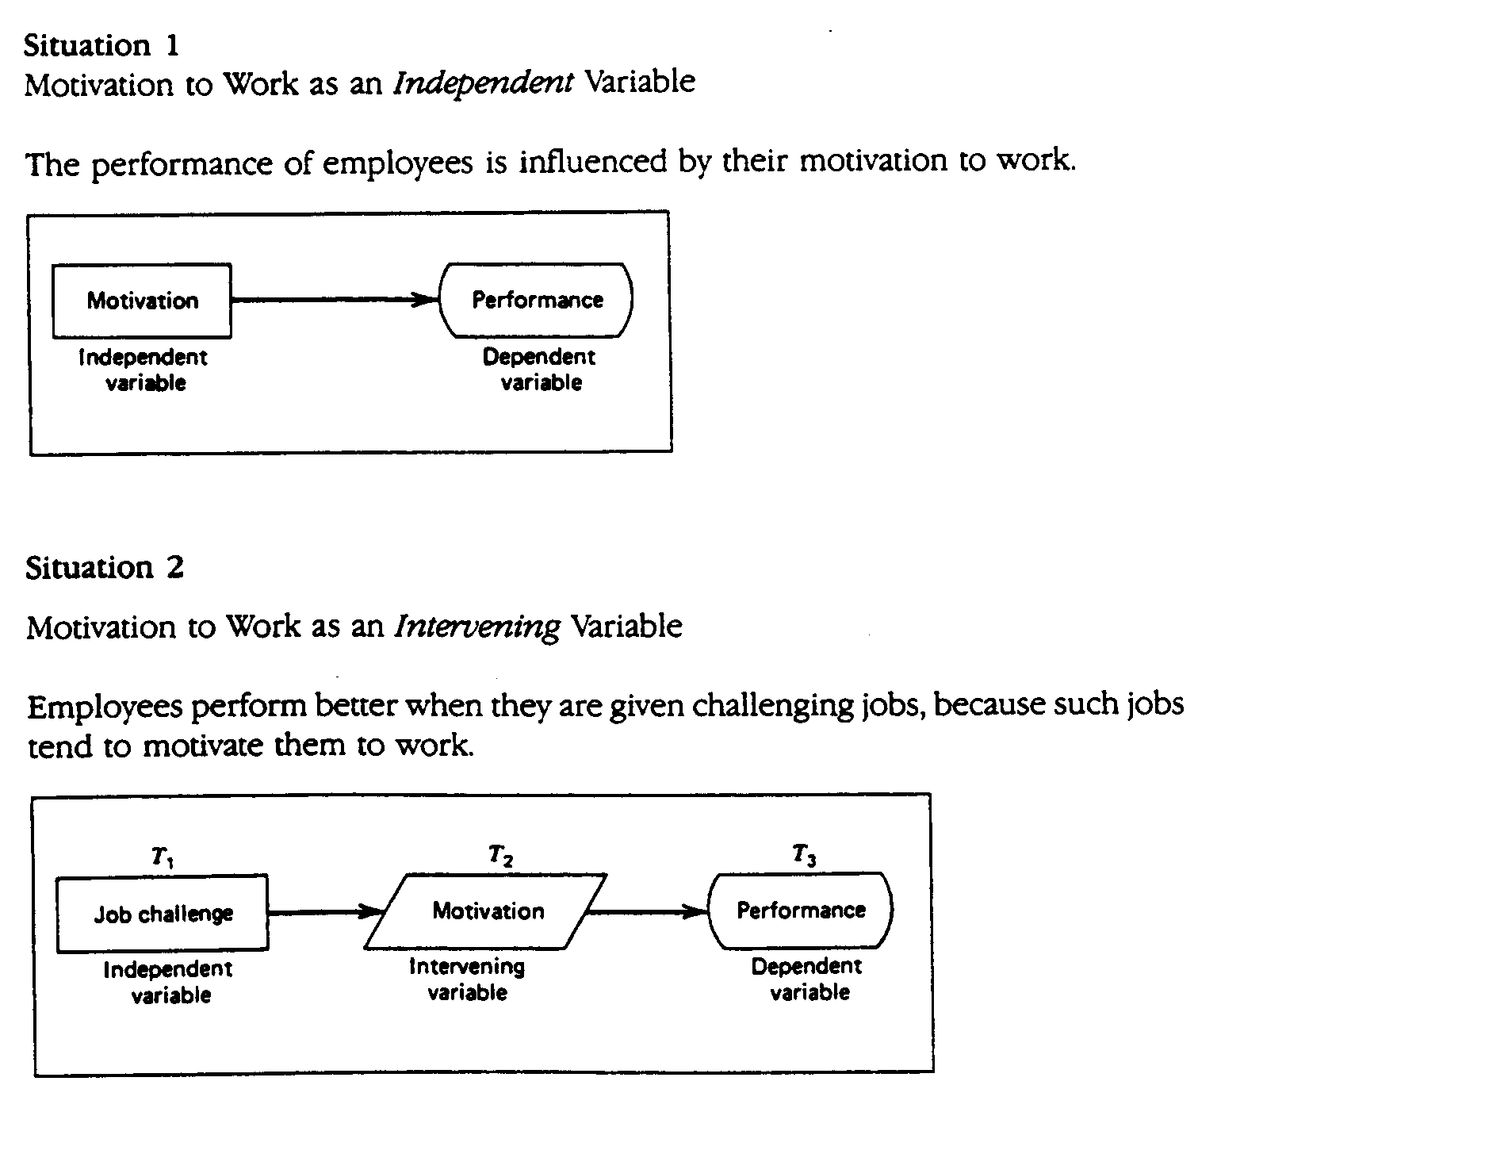

Slide 17
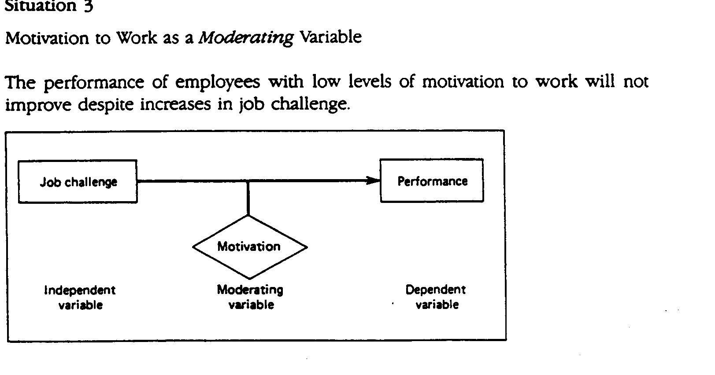

Slide 18
Hypotheses Development
Once we have identified the important variables in a situation and establish a relationship among them through logical reasoning in the theoretical framework, we are now in a position to test whether the relationship that have been theorized so in fact hold true. Formulating such testable statements is called hypothesis development.
A hypothesis can be defined as a logically conjectured relationship between two or more variables expressed in the form of a test able statement

Slide 19
Formats of Hypothesis statements
If then Statement
If employee are more healthy they will take les sick leaves
Directional and non Directional
Directional (examples)
Women are more motivated then men
The greater the stress experienced in the job, lower the job satisfaction of employees

Slide 20
Non Directional
There is a relationship between age and job satisfaction
There is difference between the work ethics values of American and Asian employees.

Slide 21
Null and Alternate Hypothesis
Null hypothesis is a proposition that states a definite, exact relationship between two variables. That is it stated that the population correlation between two variables is equal to zero or some definite number
The alternative hypothesis which is the opposite of the null is a statement expressing a relationship between two variables or indicating difference between groups.

Slide 22
Ho and Ha
Ho: Um=Uw
Ho: Um-Uw=0
Ha: um < Um
Ha: Um> Um

Slide 23
 | Relation Ship |  | Group Difference
 | Ho | Ha | Ho | Ha
Directional | HoP=0 | Ha P>0 OR Ha P <0 | Ho µa=µb | Ha µa>µb or Ha µa<µb
Non-Directional | HoP=0 | Ha P#0 | Ho µa=µb | Ha µa # µb

Slide 24
Hypotheses Testing
State null and alternate hypothesis
Choose appropriate test depending on the nature of data collected
Determine the significance level
Find critical values either from computer of from the table
When the value results > then critical then null is rejected and alternate is accepted and vice versa

Slide 25
Conclusion
Variables types
Types of model based on literature
Theoretical Analysis
Hypothesis testing

