Slide 1
Lecture 18
Introduction to Research Methods
By
Aziza Munir

Slide 2
Learning Objectives
Business Research
Scientific Method of Approaching a problem and identifying its solution
Research Process
Broad Problem Area
Theoretical Frame work
Types of variables

Slide 3
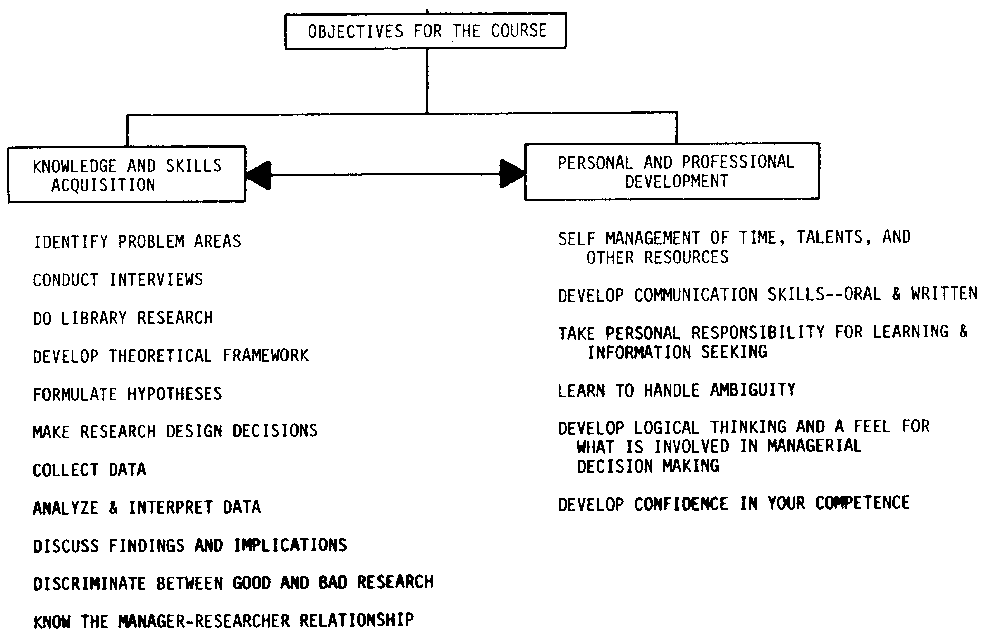
1A

Slide 4
Business Research Defined
Business research is defined as the systematic and objective process of gathering, recording and analyzing data for aid in making business decisions.

Slide 5
Business Research
Research information is neither intuitive nor haphazardly gathered.
Literally, research (re-search) -“search again”
Business research must be objective
Detached and impersonal rather than biased
It facilitates the managerial decision process for all aspects of a business.

Slide 6
Information
Reduces
Uncertainty
I don’t know
if we
should
offer on-site
Medical Insurance?

Slide 7
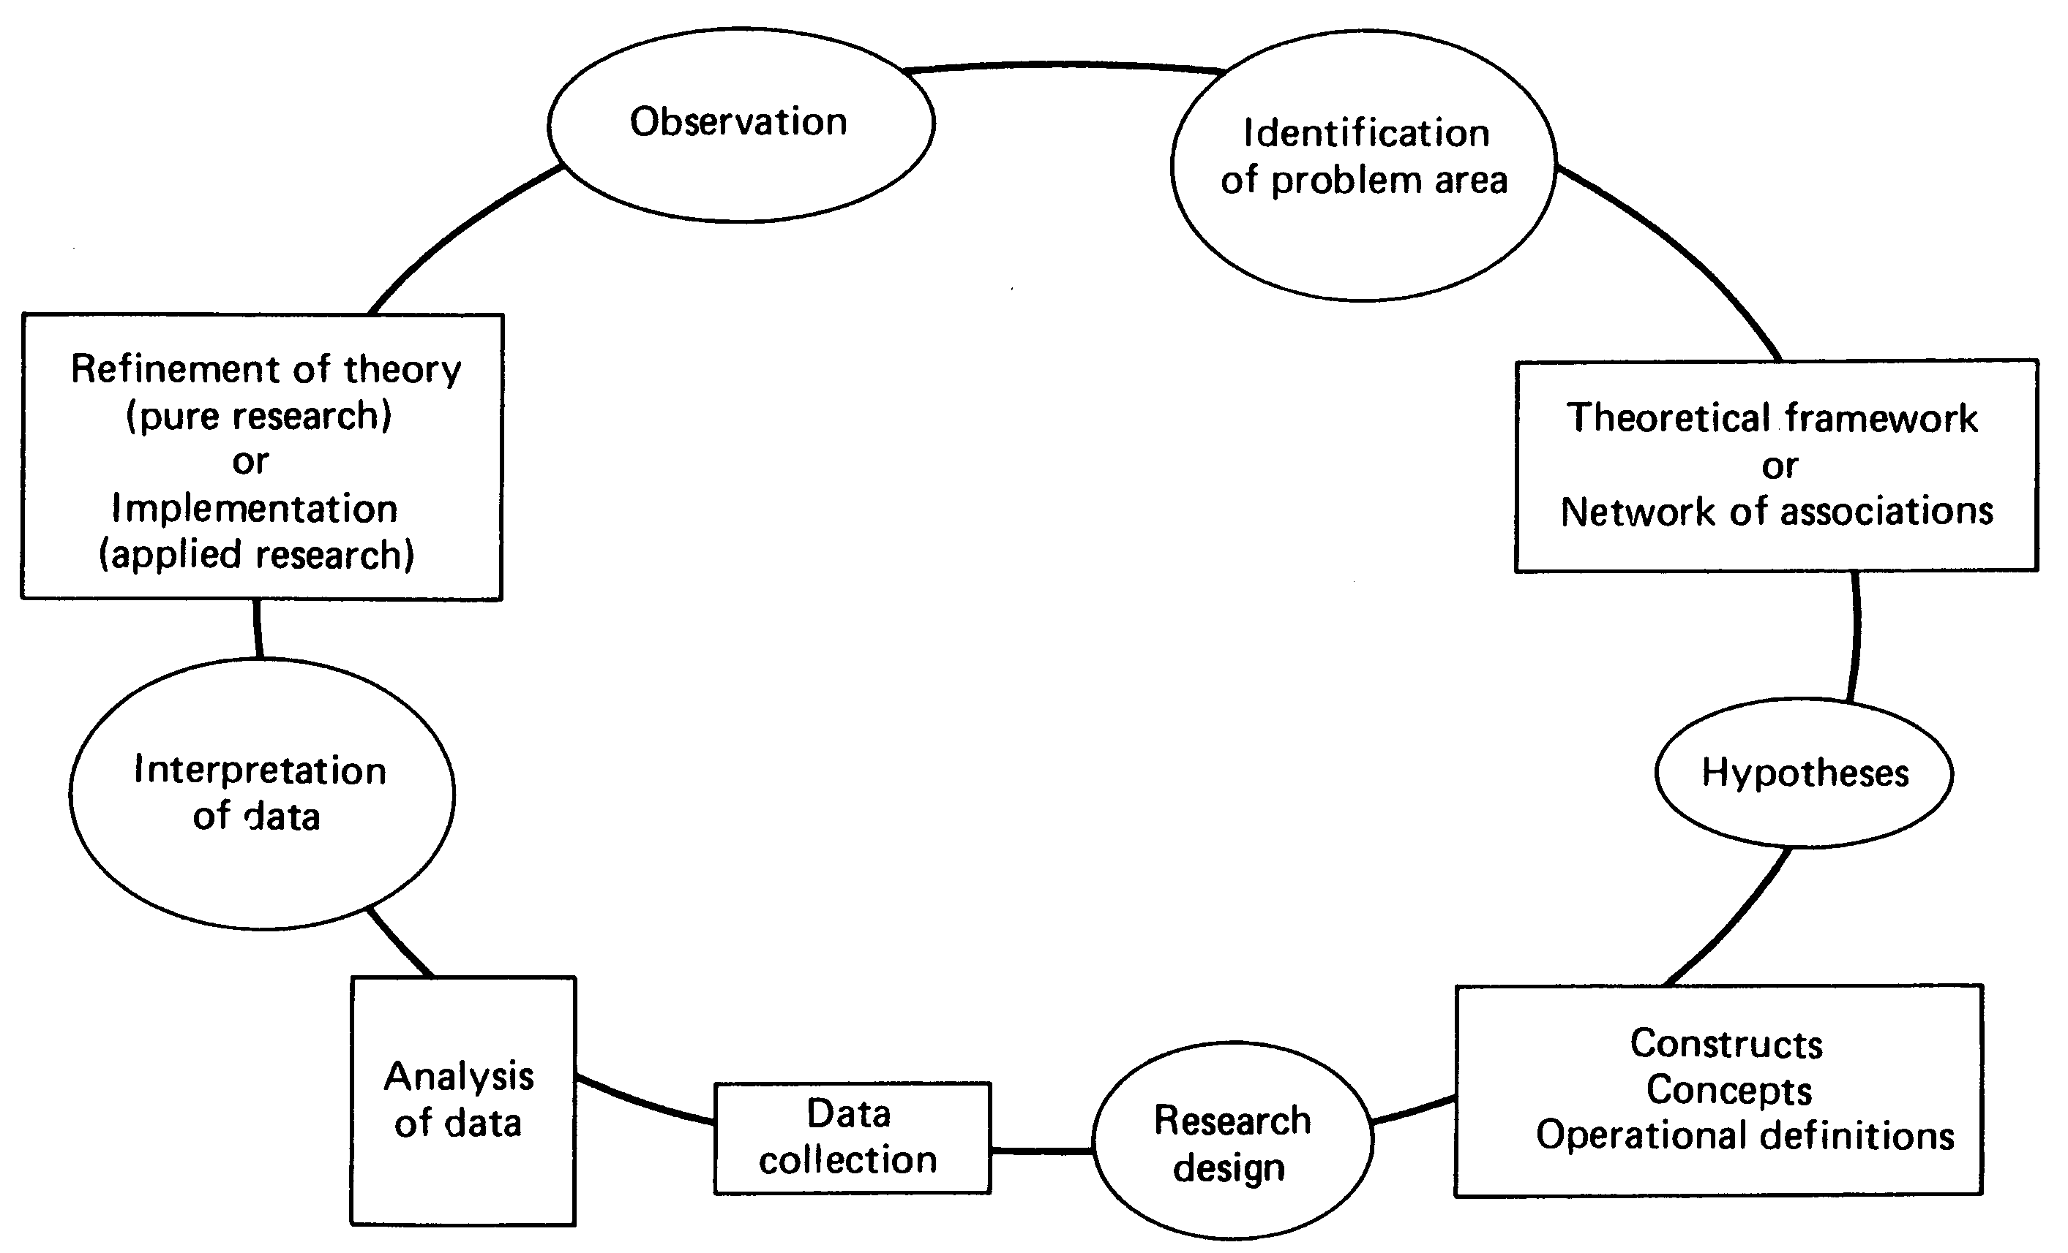
Building Blocks of Scientific Inquiry
Research provides you with the knowledge and skills needed for the fast-paced decision-making environment

Slide 8
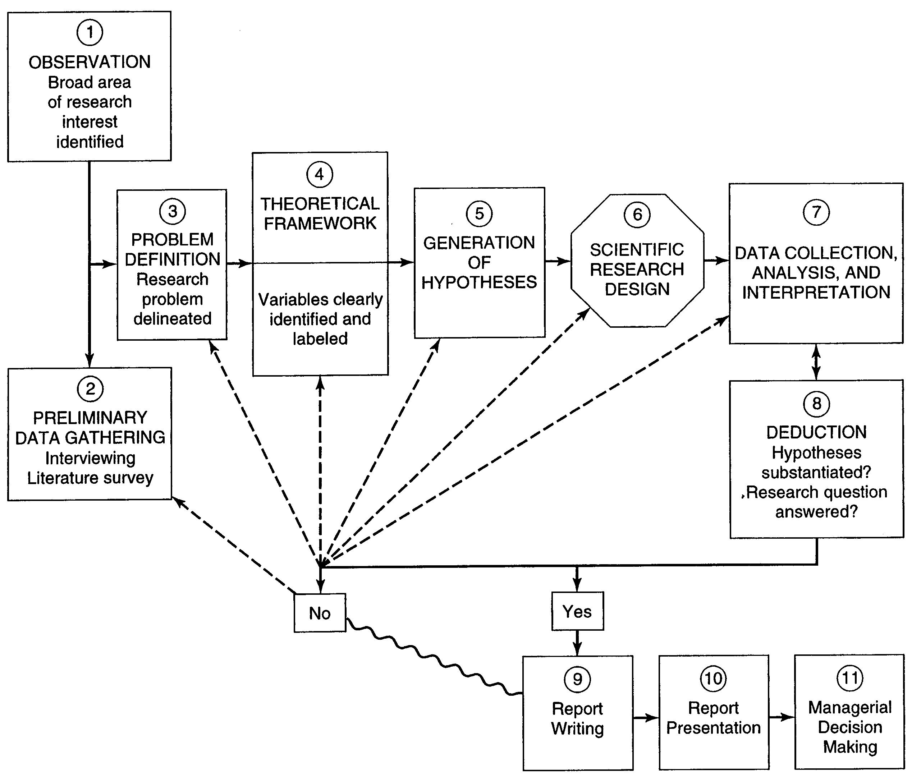
The Research Process

Slide 9
Broad Problem Area (cont..)
Entire Situation
Specific issues may need to be yet not visible
Issues related to
  Problems currently existing in an organization
  Areas where the managers believes can have improvements
  For better understanding of a Phenomena
  Some empirically research needed.

Slide 10
Examples of broad problem areas
Employee behavior, performance, turnover
Location analysis
Brand Loyalty
Portfolio investment , price model
JIT and production efficiency

Slide 11
Preliminary Data Collection
The broad problem area would be narrowed down to specific issues for investigation after some preliminary data are gathered by the researcher. This may take the forms of interviews and library research.
Nature of data collected
  Background info of the org/secondary data
  Managerial policy, philosophy, structural info
  Perception, attitudes and behavioral response of members and clients
  E.g. Production Problem (JIT vs Machine problem)
  Literature survey

Slide 12
Literature Survey
Literature survey is the documentation of a comprehensive review of the published and unpublished work from secondary sources of data in the area of specific interest to the researcher.
Library, books, WWW, magazines, conference proceedings, thesis, government publications, and financial reports.

Slide 13
Why have Literature Survey
A good literature survey ensures that:
  Distinction between symptoms and real problem
  Important variables are identified
  Develop theoretical framework and hypothesis
  Problem statement can be made with more precision.
  Avoid in reinventing the wheel.
  Recognition in the scientific community

Slide 14
Conducting the literature Survey
Identify the relevant sources
Extracting the relevant information
Writing up the literature review
Relevant source
  Bibliographic database (article name, date, author..)
  Abstract Database (all above + summary)
  Full

Slide 15
Extracting the Relevant Information
From the articles extract these following information
  Problem
  Variables
  Sample
  Data collection
  Data analysis
  Results
  Conclusion

Slide 16
Types of Literature Reviews
Quantitative : Provides an understanding of the existing knowledge of the problem and justification for the research questions
Qualitative :Present literature discussion and integrate criticism.
Meta Analysis: Summarizes statistically the results of prior research

Slide 17
Literature review helps outline a logical , well defined and sharply focused problem for the research investigation.

Slide 18
Problem Definition
Any situation where a gap exists between actual and desired status.
A problem could be a interest in a issues where finding the right answer might help to improve the existing situation.

Slide 19
Symptom Problem v.s. Real Problem
We need to be care full that we do not define Symptoms as problems
E.g. Low Productivity… a symptom of low moral
Low Sales (symptom) vs Quality Control (Actual Problem)
Symptom Problem: Decreasing Productivity
  Solution to Symptom is increase in piece rate
Real Problem : Low moral
  Solution to Real Problem : Recognition

Slide 20
Differentiate by asking
Is the factor I have identified is an antecedent
A real problem
Or the consequence
Low productivity, low moral, recognition, pay

Slide 21
Nature of the Problem:
Current exiting problem where a manager is looking for a solution
    Performance is low.
Require Improvement is situation that may not be posing any problem at the present.
    People do not come on time
Conceptual Issue where better definition , better theory building is needed
    Defining performance. (performance vs outcomes)
Empirical where researcher is trying to answer a research question empirically
    Attendance and performance related.

Slide 22
Problem to Question
A research question is a statement that identifies a incident to be studied
Product success effects on the stock market prices.
Does new product success influence stock market price ?

Slide 23
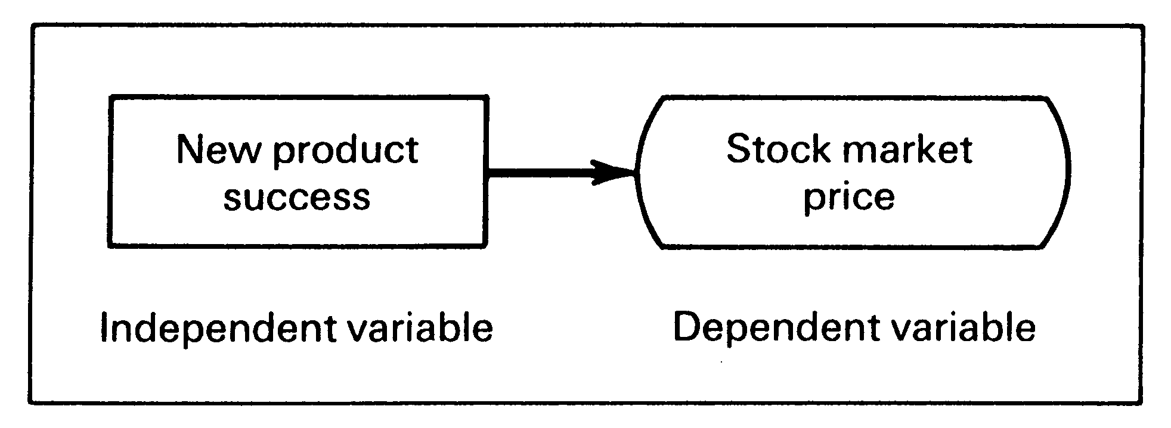
Theoretical Framework
Is conceptual Model of how one theorizes the relationship among the several factors that have been identified as important to the problem.

Slide 24
Objectives for Theoretical Framework
Objectives
  Identify and label variables associated with a given situation
  Trace and establish the links among variables and evolve a framework
  Develop Hypothesis to be tested and state them in the null and alternate

Slide 25
Variables
A variable is anything that can take on different values. The values can differ at various times for the same object or person or the values can differ at the same time for different objects or persons e.g (scores, temperature, motivation)
Types of variables
  Dependent variable
  Independent variable
  Moderating variable
  The intervening variable

Slide 26
Dependent
The dependent variable is the variable which of primary interest to the researcher. The researcher’s goal is to explain or predict the variability in the dependent variable.
E.g. The sales of new product is not as high as expected. The dependent variable is sales c=f(y)
Where c=consumption & y=income
C is the dependent

Slide 27
Independent
An independent variable is one that influences the dependent variable in either a positive or negative way. When the independent variable is present, the dependent variables is also present and with each unit increase in the independent variable, there is increase or decrease in the dependent variable.
C=f(y) here y is independent
New product success -→Stock market price

Slide 28
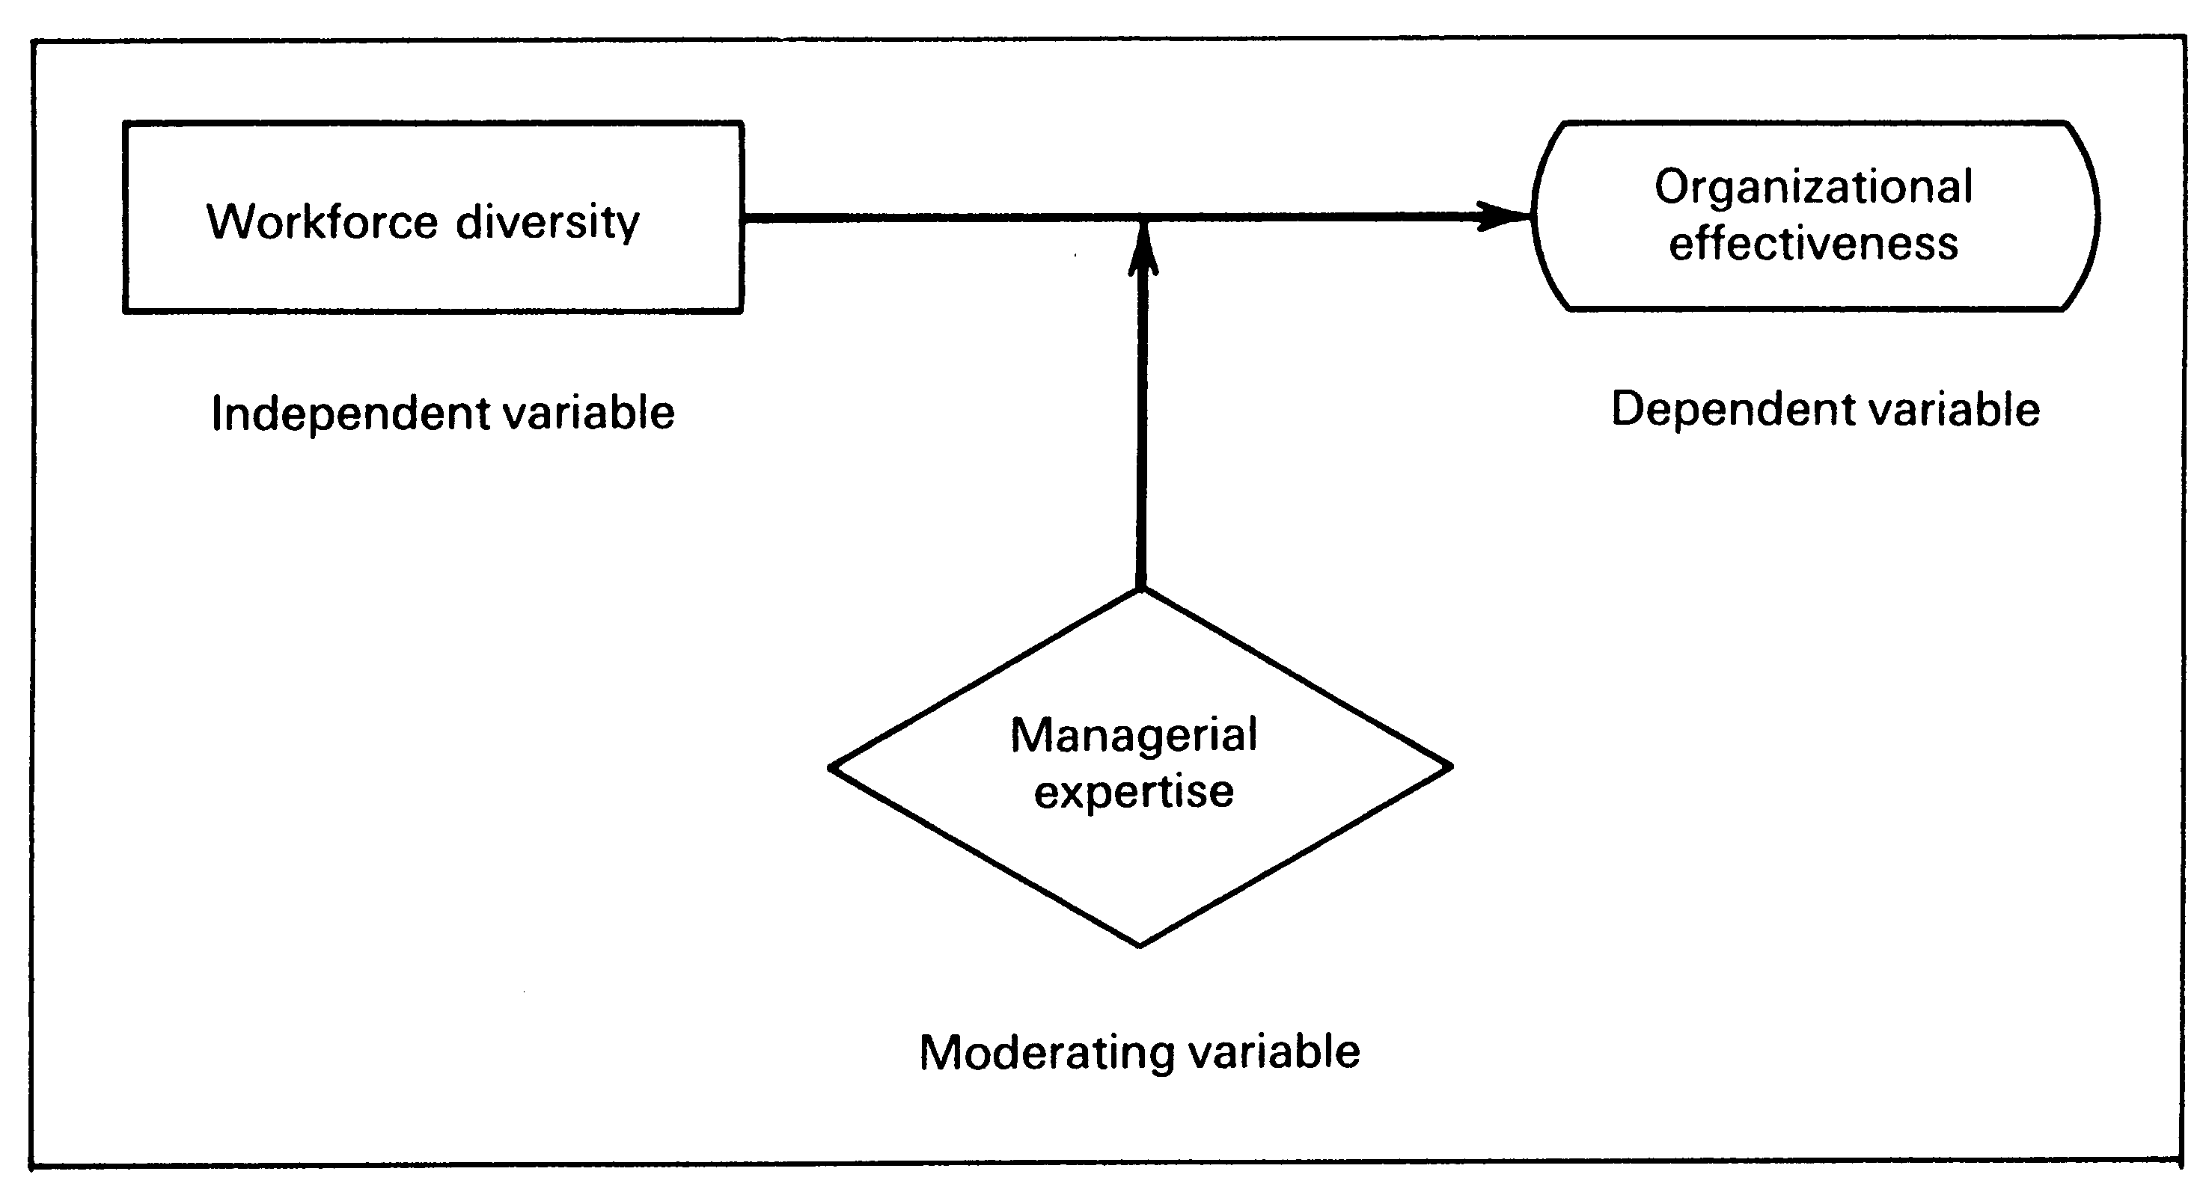
Moderating
Is a variable that has a strong contingent effect on the independent –dependent variable relationship
Does the workforce diversity influence organization effectiveness ?
Does the managerial expertise moderate the relationship?

Slide 29
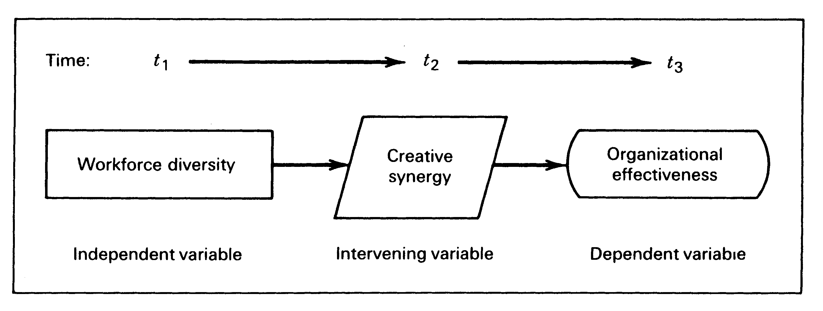
Intervening ( Mediating)
Is a variable that surfaces between the time the independent variable operate to influence the dependent variable and their impact on the dependent variable
Does the workforce creative synergy mediates the relationship?

Slide 30
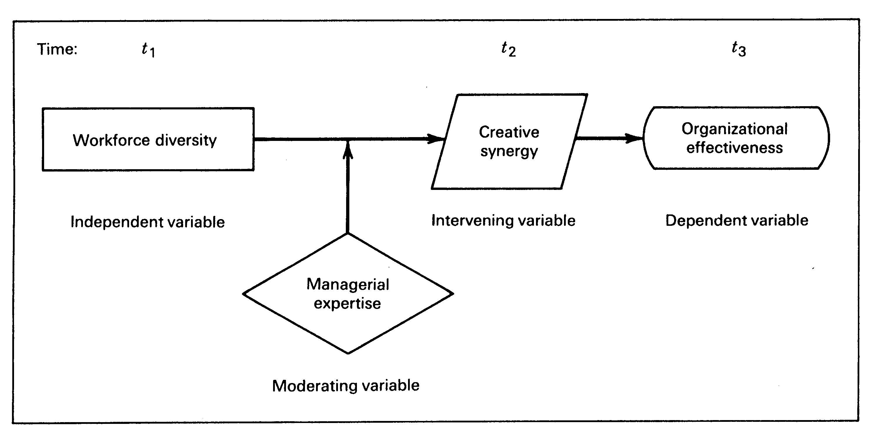

Slide 31
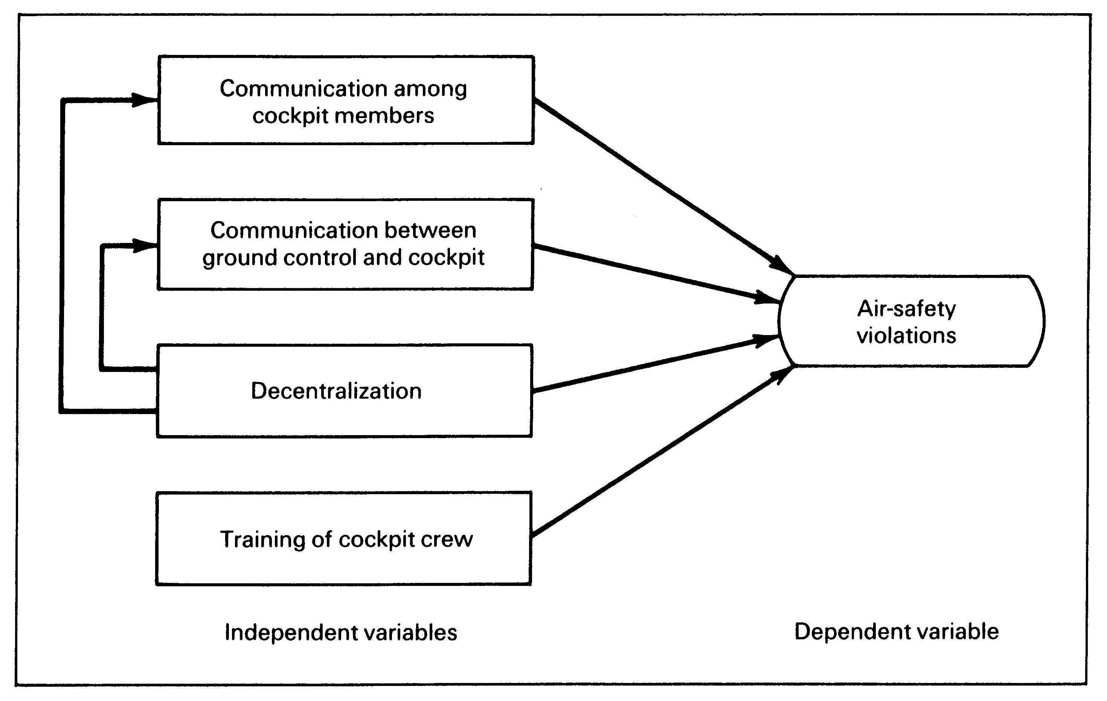

Slide 32
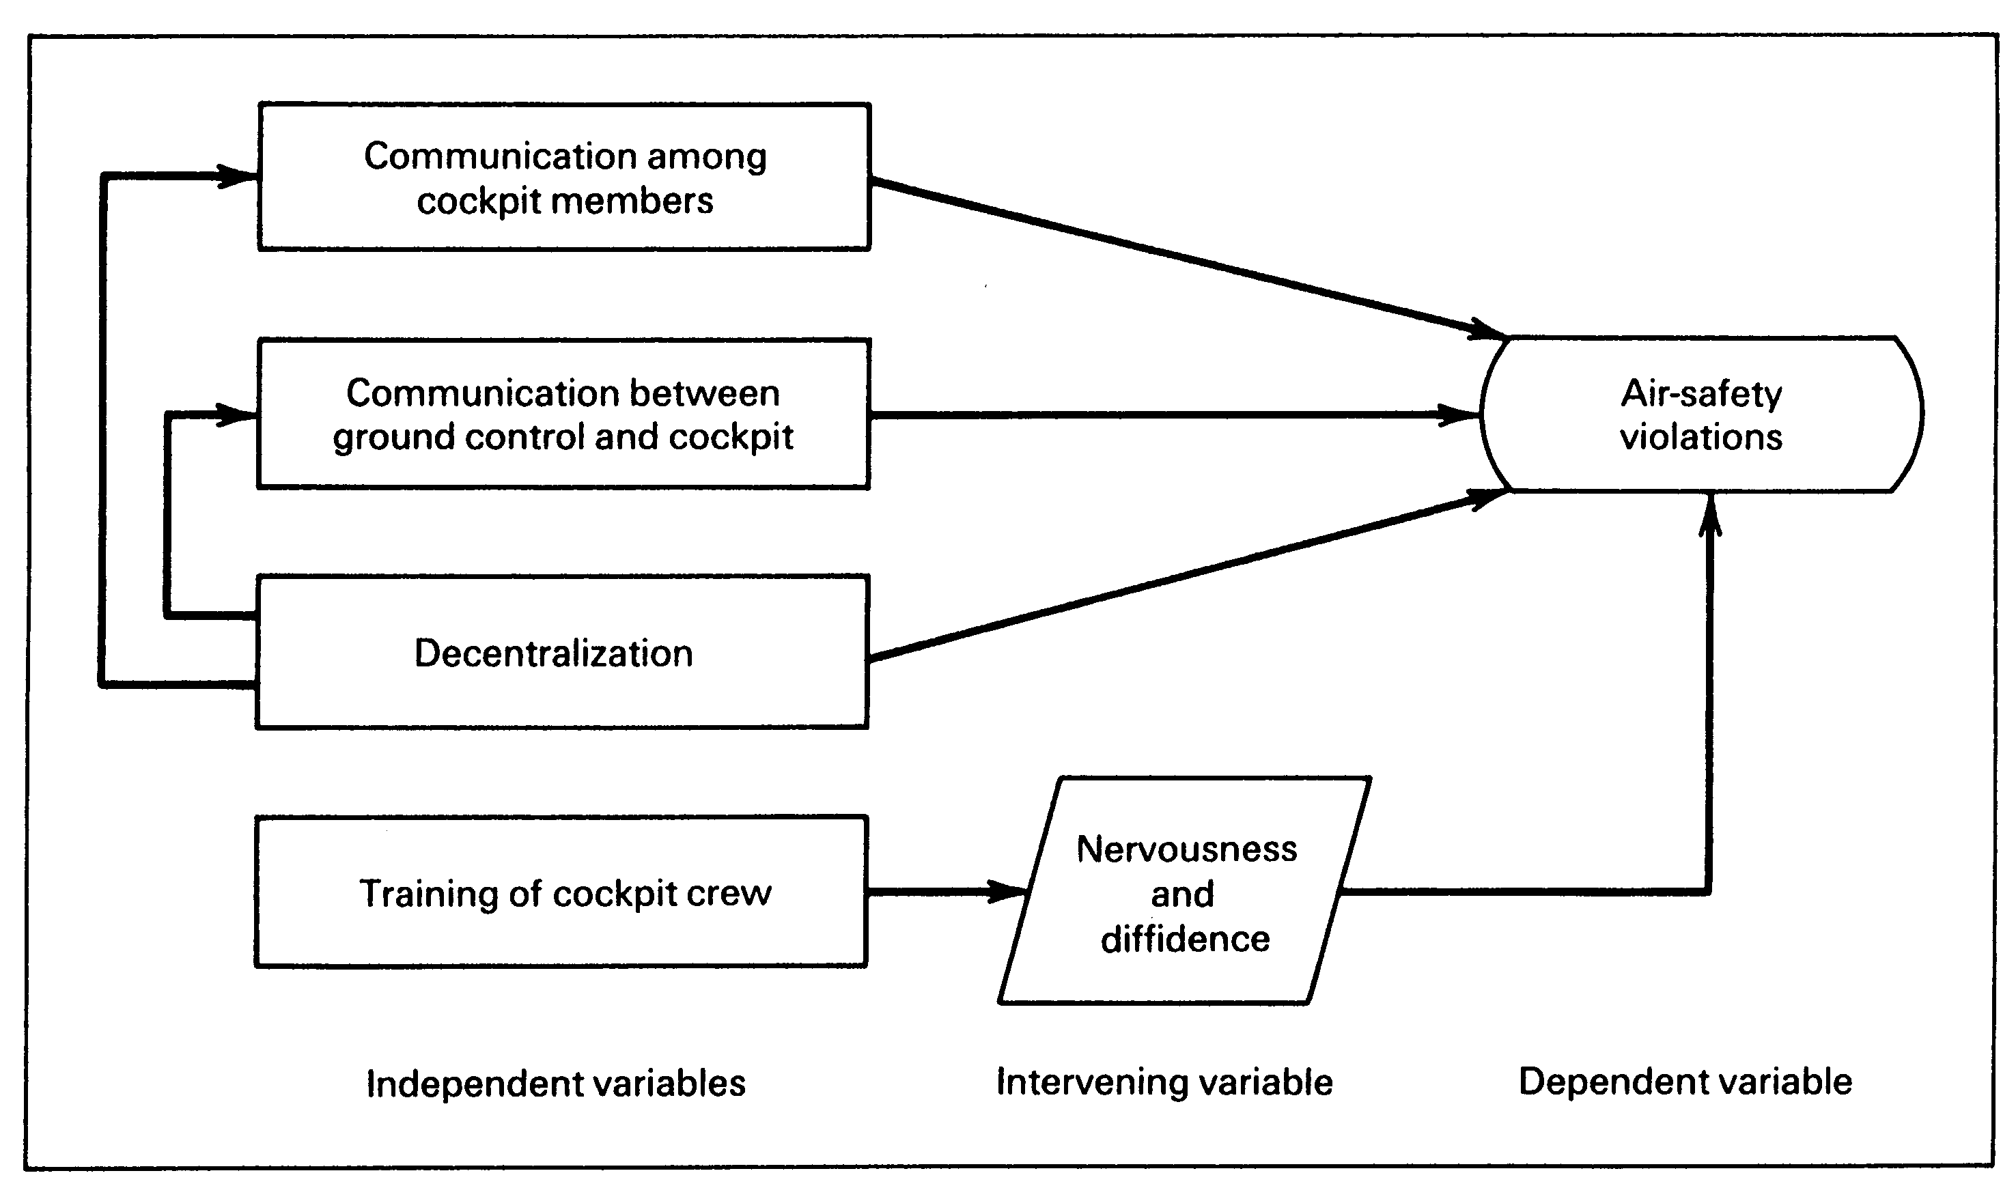

Slide 33
Conclusion
Broad Problem Area
Literature Review
Problem Defining
Theoretical Framework
      Independent
      Dependent
      Moderating
      Intervening/Mediating

