Slide 1
Lecture 15
Basics of Regression Analysis
By
Aziza Munir

Slide 2
What we will be covering
Concept of regression
Linear regression
Methods of calculating regression
Coefficient of regression
Pearson
R square
ANOVA

Slide 3
Regression Introduction
There are many statistical investigations in which the main objective is to determine if a relationship exists between two or more variables, we use mathematical formulas for making predictions. The reliability of any prediction will depend on the strength of the relationship between variables under study.

Slide 4
Linear Regression
A mathematical equation that allow us to predict values of one dependent variable from known values of one or more independent variables is called regression equation.
y=a+bx

Slide 5
Linear Regression
A statistical technique that uses a single, independent variable (X) to estimate a single dependent variable (Y).
Based on the equation for a line:
  Y = b + mX

Slide 6
Linear Regression - Model
Y
? (the actual value of Y_{i})
=
β β
Y_{i}
Y
+
X
0 1
ε
i
X
X_{i}

Slide 7
Linear Regression - Model
Population
Regression Coefficients for a . . .
ˆ
Sample
Y = b₀ + b₁X_{i} + e
ˆ
Y = b₀ + b₁X_{i}

Slide 8
Simple Linear Regression
y’ = b0 + b1X ± є
є
Dependent variable (y)
B1 = slope
= ∆y/ ∆x
b0 (y intercept)
Independent variable (x)
The output of a regression is a function that predicts the dependent variable based upon values of the independent variables.
Simple regression fits a straight line to the data.

Slide 9
Simple Linear Regression
Observation: y
^
Prediction: y
Dependent variable
Zero
Independent variable (x)
The function will make a prediction for each observed data point.
The observation is denoted by y and the prediction is denoted by y.
^

Slide 10
Simple Linear Regression
Prediction error: ε
Observation: y
^
Prediction: y
Zero
For each observation, the variation can be described as:
y = y + ε
Actual = Explained + Error
^

Slide 11
Regression
Dependent variable
Independent variable (x)
A least squares regression selects the line with the lowest total sum of squared prediction errors.
This value is called the Sum of Squares of Error, or SSE.

Slide 12
Calculating SSR
Population mean: y
Dependent variable
Independent variable (x)
The Sum of Squares Regression (SSR) is the sum of the squared differences between the prediction for each observation and the population mean.

Slide 13
Regression Formulas
The Total Sum of Squares (SST) is equal to SSR + SSE.
Mathematically,
SSR = ∑ ( y – y ) (measure of explained variation)
SSE = ∑ ( y – y ) (measure of unexplained variation)
SST = SSR + SSE = ∑ ( y – y ) (measure of total variation in y)
^
2
^
2

Slide 14
The Coefficient of Determination
The proportion of total variation (SST) that is explained by the regression (SSR) is known as the Coefficient of Determination, and is often referred to as R .
R = SSR/SST= SSR\SSR+SSE
The value of R can range between 0 and 1, and the higher its value the more accurate the regression model is. It is often referred to as a percentage.
2
2
2

Slide 15
Scatter plots
Regression analysis requires interval and ratio-level data.
To see if your data fits the models of regression, it is wise to conduct a scatter plot analysis.
The reason?
  Regression analysis assumes a linear relationship. If you have a curvilinear relationship or no relationship, regression analysis is of little use.

Slide 16
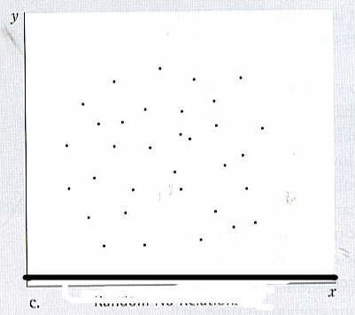
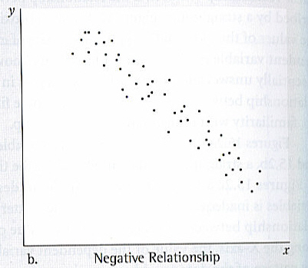
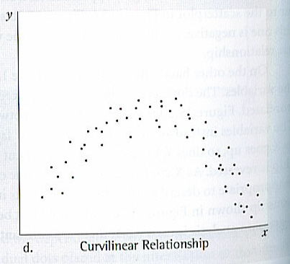
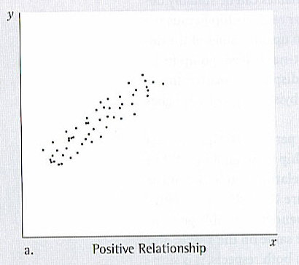
Types of Lines

Slide 17
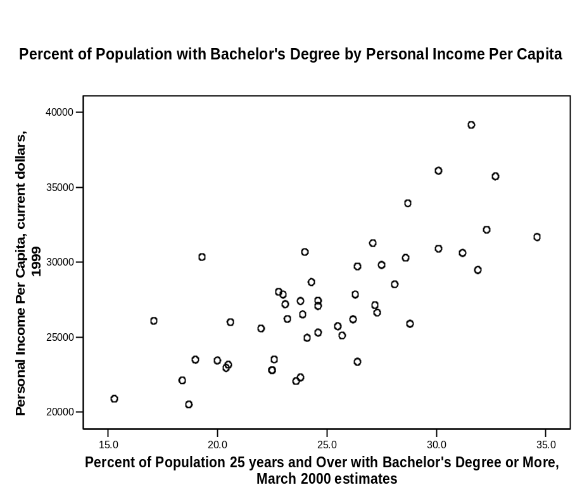
Scatter plot
This is a linear relationship
It is a positive relationship.
As population with BA’s increases so does the personal income per capita.

Slide 18
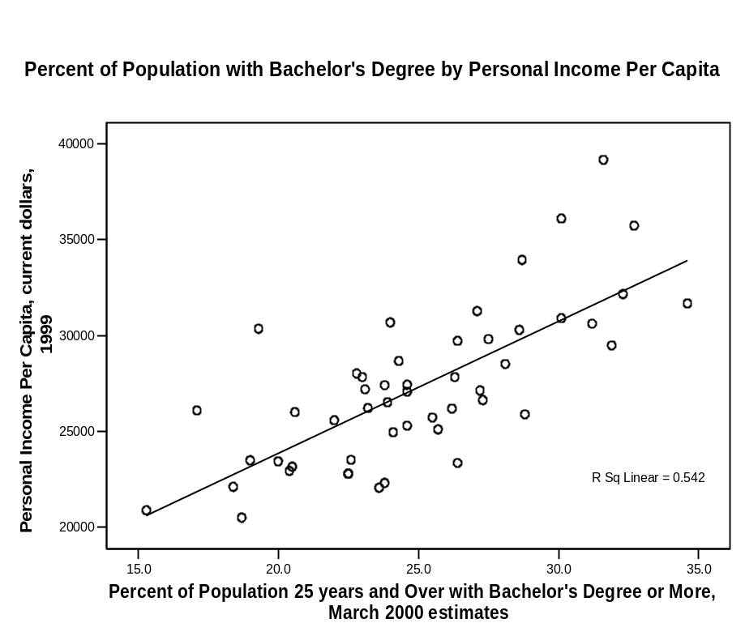
Regression Line
Regression line is the best straight line description of the plotted points and use can use it to describe the association between the variables.
If all the lines fall exactly on the line then the line is 0 and you have a perfect relationship.

Slide 19
Things to remember
Regressions are still focuses on association, not causation.
Association is a necessary prerequisite for inferring causation, but also:
  The independent variable must preceded the dependent variable in time.
  The two variables must be plausibly lined by a theory,
  Competing independent variables must be eliminated.

Slide 20
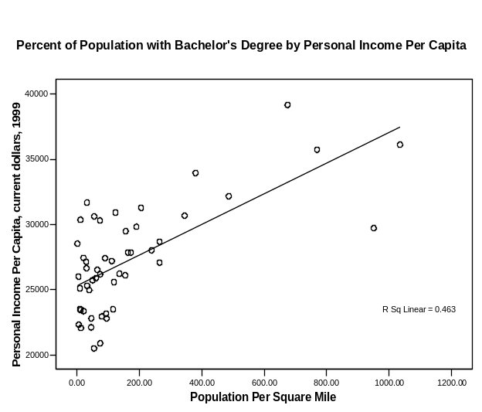
Regression Table
The regression coefficient is not a good indicator for the strength of the relationship.
Two scatter plots with very different dispersions could produce the same regression line.

Slide 21
Regression coefficient
The regression coefficient is the slope of the regression line and tells you what the nature of the relationship between the variables is.
How much change in the independent variables is associated with how much change in the dependent variable.
The larger the regression coefficient the more change.

Slide 22
Pearson’s r
To determine strength you look at how closely the dots are clustered around the line. The more tightly the cases are clustered, the stronger the relationship, while the more distant, the weaker.
Pearson’s r is given a range of -1 to + 1 with 0 being no linear relationship at all.

Slide 23
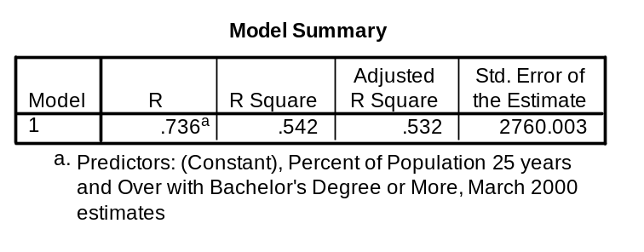
Reading the tables
When you run regression analysis on SPSS you get a 3 tables. Each tells you something about the relationship.
The first is the model summary.
The R is the Pearson Product Moment Correlation Coefficient.
In this case R is .736
R is the square root of R-Squared and is the correlation between the observed and predicted values of dependent variable.

Slide 24
R-Square
R-Square is the proportion of variance in the dependent variable (income per capita) which can be predicted from the independent variable (level of education).
This value indicates that 54.2% of the variance in income can be predicted from the variable education. Note that this is an overall measure of the strength of association, and does not reflect the extent to which any particular independent variable is associated with the dependent variable.
R-Square is also called the coefficient of determination.

Slide 25
Adjusted R-square
As predictors are added to the model, each predictor will explain some of the variance in the dependent variable simply due to chance.
One could continue to add predictors to the model which would continue to improve the ability of the predictors to explain the dependent variable, although some of this increase in R-square would be simply due to chance variation in that particular sample.
The adjusted R-square attempts to yield a more honest value to estimate the R-squared for the population. The value of R-square was .542, while the value of Adjusted R-square was .532. There isn’t much difference because we are dealing with only one variable.
When the number of observations is small and the number of predictors is large, there will be a much greater difference between R-square and adjusted R-square.
By contrast, when the number of observations is very large compared to the number of predictors, the value of R-square and adjusted R-square will be much closer.

Slide 26
Determining the Regression Line/Model
Use Excel (or any other popular statistical software)
  Select Tools, Data Analysis, Regression
  Provide the X range
  Provide the Y range
  Output the analysis to a new sheet
Manual Calculations

Slide 27
Determining the Regression Line/Model using Excel
Notes:
Like in ANOVA, the df for Regression is the number of columns – 1.
Total df is always n-1. That leaves Error/Residual df at n-2.

Slide 28
Determining the Regression Line/Model Manual Calculations
_
_
∧
∧
SSE =∑(Y_{i} - Y_{i} )²
SSR = ∑(Y_{i} - Y)²
SST = ∑(Y_{i} - Y)²
_
SSx =∑(X_{i} - X )²
b₁=SSxy/SSx
_
SSy =∑(Y_{i} - Y)²
_
_
_
_
SSxy =∑(X_{i} - X )(X_{i} - Y )
b₀ = Y – b₁X
MSE = SSE / df
MSR = SSR / df
R² = SSR/SST
=
SSE
S
YX
n-2
t-test = b₁ / S_{b1}

Slide 29
Measures of Model Goodness
R² – Coefficient of Determination
F-test > F-crit or p-value less than alpha
Standard Error
t-test

Slide 30
Hypothesis testing for
Testing to see if the linear relationship between X and Y is significant at the population level.
t-test
Follow the 5-step process
  H₀:
  H_{A}:
  t-crit, alpha or alpha/2, n-2 df

Slide 31
Standard Error Terms in Linear Regression
S_{e} (standard error of the estimate)
A measure of variation around the regression line
  If the S_{e} is small…
  Standard deviation Of the Errors
S_{b1} (standard error of the the sampling distribution of b₁)
Standard deviation of the slopes
A measure of the variation of the slopes from different samples If the S_{b1} is small…our b₁ estimate is probably very accurate
Estimates of …
b₁
b₁
b₁

Slide 32
Standard Error of Regression
The Standard Error of a regression is a measure of its variability. It can be used in a similar manner to standard deviation, allowing for prediction intervals.
y ± 2 standard errors will provide approximately 95% accuracy, and 3 standard errors will provide a 99% confidence interval.
Standard Error is calculated by taking the square root of the average prediction error.
√
SSE
n-k
Standard Error =
Where n is the number of observations in the sample and
k is the total number of variables in the model

Slide 33
The output of a simple regression is the coefficient β and the constant A. The equation is then:
y = A + β * x + ε
where ε is the residual error.
β is the per unit change in the dependent variable for each unit change in the independent variable. Mathematically:
β =
∆ y
∆ x

Slide 34
Multiple Linear Regression
More than one independent variable can be used to explain variance in the dependent variable, as long as they are not linearly related.
A multiple regression takes the form:
y = A + β X + β X + … + β k Xk + ε
where k is the number of variables, or parameters.
1 1 2 2

Slide 35
Linear Regression Example
Petfood, Estimate Sales based on Shelf Space
Two sets of samples, 12 observations each
Perform a Regression Analysis on both sets of data
Sample1
Sample2

Slide 36
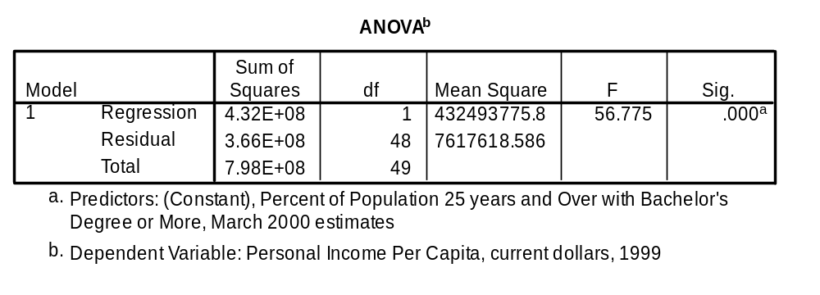
ANOVA
The p-value associated with this F value is very small (0.0000).
These values are used to answer the question "Do the independent variables reliably predict the dependent variable?".
The p-value is compared to your alpha level (typically 0.05) and, if smaller, you can conclude "Yes, the independent variables reliably predict the dependent variable".
If the p-value were greater than 0.05, you would say that the group of independent variables does not show a statistically significant relationship with the dependent variable, or that the group of independent variables does not reliably predict the dependent variable.

Slide 37
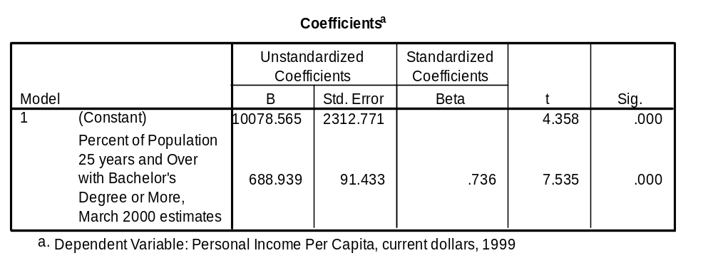
Coefficients
B - These are the values for the regression equation for predicting the dependent variable from the independent variable.
These are called unstandardized coefficients because they are measured in their natural units. As such, the coefficients cannot be compared with one another to determine which one is more influential in the model, because they can be measured on different scales.

Slide 38
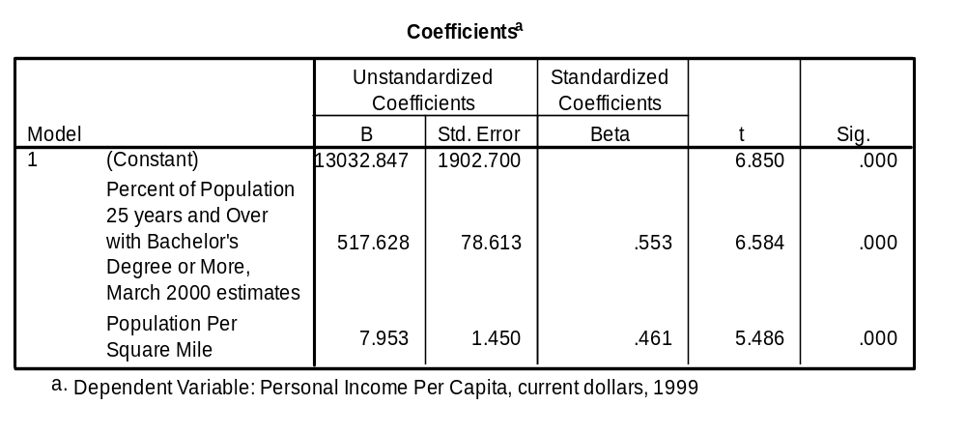
Coefficients
This chart looks at two variables and shows how the different bases affect the B value. That is why you need to look at the standardized Beta to see the differences.

Slide 39
Coefficients
Beta - The are the standardized coefficients.
These are the coefficients that you would obtain if you standardized all of the variables in the regression, including the dependent and all of the independent variables, and ran the regression.
By standardizing the variables before running the regression, you have put all of the variables on the same scale, and you can compare the magnitude of the coefficients to see which one has more of an effect.
You will also notice that the larger betas are associated with the larger t-values.

Slide 40
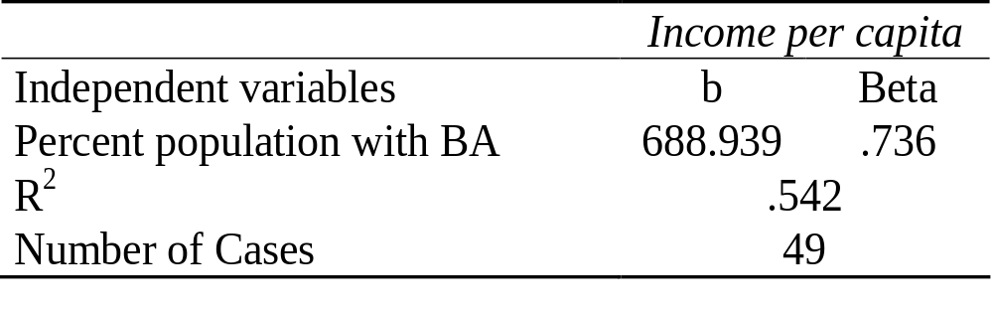
How to translate a typical table
Regression Analysis Level of Education by Income per capita

Slide 41
Part of the Regression Equation
b represents the slope of the line
  It is calculated by dividing the change in the dependent variable by the change in the independent variable.
  The difference between the actual value of Y and the calculated amount is called the residual.
  The represents how much error there is in the prediction of the regression equation for the y value of any individual case as a function of X.

Slide 42
Comparing two variables
Regression analysis is useful for comparing two variables to see whether controlling for other independent variable affects your model.
For the first independent variable, education, the argument is that a more educated populace will have higher-paying jobs, producing a higher level of per capita income in the state.
The second independent variable is included because we expect to find better-paying jobs, and therefore more opportunity for state residents to obtain them, in urban rather than rural areas.

Slide 43
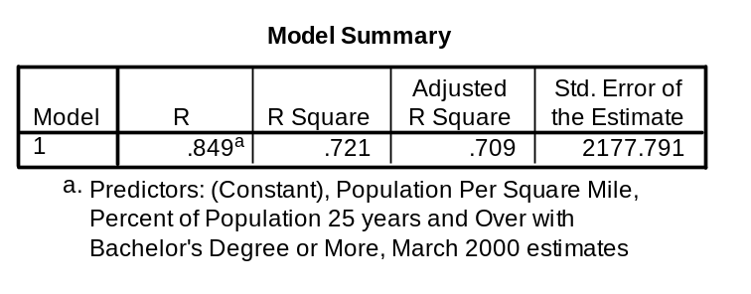
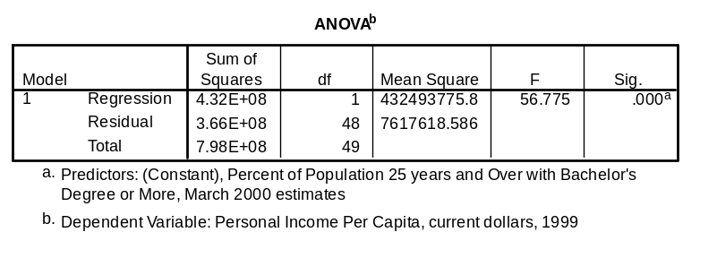
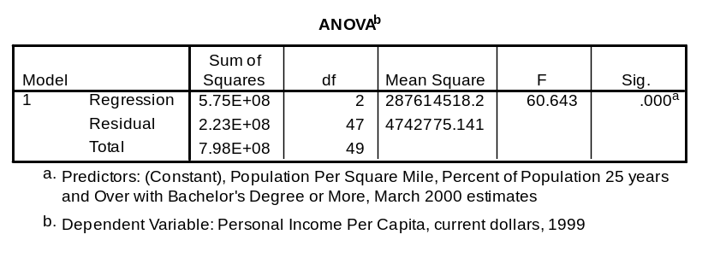


Single
Multiple Regression

Slide 44
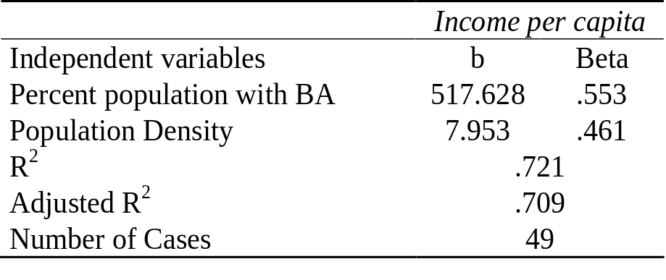
Single Regression
Multiple Regression

