Slide 1
Lecture 13
Statistical Hypothesis
By
Aziza Munir

Slide 2
Learning Objectives
Non statistical hypothesis testing
Statistical hypothesis
Testing a Statistical Hypothesis
Type I and type II errors
One tailed and two tailed tests
Understanding test statistic approach
Interpreting the p value

Slide 3
Nonstatistical Hypothesis Testing…
A criminal trial is an example of hypothesis testing without the statistics.
In a trial a jury must decide between two hypotheses. The null hypothesis is
H₀: The defendant is innocent
The alternative hypothesis or research hypothesis is
H₁: The defendant is guilty
The jury does not know which hypothesis is true. They must make a decision on the basis of evidence presented.

Slide 4
Nonstatistical Hypothesis Testing…
In the language of statistics convicting the defendant is called rejecting the null hypothesis in favor of the alternative hypothesis. That is, the jury is saying that there is enough evidence to conclude that the defendant is guilty (i.e., there is enough evidence to support the alternative hypothesis).
If the jury acquits it is stating that there is not enough evidence to support the alternative hypothesis. Notice that the jury is not saying that the defendant is innocent, only that there is not enough evidence to support the alternative hypothesis. That is why we never say that we accept the null hypothesis, although most people in industry will say “We accept the null hypothesis”

Slide 5
Nonstatistical Hypothesis Testing…
There are two possible errors.
A Type I error occurs when we reject a true null hypothesis. That is, a Type I error occurs when the jury convicts an innocent person. We would want the probability of this type of error [maybe 0.001 – beyond a reasonable doubt] to be very small for a criminal trial where a conviction results in the death penalty, whereas for a civil trial, where conviction might result in someone having to “pay for damages to a wrecked auto”,we would be willing for the probability to be larger [0.49 – preponderance of the evidence ]
P(Type I error) = α [usually 0.05 or 0.01]

Slide 6
Nonstatistical Hypothesis Testing…
A Type II error occurs when we don’t reject a false null hypothesis [accept the null hypothesis]. That occurs when a guilty defendant is acquitted.
In practice, this type of error is by far the most serious mistake we normally make. For example, if we test the hypothesis that the amount of medication in a heart pill is equal to a value which will cure your heart problem and “accept the hull hypothesis that the amount is ok”. Later on we find out that the average amount is WAY too large and people die from “too much medication” [I wish we had rejected the hypothesis and threw the pills in the trash can], it’s too late because we shipped the pills to the public.

Slide 7
Nonstatistical Hypothesis Testing…
The probability of a Type I error is denoted as α (Greek letter alpha). The probability of a type II error is β (Greek letter beta).
The two probabilities are inversely related. Decreasing one increases the other, for a fixed sample size.
In other words, you can’t have α and β both real small for any old sample size. You may have to take a much larger sample size, or in the court example, you need much more evidence.

Slide 8
Types of Errors…
A Type I error occurs when we reject a true null hypothesis (i.e. Reject H₀ when it is TRUE)
A Type II error occurs when we don’t reject a false null hypothesis (i.e. Do NOT reject H₀ when it is FALSE)
H₀ | T | F
Reject | I
Reject |  | II

Slide 9
Nonstatistical Hypothesis Testing…
The critical concepts are theses:
1. There are two hypotheses, the null and the alternative hypotheses.
2. The procedure begins with the assumption that the null hypothesis is true.
3. The goal is to determine whether there is enough evidence to infer that the alternative hypothesis is true, or the null is not likely to be true.
4. There are two possible decisions:
Conclude that there is enough evidence to support the alternative hypothesis. Reject the null.
Conclude that there is not enough evidence to support the alternative hypothesis. Fail to reject the null.

Slide 10
Concepts of Hypothesis Testing (1)…
The two hypotheses are called the null hypothesis and the other the alternative or research hypothesis. The usual notation is:
H₀: — the ‘null’ hypothesis
H₁: — the ‘alternative’ or ‘research’ hypothesis
The null hypothesis (H₀) will always state that the parameter equals the value specified in the alternative hypothesis (H₁)
pronounced
H “nought”

Slide 11


Concepts of Hypothesis Testing…
Consider mean demand for computers during assembly lead time. Rather than estimate the mean demand, our operations manager wants to know whether the mean is different from 350 units. In other words, someone is claiming that the mean time is 350 units and we want to check this claim out to see if it appears reasonable. We can rephrase this request into a test of the hypothesis:
H₀: = 350
Thus, our research hypothesis becomes:
H₁: ≠ 350
Recall that the standard deviation [σ]was assumed to be 75, the sample size [n] was 25, and the sample mean [ ] was calculated to be 370.16

Slide 12
Concepts of Hypothesis Testing…
For example, if we’re trying to decide whether the mean is not equal to 350, a large value of (say, 600) would provide enough evidence.
If is close to 350 (say, 355) we could not say that this provides a great deal of evidence to infer that the population mean is different than 350.

Slide 13
Concepts of Hypothesis Testing (4)…
The two possible decisions that can be made:
Conclude that there is enough evidence to support the alternative hypothesis
(also stated as: reject the null hypothesis in favor of the alternative)
Conclude that there is not enough evidence to support the alternative hypothesis
(also stated as: failing to reject the null hypothesis in favor of the alternative)
NOTE: we do not say that we accept the null hypothesis if a statistician is around…

Slide 14


Concepts of Hypothesis Testing (2)…
The testing procedure begins with the assumption that the null hypothesis is true.
Thus, until we have further statistical evidence, we will assume:
H₀: = 350 (assumed to be TRUE)
The next step will be to determine the sampling distribution of the sample mean assuming the true mean is 350.
is normal with 350
75/SQRT(25) = 15

Slide 15
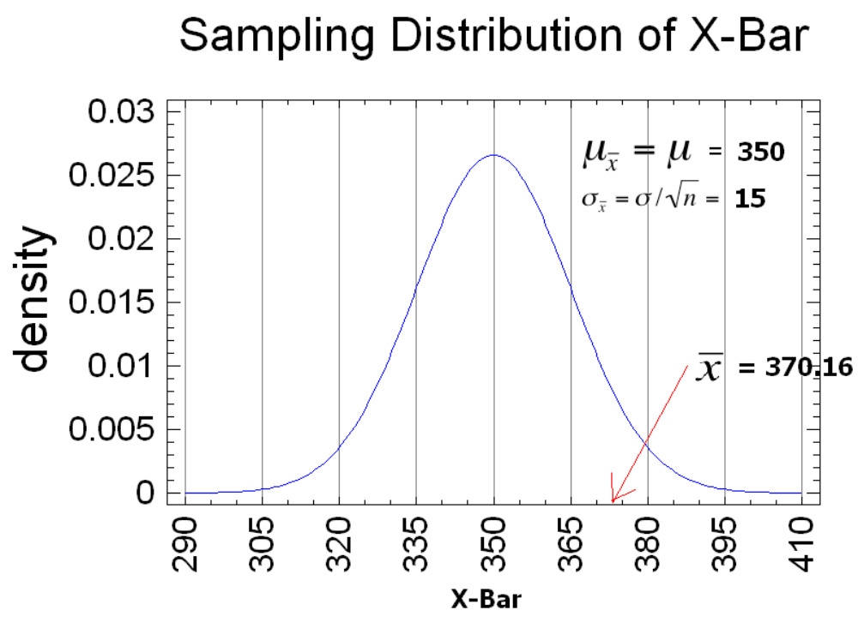
Is the Sample Mean in the Guts of the Sampling Distribution??

Slide 16
Three ways to determine this: First way
Unstandardized test statistic: Is in the guts of the sampling distribution? Depends on what you define as the “guts” of the sampling distribution.
If we define the guts as the center 95% of the distribution [this means α = 0.05], then the critical values that define the guts will be 1.96 standard deviations of X-Bar on either side of the mean of the sampling distribution [350], or
UCV = 350 + 1.96*15 = 350 + 29.4 = 379.4
LCV = 350 – 1.96*15 = 350 – 29.4 = 320.6

Slide 17
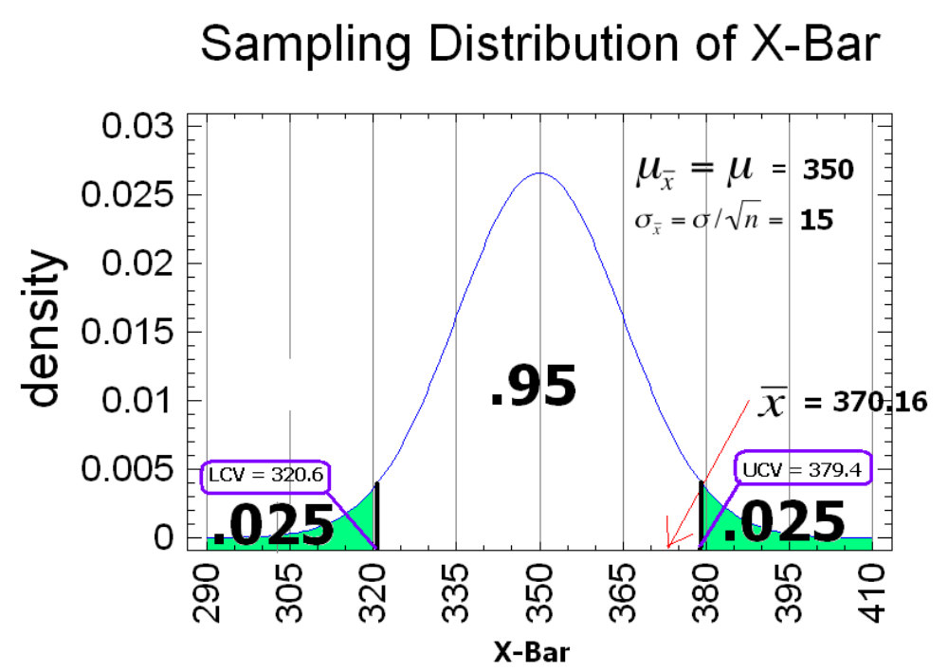
1. Unstandardized Test Statistic Approach

Slide 18

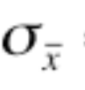
Three ways to determine this: Second way
2. Standardized test statistic: Since we defined the “guts” of the sampling distribution to be the center 95% [α = 0.05],
If the Z-Score for the sample mean is greater than 1.96, we know that will be in the reject region on the right side or
If the Z-Score for the sample mean is less than -1.97, we know that will be in the reject region on the left side.
Z = ( - )/ = (370.16 – 350)/15 = 1.344
Is this Z-Score in the guts of the sampling distribution???

Slide 19
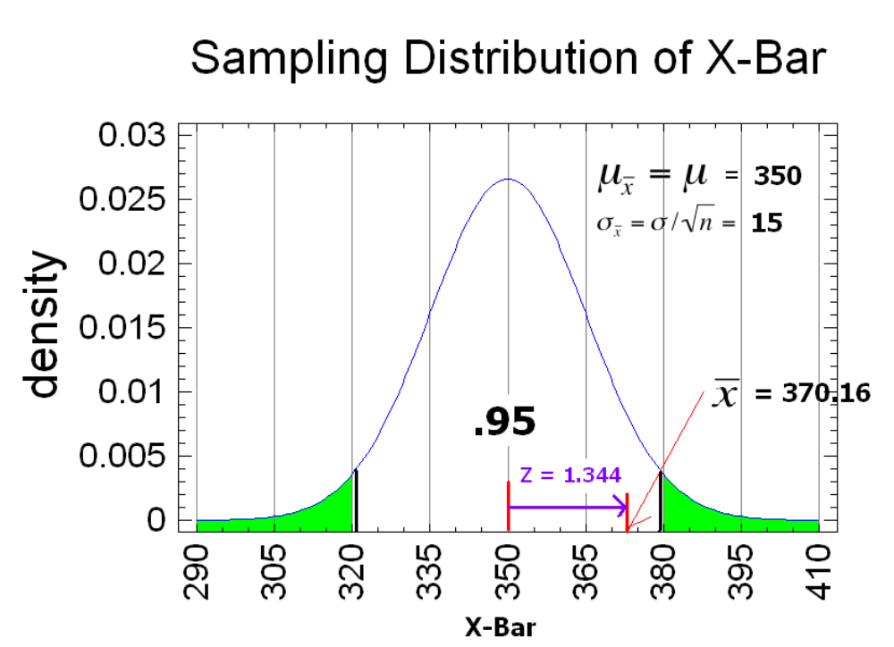
2. Standardized Test Statistic Approach

Slide 20
Three ways to determine this: Third way
3. The p-value approach (which is generally used with a computer and statistical software): Increase the “Rejection Region” until it “captures” the sample mean.
For this example, since is to the right of the mean, calculate
P(Z > 370.16) = P(Z > 1.344) = 0.0901
Since this is a two tailed test, you must double this area for the p-value.
p-value = 2*(0.0901) = 0.1802
Since we defined the guts as the center 95% [α = 0.05], the reject region is the other 5%. Since our sample mean, , is in the 18.02% region, it cannot be in our 5% rejection region [α = 0.05].

Slide 21
α-Level (Used in some situations)
Let α ≡ probability of erroneously rejecting H₀
Set α threshold (e.g., let α = .10, .05, or whatever)
Reject H₀ when P ≤ α
Retain H₀ when P > α
Example: Set α = .10. Find P = 0.27 ⇒ retain H₀
Example: Set α = .01. Find P = .001 ⇒ reject H₀

Slide 22
P-value
The P-value answer the question: What is the probability of the observed test statistic or one more extreme when H₀ is true?
This corresponds to the AUC in the tail of the Standard Normal distribution beyond the z_{stat.}
Convert z statistics to P-value :
  For H_{a}: μ > μ₀ ⇒ P = Pr(Z > z_{stat}) = right-tail beyond z_{stat}
  For H_{a}: μ < μ₀ ⇒ P = Pr(Z < z_{stat}) = left tail beyond z_{stat}
  For H_{a}: μ ≠ μ₀ ⇒ P = 2 × one-tailed P-value
Use Table B or software to find these probabilities (next two slides).

Slide 23
Interpretation
P-value answer the question: What is the probability of the observed test statistic … when H₀ is true?
Thus, smaller and smaller P-values provide stronger and stronger evidence against H₀
Small P-value ⇒ strong evidence

Slide 24
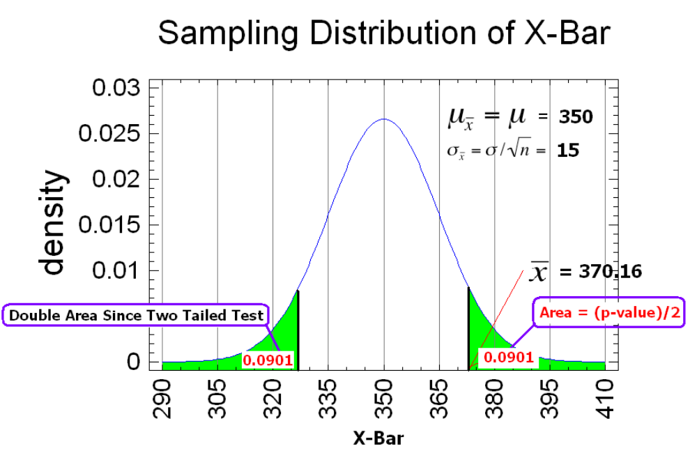
3. p-value approach

Slide 25
Statistical Conclusions:
Unstandardized Test Statistic:
Since LCV (320.6) < (370.16) < UCV (379.4), we reject the null hypothesis at a 5% level of significance.
Standardized Test Statistic:
Since -Z_{α/2}(-1.96) < Z(1.344) < Z_{α/2} (1.96), we fail to reject the null hypothesis at a 5% level of significance.
P-value:
Since p-value (0.1802) > 0.05 [α], we fail to reject the hull hypothesis at a 5% level of significance.

Slide 26
Example
A department store manager determines that a new billing system will be cost-effective only if the mean monthly account is more than $170.
A random sample of 400 monthly accounts is drawn, for which the sample mean is $178. The accounts are approximately normally distributed with a standard deviation of $65.
Can we conclude that the new system will be cost-effective?

Slide 27
Example….
The system will be cost effective if the mean account balance for all customers is greater than $170.
We express this belief as a our research hypothesis, that is:
H₁: > 170 (this is what we want to determine)
Thus, our null hypothesis becomes:
H₀: = 170 (this specifies a single value for the parameter of interest) – Actually H₀: μ < 170

Slide 28


Example ….
What we want to show:
H₁: > 170
H₀: < 170 (we’ll assume this is true)
Normally we put H_{o} first.
We know:
n = 400,
= 178, and
= 65
= 65/SQRT(400) = 3.25
α = 0.05

Slide 29
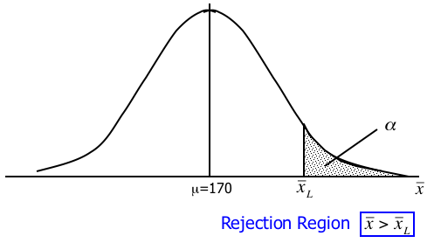

Example … Rejection Region…
The rejection region is a range of values such that if the test statistic falls into that range, we decide to reject the null hypothesis in favor of the alternative hypothesis.
is the critical value of to reject H₀.

Slide 30
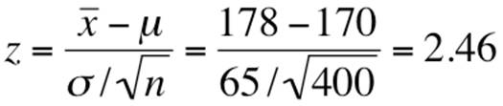
Example 11.1…
At a 5% significance level (i.e. =0.05), we get [all α in one tail]
Z_{α} = Z_{0.05} = 1.645
Therefore, UCV = 170 + 1.645*3.25 = 175.35
Since our sample mean (178) is greater than the critical value we calculated (175.35), we reject the null hypothesis in favor of H₁
OR
(>1.645) Reject null
OR
p-value = P( > 178) = P(Z > 2.46) = 0.0069 < 0.05 Reject null

Slide 31
Example The Big Picture…
H₁: > 170
H₀: = 170
=175.34
=178
Reject H₀ in favor of

Slide 32
Interpreting the p-value…
The smaller the p-value, the more statistical evidence exists to support the alternative hypothesis.
If the p-value is less than 1%, there is overwhelming evidence that supports the alternative hypothesis.
If the p-value is between 1% and 5%, there is a strong evidence that supports the alternative hypothesis.
If the p-value is between 5% and 10% there is a weak evidence that supports the alternative hypothesis.
If the p-value exceeds 10%, there is no evidence that supports the alternative hypothesis.
We observe a p-value of .0069, hence there is overwhelming evidence to support H₁: > 170.

Slide 33
Interpreting the p-value…
Overwhelming Evidence
(Highly Significant)
Strong Evidence
(Significant)
Weak Evidence
(Not Significant)
No Evidence
(Not Significant)
0 .01 .05 .10
p=.0069

Slide 34
Conclusions of a Test of Hypothesis…
If we reject the null hypothesis, we conclude that there is enough evidence to infer that the alternative hypothesis is true.
If we fail to reject the null hypothesis, we conclude that there is not enough statistical evidence to infer that the alternative hypothesis is true. This does not mean that we have proven that the null hypothesis is true!
Keep in mind that committing a Type I error OR a Type II error can be VERY bad depending on the problem.

Slide 35
One tail test with rejection region on right
The last example was a one tail test, because the rejection region is located in only one tail of the sampling distribution:
More correctly, this was an example of a right tail test.
H₁: μ > 170
H₀: μ < 170

Slide 36
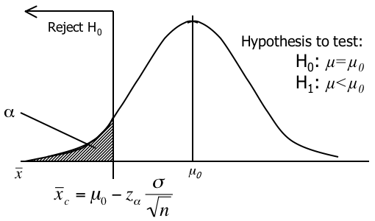
One tail test with rejection region on left
The rejection region will be in the left tail.

Slide 37
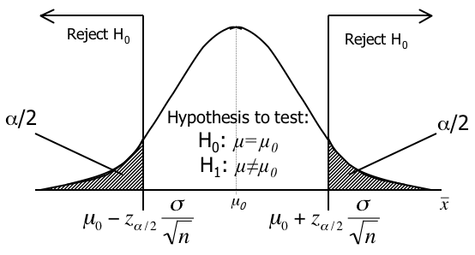
Two tail test with rejection region in both tails
The rejection region is split equally between the two tails.

Slide 38
Example … Students work
AT&T’s argues that its rates are such that customers won’t see a difference in their phone bills between them and their competitors. They calculate the mean and standard deviation for all their customers at $17.09 and $3.87 (respectively). Note: Don’t know the true value for σ, so we estimate σ from the data [σ ~ s = 3.87] – large sample so don’t worry.
They then sample 100 customers at random and recalculate a monthly phone bill based on competitor’s rates.
Our null and alternative hypotheses are
H₁: ≠ 17.09. We do this by assuming that:
H₀: = 17.09

Slide 39
Example 11.2…
The rejection region is set up so we can reject the null hypothesis when the test statistic is large or when it is small.
That is, we set up a two-tail rejection region. The total area in the rejection region must sum to , so we divide α by 2.
stat is “small”
stat is “large”

Slide 40
Example 11.2…
At a 5% significance level (i.e. = .05), we have
/2 = .025. Thus, z_{.025} = 1.96 and our rejection region is:
z < –1.96 -or- z > 1.96
z
-z_{.025}
0
+z_{.025}

Slide 41


Example 11.2…
From the data, we calculate = 17.55
Using our standardized test statistic:
We find that:
Since z = 1.19 is not greater than 1.96, nor less than –1.96 we cannot reject the null hypothesis in favor of H₁. That is “there is insufficient evidence to infer that there is a difference between the bills of AT&T and the competitor.”

Slide 42



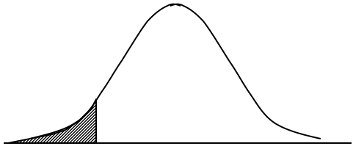
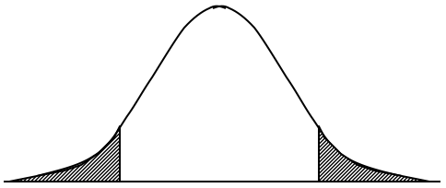
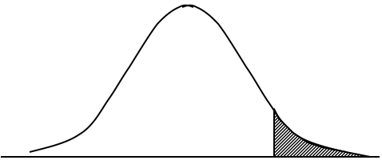
Summary of One- and Two-Tail Tests…
One-Tail Test (left tail) | Two-Tail Test | One-Tail Test (right tail)

Slide 43
Probability of a Type II Error –
A Type II error occurs when a false null hypothesis is not rejected or “you accept the null when it is not true” but don’t say it this way if a statistician is around.
In practice, this is by far the most serious error you can make in most cases, especially in the “quality field”.

Slide 44
Judging the Test…
A statistical test of hypothesis is effectively defined by the significance level ( ) and the sample size (n), both of which are selected by the statistics practitioner.
Therefore, if the probability of a Type II error ( ) is too large [we have insufficient power], we can reduce it by
increasing , and/or
increasing the sample size, n.

Slide 45
Judging the Test…
The power of a test is defined as 1– .
It represents the probability of rejecting the null hypothesis when it is false and the true mean is something other than the null value for the mean.
If we are testing the hypothesis that the average amount of medication in blood pressure pills is equal to 6 mg (which is good), and we “fail to reject” the null hypothesis, ship the pills to patients worldwide, only to find out later that the “true” average amount of medication is really 8 mg and people die, we get in trouble. This occurred because the P(reject the null / true mean = 7 mg) = 0.32 which would mean that we have a 68% chance on not rejecting the null for these BAD pills and shipping to patients worldwide.

Slide 46
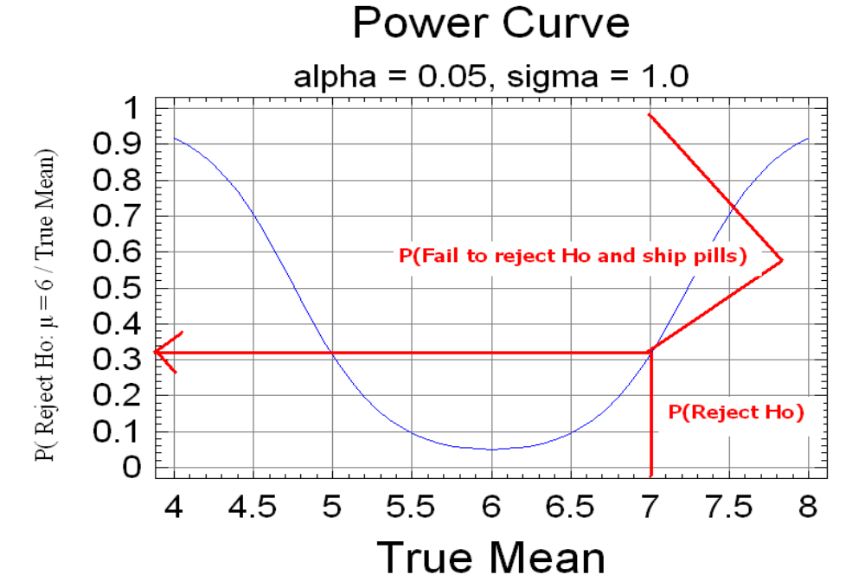
Probability you ship pills whose mean amount of medication is 7 mg approximately 67%

Slide 47
Closing note
Hypothesis testing
Statistical Vs non statistical hypothesis
Methods in testing of hypothesis
P value calculations and interpretations
Type I and type II errors
Applications of these appraoches

