Slide 1
Lecture 7
Introduction to Time Series Analysis
By
Aziza Munir

Slide 2
What we covered in last lecture
Continous distribution
Normal Distribution
Normal approximation to Binomial

Slide 3
Learning Objectives
  Introduction to Time series with practical examples and applications
  the basic time-series models: autoregressive (AR) and moving average (MA) models,
  stationary and nonstationary time series,
  and the Box-Jenkins approach to time-series modeling

Slide 4
Introduction and forecasting
Discrete time series may arise in two ways:
  1- By sampling a continuous time series
  2- By accumulating a variable over a period of time
Characteristics of time series
  Time periods are of equal length
  No missing values

Slide 5
Introduction
Whatever is going on around us are processes occurring in certain systems. Some obvious examples are:
the change of weather (system: Earth atmospehere)
the change of illumination during the day (system: Earth atmospehere)
the daily change in exchange rates (system: financial market)
the change in monthly amount of beer drunk by a certain person (system: person)
In lay terms: process is the change in time of the state of the system.
Note: the state of the same system can be characterized by one or several variables.
Examples:
weather at the current moment can be characterized by air temperature, humidity, wind velocity, atmosphere pressure, etc.
state of the person can be characterized by his/her body temperature, average heart rate, average respiration frequency, blood pressure, appetite, etc.
One may record and observe the change in time of several, or of just one variable characterizing the system state. The recorded dependence of some variable in time
is also called a realization.

Slide 6
Components of a time series

Slide 7
Areas of application
Forecasting
Determination of a transfer function of a system
Design of simple feed-forward and feedback control schemes

Slide 9
Applications towards forecasting
    Economic and business planning
    Inventory and production control
    Control and optimization of industrial processes
Lead time of the forecasts
  is the period over which forecasts are needed
Degree of sophistication
  Simple ideas
    Moving averages
    Simple regression techniques
  Complex statistical concepts
    Box-Jenkins methodology

Slide 10
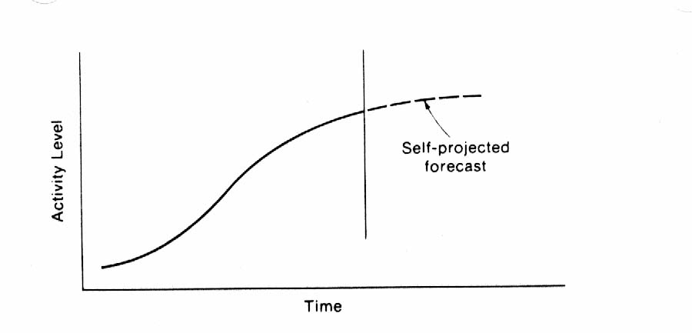
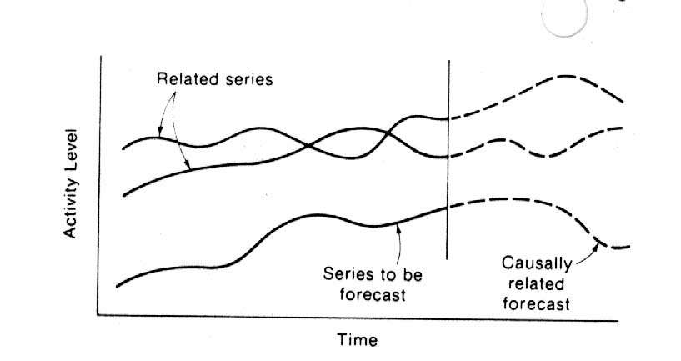
Approaches to forecasting
Self-projecting approach
Cause-and-effect approach

Slide 11
Approaches to forecasting (cont.)
Self-projecting approach
  Advantages
    Quickly and easily applied
    A minimum of data is required
    Reasonably short-to medium-term forecasts
    They provide a basis by which forecasts developed through other models can be measured against
  Disadvantages
    Not useful for forecasting into the far future
    Do not take into account external factors
Cause-and-effect approach
  Advantages
    Bring more information
    More accurate medium-to long-term forecasts
  Disadvantages
    Forecasts of the explanatory time series are required

Slide 12
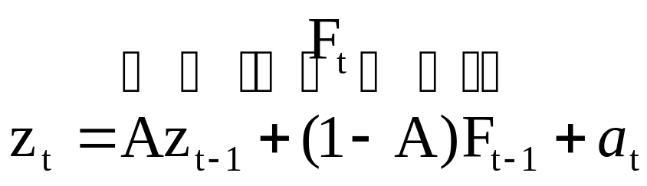
Some traditional self-projecting models
Overall trend models
  The trend could be linear, exponential, parabolic, etc.
  A linear Trend has the form
    Trend_{t} = A + Bt
  Short-term changes are difficult to track
Smoothing models
  Respond to the most recent behavior of the series
  Employ the idea of weighted averages
  They range in the degree of sophistication
  The simple exponential smoothing method:

Slide 13
Some traditional self-projecting models (cont.)
Seasonal models
  Very common
  Most seasonal time series also contain long- and short-term trend patterns
Decomposition models
  The series is decomposed into its separate patterns
  Each pattern is modeled separately

Slide 14
Drawbacks of the use of traditional models
There is no systematic approach for the identification and selection of an appropriate model, and therefore, the identification process is mainly trial-and-error
There is difficulty in verifying the validity of the model
  Most traditional methods were developed from intuitive and practical considerations rather than from a statistical foundation
Too narrow to deal efficiently with all time series

Slide 15
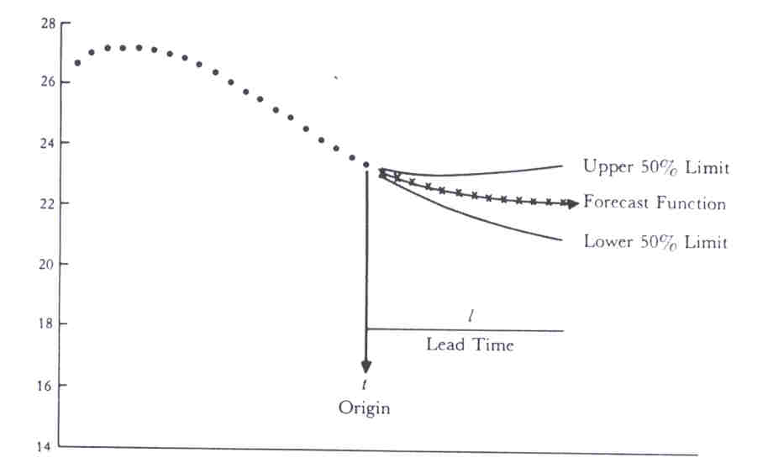
ARIMA models
Autoregressive Integrated Moving-average
Can represent a wide range of time series
A “stochastic” modeling approach that can be used to calculate the probability of a future value lying between two specified limits

Slide 17
ARIMA models (Cont.)
In the 1960’s Box and Jenkins recognized the importance of these models in the area of economic forecasting
“Time series analysis - forecasting and control”
  George E. P. Box Gwilym M. Jenkins
  1st edition was in 1976
Often called The Box-Jenkins approach

Slide 18
The Box-Jenkins model building process
Model identification
Model estimation
Is model adequate ?
No
Modify model
Yes
Forecasts

Slide 19
The Box-Jenkins model building process (cont.)
Model identification
    Autocorrelations
    Partial-autocorrelations
Model estimation
  The objective is to minimize the sum of squares of errors
Model validation
  Certain diagnostics are used to check the validity of the model
Model forecasting
  The estimated model is used to generate forecasts and confidence limits of the forecasts

Slide 20
Important Fundamentals
A Normal process
Stationarity
Regular differencing
Autocorrelations (ACs)
The white noise process
The linear filter model
Invertibility

Slide 21
Stationary stochastic processes
In order to model a time series with the Box-Jenkins approach, the series has to be stationary
In practical terms, the series is stationary if tends to wonder more or less uniformly about some fixed level
In statistical terms, a stationary process is assumed to be in a particular state of statistical equilibrium, i.e., p(x_{t}) is the same for all t

Slide 22
Stationary stochastic processes (cont.)
the process is called “strictly stationary”
  if the joint probability distribution of any m observations made at times t₁, t₂, …, t_{m} is the same as that associated with m observations made at times t_{1 + k}, t_{2 + k}, …, t_{m + k}
When m = 1, the stationarity assumption implies that the probability distribution p(z_{t}) is the same for all times t

Slide 23
Stationary stochastic processes (cont.)
In particular, if z_{t} is a stationary process, then the first difference ∇z_{t} = z_{t} - z_{t-1}and higher differences ∇^{d}z_{t} are stationary
Most time series are nonstationary

Slide 24
Model building blocks
Autoregressive (AR) models
Moving-average (MA) models
Mixed ARMA models
Non stationary models (ARIMA models)
The mean parameter
The trend parameter

Slide 25
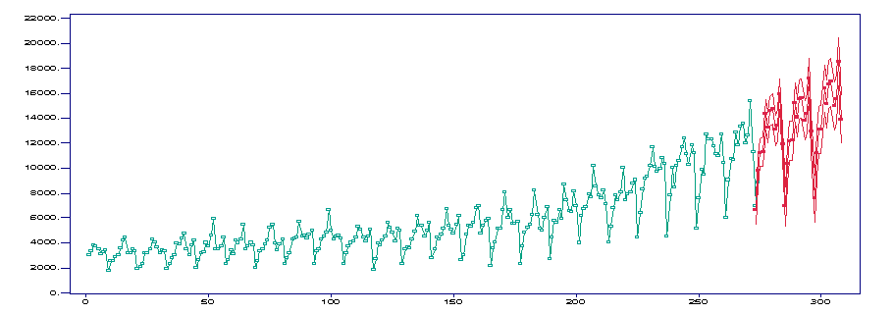
Marketing example: wine sales of a certain company
System: company
State variable: monthly wine sales
months
Data are taken from http://home.vicnet.net.au/~norca/Red_Wine.htm

Slide 26

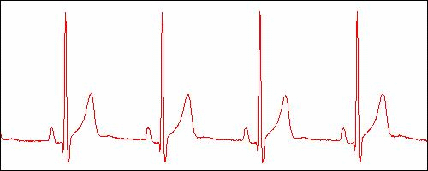
A medical example:
Human Electrocardiogramme (ECG)
System: cardiovascular system of a human
Process: heart beats
State variable: voltage between two points on the human body.
~ 1 sec
voltage
time
Measures electrical activity of a human heart.

Slide 27

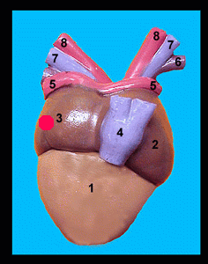
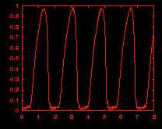
A biological example: position of a point on the surface of Isolated Frog’s Heart
System: frog’s heart
State variable: position of a point on its surface
coordinate
position of this point is recorded
time

Slide 28
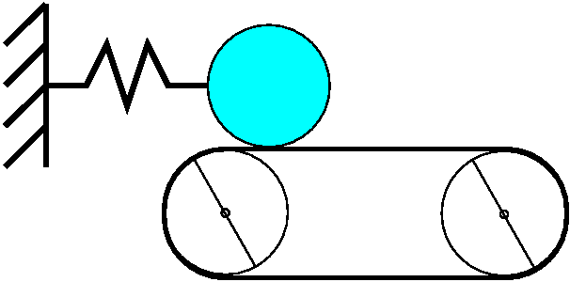
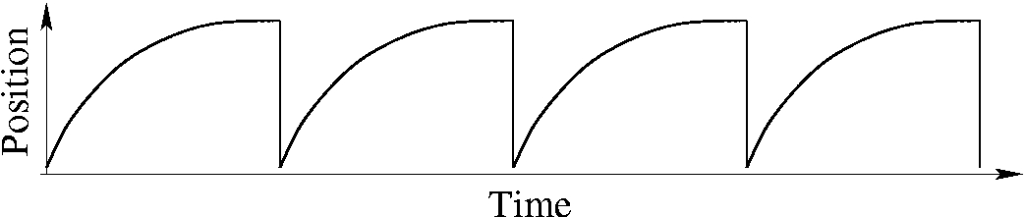
A mechanical example
System: mechanical system
State variable: position of the load

Slide 29
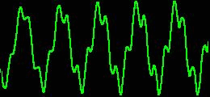
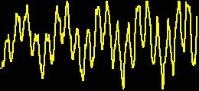
System, Process and Signal
State variable 1
Signals
System
State variable 2

Slide 30
Time Series
Time series: a collection of observations of state variables made sequentially in time.
Univariate (bivariate, multivariate) time series: collection of observations of one
(two, several) state variables, each made at sequential time moments.
Note: the order of observations is important!
Notations
continuous signal a(t) | time series a(t_{i})=a(iΔt)=a_{i}, i=1,2,…,L
sampling step Δt | length of time series L
sampling frequency f_{s}=1/Δt
Synonims:
Time series, (experimental) data, sampled signal, discretized signal
Sampling rate (step), discretization rate (step)
Time Series Analysis, Data Analysis, Signal Processing, Data Processing
Remark:
Mathematically, “time series” is not a SERIES, but a SEQUENCE!

Slide 31
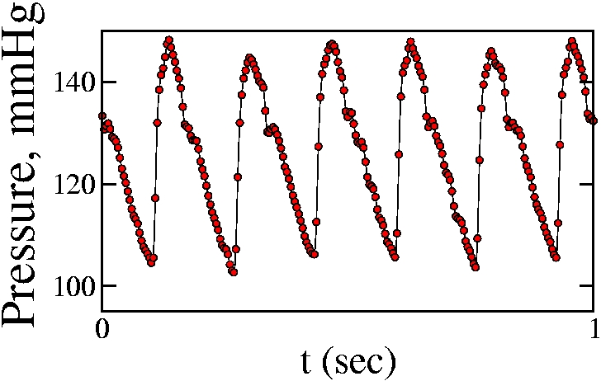
Example of time series: blood pressure of a rat
Pressure, au

Slide 32
Aims of Time Series Analysis
Description
Describe (characterize) a generating process using its time series.
Explanation
If time series is bi- or multi-variate, then it may be possible to use variations in one
variable to explain the variations in another variable.
Prediction (forecasting)
Use the knowledge of the past of the time series to predict its future.
Control
To change deliberately the properties of the process by influencing it and
observing the changes introduced by our intervention. One can then learn to make
the needed effort to achive control.

Slide 33
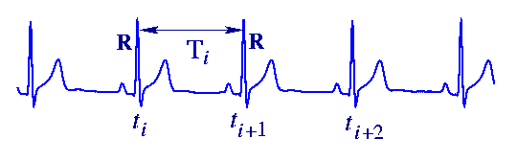
Example of description
Assume the time series shows the tendency to repeat itself with
some accuracy. ECG shows a sign of periodicity.
Then one can assume that the process is inherently rhythmic, and can estimate
the average or most probable rhythm in it.
The average rhythm of heartbeats can be estimated from estimating the
rhythm of ECG.
For information:
Average heart rate of a healthy
Human is ~ 1 sec.

Slide 34
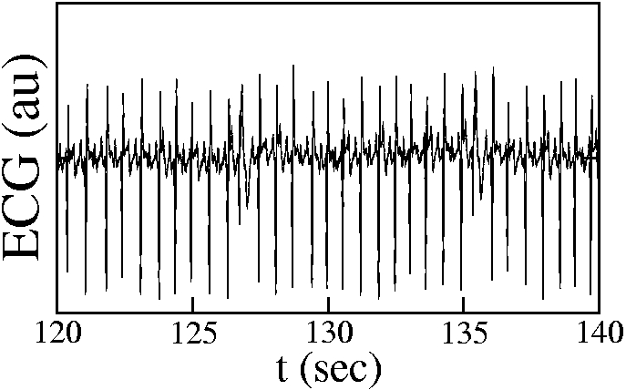
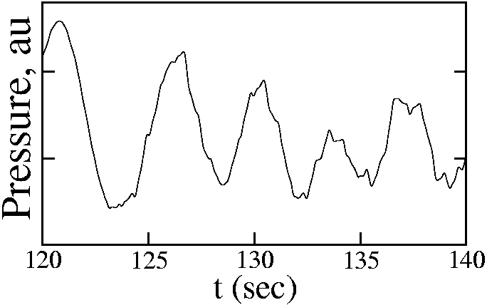
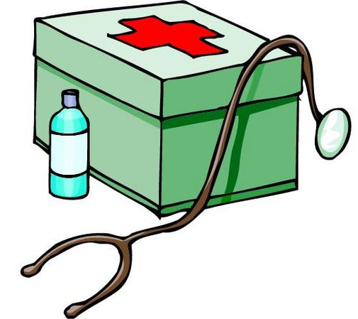
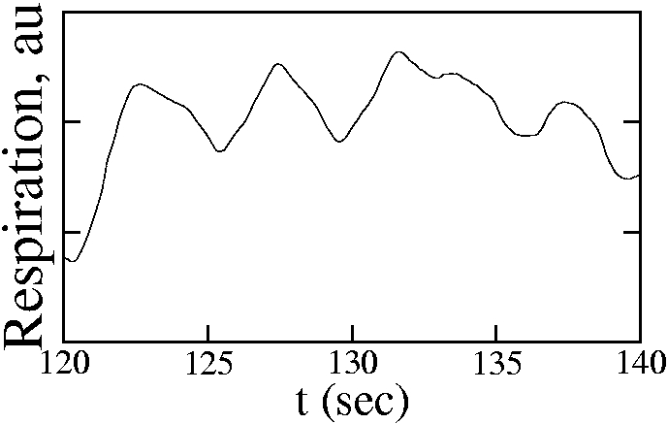
Example of explanation
Three signals are
measured
from the same ill human
simultaneously:
Electrocardiogramme
(ECG),
pressure, respiration.
Floating of average
level of ECG and
especially of pressure
are caused by breathing.

Slide 35




Example of prediction
Weather forecast
A lot of experimental data are measured during a certain time interval.
The data are being analysed, the tendencies are being revealed.
From what is available by the current moment the future weather is predicted.

Slide 36

Example of control 1
Balancing a tray.

Slide 37

Example of control 2
A sailing boat is being navigated in windy weather. It needs to go in the
particular direction, and this direction is governed by the angle between the wind
and the sail. The wind is occasionally changing its direction. The sailor
needs to adjust the angle between the sail and the wind in such a way that the
direction of motion is kept as constant as possible.
System: atmosphere interacting with the sail
Process: change of the direction of sail
Signal: angle between the sail and the wind.

Slide 38


Example of control 3
Imagine rainy, windy weather, and the wind changes its direction all the time.
A girl is holding an umbrella. In order to protect the umbrella from breaking, its roof should be held perpendicular to wind.
System: atmosphere interacting with the umbrella
Process: changing of the direction of the wind
The girl’s brain “measures” (without perhaps the girl realizing it) the angle between the stick of umbrella and the wind.
Signal: the angle α between the umbrella stick and
the wind
If this angle α deviates from zero, the girl turns the
umbrella in order to reduce angle α to zero.

Slide 39
How time series can arise
Given a continuous signal, one can sample its values at equal time intervals.
Example: sampled human electrocardiogramme
2. The value of the state variable aggregates (accumulates) during some time interval.
Example: daily rainfall
Some processes are inherently discrete.
Example: trains arriving to the station at discrete time moments
Kinds of processes
Random (stochastic) process
Deterministic process
Mixed

Slide 40
Summary

Slide 41
Preamble of next lecture
Sample and sampling distribution

