Slide 1
Lecture 6
Normal Distribution
By
Aziza Munir

Slide 2
Summary of last lecture
Uniform discrete distribution
Binomial Distribution
Mean and Variance of binomial disrribution

Slide 3
Learning Objectives
Continuous distribution
The normal distribution
A check for normality
Application of the normal distribution
Normal approximation to Binomial

Slide 4
Continuous Distribution
For a discrete distribution, for example
Binomial distribution with n=5, and p=0.4, the probability distribution is
x 0 1 2 3 4 5
f(x) 0.07776 0.2592 0.3456 0.2304 0.0768 0.01024

Slide 5
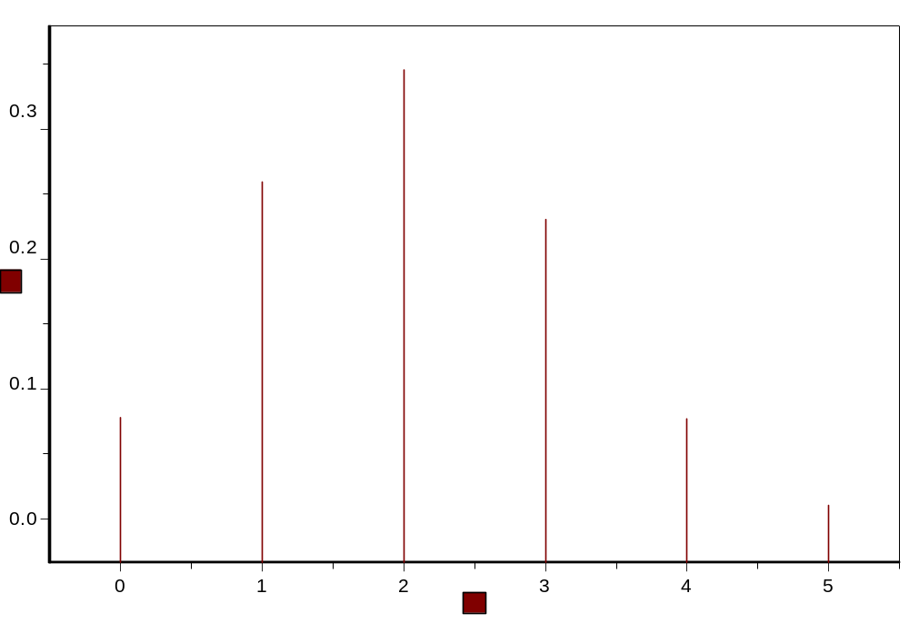
A probability histogram
P(x)
x

Slide 6
Continuous random variable
For continuous random variable, we also represent probabilities by areas—not by areas of rectangles, but by areas under continuous curves.
For continuous random variables, the place of histograms will be taken by continuous curves.
Imagine a histogram with narrower and narrower classes. Then we can get a curve by joining the top of the rectangles. This continuous curve is called a probability density (or probability distribution).

Slide 7
Continuous distributions
For any x, P(X=x)=0. (For a continuous distribution, the area under a point is 0.)
Can’t use P(X=x) to describe the probability distribution of X
Instead, consider P(a≤X≤b)

Slide 8
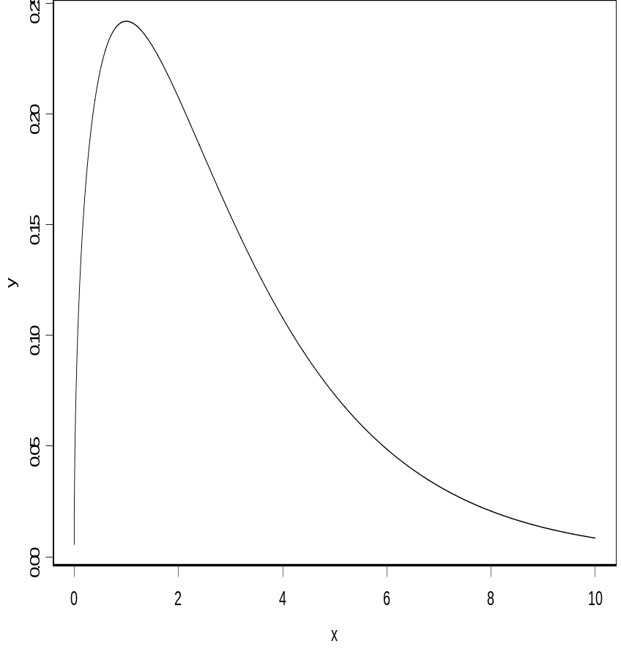
Density function
A curve f(x):
f(x) ≥ 0
The area under the curve is 1
P(a≤X≤b) is the area between a and b

Slide 9
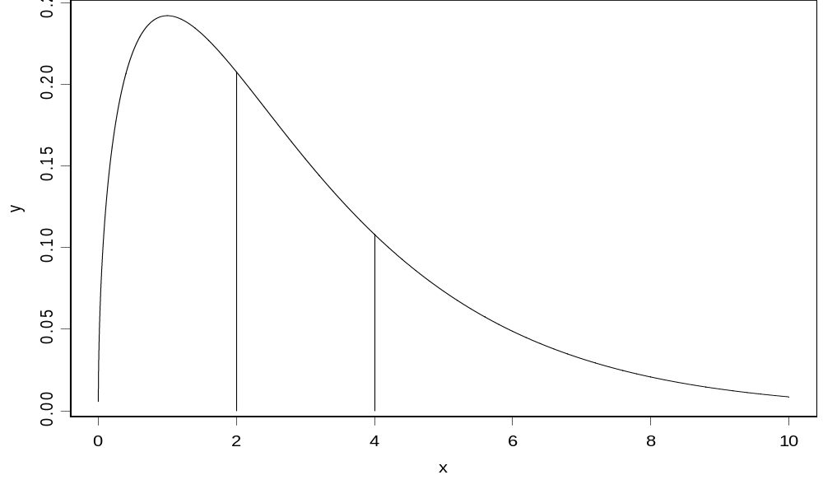
P(2≤X≤4)= P(2≤X<4)= P(2<X<4)

Slide 10
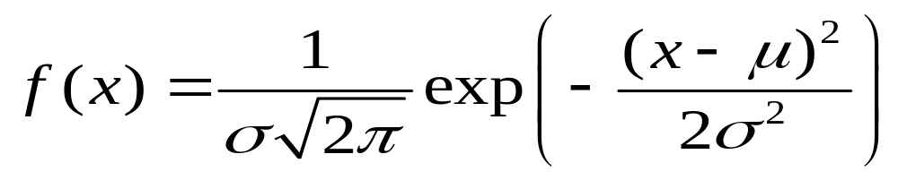
The normal distribution
A normal curve: Bell shaped
Density is given by
μand σ² are two parameters: mean and variance of a normal population
(σ is the standard deviation)

Slide 11
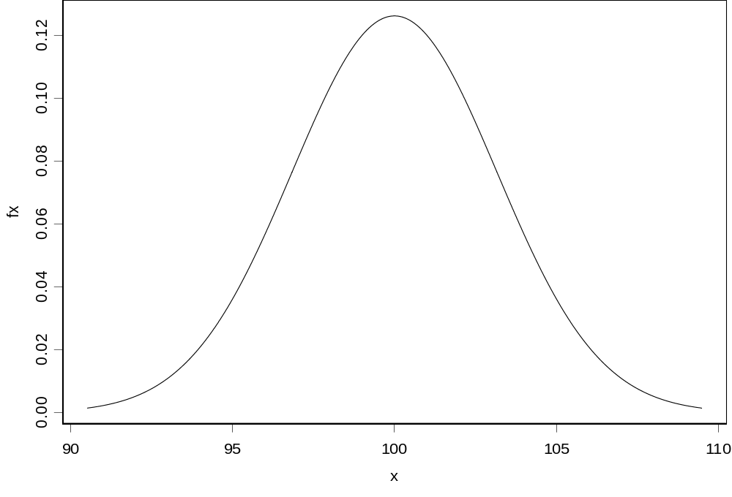
The normal—Bell shaped curve: μ=100, σ²=10

Slide 12
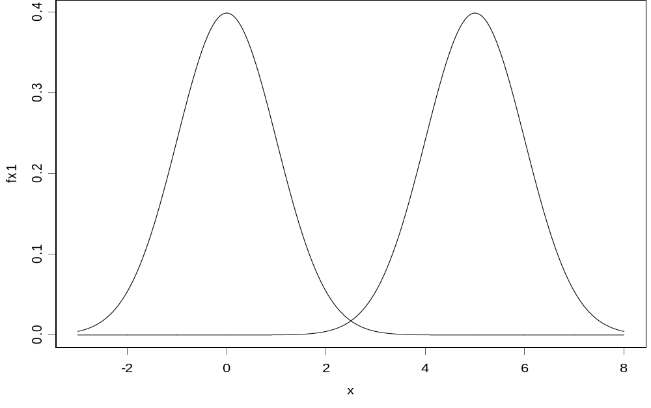
Normal curves:
(μ=0, σ²=1) and (μ=5, σ ²=1)

Slide 13
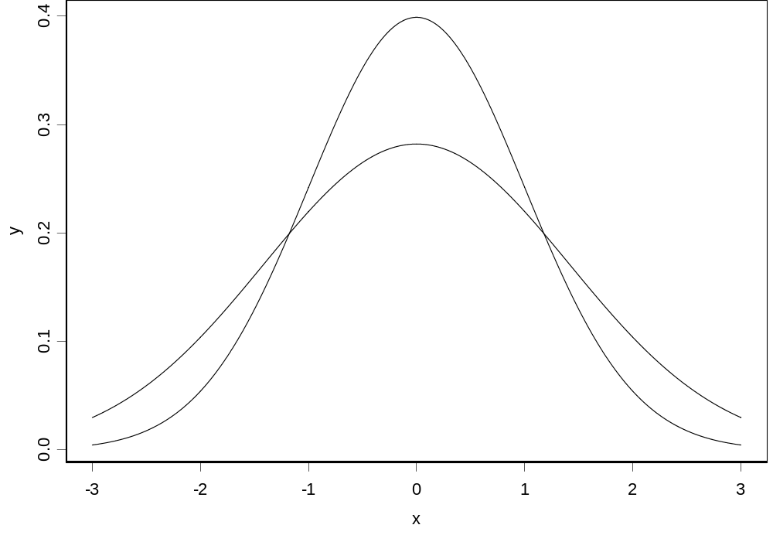
Normal curves:
(μ=0, σ²=1) and (μ=0, σ²=2)

Slide 14
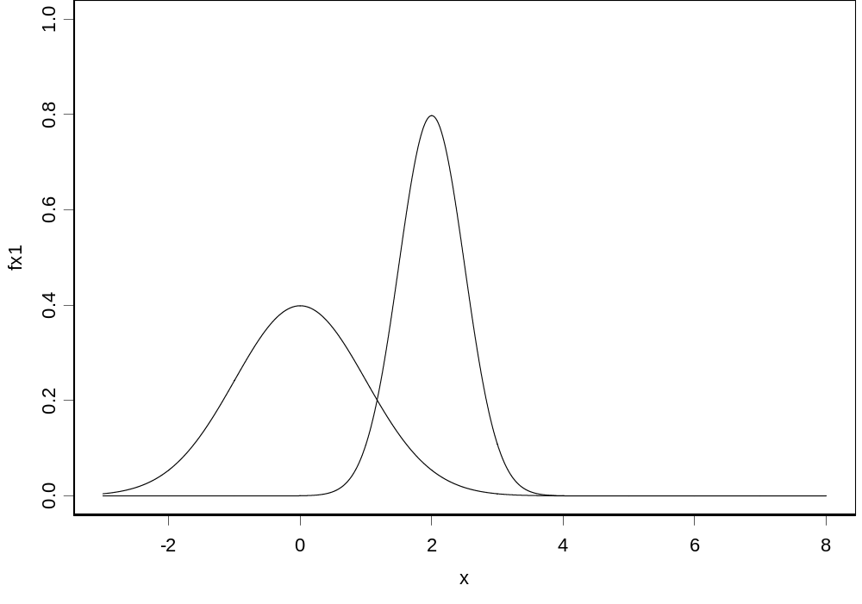
Normal curves:
(μ=0, σ²=1) and (μ=2, σ²=0.25)

Slide 15
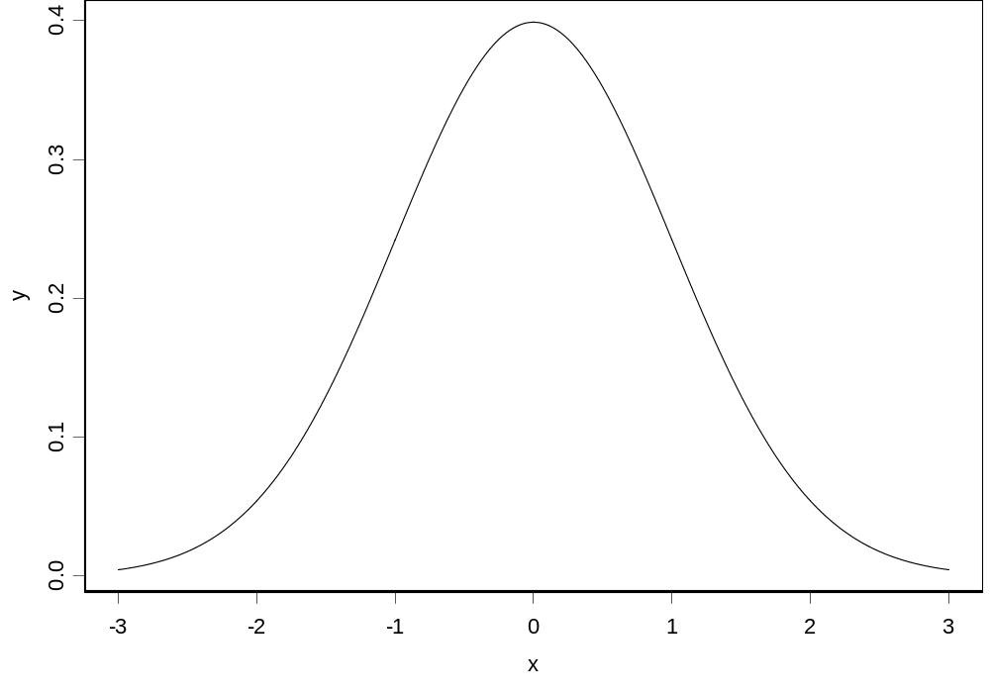
The standard normal curve: μ=0, and σ²=1

Slide 16
How to calculate the probability of a normal random variable?
Each normal random variable, X, has a density function, say f(x) (it is a normal curve).
Probability P(a<X<b) is the area between a and b, under the normal curve f(x)
Table I gives areas for a standard normal curve with μ=0 and σ=1.
Probabilities for any normal curve (any μ and σ) can be rewritten in terms of a standard normal curve.

Slide 17
Get the probability from standard normal table
z denotes a standard normal random variable
Standard normal curve is symmetric about the origin 0
Draw a graph

Slide 18
Table I: P(0<Z<z)
z .00 .01 .02 .03 .04 .05 .06
0.0 .0000 .0040 .0080 .0120 .0160 .0199 .0239
0.1 .0398 .0438 .0478 .0517 .0557 .0596 .0636
0.2 .0793 .0832 .0871 .0910 .0948 .0987 .1026
0.3 .1179 .1217 .1255 .1293 .1331 .1368 .1404
0.4 .1554 .1591 .1628 .1664 .1700 .1736 .1772
0.5 .1915 .1950 .1985 .2019 .2054 .2088 .2123
… … … … … … … …
1.0 .3413 .3438 .3461 .3485 .3508 .3531 .3554
1.1 .3643 .3665 .3686 .3708 .3729 .3749 .3770

Slide 19

Examples
Example 1
P(0<Z<1)
= 0.3413

Slide 20
From non-standard normal to standard normal
X is a normal random variable with mean μ, and standard deviation σ
Set Z=(X–μ)/σ
Z=standard unit or z-score of X
Then Z has a standard normal distribution and

Slide 21
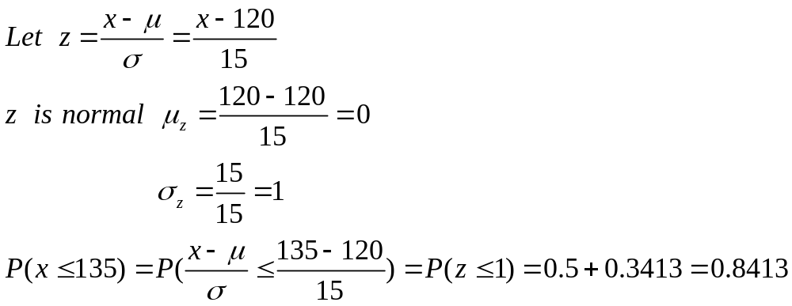
Example 9.8
X is a normal random variable
with μ=120, and σ=15
Find the probability P(X≤135)
Solution:

Slide 22
X➔Z
x→ z-score of x
Example 9.8 (continued)
P(X≤150)
x=150 → z-score z=(150-120)/15=2
P(X≤150)=P(Z≤2)
= 0.5+0.4772= 0.9772

Slide 23
Checking Normality
Most of the statistical tools use to assume normal distributions.
In order to know if these are the right tools for a particular job, we need to be able to assess if the data appear to have come from a normal population.
A normal plot gives a good visual check for normality.

Slide 24
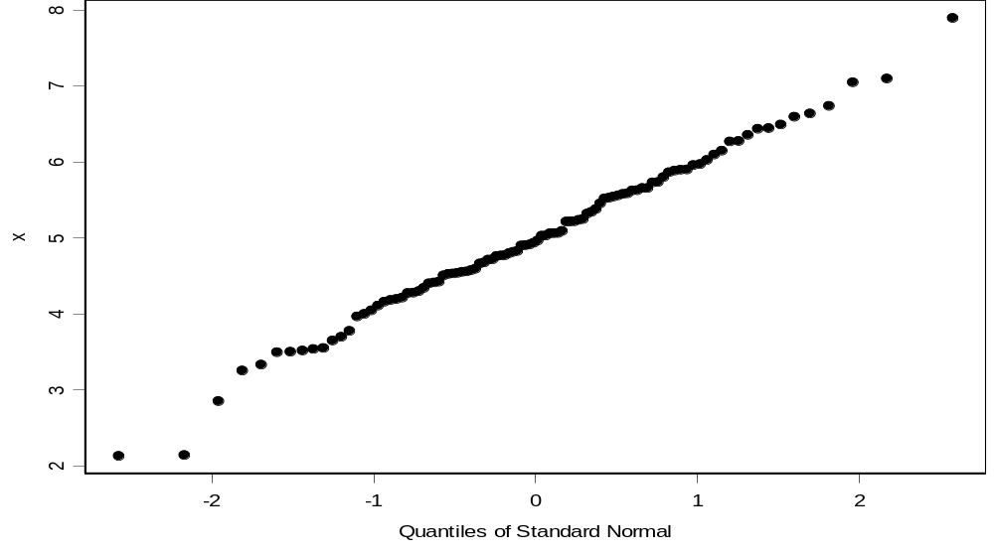
Simulation: 100 observations, normal with mean=5, st dev=1
x<-rnorm(100, mean=5, sd=1)
qqnorm(x)

Slide 25
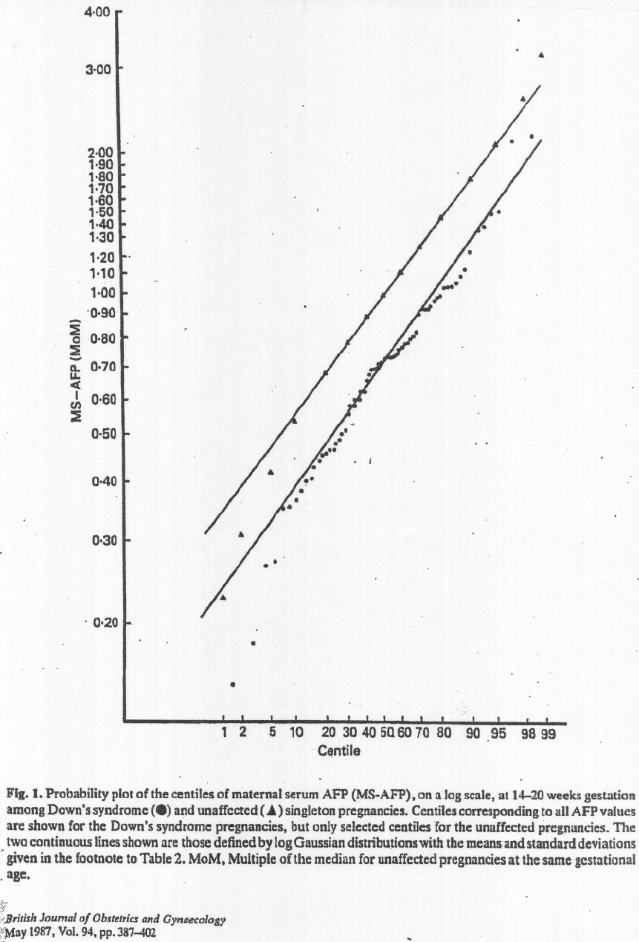
The plot below shows results on alpha-fetoprotein (AFP) levels in maternal blood for normal and Down’s syndrome fetuses.
Estimating a woman’s risk of having a preganancy
associated with Down’s syndrome using her age
and serum alpha-fetoprotein level
H.S.Cuckle, N.J.Wald, S.O.Thompson

Slide 26
Normal Plot
The way these normal plots work is
  Straight means that the data appear normal
  Parallel means that the groups have similar variances.

Slide 27
Normal plot
In order to plot the data and check for normality, we compare
    our observed data to
    what we would expect from a sample of normal data.

Slide 28
To begin with, imagine taking n=5 random values from a standard normal population (μ=0, σ=1)
Let Z₍₁₎ Z₍₂₎ Z₍₃₎ Z₍₄₎ Z₍₅₎ be the ordered values. Suppose we do this over and over.
Sample Z₍₁₎ Z₍₂₎ Z₍₃₎ Z₍₄₎ Z₍₅₎
1 -1.7 -0.2 0.8 1.3 1.9
2 -0.9 0.2 0.5 0.9 2.0
3 -2.3 -1.5 -0.6 0.4 1.3
… … … … … …
Forever ___ ___ ___ ___ ___
Mean -1.163 -0.495 0 0.495 1.163
E(Z₍₁₎) E(Z₍₂₎) E(Z₍₃₎) E(Z₍₄₎) E(Z₍₅₎)
On average
  the smallest of n=5 standard normal values is 1.163 standard deviations below average
  the second smallest of n=5 standard normal values is 0.495 standard deviations below average
  the middle of n=5 standard normal values is at the average, 0 standard deviations from average

Slide 29
The table of “rankits” from the Statistics in Biology table gives these expected values.
For larger n, space is saved by just giving the positive values. The negative values are a mirror image of the positive values, since a standard normal distribution is symmetric about its mean of zero.

Slide 30
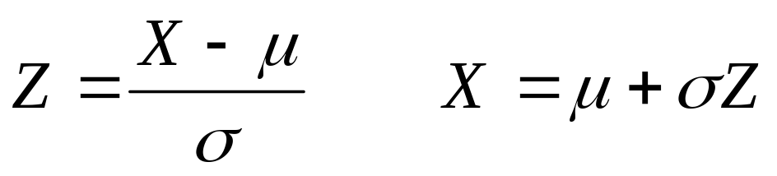
Check for normality
If X is normal, how do ordered values of X, X_{(i)} , relate to expected ordered Z values, E( Z_{(i)} ) ?
For normal with mean μ and standard deviation σ, the expected values of the data, X_{(i)}, will be a linear rescaling of standard normal expected values
E(X_{(i)}) ≈ μ + σ E( Z_{(i)} )
The observed data X_{(i)} will be approximately a linearly related to E( Z_{(i)} ).
X_{(i)} ≈ μ + σ E( Z_{(i)} )

Slide 31
If we plot the ordered X values versus E( Z_{(i)} ), we should see roughly a straight line with
    intercept μ
    slope σ

Slide 32
Normal plot
In order to plot the data and check for normality, we compare
    our observed data to
    what we would expect from a sample of normal data.

Slide 33
Example
Example: Lifetimes of springs under 900 N/mm² stress
i E( Z(i) ) X(i)
1 -1.539 153
2 -1.001 162
3 -0.656 189
4 -0.376 216
5 -0.123 216
6 0.123 216
7 0.376 225
8 0.656 225
9 1.001 243
10 1.539 306

Slide 34
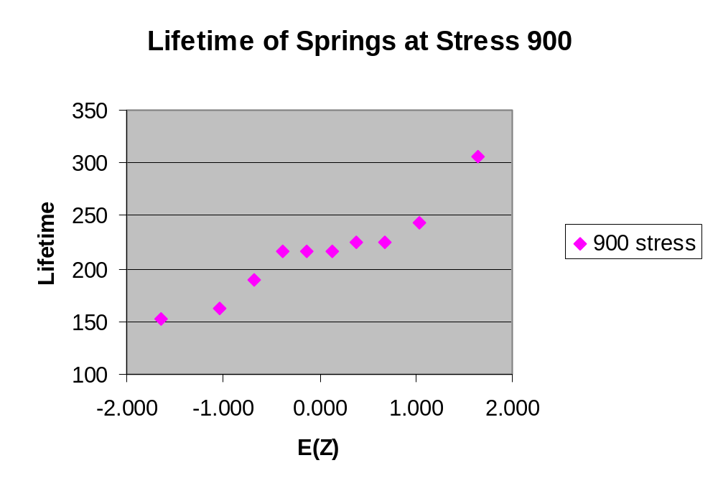
The plot is fairly linear indicating that the data are
pretty similar to what we would expect from
normal data.

Slide 35
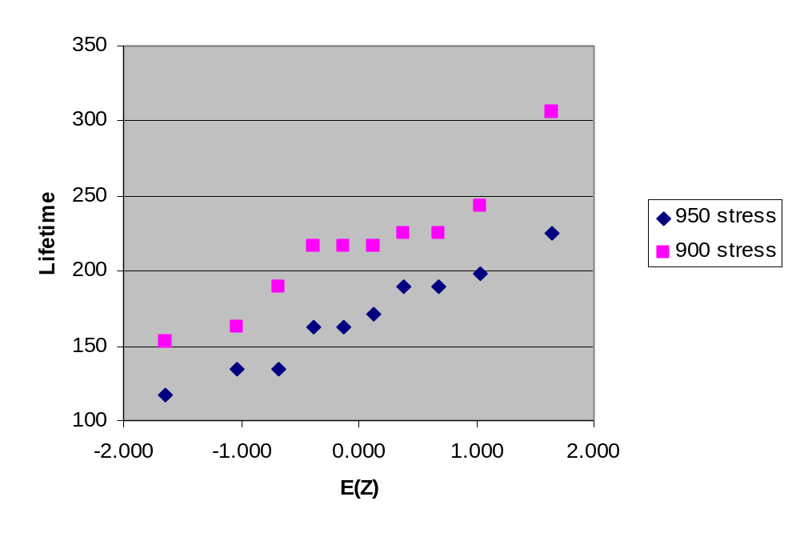
To compare results from different treatments, we can put more than one normal plot on the same graph.
The intercept for the 900 stress level is above the intercept for the 950 stress group, indicating that the mean lifetime of the 900 stress group is greater than the mean of the 950 stress group.
The slopes are similar, indicating that the variances or standard deviations are similar.

Slide 36
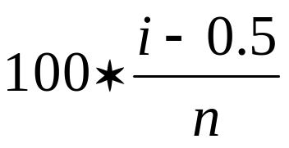
These plots were done in Excel. In Excel you can either enter values from the table of E(Z) values or generate approximations to these tables values.
One way to generate approximate E(Z) values is to generate evenly spaced percentiles of a standard normal, Z, distribution.
The ordered X values correspond roughly to particular percentiles of a normal distribution.
For example if we had n=5 values, the 3rd ordered values would be roughly the median or 50th percentile.
A common method is to use percentiles corresponding to .

Slide 37
9.4 Application of the normal distribution
1960-62 Public Health Service
Health Examination Survey
6,672 Americans 18-79 years old
The woman’s heights were approximately
normal with 63′′ and standard deviation
2.5 ′′.
What percentage of women were over 68′′
tall?

Slide 38
Solution:
X=height
P(X>68)=P(Z>(68-63)/2.5))
=P(Z>2)
=0.5-0.4772
=0.0228

Slide 39
9.5 Normal Approximation to Binomial
A binomial distribution:
n=10, p=0.5
μ=np=5
σ²=np(1-p)=2.5 → σ=1.58
P(X≥7)=0.172 from Binomial
P(X≥7)= P(Z>(6.5-5)/1.58)
=P(Z>0.95)
=0.5-0.3289=0.1711
from normal approximation

Slide 40
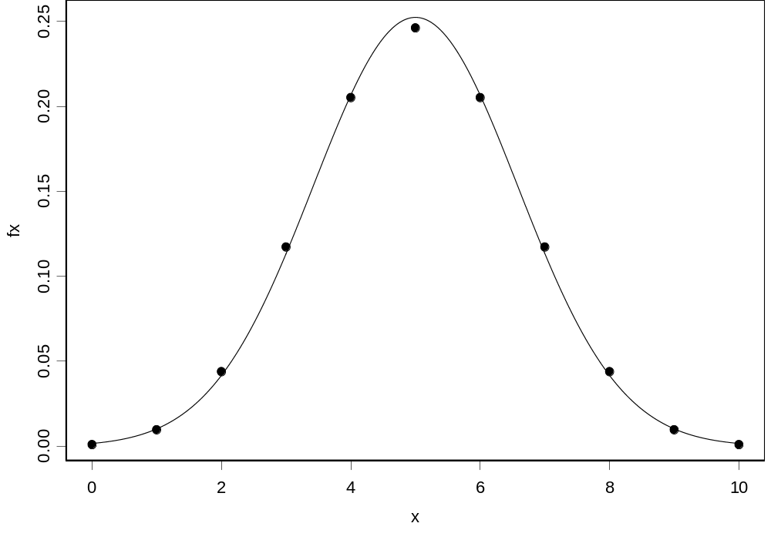
Dots: Binomial Probabilities
Smoot Line: Normal Curve With Same Mean and Variance

Slide 41
Normal Approximation Is Good If
The normal curve has the same mean and standard deviation as binomial
np>5 and n(1-p)>5
Continuity correction is made

Slide 42
Conclusion
Normal distribution
Check for normality
Normal distribution Vs Probability distribution

Slide 43
Preamble of next lecture
Time series analysis

