Slide 1
Lecture 5
Random Variables (Continued)
By
Aziza Munir

Slide 2
Summary of last lecture
Random Variable
Discrete and continous random variable
Discrete and continous probability distribution
Mean and variance of random variable

Slide 3
Learning Objectives
Calculation of variance in frequency distribution
Properties of Mean and Variance
Discrete uniform distribution
Binomial and multinomial distributions

Slide 4
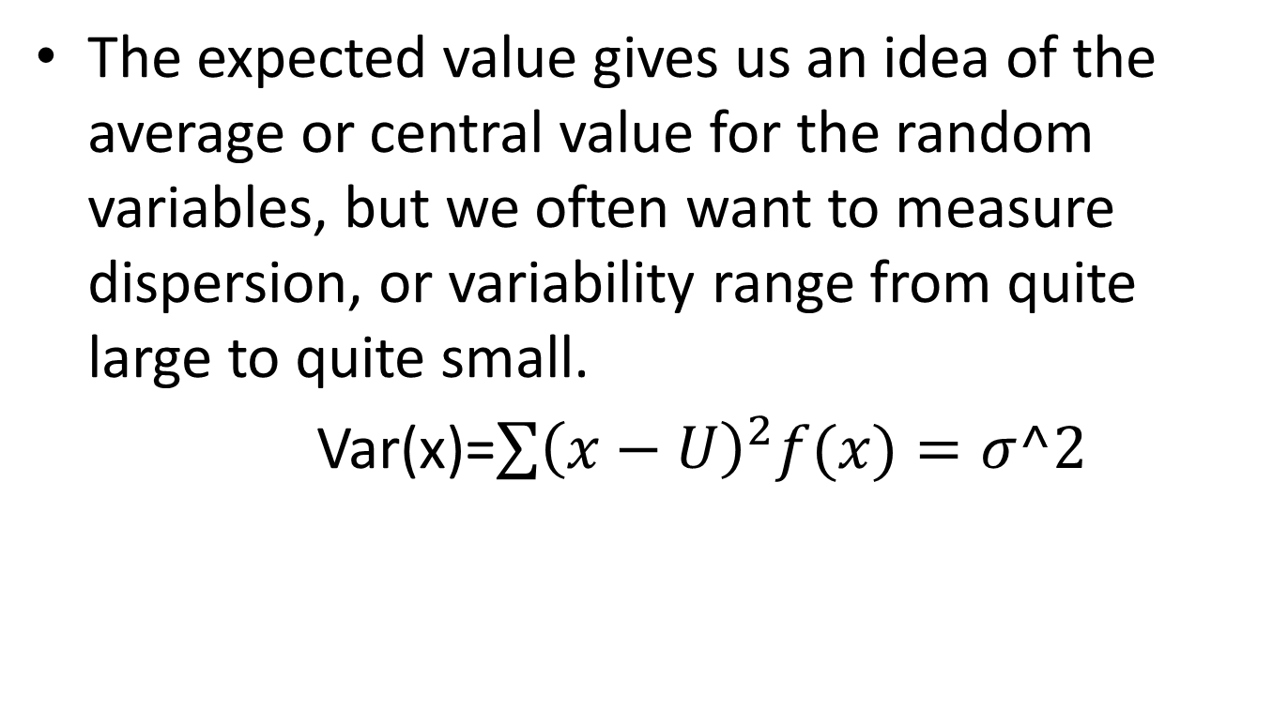
Variance for frequency distribution
The expected value gives us an idea of the average or central value for the random variables, but we often want to measure dispersion, or variability range from quite large to quite small.
Var(x)=$\sum{{\left(x−U\right)}^{2}f(x)=σ^2}$

Slide 5
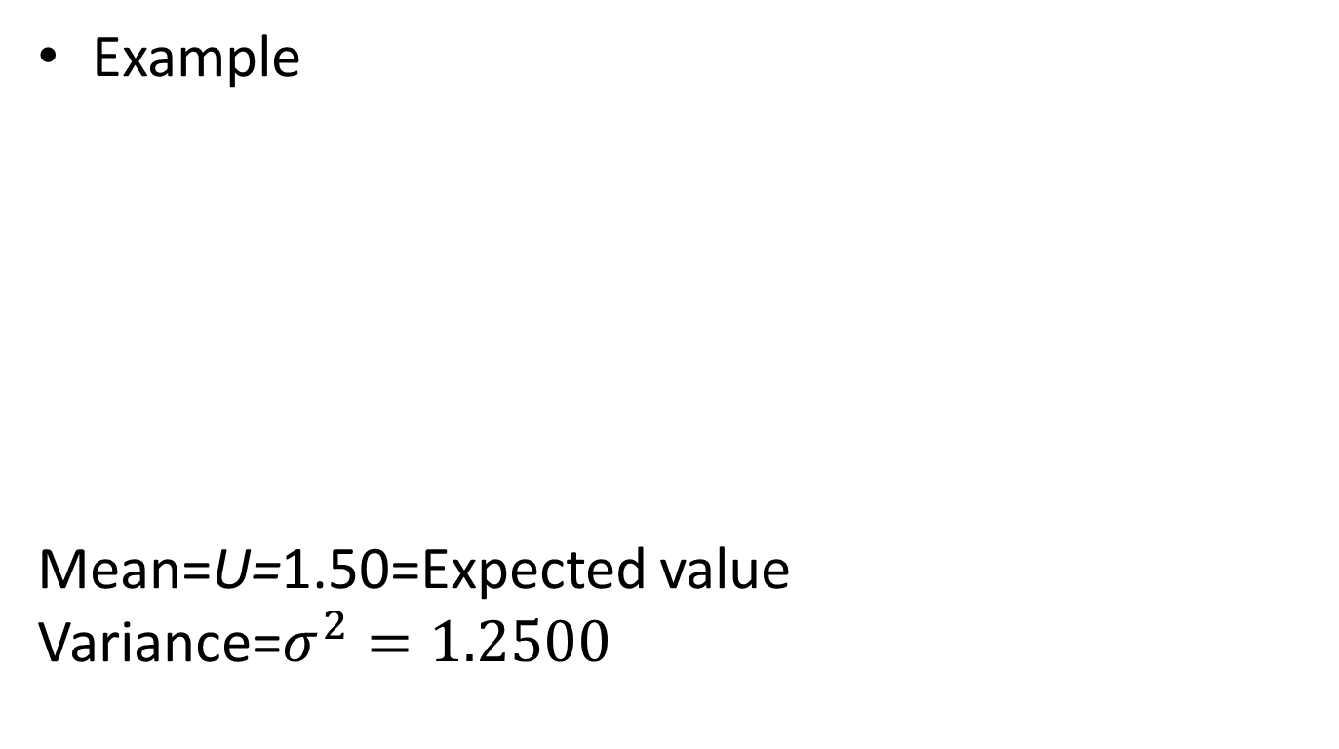
Variance calculation
Example
Mean=U=1.50=Expected value
Variance=$σ^{2}=1.2500$
X | f(x) | X-U | (x-u)^2 | (x-u)^2f(x)
0 | .18 | 0-1.50=-1.50 | 2.25 | 2.25(.18)=0.4050
1 | .39 | 1-1.50=-.50 | .25 | .25(.39)=.0975
2 | .24 | 2-1.50=.50 | .25 | .25(.24)=.0600
3 | .14 | 3-1.50=1.50 | 2.25 | 2.25(.14)=.3150
4 | .04 | 4-1.50=2.50 | 6.25 | 6.25(.04)=.2500
5 | .01 | 5-1.50=3.50 | 12.25 | 12.25(.01)=.1225

Slide 6
Properties of Mean and Variance
If a and b are constants, then
Uax+b=E(aX+b)=∑(ax+b)f(x)
=(ax1+b)f(x1)+(ax2+b)f(x2)+……+(axn+b)f(x)
=a[x1f(x)+x2f(x)+….+xnf(x)]+b [f(x1)+f(x2)+ ……+f(xn)]
=a∑xf(x)+b∑f(x)
First sum states the definition of mean and second sum equals to 1, gives us
Uax+b=au+b

Slide 7
Corollaries to properrties
Setting a=0, we see that Ub=b
Setting b=0, we see that Uax=aU

Slide 8
Uniform Distribution
The simplest of all discrete probability distributions is one in which the random variable assumes all its values with equal probabilities, then the discrete uniform distribution is given by
f(x;k)=1/k for x=x1,x2,x3….xk
We have used the notion f(x;k) instead f(x) to indicate that the uniform distribution depends on the parameter k

Slide 9
Uniform distribution
Example:
When a die is tossed, each element of the sample space S={1,2,3,4,5,6} occurs with probability 1/6. therefore we have a uniform distribution with,
f(x;6)=1/6 for x=1,2,3…6
Example
Suppose that an employee is selected at random from a staff of 10 to supervise a certain project. Each employee has the same probability 1/10 of being selected. If we assume that the employees have been numbered in some way from1 to 10 the distribution is uniform with f(x;10)=1/10 for x=1,2,3…10

Slide 11
Binomial and Multinomial distributions
Binomial distribution:
An experiment often consists of repeated trials, each with two possible outcomes, which may be labeled success, or failure. This is true in flipping of a coin 5 times, where each trial may result in a head or a tail. We may choose to define either outcome as a success. It is also true if 5 cards are drawn in succession from an ordinary deck and each trial is labeled success or failure depending on whether the card is red or black. If each card is replaced and deck is shuffuled before next drawing, then both experiments describe above have similar properties and shows similar probability of ½, from trial to trial. Experiments of this type are known as binomial experiments.

Slide 12
Binomial Distribution
Moreover, in the card drawing example,the probabilites of a success for the repeated trials change if the cards are not replaced. That is the probability of selecting a red card on first draw is ½, but on the second draw it is a conditional probability having a value of 26/51 or 25/51, depending on the color that occurred on first draw. Then it will no longer be considered as binomial experiment.

Slide 13
Binomial Distribution
Properties:
The experiment consists on n repeated trials
Each trial result in an outcome that may be classifies as a success or a failure.
The probability of a success denoted by p, remains constant from trial to trial.
The repeated trials are independent

Slide 14
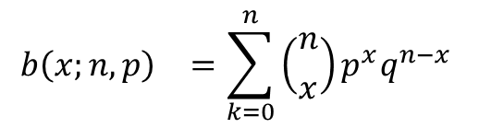
Binomial Distribution
If a binomial trial can result in a success with probability p and a filure with probabilityq=1-p, then the probability distribution of the binomial random variable X, the number of successes in n independent trials will be
For x=0,1,2….n
$${b\left(x;n,p\right)}^{}=\sum_{k=0}^{n}{\left({n \atop x}\right)p^{x}q^{n−x}}$$

Slide 15
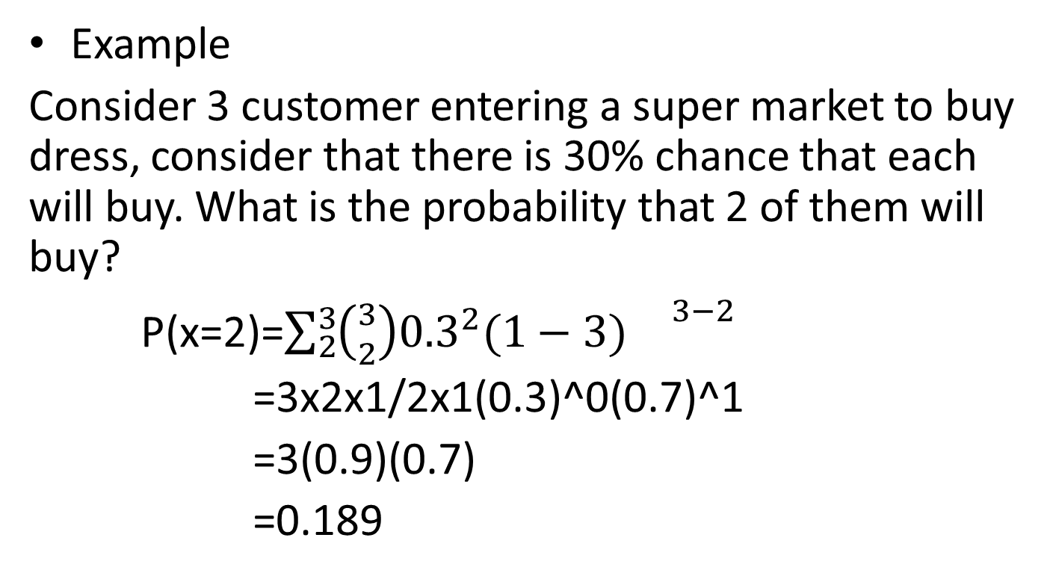
Binomial Distribution
Example
Consider 3 customer entering a super market to buy dress, consider that there is 30% chance that each will buy. What is the probability that 2 of them will buy?
P(x=2)=$\sum_{2}^{3}{\left({3 \atop 2}\right){0.3}^{2}(1−3){}^{3−2}}$
=3x2x1/2x1(0.3)^0(0.7)^1
=3(0.9)(0.7)
=0.189

Slide 16
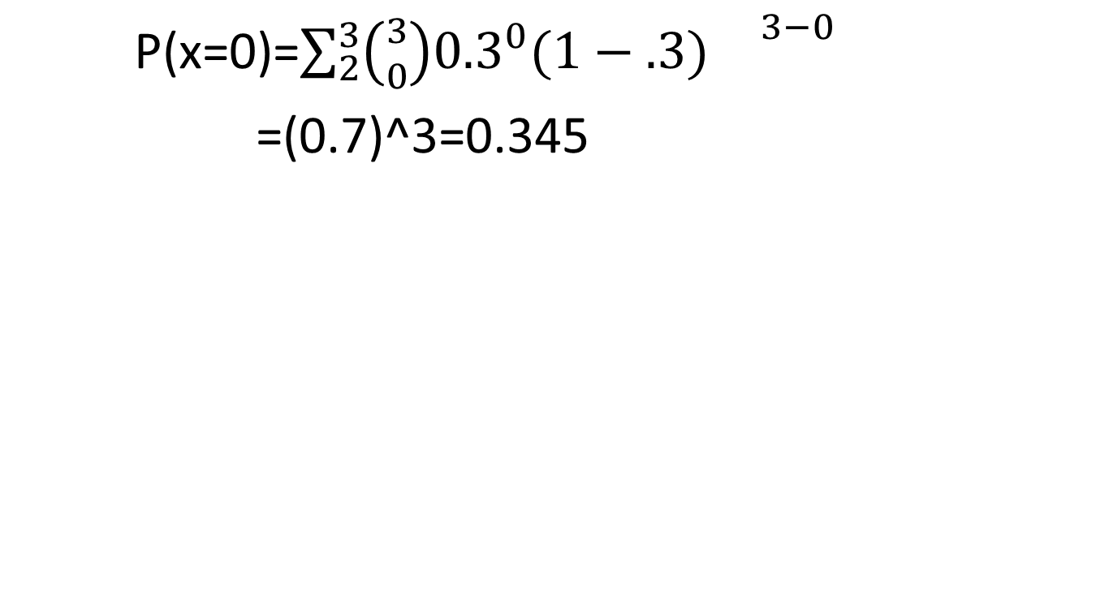
P(x=0)=$\sum_{2}^{3}{\left({3 \atop 0}\right){0.3}^{0}(1−.3){}^{3−0}}$
=(0.7)^3=0.345

Slide 17
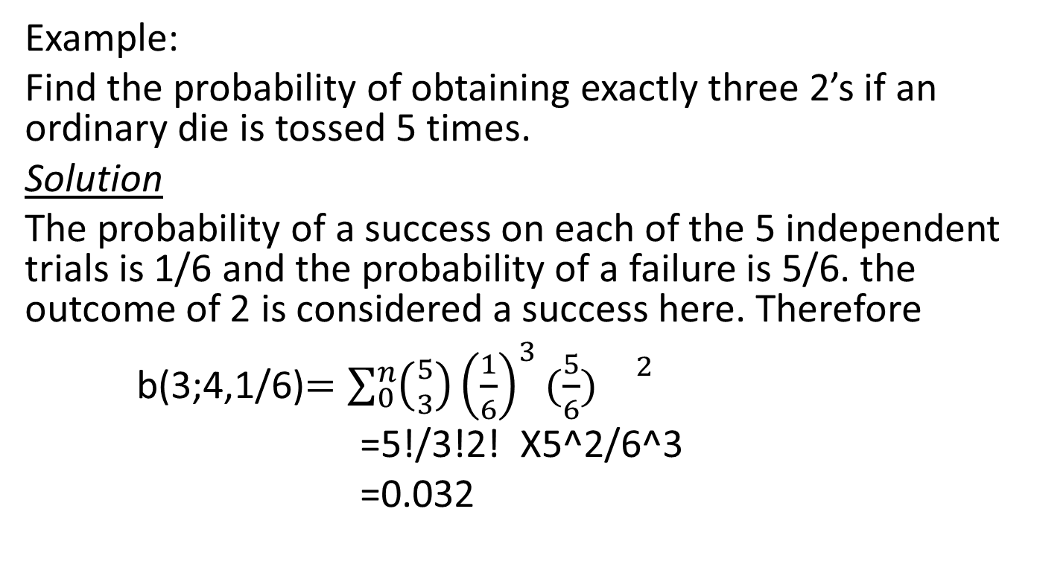
Binomial Distribution
Example:
Find the probability of obtaining exactly three 2’s if an ordinary die is tossed 5 times.
Solution
The probability of a success on each of the 5 independent trials is 1/6 and the probability of a failure is 5/6. the outcome of 2 is considered a success here. Therefore
b(3;4,1/6)$=\sum_{0}^{n}{\left({5 \atop 3}\right){\left(\frac{1}{6}\right)}^{3}(\frac{5}{6}){}^{2}}$
=5!/3!2! X5^2/6^3
=0.032

Slide 18
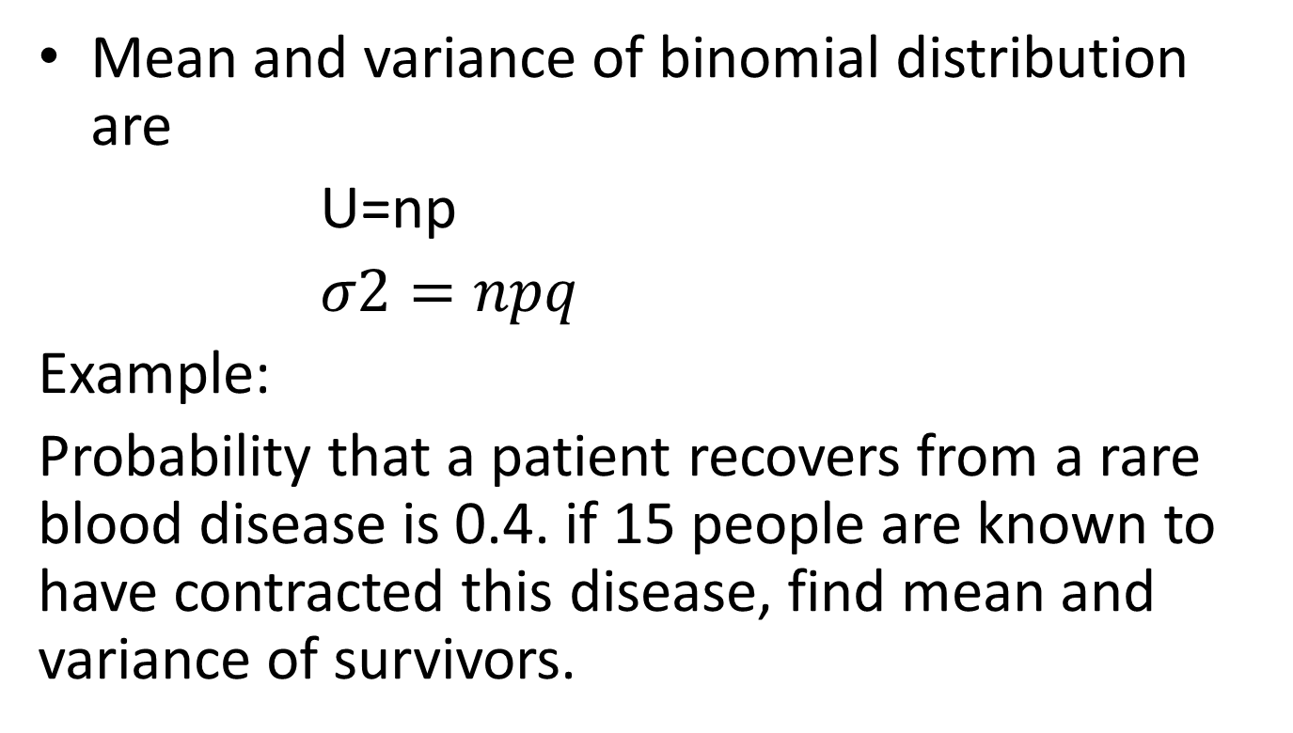
Mean and Variance of Binomial Distribution
Mean and variance of binomial distribution are
U=np
$σ2=npq$
Example:
Probability that a patient recovers from a rare blood disease is 0.4. if 15 people are known to have contracted this disease, find mean and variance of survivors.

Slide 19
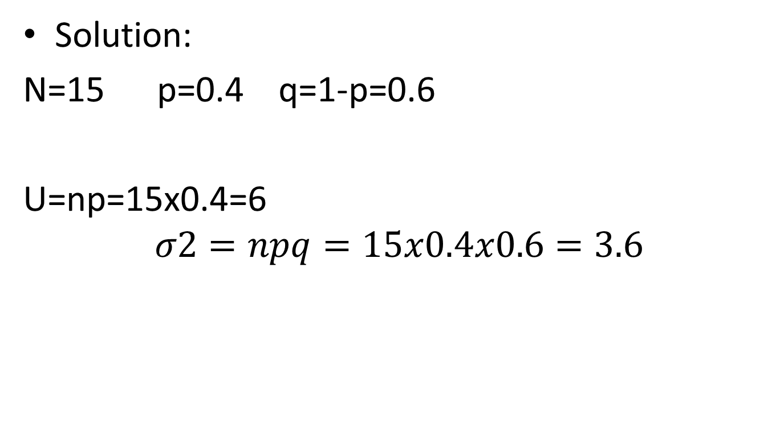
Solution:
N=15 p=0.4 q=1-p=0.6
U=np=15x0.4=6
$$σ2=npq=15x0.4x0.6=3.6$$

Slide 20
Summary
Variance and its calculation in frequency distribution
Uniform discrete distribution
Binomial distribution with examples

Slide 21
Preamble of next lecture
Normal distribution
Examples
Properties

