Slide 1
Lecture 3
Probability
By
Aziza Munir

Slide 2
Summary of last lecture
Probability
Experiment and sample space
Assigning probabilities
Simple theory of sets
Addition law of probability

Slide 3
Learning Objectives
Multiplicative law of probability
Conditional Probability
Joint probability
Mutually exclusive events

Slide 4
Conditional Probability
In many probability situations, we determine the probability of one event is known to have occurred is important.
Suppose we have an event A, with probability P(A), and that we obtain new information or learn that another event B has occurred. If A is related to B, we will want to take advantage of this information in computing a new or revised probability for event A.

Slide 5
Conditional Probability
Event A Event B
Event A and Event B are Mutually Exclusive Events
A
B

Slide 6
Mutually Exclusive Events
Nothing in common
When there exist no relation in events
Whether A appears or not it has nothing to do with event B
If A and B are disjoints then AnB={}
P(AnB)=P(BnA)

Slide 7
Conditional probability
This new probability of event a is written P(A|B). The “|” denotes the fact that we are considering the probability of event A giving the condition that event B has occurred. Thus the notion P(A|B) is read , Probability of A given B.
If conditional probability of P(A|B)=0.25, value refers to only probability of event A, placing condition that event B has occurred but its impacts is not taken

Slide 8
Conditional Probability
  P(A|B) =P(AnB)/P(B)………….P(B) is not zero
  P(B|A)=P(BnA)/P(A)………….P(A) is not zero

Slide 9
Conditional Probability through Venn diagram
B
A

Slide 10
Example
Consider that islamabad police force consists of 1200 officers, during the period 2000 to 2011. the ministry of interior promoted 288 men and 36 women to the rank of sergeant. Following table describes
Police Cops | Promoted | Not Promoted | Total
Men | 288 | 672 | 960
Women | 36 | 204 | 240
Total | 324 | 876 | 1200

Slide 11
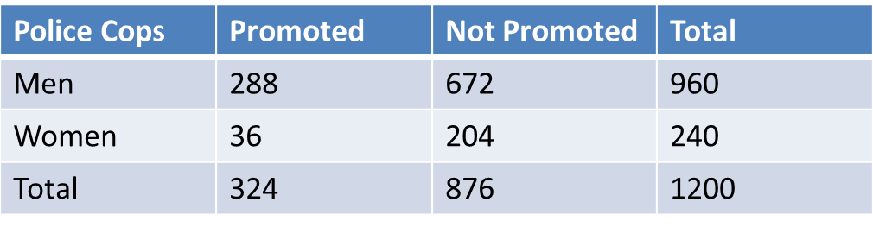
Solution
P(Promoted|Men)=P(PnM)/P(M)=0.30
P(Women|Promoted)=P(WnP)/P(P)=0.11

Slide 12
Multiplication law
When we have two events that we want to get the probability of obtaining both (either simultaneously or in a sequence) such as A and B
P(AnB)=P(A) P(A|B)
Where A and B are independent events

Slide 13
Joint Probability
We meet with cases where event A cannot happen except when /after event B has occurred then we call this probability as
P(A|B)≠ P(B|A)
i.E we look inside the event that forms the condition and find the intersection if it exists inside the condition then
P(A|B`)=P(AnB)/P(B)
While P(B|A)=P(AnB)/P(A)

Slide 14
Mutually Exclusive event and Independent events
If one mutually exclusive event is known to occur the probability of other occurring is reduced to zero, thus cannot be independent

Slide 15
Summary
Multiplicative law
Conditional Probability
Mutually exclusive events
Joint Probability

