Slide 1
Applied Marketing Strategies
MGT 681
Lecture 8

Slide 2
Marketing Ecology
Part 2

Slide 3
Collecting Information and
Forecasting Demand

Slide 4
Lecture Agenda
What are the components of a modern marketing information system?
What are useful internal records?
What makes up a marketing intelligence system?
What are some influential macro environment developments?
How can companies accurately measure and forecast demand?
Notes:
These are the questions we will address in this chapter. Why? Firms are adjusting the way they do business. And for many reasons! Virtually every industry has been touched by dramatic shifts in the technological, demographic, socio-cultural, natural, and political-legal environments.
In this chapter, we consider how firms can develop processes to identify and track important microenvironment trends. We also address how to assess sales forecasts.

Slide 5
What is a
Marketing Information System?
A marketing information system consists of people, equipment, and procedures to gather, sort, analyze, evaluate, and distribute needed, timely, and accurate information to marketing decision makers.
Notes:
The major responsibility for identifying significant marketplace changes falls to the company’s marketers. Marketers have two advantages for the task: disciplined methods for collecting information, and time spent interacting with customers and observing competitors and other outside groups. Some firms have marketing information systems that provide rich detail about buyer wants, preferences, and behavior. Every firm must organize and distribute a continuous flow of information to its marketing managers.
A marketing information system (MIS) consists of people, equipment, and procedures to gather, sort, analyze, evaluate, and distribute needed, timely, and accurate information to marketing decision makers. It relies on internal company records, marketing intelligence activities, and marketing research.

Slide 6

Case Study: MEDC
Notes:
Companies with superior information can choose their markets better, develop better offerings, and execute better marketing planning. The Michigan Economic Development Corporation (MEDC) studied the demographic information of its visitors and those of competing Midwestern cities to create a new marketing message and tourism campaign. The information helped MEDC attract 3.8 million new trips to Michigan, $805 million in new visitor spending, and $56 million in incremental state tax revenue over the period 2004–2008.

Slide 7
Information Needs Probes
What decisions do you regularly make?
What information do you need to make these decisions?
What information do you regularly get?
What studies do you periodically request?
What information would you want that you are not getting now?
What are the four most helpful improvements that could be made in the present marketing information system?
Notes:
The company’s marketing information system should be a mixture of what managers think they need, what they really need, and what is economically feasible. An internal MIS committee can interview a cross-section of marketing managers to discover their information needs. Table 3.2 lists questions to ask.

Slide 8
Internal Records and
Marketing Intelligence
Order-to-payment cycle
Sales information system
Databases, warehousing, data mining
Marketing intelligence system
Notes:
To spot important opportunities and potential problems, marketing managers rely on internal reports of orders, sales, prices, costs, inventory levels, receivables, and payables.
The heart of the internal records system is the order-to-payment cycle. Sales representatives, dealers, and customers send orders to the firm. The sales department prepares invoices, transmits copies to various departments, and back-orders out-of-stock items. Shipped items generate shipping and billing documents that go to various departments.
Marketing managers need timely and accurate reports on current sales.
Companies organize their information into customer, product, and salesperson databases and combine their data. The customer database will contain every customer’s name, address, past transactions, and sometimes even demographics and psychographics (activities, interests, and opinions).
Companies make these data easily accessible to their decision makers. Analysts can “mine” the data and garner fresh insights into neglected customer segments, recent customer trends, and other useful information.

Slide 9
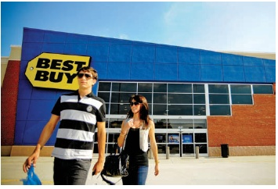
Database Management
Notes:
Best Buy has assembled a 15-plus terabyte database with seven years of data on 75 million households. It captures information about every interaction— from phone calls and mouse clicks to delivery and rebate check. The firm also applies a customer lifetime value model that measures transaction-level profitability and factors in customer behaviors that increase or decrease the value of the relationship. Knowing so much about consumers allows Best Buy to employ precision marketing and customer-triggered incentive programs with positive response rates.

Slide 10
What is a
Marketing Intelligence System?
A marketing intelligence system is a set of procedures and sources that managers use to obtain everyday information about developments in the marketing environment.
Notes:
A marketing intelligence system is a set of procedures and sources that managers use to obtain everyday information about developments in the marketing environment. The internal records system supplies results data, but the marketing intelligence system supplies happenings data.
Marketing managers collect marketing intelligence in a variety of different ways, such as by reading books, newspapers, and trade publications; talking to customers, suppliers, and distributors; monitoring social media on the Internet; and meeting with other company managers.

Slide 11
Steps to Quality Marketing Intelligence
Train sales force to scan for new developments
Motivate channel members to share intelligence
Hire external experts to collect intelligence
Network externally
Utilize a customer advisory panel
Utilize government data sources
Purchase information
Notes:
A company can take eight possible actions (listed in the slide) to improve the quantity and quality of its marketing intelligence. The company must “sell” its sales force on their importance as intelligence gatherers. Marketing intermediaries are often closer to the customer and competition and can offer helpful insights. Many companies hire specialists to gather marketing intelligence. The firm can purchase competitors’ products, attend open houses and trade shows, read competitors’ published reports, attend stockholders’ meetings, talk to employees, collect competitors’ ads, consult with suppliers, and look up news stories about competitors. The U.S. Census Bureau provides an in-depth look at the population swings, demographic groups, regional migrations, and changing family structure of the estimated 304,059,724 people in the United States (as of July 1, 2008). Census marketer Nielsen Claritas cross-references census figures with consumer surveys and its own grassroots research for clients such as The Weather Channel, BMW, and Sovereign Bank. Partnering with “list houses” that provide customer phone and address information, Nielsen Claritas can help firms select and purchase mailing lists with specific clusters. A.C. Nielsen Company and Information Resources Inc. collect information about product sales in a variety of categories and consumer exposure to various media and gather consumer-panel data much more cheaply than marketers manage on their own.

Slide 12
Sources of Competitive Information
Independent customer goods and service review forums
Distributor or sales agent feedback sites
Combination sites offering customer reviews and expert opinions
Customer complaint sites
Public blogs
Notes:
Thanks to the explosion of outlets available on the Internet, online customer review boards, discussion forums, chat rooms, and blogs can distribute one customer’s experiences or evaluation to other potential buyers and, of course, to marketers seeking information about the consumers and the competition. There are five main ways identified in the slide which marketers can use to research competitors’ product strengths and weaknesses online.

Slide 13
Needs and Trends
Fad
Trend
Megatrend
Notes:
A fad is “unpredictable, short-lived, and without social, economic, and political significance.” A company can cash in on a fad such as Crocs clogs, Elmo TMX dolls, and Pokémon gifts and toys, but getting it right requires luck and good timing.
A direction or sequence of events with momentum and durability, a trend is more predictable and durable than a fad; trends reveal the shape of the future and can provide strategic direction.
A megatrend is a “large social, economic, political, and technological change [that] is slow to form, and once in place, influences us for some time—between seven and ten years, or longer.
What are today’s fads, trends, and megatrends?

Slide 14
Needs and Trends
Fad: is “unpredictable, short-lived, and without social, economic, and political significance.”
  A company can cash in on a fad, but getting it right requires luck and good timing.
Trend: A direction or sequence of events with momentum and durability,
  a trend is more predictable and durable than a fad
  trends reveal the shape of the future
  can provide strategic direction.
Megatrend: is a “large social, economic, political, and technological change [that] is slow to form, and once in place, influences us for some time—between seven and ten years, or longer.
What are today’s fads, trends, and megatrends?

Slide 15
Major Forces in the Environment
Demographic
Political-legal
Economic
Technological
Socio-cultural
Natural
Notes:
Firms must monitor six major forces in the broad environment: demographic, economic, socialcultural, natural, technological, and political-legal. We’ll describe them separately, but remember that their interactions will lead to new opportunities and threats.

Slide 16
Population and Demographics
Population growth
Population age mix
Ethnic markets
Educational groups
Household patterns
Notes:
Demographic developments often move at a fairly predictable pace. The main one marketers monitor is population, including the size and growth rate of population in cities, regions, and nations; age distribution and ethnic mix; educational levels; household patterns; and regional characteristics and movements.

Slide 17
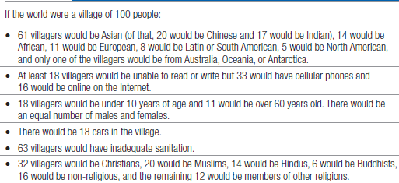
Perspective on the Global Demographic Environment
Notes:
Table 3.3, excerpted here, explains some surprising facts about the world, if it were a village of 100 people.

Slide 18
Economic Environment
Consumer Psychology
Income Distribution
Income, Savings, Debt, Credit
Notes:
The available purchasing power in an economy depends on current income, prices, savings, debt, and credit availability. As the recent economic downturn vividly demonstrated, trends affecting purchasing power can have a strong impact on business, especially for companies whose products are geared to high-income and price-sensitive consumers.

Slide 19

Economic Environment and Consumer Psychology
Notes:
Some experts believed the recession would fundamentally shake consumers’ faith in the economy and their personal financial situations. Others maintained tighter spending reflected a mere economic constraint and not a fundamental behavioral change. Thus, consumers’ aspirations would stay the same, and spending would resume when the economy improves. Who is right?
Identifying the more likely long-term scenario—especially with the coveted 18- to 34-year-old age group—would help to direct how marketers spend their money. After six months of research and development in the baby boomer market, Starwood launched a “style at a steal” initiative to offer affordable but stylish hotel alternatives to its high-end W, Sheraton, and Westin chains. Targeting an audience seeking both thrift and luxury, it introduced two new low-cost chains: Aloft, designed to reflect the urban cool of loft apartments, and Element, suites with every “element” of modern daily lives, including healthy food choices and spa-like bathrooms.

Slide 20
Income Distribution
Subsistence economies
Raw-material-exporting economies
Industrializing economies
Industrial economies
Notes:
There are four types of industrial structures: subsistence economies like Papua New Guinea, with few opportunities for marketers; raw-material-exporting economies like Democratic Republic of Congo (copper) and Saudi Arabia (oil), with good markets for equipment, tools, supplies, and luxury goods for the rich; industrializing economies like India, Egypt, and the Philippines, where a new rich class and a growing middle class demand new types of goods; and industrial economies like Western Europe, with rich markets for all sorts of goods.
Marketers often distinguish countries using five income-distribution patterns: (1) very low incomes; (2) mostly low incomes; (3) very low, very high incomes; (4) low, medium, high incomes; and (5) mostly medium incomes.

Slide 21
Social-Cultural Environment
Views of themselves
Views of others
Views of organizations
Views of society
Views of nature
Views of the universe
Notes:
From our sociocultural environment we absorb, almost unconsciously, a world view that defines our relationships to ourselves, others, organizations, society, nature, and the universe.

Slide 22
Table 3.4 Most Popular
American Leisure Activities
Reading
TV Watching
Spending time with family
Going to movies
Fishing
Computer activities
Gardening
Renting movies
Walking
Exercise
Notes:
This table lists the favorite consumer leisure-time activities. In the text, you’ll see how these activities (percentage partaking) have changed from 1995 until 2008.

Slide 23

Socio-Cultural Influences
Notes:
Most people in the United States still believe in working, getting married, giving to charity, and being honest. Core beliefs and values are passed from parents to children and reinforced by social institutions—schools, churches, businesses, and governments. Secondary beliefs and values are more open to change. Believing in the institution of marriage is a core belief; believing people should marry early is a secondary belief. Marketers have some chance of changing secondary values, but little chance of changing core values.
Although core values are fairly persistent, cultural swings do take place. Each society contains subcultures, groups with shared values, beliefs, preferences, and behaviors emerging from their special life experiences or circumstances.

Slide 24
Natural Environment
Shortage of raw materials
Increased energy costs
Anti-pollution pressures
Governmental protections
Notes:
Corporate environmentalism recognizes the need to integrate environmental issues into the firm’s strategic plans. Trends in the natural environment for marketers to be aware of include the shortage of raw materials, especially water; the increased cost of energy; increased pollution levels; and the changing role of governments. There’s more on this topic in the Marketing Insight on The Green Marketing Revolution.

Slide 25
Keys to Avoiding
Green Marketing Myopia
Consumer Value Positioning
Calibration of Consumer Knowledge
Credibility of Product Claims
Notes:
Consumers report being concerned about the environment, yet research tells us that most consumers have not made major changes in how they shop and live in order to protect the environment. Thus, we have a gap in terms of what consumers claim to want and what they do – a green marketing myopia. In the past, the “green marketing” programs launched by companies around specific products were not always entirely successful. Consumers might have thought that the product was inferior because it was green, or that it was not even really green to begin with. Those green products that were successful, however, persuaded consumers that they were acting in their own and society’s long-run interest at the same time. Some examples were organic foods that were seen as healthier, tastier, and safer, and energy-efficient appliances that were seen as costing less to run.
There are some expert recommendations as to how to avoid “green marketing myopia” by focusing on consumer value positioning, calibration of consumer knowledge, and the credibility of product claims. One challenge with green marketing is the difficulty consumers have in understanding the environmental benefits of products, leading to many accusations of “greenwashing” where products are not nearly as green and environmentally beneficial as their marketing might suggest.

Slide 26

Consumer Environmental Segments
Genuine Greens
Not Me Greens
Go-with-the-Flow Greens
Dream Greens
Business First Greens
Mean Greens
Notes:
Genuine Greens (15%): This segment is the most likely to think and act green. Some may be true environmental activists, but most probably fall more under the category of strong advocates.
Not Me Greens (18%): This segment expresses very pro-green attitudes, but its behaviors are only moderate, perhaps because these people perceive lots of barriers to living green.
Go-with-the-FlowGreens (17%): This group engages in some green behaviors—mostly the “easy” ones such as recycling. But being green is not a priority for them, and they seem to take the path of least resistance.
Dream Greens (13%): This segment cares a great deal about the environment, but doesn’t seem to have the knowledge or resources to take action. This group may offer the greatest opportunity to act green if given the chance.
Business First Greens (23%): This segment’s perspective is that the environment is not a huge concern and that business and industry is doing its part to help.
Mean Greens (13%): This group claims to be knowledgeable about environmental issues, but does not express pro-green attitudes or behaviors. Indeed, it is practically hostile toward pro-environmental ideas.

Slide 27
Technological Environment
Pace of change
Opportunities for innovation
Varying R&D budgets
Increased regulation of change
Notes:
Marketers must monitor technology trends including the accelerating pace of change, opportunities for innovation, R&D budgets, and increased regulation of technological change.
More ideas than ever are in the works, and the time between idea and implementation is shrinking. Some of the most exciting work today is taking place in biotechnology, computers, microelectronics, telecommunications, robotics, and designer materials.
Many companies put their money into copying competitors’ products and making minor feature and style improvements.
Government has expanded its agencies’ powers to investigate and ban potentially unsafe products. In the United States, the Food and Drug Administration (FDA) must approve all drugs before they can be sold. Safety and health regulations have increased for food, automobiles, clothing, electrical appliances, and construction.

Slide 28
The Political-Legal Environment
Business Legislation
Growth of Special Interest Groups
Notes:
The political and legal environment consists of laws, government agencies, and pressure groups that influence various organizations and individuals. Sometimes these laws create new business opportunities. Mandatory recycling laws have boosted the recycling industry and launched dozens of new companies making new products from recycled materials. Two major trends are the increase in business legislation and the growth of special-interest groups.

Slide 29
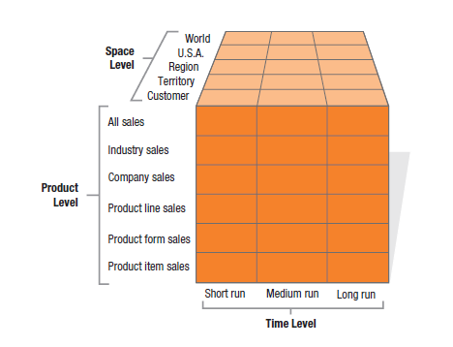
Forecasting and
Demand Measurement
How can we measure market demand?
  Potential market
  Available market
  Target market
  Penetrated market
Notes:
Figure 3.2 illustrates that companies can prepare as many as 90 different types of demand estimates for six different product levels, five space levels, and three time periods. Each demand measure serves a specific purpose. A company might forecast short-run demand to order raw materials, plan production, and borrow cash. It might forecast regional demand to decide whether to set up regional distribution.
There are many productive ways to break down the market:
The potential market is the set of consumers with a sufficient level of interest in a market offer.
The available market is the set of consumers who have interest, income, and access to a particular offer.
The target market is the part of the qualified available market the company decides to pursue.
The penetrated market is the set of consumers who are buying the company’s product.

Slide 30
A Vocabulary for
Demand Measurement
Market Demand
Market Forecast
Market Potential
Company Demand
Company Sales Forecast
Company Sales Potential
Notes:
This slide lists the major concepts in demand measurement. Market demand is discussed further on the next slide.
Only one level of industry marketing expenditure will actually occur. The market demand corresponding to this level is called the market forecast. The market forecast shows expected market demand, not maximum market demand. Market potential is the limit approached by market demand as industry marketing expenditures approach infinity for a given marketing environment.
Companies interested in market potential have a special interest in the product-penetration percentage, the percentage of ownership or use of a product or service in a population. Companies assume that the lower the product-penetration percentage, the higher the market potential, although this also assumes everyone will eventually be in the market for every product.
Company demand is the company’s estimated share of market demand at alternative levels of company marketing effort in a given time period. It depends on how the company’s products, services, prices, and communications are perceived relative to the competitors’.
The company sales forecast is the expected level of company sales based on a chosen marketing plan and an assumed marketing environment. Two other concepts are important here. A sales quota is the sales goal set for a product line, company division, or sales representative. It is primarily a managerial device for defining and stimulating sales effort, often set slightly higher than estimated sales to stretch the sales force’s effort.
A sales budget is a conservative estimate of the expected volume of sales, primarily for making current purchasing, production, and cash flow decisions. Company sales potential is the sales limit approached by company demand as company marketing effort increases relative to that of competitors.

Slide 31
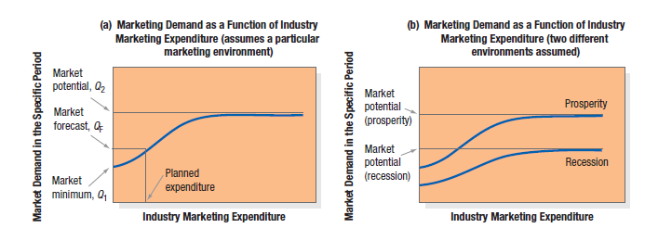
Market Demand Functions
Notes:
The marketer’s first step in evaluating marketing opportunities is to estimate total market demand. Market demand for a product is the total volume that would be bought by a defined customer group in a defined geographical area in a defined time period in a defined marketing environment under a defined marketing program.
Market demand is not a fixed number, but rather a function of the stated conditions. For this reason, we call it the market demand function. Its dependence on underlying conditions is illustrated in Figure 3.3(a).
The horizontal axis shows different possible levels of industry marketing expenditure in a given time period. The vertical axis shows the resulting demand level. The curve represents the estimated market demand associated with varying levels of marketing expenditure.
Some base sales—called the market minimum and labeled Q1 in the figure—would take place without any demand-stimulating expenditures. Higher marketing expenditures would yield higher levels of demand, first at an increasing rate, then at a decreasing rate.
Marketing expenditures beyond a certain level would not stimulate much further demand, suggesting an upper limit called the market potential and labeled Q2 in the figure.
The distance between the market minimum and the market potential shows the overall marketing sensitivity of demand. We can think of two extreme types of market, the expansible and the nonexpansible. An expansible market, such as the market for racquetball playing, is very much affected in size by the level of industry marketing expenditures.
In terms of Figure 3.3(a), the distance between Q1 and Q2 is relatively large. A nonexpansible market—for example, the market for weekly trash or garbage removal—is not much affected by the level of marketing expenditures; the distance between Q1 and Q2 is relatively small.

Slide 32
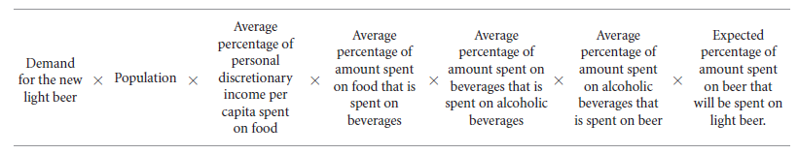
Estimating Current Demand:
Total Market Potential
Calculations
  Multiple potential number of buyers by average quantity each purchases times price
  Chain-ratio method
Notes:
Total market potential is the maximum sales available to all firms in an industry during a given period, under a given level of industry marketing effort and environmental conditions. A common way to estimate total market potential is to multiply the potential number of buyers by the average quantity each purchases, times the price.
For example, if 100 million people buy books each year, and the average book buyer buys three books a year at an average price of $20 each, then the total market potential for books is $6 billion (100 million 3 $20). The most difficult component to estimate is the number of buyers. We can always start with the total population in the nation, say, 261 million people. Next we eliminate groups that obviously would not buy the product. Assume illiterate people and children under 12 don’t buy books and constitute 20 percent of the population. This means 80 percent of the population, or 209 million people, are in the potentials pool. Further research might tell us that people of low income and low education don’t buy books, and they constitute over 30 percent of the potentials pool. Eliminating them, we arrive at a prospect pool of approximately 146.3 million book buyers. We use this number to calculate total market potential.
A variation on this method is the chain-ratio method, which multiplies a base number by several adjusting percentages. Suppose a brewery is interested in estimating the market potential for a new light beer especially designed to accompany food. It can make an estimate with the calculation illustrated in the slide.

Slide 33
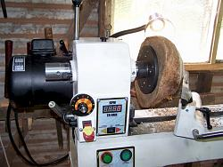
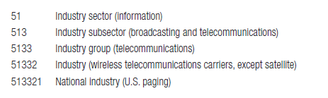
Estimating Current Demand:
Area Market Potential
Market-Buildup
Notes:
The market-buildup method calls for identifying all the potential buyers in each market and estimating their potential purchases. It produces accurate results if we have a list of all potential buyers and a good estimate of what each will buy. Unfortunately, this information is not always easy to gather.
Consider a machine-tool company that wants to estimate the area market potential for its wood lathe in the Boston area. Its first step is to identify all potential buyers of wood lathes in the area, primarily manufacturing establishments that shape or ream wood as part of their operations. The company could compile a list from a directory of all manufacturing establishments in the area. Then it could estimate the number of lathes each industry might purchase, based on the number of lathes per thousand employees or per $1 million of sales in that industry.
An efficient method of estimating area market potentials makes use of the North American Industry Classification System (NAICS), developed by the U.S. Bureau of the Census in conjunction with the Canadian and Mexican governments. The NAICS classifies all manufacturing into 20 major industry sectors and further breaks each sector into a six-digit, hierarchical structure as shown in the slide.
To use the NAICS, the lathe manufacturer must first determine the six-digit NAICS codes that represent products whose manufacturers are likely to require lathe machines. To get a full picture of all six-digit NAICS industries that might use lathes, the company can (1) determine past customers’ NAICS codes; (2) go through the NAICS manual and check off all the six-digit industries that might have an interest in lathes; (3) mail questionnaires to a wide range of companies inquiring about their interest in wood lathes.
The company’s next task is to determine an appropriate base for estimating the number of lathes each industry will use. Suppose customer industry sales are the most appropriate base. Once the company estimates the rate of lathe ownership relative to the customer industry’s sales, it can compute the market potential.

Slide 34
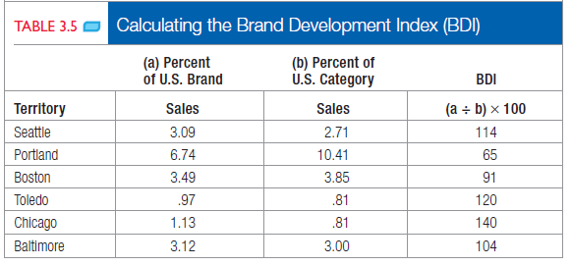
Estimating Current Demand:
Area Market Potential
Multiple-Factor Index
Notes:
Many companies compute area indexes to allocate marketing resources. Suppose q drug company is reviewing the six cities listed in Table 3.5. The first two columns show its percentage of U.S. brand and category sales in these six cities. Column 3 shows the brand development index (BDI), the index of brand sales to category sales. Seattle has a BDI of 114 because the brand is relatively more developed than the category in Seattle. Portland’s BDI is 65, which means the brand is relatively underdeveloped there.
Normally, the lower the BDI, the higher the market opportunity, in that there is room to grow the brand. Other marketers would argue instead that marketing funds should go into the brand’s strongest markets, where it might be important to reinforce loyalty or more easily capture additional brand share. Investment decisions should be based on the potential to grow brand sales.

Slide 35
Estimating Future Demand
Survey of Buyers’ Intentions
Composite of Sales Force Opinions
Expert Opinion
Past-Sales Analysis
Market-Test Method
Notes:
How do firms develop their forecasts? They may create their own or buy forecasts from outside sources such as marketing research firms, which interview customers, distributors, and other knowledgeable parties.
Forecasting is the art of anticipating what buyers are likely to do under a given set of conditions. For major consumer durables such as appliances, research organizations conduct periodic surveys of consumer buying intentions, ask questions like Do you intend to buy an automobile within the next six months?
When buyer interviewing is impractical, the company may ask its sales representatives to estimate their future sales. Companies can also obtain forecasts from experts, including dealers, distributors, suppliers, marketing consultants, and trade associations.
Firms can develop sales forecasts on the basis of past sales. Time-series analysis breaks past time series into four components (trend, cycle, seasonal, and erratic) and projects them into the future. Exponential smoothing projects the next period’s sales by combining an average of past sales and the most recent sales, giving more weight to the latter.
Statistical demand analysis measures the impact of a set of causal factors (such as income, marketing expenditures, and price) on the sales level. Finally, econometric analysis builds sets of equations that describe a system and statistically derives the different parameters that make up the equations statistically. When buyers don’t plan their purchases carefully, or experts are unavailable or unreliable, a direct-market test can help forecast new-product sales or established product sales in a new distribution channel or territory.

Slide 36
For Review
What are the components of a modern marketing information system?
What are useful internal records?
What makes up a marketing intelligence system?
What are some influential macroenvironment developments?
How can companies accurately measure and forecast demand?
Notes:
In this slide, we revisit the chapter questions we sought to answer.

