Slide 1
Applied Marketing Strategies
MGT 681
Lecture 7

Slide 2
Review of Concepts
Part 1

Slide 3
Lecture Agenda
What does a marketing plan include?
Notes:
Good marketing is no accident, but a result of careful planning and execution using state-of-the-art tools and techniques. It becomes both an art and a science as marketers strive to find creative new solutions to challenges in a complex marketing environment.
In this book, the authors describe how top marketers balance discipline and imagination to address these new marketing realities. In the first chapter, they set the stage by reviewing important marketing concepts, tools, frameworks, and issues.
The questions identified in the slide will be our focus.

Slide 4
What is Corporate Culture?
Strategic planning happens within the context of the organization.
A company’s organization consists of its structures, policies, and corporate culture
  can become dysfunctional in a rapidly changing business environment
Adapting the culture is often the key to successfully implementing a new strategy
Corporate culture is the shared experiences, stories, beliefs, and norms that characterize an organization.
Notes:
Strategic planning happens within the context of the organization. A company’s
organization consists of its structures, policies, and corporate culture, all of which can become dysfunctional in a rapidly changing business environment. Whereas managers can change structures and policies (though with difficulty), the company’s culture is very hard to change. Yet adapting the culture is often the key to successfully implementing a new strategy.
What exactly is a corporate culture? Some define it as “the shared experiences, stories, beliefs, and norms that characterize an organization.” Walk into any company and the first thing that strikes you is the corporate culture—the way people dress, talk to one another, and greet customers.

Slide 5
The Business Unit Strategic Planning Process
Define its specific mission within the broader company mission.
Evaluation of a company’s strengths, weaknesses, opportunities, and threats is called SWOT analysis.
  a way of monitoring the external and internal marketing environment.
Next step is goal formulation, developing specific goals for the planning period.
  Goals are objectives that are specific with respect to magnitude and time.
  Goals indicate what a business unit wants to achieve
Strategy is a game plan for meeting planned goals.
  Strategy consists of:
    Marketing strategy
    Compatible technology strategy
    Sourcing strategy.
Even a great marketing strategy can be sabotaged by poor implementation.
Once they have formulated marketing programs, marketers must estimate their costs.

Slide 6
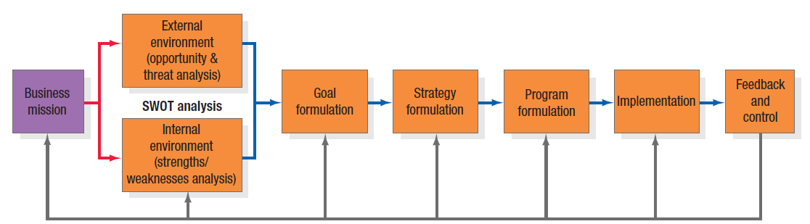
The Business Unit Strategic Planning Process
Notes:
The business unit strategic-planning process consists of the steps shown in Figure 2.3.. Each business unit needs to define its specific mission within the broader company mission. The overall evaluation of a company’s strengths, weaknesses, opportunities, and threats is called SWOT analysis. It’s a way of monitoring the external and internal marketing environment. Once the company has performed a SWOT analysis, it can proceed to goal formulation, developing specific goals for the planning period. Goals are objectives that are specific with respect to magnitude and time. Goals indicate what a business unit wants to achieve; strategy is a game plan for getting there. Every business must design a strategy for achieving its goals, consisting of a marketing strategy and a compatible technology strategy and sourcing strategy. Even a great marketing strategy can be sabotaged by poor implementation. If the unit has decided to attain technological leadership, it must strengthen its R&D department, gather technological intelligence, develop leading-edge products, train its technical sales force, and communicate its technological leadership. Once they have formulated marketing programs, marketers must estimate their costs.

Slide 7
SWOT Analysis
Strengths
Weaknesses
Opportunities
Threats
Notes:
The overall evaluation of a company’s strengths, weaknesses, opportunities, and threats is called SWOT analysis. It’s a way of monitoring the external and internal marketing environment.

Slide 8
Market Opportunity Analysis (MOA)
Can the benefits involved in the opportunity be articulated convincingly to a defined target market?
Can the target market be located and reached with cost-effective media and trade channels?
Does the company possess or have access to the critical capabilities and resources needed to deliver the customer benefits?
Notes:
To evaluate opportunities, companies can use market opportunity analysis (MOA) to ask questions like those posed on this slide and the next one.

Slide 9
Market Opportunity Analysis (MOA)
Can the company deliver the benefits better than any actual or potential competitors?
Will the financial rate of return meet or exceed the company’s required threshold for investment?

Slide 10
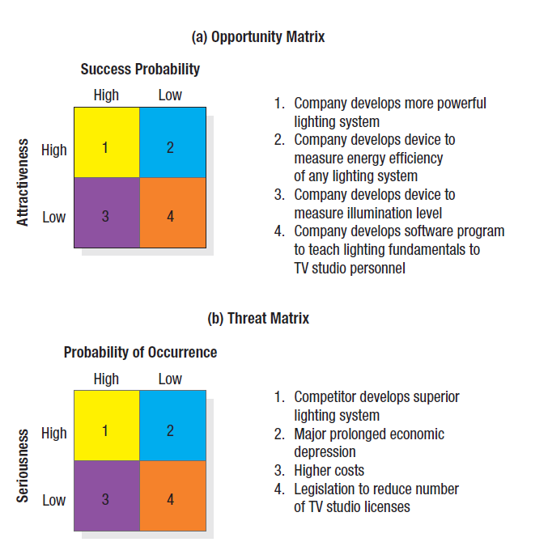
Figure 2.4
Opportunity and Threat Matrices
Notes:
By using the SWOT analysis and market opportunity analysis, we can create opportunity and threat matrices.
In the opportunity matrix in Figure 2.4 (a), the best marketing opportunities facing the TV-lighting-equipment company appear in the upper-left cell (#1). The opportunities in the lower-right cell (#4) are too minor to consider. The opportunities in the upper-right cell (#2) and the lower-left cell (#3) are worth monitoring in the event that any improve in attractiveness and potential.

Slide 11
Goal Formulation and MBO
Business units pursue a mix of objectives, including
    Profitability
    Sales growth
    Market share improvement
    Risk containment
    Innovation
    Reputation
Business unit sets these objectives and then manages by objectives
For an MBO system to work, the unit’s objectives must meet four criteria
  Unit’s objectives must be hierarchical
  Objectives should be quantitative
  Goals should be realistic
  Objectives must be consistent
Notes:
Most business units pursue a mix of objectives, including profitability, sales growth, market share improvement, risk containment, innovation, and reputation. The business unit sets these objectives and then manages by objectives (MBO). For an MBO system to work, the unit’s objectives must meet four criteria as shown in the slide.

Slide 12
Porter’s Generic Strategies
Overall cost leadership
Differentiation
Focus
Notes:
Michael Porter has proposed three generic strategies that provide a good starting point for strategic thinking: overall cost leadership, differentiation, and focus.
With overall cost leadership, firms work to achieve the lowest production and distribution costs so they can underprice competitors and win market share.
With differentiation, the business concentrates on achieving superior performance in an important customer benefit area valued by a large part of the market.
With focus, the business focuses on one or more narrow market segments, gets to know them intimately, and pursues either cost leadership or differentiation within the target segment.

Slide 13
Porter’s Generic Strategies
Overall cost leadership, firms work to achieve the lowest production and distribution costs so they can underprice competitors and win market share.
Differentiation, the business concentrates on achieving superior performance in an important customer benefit area valued by a large part of the market.
Focus, the business focuses on one or more narrow market segments, gets to know them intimately, and pursues either cost leadership or differentiation within the target segment.

Slide 14
Categories of Marketing Alliances
Product or service alliances—One company licenses another to produce its product, or two companies jointly market their complementary products or a new product.
Promotional alliances—One company agrees to carry a promotion for another company’s product or service.
Logistics alliances—One company offers logistical services for another company’s product.
Pricing collaborations—One or more companies join in a special pricing collaboration.
Notes:
Even giant companies often cannot achieve leadership, either nationally or globally, without forming alliances with domestic or multinational companies that complement or leverage their capabilities and resources.
Many strategic alliances take the form of marketing alliances. These fall into four major categories.
Product or service alliances—One company licenses another to produce its product, or two companies jointly market their complementary products or a new product.
Promotional alliances—One company agrees to carry a promotion for another company’s product or service.
Logistics alliances—One company offers logistical services for another company’s product.
Pricing collaborations—One or more companies join in a special pricing collaboration.

Slide 15
McKinsey’s Elements of Success
Skills
Strategy
Staff
Structure
Style
Systems
Shared values
Notes:
According to McKinsey & Company, strategy is only one of seven elements—all of which start with the letter s—in successful business practice.41 The first three—strategy, structure, and systems—are considered the “hardware” of success. The next four—style, skills, staff, and shared values—are the “software.” The first “soft” element, style, means company employees share a common way of thinking and behaving. The second, skills, means employees have the skills needed to carry out the company’s strategy. Staffing means the company has hired able people, trained them well, and assigned them to the right jobs. The fourth element, shared values, means employees share the same guiding values. When these elements are present, companies are usually more successful at strategy implementation.

Slide 16
Marketing Plan Contents
Executive summary
Table of contents
Situation analysis
Marketing strategy
Financial projections
Implementation controls
Notes:
Although the exact length and layout varies from company to company, most marketing plans cover one year in anywhere from 5 to 50 pages. Smaller businesses may create shorter or less formal marketing plans, whereas corporations generally require highly structured documents.
A marketing plan usually contains the sections listed in the slide.

Slide 17
Evaluating a Marketing Plan
Is the plan simple?
Is the plan specific?
Is the plan realistic?
Is the plan complete?
Notes:
In the Marketing Memo, these questions are suggested for evaluating the quality of the marketing plan.

