Slide 1
Applied Marketing Strategies
MGT 681
Lecture 6

Slide 2
Review of Concepts
Part 1

Slide 3
Lecture Agenda
How is strategic planning carried out at different levels of the organization?
What does a marketing plan include?
Notes:
Good marketing is no accident, but a result of careful planning and execution using state-of-the-art tools and techniques. It becomes both an art and a science as marketers strive to find creative new solutions to challenges in a complex marketing environment.
In this book, the authors describe how top marketers balance discipline and imagination to address these new marketing realities. In the first chapter, they set the stage by reviewing important marketing concepts, tools, frameworks, and issues.
The questions identified in the slide will be our focus.

Slide 4
Strategic Planning Priority
(1) managing a company’s businesses as an investment portfolio
(2) assessing each business’s strength by considering the market’s growth rate and the company’s position and fit in that market
(3) establishing a strategy. The company must develop a game plan for achieving each business’s long-run objectives.

Slide 5
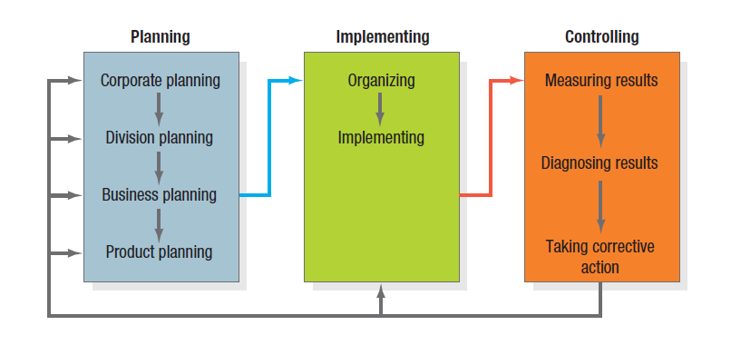
The Strategic Planning, Implementation, and
Control Processes
Notes:
To ensure they select and execute the right activities, marketers must give priority to strategic planning in three key areas: (1) managing a company’s businesses as an investment portfolio, (2) assessing each business’s strength by considering the market’s growth rate and the company’s position and fit in that market, and (3) establishing a strategy. The company must develop a game plan for achieving each business’s long-run objectives.
Most large companies consist of four organizational levels: (1) corporate, (2) division, (3) business unit, and (4) product. Corporate headquarters is responsible for designing a corporate strategic plan to guide the whole enterprise; it makes decisions on the amount of resources to allocate to each division, as well as on which businesses to start or eliminate. Each division establishes a plan covering the allocation of funds to each business unit within the division. Each business unit develops a strategic plan to carry that business unit into a profitable future. Finally, each product level (product line, brand) develops a marketing plan for achieving its objectives.

Slide 6
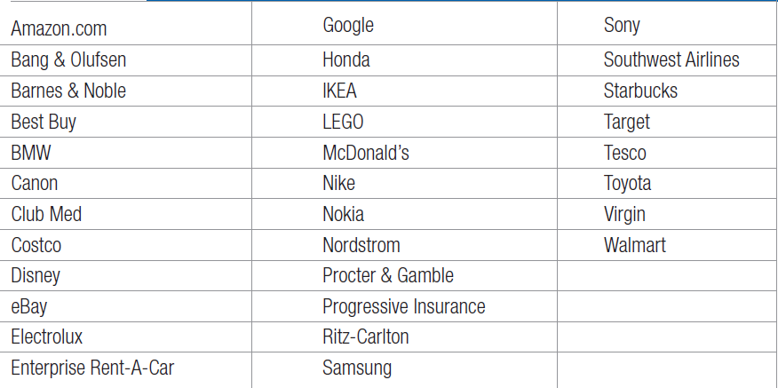
Master Marketers
Notes:
Only a small group of companies stand out over time as master marketers as shown in Table 2.1.

Slide 7
What is a Marketing Plan?
A marketing plan is the central instrument for directing and coordinating the marketing effort.
It operates at a two levels
  strategic
  tactical
Notes:
The marketing plan is the central instrument for directing and coordinating the marketing effort. It operates at two levels: strategic and tactical. The strategic marketing plan lays out the target markets and the firm’s value proposition, based on an analysis of the best market opportunities. The tactical marketing plan specifies the marketing tactics, including product features, promotion, merchandising, pricing, sales channels, and service.

Slide 8
Levels of a Marketing Plan
Strategic
  Target marketing decisions
  Value proposition
  Analysis of marketing opportunities
Tactical
  Product features
  Promotion
  Merchandising
  Pricing
  Sales channels
  Service
Notes:
The marketing plan is the central instrument for directing and coordinating the marketing effort. It operates at two levels: strategic and tactical. The strategic marketing plan lays out the target markets and the firm’s value proposition, based on an analysis of the best market opportunities.
The tactical marketing plan specifies the marketing tactics, including product features, promotion, merchandising, pricing, sales channels, and service.

Slide 9
Corporate Headquarters’
Planning Activities
Define the corporate mission
Establish strategic business units (SBUs)
Assign resources to each SBU
Assess growth opportunities
Notes:
Some corporations give their business units freedom to set their own sales and profit goals and strategies. Others set goals for their business units but let them develop their own strategies.
Still others set the goals and participate in developing individual business unit strategies.
All corporate headquarters undertake four planning activities which are identified in the slide. We’ll discuss each more as we move forward.

Slide 10
Good Mission Statements
Focus on a limited number of goals
Stress major policies and values
Define major competitive spheres
Take a long-term view
Short, memorable, meaningful
Notes:
To define its mission, a company should address Peter Drucker’s classic questions: What is our business? Who is the customer? What is of value to the customer? What will our business be? What should our business be? These simple-sounding questions are among the most difficult a company will ever have to answer. Successful companies continuously raise and answer them.
Organizations develop mission statements to share with managers, employees, and (in many cases) customers. A clear, thoughtful mission statement provides a shared sense of purpose, direction, and opportunity.

Slide 11
Major Competitive Spheres
Industry
Products
Competence
Market segment
Vertical channels
Geographic
Notes:
In Table 2.2, the major areas with which companies can define competitive territories in their mission statements are reviewed.

Slide 12
Establish Strategic Business Units (SBUs)
Companies often define themselves in terms of products: “auto business” “clothing business.”
Market definitions of a business, however, describe the business as a customer satisfying process.
Viewing businesses in terms of customer needs can suggest additional growth opportunities.
Notes:
Companies often define themselves in terms of products: They are in the “auto business” or the “clothing business.” Market definitions of a business, however, describe the business as a customer satisfying process.
Transportation is a need: the horse and carriage, automobile, railroad, airline, ship, and truck are products that meet that need.
Viewing businesses in terms of customer needs can suggest additional growth opportunities. Table 2.3 lists companies that have moved from a product to a market definition of their business. It highlights the difference between a target market definition and a strategic market definition.

Slide 13
Product Orientation vs.
Market Orientation
Company | Product | Market
Missouri-Pacific Railroad | We run a railroad | We are a people-and-goods mover
Xerox | We make copying equipment | We improve office productivity
Standard Oil | We sell gasoline | We supply energy
Columbia Pictures | We make movies | We entertain people
Notes:
Companies often define themselves in terms of products: They are in the “auto business” or the “clothing business.” Market definitions of a business, however, describe the business as a customer satisfying process.
Transportation is a need: the horse and carriage, automobile, railroad, airline, ship, and truck are products that meet that need.
Viewing businesses in terms of customer needs can suggest additional growth opportunities. Table 2.3 lists companies that have moved from a product to a market definition of their business. It highlights the difference between a target market definition and a strategic market definition.

Slide 14
Dimensions Define a Business
Customer Groups
Customer Needs
Technology
Notes:
A business can define itself in terms of three dimensions: customer groups, customer needs, and technology. Consider a small company that defines its business as designing incandescent lighting systems for television studios. Its customer group is television studios; the customer need is lighting; the technology is incandescent lighting. The company might want to expand to make lighting for homes, factories, and offices, or it could supply other services television studios need, such as heating, ventilation, or air conditioning.

Slide 15
The Characteristics of SBUs
It is a single business or a collection of related business that can be planned separately from the rest of the company
It has its own set of competitors
It has a manager responsible for a strategy planning and profit performance who controls most of the factors affecting profit

Slide 16
Assigning Resources to Each SBU
Process to allocate resources
Utilise portfolio planning models for investment decision
  BCG Matix
portfolio planning models have become redundant
  oversimplified
  Subjective
New methods to rely on shareholder value analysis
The value calculation assesses the potential of business based on what opportunities from
  Global expansion, repositioning or retargeting and strategic outsourcingr

Slide 17
Assessing Growth Opportunities
Assessing growth opportunities includes
  planning new businesses
  downsizing
  terminating older businesses.
If there is a gap between future desired sales and projected sales, corporate management will need to develop or acquire new businesses to fill it.

Slide 18
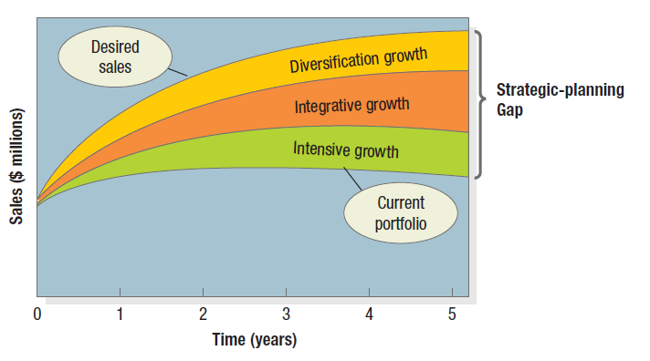
The Strategic Planning Gap
Notes:
Assessing growth opportunities includes planning new businesses, downsizing, and terminating older businesses. If there is a gap between future desired sales and projected sales, corporate management will need to develop or acquire new businesses to fill it.
Figure 2.2 illustrates this strategic-planning gap for a major manufacturer of blank compact disks called Musicale (name disguised). The lowest curve projects the expected sales over the next five years from the current business portfolio. The highest describes desired sales over the same period. Evidently, the company wants to grow much faster than its current businesses will permit.
How can it fill the strategic-planning gap? The first option is to identify opportunities for growth within current businesses (intensive opportunities). The second is to identify opportunities to build or acquire businesses related to current businesses (integrative opportunities). The third is to identify opportunities to add attractive unrelated businesses (diversification opportunities).

Slide 19
How can it fill the strategic-planning gap?
The first option is to identify opportunities for growth within current businesses (intensive opportunities).
The second is to identify opportunities to build or acquire businesses related to current businesses (integrative opportunities).
The third is to identify opportunities to add attractive unrelated businesses (diversification opportunities).
Downsizing and divesting older businesses

