Slide 1
Applied Marketing Strategies
MGT 681
Lecture 5

Slide 2
Review of Concepts
Part 1

Slide 3
Lecture Agenda
How does marketing affect customer value?
How is strategic planning carried out at different levels of the organization?
What does a marketing plan include?
Notes:
Good marketing is no accident, but a result of careful planning and execution using state-of-the-art tools and techniques. It becomes both an art and a science as marketers strive to find creative new solutions to challenges in a complex marketing environment.
In this book, the authors describe how top marketers balance discipline and imagination to address these new marketing realities. In the first chapter, they set the stage by reviewing important marketing concepts, tools, frameworks, and issues.
The questions identified in the slide will be our focus.

Slide 4
Phases of Value Creation and Delivery
Choosing the value
Providing the value
Communicating the value
Notes:
We can divide the value creation and delivery sequence into three phases.2 First, choosing the value represents the “homework” marketing must do before any product exists. Marketers must segment the market, select the appropriate target, and develop the offering’s value positioning. The formula “segmentation, targeting, positioning (STP)” is the essence of strategic marketing. The second phase is providing the value. Marketing must determine specific product features, prices, and distribution. The task in the third phase is communicating the value by utilizing the sales force, Internet, advertising, and any other communication tools to announce and promote the product. The value delivery process begins before there is a product and continues through development and after launch.

Slide 5
What is the Value Chain?
The value chain is a tool for identifying and was to create more customer value because every firm is a synthesis of primary and support activities performed to design, produce, market, deliver, and support its product.
Notes:
Harvard’s Michael Porter has proposed the value chain as a tool for identifying ways to create more customer value.3 According to this model, every firm is a synthesis of activities performed to design, produce, market, deliver, and support its product. The value chain identifies nine strategically relevant activities—five primary and four support activities—that create value and cost in a specific business. The primary activities are (1) inbound logistics, or bringing materials into the business; (2) operations, or converting materials into final products; (3) outbound logistics, or shipping out final products; (4) marketing, which includes sales; and (5) service. Specialized departments handle the support activities—(1) procurement, (2) technology development, (3) human resource management, and (4) firm infrastructure. (Infrastructure covers the costs of general management, planning, finance, accounting, legal, and government affairs.)

Slide 6
What is the Value Chain?
Harvard’s Michael Porter proposed the value chain
A tool for identifying ways to create more customer value.
Every firm is a synthesis of activities performed to design, produce, market, deliver, and support its product.
The value chain identifies nine strategically relevant activities
  Five primary
  Four support.

Slide 7
What is the Value Chain?
Primary activities
  (1) inbound logistics, or bringing materials into the business;
  (2) operations, or converting materials into final products;
  (3) outbound logistics, or shipping out final products;
  (4) marketing, which includes sales
  (5) service.
Specialized departments handle the support activities
  (1) procurement,
  (2) technology development,
  (3) human resource management
  (4) firm infrastructure. (Infrastructure covers the costs of general management, planning, finance, accounting, legal, and government affairs.)

Slide 8
Core Business Processes
Market-sensing process
New-offering realization process
Customer acquisition process
Customer relationship management process
Fulfillment management process
Notes:
The firm’s success depends not only on how well each department performs its work, but also on how well the company coordinates departmental activities to conduct core business processes.
These processes include:
• The market-sensing process which refers to all the activities in gathering and acting upon information about the market.
• The new-offering realization process which is all the activities in researching, developing, and launching new high-quality offerings quickly and within budget.
• The customer acquisition process which entails all the activities in defining target markets and prospecting for new customers.
• The customer relationship management process which entails all the activities in building deeper understanding, relationships, and offerings to individual customers.
• The fulfillment management process which includes all the activities in receiving and approving orders, shipping the goods on time, and collecting payment.

Slide 9
Core Business Processes
The market-sensing process which refers to all the activities in gathering and acting upon information about the market.
The new-offering realization process which is all the activities in researching, developing, and launching new high-quality offerings quickly and within budget.
The customer acquisition process which entails all the activities in defining target markets and prospecting for new customers.
The customer relationship management process which entails all the activities in building deeper understanding, relationships, and offerings to individual customers.
The fulfillment management process which includes all the activities in receiving and approving orders, shipping the goods on time, and collecting payment.
Notes:
The firm’s success depends not only on how well each department performs its work, but also on how well the company coordinates departmental activities to conduct core business processes.
These processes include:
• The market-sensing process which refers to all the activities in gathering and acting upon information about the market.
• The new-offering realization process which is all the activities in researching, developing, and launching new high-quality offerings quickly and within budget.
• The customer acquisition process which entails all the activities in defining target markets and prospecting for new customers.
• The customer relationship management process which entails all the activities in building deeper understanding, relationships, and offerings to individual customers.
• The fulfillment management process which includes all the activities in receiving and approving orders, shipping the goods on time, and collecting payment.

Slide 10

Characteristics of
Core Competencies
A source of competitive advantage
Applications in a wide variety of markets
Difficult to imitate
Notes:
The key, then, is to own and nurture the resources and competencies that make up the essence of the business. Many textile, chemical, and computer/electronic product firms do not manufacture their own products because offshore manufacturers are more competent in this task. Instead, they focus on product design and development and marketing, their core competencies. A core competency has three characteristics: (1) It is a source of competitive advantage and makes a significant contribution to perceived customer benefits. (2) It has applications in a wide variety of markets. (3) It is difficult for competitors to imitate.

Slide 11
Maximizing Core Competencies
(Re)define the business concept
(Re)shaping the business scope
(Re)positioning the company’s brand identity
Notes:
Business realignment may be necessary to maximize core competencies. It has three steps: (1) (re)defining the business concept or “big idea”, (2) (re)shaping the business scope, and (3) (re)positioning the company’s brand identity. Consider what Kodak is doing to realign its business by taking a look at the case in the text.

Slide 12
What is Holistic Marketing?
Holistic marketing sees itself as integrating the value exploration, value creation, and value delivery activities with the purpose of building long-term, mutually satisfying relationships and co-prosperity among key stakeholders.
Notes:
Holistic marketers thus succeed by managing a superior value chain that delivers a high level of product quality, service, and speed. They achieve profitable growth by expanding customer share, building customer loyalty, and capturing customer lifetime value.

Slide 13
Questions to Address in
Holistic Marketing
What value opportunities are available?
How can we create new value offerings efficiently?
How can we delivery the new offerings efficiently?
Notes:
Holistic marketers address three key management questions:
1. Value exploration—How a company identifies new value opportunities
2. Value creation—How a company efficiently creates more promising new value offerings
3. Value delivery—How a company uses its capabilities and infrastructure to deliver the new value offerings more efficiently

Slide 14
Strategic Planning Priority
(1) managing a company’s businesses as an investment portfolio
(2) assessing each business’s strength by considering the market’s growth rate and the company’s position and fit in that market
(3) establishing a strategy. The company must develop a game plan for achieving each business’s long-run objectives.

Slide 15
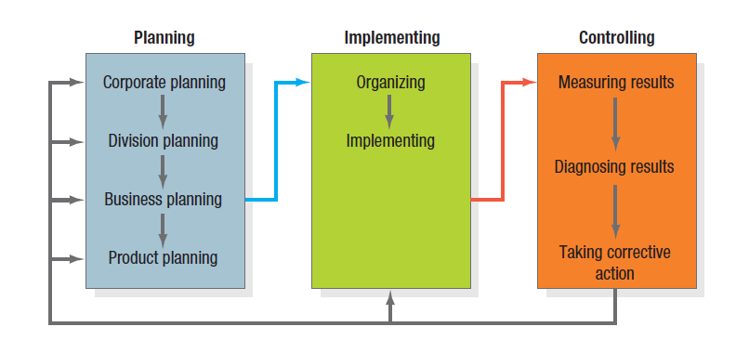
Figure 2.1 The Strategic Planning, Implementation, and
Control Processes
Notes:
To ensure they select and execute the right activities, marketers must give priority to strategic planning in three key areas: (1) managing a company’s businesses as an investment portfolio, (2) assessing each business’s strength by considering the market’s growth rate and the company’s position and fit in that market, and (3) establishing a strategy. The company must develop a game plan for achieving each business’s long-run objectives.
Most large companies consist of four organizational levels: (1) corporate, (2) division, (3) business unit, and (4) product. Corporate headquarters is responsible for designing a corporate strategic plan to guide the whole enterprise; it makes decisions on the amount of resources to allocate to each division, as well as on which businesses to start or eliminate. Each division establishes a plan covering the allocation of funds to each business unit within the division. Each business unit develops a strategic plan to carry that business unit into a profitable future. Finally, each product level (product line, brand) develops a marketing plan for achieving its objectives.

Slide 16
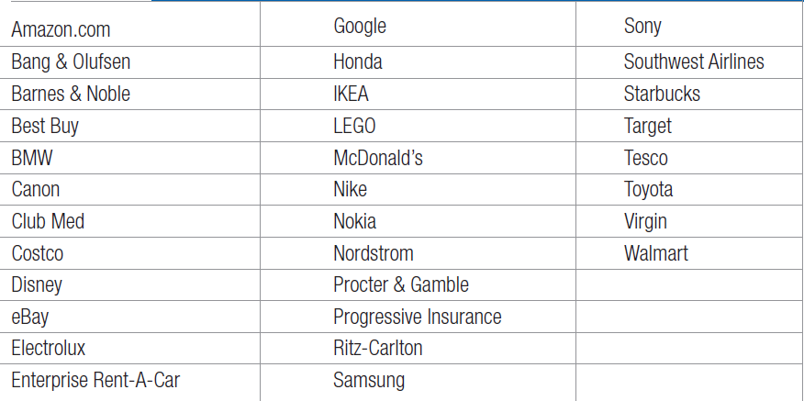
Table 2.1 Master Marketers
Notes:
Only a small group of companies stand out over time as master marketers as shown in Table 2.1.

Slide 17
What is a Marketing Plan?
A marketing plan is the
central instrument for
directing and coordinating
the marketing effort.
It operates at a strategic and tactical level.
Notes:
The marketing plan is the central instrument for directing and coordinating the marketing effort. It operates at two levels: strategic and tactical. The strategic marketing plan lays out the target markets and the firm’s value proposition, based on an analysis of the best market opportunities. The tactical marketing plan specifies the marketing tactics, including product features, promotion, merchandising, pricing, sales channels, and service.

Slide 18
Levels of a Marketing Plan
Strategic
  Target marketing decisions
  Value proposition
  Analysis of marketing opportunities
Tactical
  Product features
  Promotion
  Merchandising
  Pricing
  Sales channels
  Service
Notes:
The marketing plan is the central instrument for directing and coordinating the marketing effort. It operates at two levels: strategic and tactical. The strategic marketing plan lays out the target markets and the firm’s value proposition, based on an analysis of the best market opportunities.
The tactical marketing plan specifies the marketing tactics, including product features, promotion, merchandising, pricing, sales channels, and service.

Slide 19
Corporate Headquarters’
Planning Activities
Define the corporate mission
Establish strategic business units (SBUs)
Assign resources to each SBU
Assess growth opportunities
Notes:
Some corporations give their business units freedom to set their own sales and profit goals and strategies. Others set goals for their business units but let them develop their own strategies.
Still others set the goals and participate in developing individual business unit strategies.
All corporate headquarters undertake four planning activities which are identified in the slide. We’ll discuss each more as we move forward.

Slide 20
Good Mission Statements
Focus on a limited number of goals
Stress major policies and values
Define major competitive spheres
Take a long-term view
Short, memorable, meaningful
Notes:
To define its mission, a company should address Peter Drucker’s classic questions: What is our business? Who is the customer? What is of value to the customer? What will our business be? What should our business be? These simple-sounding questions are among the most difficult a company will ever have to answer. Successful companies continuously raise and answer them.
Organizations develop mission statements to share with managers, employees, and (in many cases) customers. A clear, thoughtful mission statement provides a shared sense of purpose, direction, and opportunity.

Slide 21
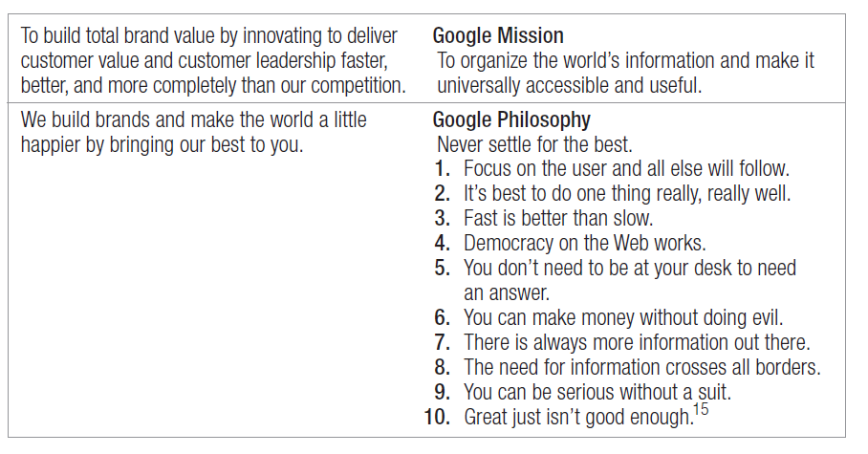
Google
Notes:
Compare the rather vague mission statements on the left with Google’s mission statement and philosophy on the right. Does Google’s mission meet the criteria of good mission statements?

Slide 22
Table 2.2
Major Competitive Spheres
Industry
Products
Competence
Market segment
Vertical channels
Geographic
Notes:
In Table 2.2, the major areas with which companies can define competitive territories in their mission statements are reviewed.

Slide 23
Product Orientation vs.
Market Orientation
Company | Product | Market
Missouri-Pacific Railroad | We run a railroad | We are a people-and-goods mover
Xerox | We make copying equipment | We improve office productivity
Standard Oil | We sell gasoline | We supply energy
Columbia Pictures | We make movies | We entertain people
Notes:
Companies often define themselves in terms of products: They are in the “auto business” or the “clothing business.” Market definitions of a business, however, describe the business as a customer satisfying process.
Transportation is a need: the horse and carriage, automobile, railroad, airline, ship, and truck are products that meet that need.
Viewing businesses in terms of customer needs can suggest additional growth opportunities. Table 2.3 lists companies that have moved from a product to a market definition of their business. It highlights the difference between a target market definition and a strategic market definition.

Slide 24
Dimensions Define a Business
Customer Groups
Customer Needs
Technology
Notes:
A business can define itself in terms of three dimensions: customer groups, customer needs, and technology. Consider a small company that defines its business as designing incandescent lighting systems for television studios. Its customer group is television studios; the customer need is lighting; the technology is incandescent lighting. The company might want to expand to make lighting for homes, factories, and offices, or it could supply other services television studios need, such as heating, ventilation, or air conditioning.

Slide 25
Characteristics of SBUs
It is a single business or collection of related businesses
It has its own set of competitors
It has a leader responsible for strategic planning and profitability
Notes:
Large companies normally manage quite different businesses, each requiring its own strategy. At one time, General Electric classified its businesses into 49 strategic business units (SBUs). An SBU has three characteristics, as listed in the slide.

Slide 26

Notes:
Kate Spade is a SBU under the Liz Claiborne corporate umbrella.

Slide 27
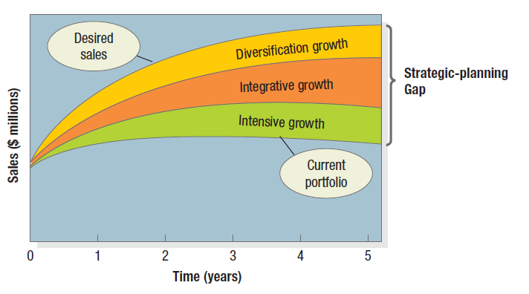
Figure 2.2 The Strategic Planning Gap
Notes:
Assessing growth opportunities includes planning new businesses, downsizing, and terminating older businesses. If there is a gap between future desired sales and projected sales, corporate management will need to develop or acquire new businesses to fill it.
Figure 2.2 illustrates this strategic-planning gap for a major manufacturer of blank compact disks called Musicale (name disguised). The lowest curve projects the expected sales over the next five years from the current business portfolio. The highest describes desired sales over the same period. Evidently, the company wants to grow much faster than its current businesses will permit.
How can it fill the strategic-planning gap? The first option is to identify opportunities for growth within current businesses (intensive opportunities). The second is to identify opportunities to build or acquire businesses related to current businesses (integrative opportunities). The third is to identify opportunities to add attractive unrelated businesses (diversification opportunities).

Slide 28
What is Corporate Culture?
Corporate culture is the
shared experiences, stories, beliefs,
and norms that
characterize an organization.
Notes:
Strategic planning happens within the context of the organization. A company’s
organization consists of its structures, policies, and corporate culture, all of which can become dysfunctional in a rapidly changing business environment. Whereas managers can change structures and policies (though with difficulty), the company’s culture is very hard to change. Yet adapting the culture is often the key to successfully implementing a new strategy.
What exactly is a corporate culture? Some define it as “the shared experiences, stories, beliefs, and norms that characterize an organization.” Walk into any company and the first thing that strikes you is the corporate culture—the way people dress, talk to one another, and greet customers.

Slide 29
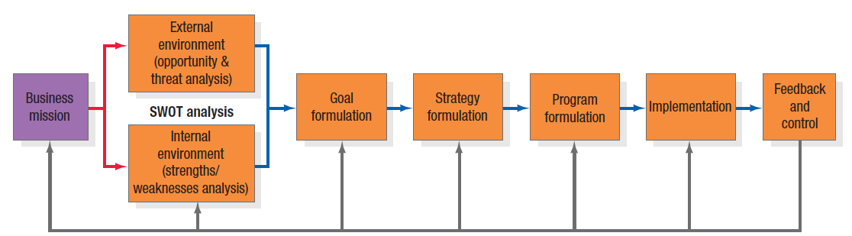
Figure 2.3 The Business Unit Strategic Planning Process
Notes:
The business unit strategic-planning process consists of the steps shown in Figure 2.3.. Each business unit needs to define its specific mission within the broader company mission. The overall evaluation of a company’s strengths, weaknesses, opportunities, and threats is called SWOT analysis. It’s a way of monitoring the external and internal marketing environment. Once the company has performed a SWOT analysis, it can proceed to goal formulation, developing specific goals for the planning period. Goals are objectives that are specific with respect to magnitude and time. Goals indicate what a business unit wants to achieve; strategy is a game plan for getting there. Every business must design a strategy for achieving its goals, consisting of a marketing strategy and a compatible technology strategy and sourcing strategy. Even a great marketing strategy can be sabotaged by poor implementation. If the unit has decided to attain technological leadership, it must strengthen its R&D department, gather technological intelligence, develop leading-edge products, train its technical sales force, and communicate its technological leadership. Once they have formulated marketing programs, marketers must estimate their costs.

Slide 30
SWOT Analysis
Strengths
Weaknesses
Opportunities
Threats
Notes:
The overall evaluation of a company’s strengths, weaknesses, opportunities, and threats is called SWOT analysis. It’s a way of monitoring the external and internal marketing environment.

Slide 31
Market Opportunity Analysis (MOA)
Can the benefits involved in the opportunity be articulated convincingly to a defined target market?
Can the target market be located and reached with cost-effective media and trade channels?
Does the company possess or have access to the critical capabilities and resources needed to deliver the customer benefits?
Notes:
To evaluate opportunities, companies can use market opportunity analysis (MOA) to ask questions like those posed on this slide and the next one.

Slide 32
Market Opportunity Analysis (MOA)
Can the company deliver the benefits better than any actual or potential competitors?
Will the financial rate of return meet or exceed the company’s required threshold for investment?

Slide 33
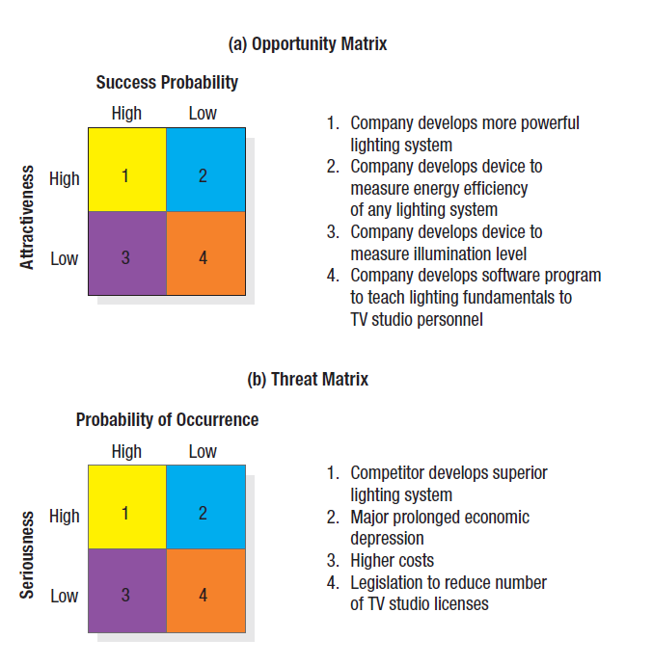
Figure 2.4
Opportunity and Threat Matrices
Notes:
By using the SWOT analysis and market opportunity analysis, we can create opportunity and threat matrices.
In the opportunity matrix in Figure 2.4 (a), the best marketing opportunities facing the TV-lighting-equipment company appear in the upper-left cell (#1). The opportunities in the lower-right cell (#4) are too minor to consider. The opportunities in the upper-right cell (#2) and the lower-left cell (#3) are worth monitoring in the event that any improve in attractiveness and potential.

Slide 34
Goal Formulation and MBO
Unit’s objectives must be hierarchical
Objectives should be quantitative
Goals should be realistic
Objectives must be consistent
Notes:
Most business units pursue a mix of objectives, including profitability, sales growth, market share improvement, risk containment, innovation, and reputation. The business unit sets these objectives and then manages by objectives (MBO). For an MBO system to work, the unit’s objectives must meet four criteria as shown in the slide.

Slide 35
Porter’s Generic Strategies
Overall cost leadership
Differentiation
Focus
Notes:
Michael Porter has proposed three generic strategies that provide a good starting point for strategic thinking: overall cost leadership, differentiation, and focus.
With overall cost leadership, firms work to achieve the lowest production and distribution costs so they can underprice competitors and win market share.
With differentiation, the business concentrates on achieving superior performance in an important customer benefit area valued by a large part of the market.
With focus, the business focuses on one or more narrow market segments, gets to know them intimately, and pursues either cost leadership or differentiation within the target segment.

Slide 36
Categories of Marketing Alliances
Product or service alliance
Promotional alliance
Logistics alliances
Pricing collaborations
Notes:
Even giant companies often cannot achieve leadership, either nationally or globally, without forming alliances with domestic or multinational companies that complement or leverage their capabilities and resources.
Many strategic alliances take the form of marketing alliances. These fall into four major categories.
Product or service alliances—One company licenses another to produce its product, or two companies jointly market their complementary products or a new product.
Promotional alliances—One company agrees to carry a promotion for another company’s product or service.
Logistics alliances—One company offers logistical services for another company’s product.
Pricing collaborations—One or more companies join in a special pricing collaboration.

Slide 37
McKinsey’s Elements of Success
Skills
Strategy
Staff
Structure
Style
Systems
Shared values
Notes:
According to McKinsey & Company, strategy is only one of seven elements—all of which start with the letter s—in successful business practice.41 The first three—strategy, structure, and systems—are considered the “hardware” of success. The next four—style, skills, staff, and shared values—are the “software.” The first “soft” element, style, means company employees share a common way of thinking and behaving. The second, skills, means employees have the skills needed to carry out the company’s strategy. Staffing means the company has hired able people, trained them well, and assigned them to the right jobs. The fourth element, shared values, means employees share the same guiding values. When these elements are present, companies are usually more successful at strategy implementation.

Slide 38
Marketing Plan Contents
Executive summary
Table of contents
Situation analysis
Marketing strategy
Financial projections
Implementation controls
Notes:
Although the exact length and layout varies from company to company, most marketing plans cover one year in anywhere from 5 to 50 pages. Smaller businesses may create shorter or less formal marketing plans, whereas corporations generally require highly structured documents.
A marketing plan usually contains the sections listed in the slide.

Slide 39
Evaluating a Marketing Plan
Is the plan simple?
Is the plan specific?
Is the plan realistic?
Is the plan complete?
Notes:
In the Marketing Memo, these questions are suggested for evaluating the quality of the marketing plan.

Slide 40
For Review
How does marketing affect customer value?
How is strategic planning carried out at different levels of the organization?
What does a marketing plan include?
Notes:
In this chapter, we learned how to answer these questions.

