Slide 1
Applied Marketing Strategies
MGT 681
Lecture 4

Slide 2
Review of Concepts
Part 1

Slide 3
Lecture Agenda
How has marketing changed?
What are the tasks necessary for successful marketing?
Notes:
Good marketing is no accident, but a result of careful planning and execution using state-of-the-art tools and techniques. It becomes both an art and a science as marketers strive to find creative new solutions to challenges in a complex marketing environment.
In this book, the authors describe how top marketers balance discipline and imagination to address these new marketing realities. In the first chapter, they set the stage by reviewing important marketing concepts, tools, frameworks, and issues.
The questions identified in the slide will be our focus.

Slide 4
Holistic Marketing
The holistic marketing concept is based on the:
  Development
  Design
  Implementation
of marketing programs, processes, and activities that recognize their breadth and interdependencies.
Holistic marketing acknowledges that everything matters in marketing
A broad, integrated perspective is necessary.
Notes:
The holistic marketing concept is based on the development, design, and implementation of marketing programs, processes, and activities that recognize their breadth and interdependencies.
Holistic marketing acknowledges that everything matters in marketing—and that a broad, integrated perspective is often necessary. Figure 1.3 provides a schematic overview of four broad components characterizing holistic marketing: relationship marketing, integrated marketing, internal marketing, and performance marketing.

Slide 5
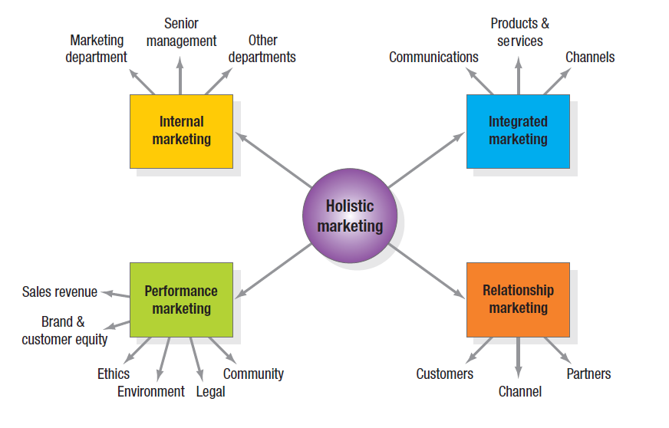
Holistic Marketing
Notes:
The holistic marketing concept is based on the development, design, and implementation of marketing programs, processes, and activities that recognize their breadth and interdependencies.
Holistic marketing acknowledges that everything matters in marketing—and that a broad, integrated perspective is often necessary. Figure 1.3 provides a schematic overview of four broad components characterizing holistic marketing: relationship marketing, integrated marketing, internal marketing, and performance marketing.

Slide 6
Relationship Marketing
Relationship marketing aims to build mutually satisfying long-term relationships with key constituents in order to earn and retain their business.
Notes:
Relationship marketing aims to build mutually satisfying long-term relationships with key constituents in order to earn and retain their business.
Four key constituents for relationship marketing are customers, employees, marketing partners (channels, suppliers, distributors, dealers, agencies), and members of the financial community (shareholders, investors, analysts). Marketers must create prosperity among all these constituents and balance the returns to all key stakeholders. To develop strong relationships with them requires understanding their capabilities and resources, needs, goals, and desires. The ultimate outcome of relationship marketing is a unique company asset called a marketing network, consisting of the company and its supporting stakeholders—customers, employees, suppliers, distributors, retailers, and others—with whom it has built mutually profitable business relationships. The operating principle is simple: build an effective network of relationships with key stakeholders, and profits will follow.

Slide 7
Relationship Marketing
Customers
Employees
Marketing Partners
(channels, suppliers, distributors, dealers, agencies)
Financial Community
(shareholders, investors, analysts).
Notes:
Relationship marketing aims to build mutually satisfying long-term relationships with key constituents in order to earn and retain their business.
Four key constituents for relationship marketing are customers, employees, marketing partners (channels, suppliers, distributors, dealers, agencies), and members of the financial community (shareholders, investors, analysts). Marketers must create prosperity among all these constituents and balance the returns to all key stakeholders. To develop strong relationships with them requires understanding their capabilities and resources, needs, goals, and desires. The ultimate outcome of relationship marketing is a unique company asset called a marketing network, consisting of the company and its supporting stakeholders—customers, employees, suppliers, distributors, retailers, and others—with whom it has built mutually profitable business relationships. The operating principle is simple: build an effective network of relationships with key stakeholders, and profits will follow.

Slide 8
Relationship Marketing
Create prosperity among all these constituents
Balance the returns to all key stakeholders.
Understanding constituents’
  capabilities and resources
  Needs
  Goals
  Desires.

Slide 9
Marketing Network
The ultimate outcome of relationship marketing:
  A unique company asset
Consists of the company and its supporting stakeholders—customers, employees, suppliers, distributors, retailers, and others—with whom it has built mutually profitable business relationships.
The operating principle is : build an effective network of relationships with key stakeholders, and profits will follow.

Slide 10
Holistic Marketing
Notes:
The holistic marketing concept is based on the development, design, and implementation of marketing programs, processes, and activities that recognize their breadth and interdependencies.
Holistic marketing acknowledges that everything matters in marketing—and that a broad, integrated perspective is often necessary. Figure 1.3 provides a schematic overview of four broad components characterizing holistic marketing: relationship marketing, integrated marketing, internal marketing, and performance marketing.

Slide 11
Integrated Marketing
Integrated marketing occurs when the marketer devises marketing activities and assembles marketing programs to:
  Create value
  Communicate value
  Deliver value
For consumers such that “the whole is greater than the sum of its parts.”
Two key themes are that
  many different marketing activities can create, communicate, and deliver value and
  marketers should design and implement any one marketing activity with all other activities in mind.
Notes:
Integrated marketing occurs when the marketer devises marketing activities and assembles marketing programs to create, communicate, and deliver value for consumers such that “the whole is greater than the sum of its parts.” Two key themes are that (1) many different marketing activities can create, communicate, and deliver value and (2) marketers should design and implement any one marketing activity with all other activities in mind.

Slide 12
Holistic Marketing
Notes:
The holistic marketing concept is based on the development, design, and implementation of marketing programs, processes, and activities that recognize their breadth and interdependencies.
Holistic marketing acknowledges that everything matters in marketing—and that a broad, integrated perspective is often necessary. Figure 1.3 provides a schematic overview of four broad components characterizing holistic marketing: relationship marketing, integrated marketing, internal marketing, and performance marketing.

Slide 13
Internal Marketing
Internal marketing is the task of
hiring, training, and motivating able employees
who want to serve customers well.
Notes:
Snowshoe Mountain in Snowshoe, West Virginia, embarked on a marketing program based on internal marketing to better brand the ski resort with a promise of an “authentic, rustic and engaging wilderness experience.” In launching a branding initiative to define their goals and articulate what they wanted the Snowshoe Mountain brand to represent to visitors, the resort’s marketers started inside. They incorporated the new brand promise in a 40-page brand book that contained the history of the resort and a list of seven attitude words that characterized how employees should interact with guests. On-mountain messaging and signs also reminded employees to deliver on the brand promise. All new hires received a brand presentation from the director of marketing to help them better understand the brand and become effective advocates.

Slide 14
Holistic Marketing
Notes:
The holistic marketing concept is based on the development, design, and implementation of marketing programs, processes, and activities that recognize their breadth and interdependencies.
Holistic marketing acknowledges that everything matters in marketing—and that a broad, integrated perspective is often necessary. Figure 1.3 provides a schematic overview of four broad components characterizing holistic marketing: relationship marketing, integrated marketing, internal marketing, and performance marketing.

Slide 15
Performance Marketing
Performance marketing requires understanding the financial and nonfinancial returns to business and society from marketing activities and programs.
Going beyond sales revenue and examine the marketing scorecard and interpret what is happening to
  market share
  customer loss rate
  customer satisfaction
  product quality and other measures.
Considering the legal, ethical, social, and environmental effects of marketing activities and programs.
Notes:
Performance marketing requires understanding the financial and nonfinancial returns to business and society from marketing activities and programs. Top marketers are increasingly going beyond sales revenue to examine the marketing scorecard and interpret what is happening to market share, customer loss rate, customer satisfaction, product quality, and other measures. They are also considering the legal, ethical, social, and environmental effects of marketing activities and programs.

Slide 16
Performance Marketing
Financial
Accountability
Social Responsibility Marketing
Notes:
Performance marketing requires understanding the financial and nonfinancial returns to business and society from marketing activities and programs. Top marketers are increasingly going beyond sales revenue to examine the marketing scorecard and interpret what is happening to market share, customer loss rate, customer satisfaction, product quality, and other measures. They are also considering the legal, ethical, social, and environmental effects of marketing activities and programs.

Slide 17
Types of
Corporate Social Initiatives
Corporate social marketing
Cause marketing
Cause-related marketing
Corporate philanthropy
Corporate community involvement
Socially responsible business practices
Notes:
In Table 1.2 these forms of social activity are defined and examples from McDonald’s are provided.

Slide 18
The Marketing Mix
McCarthy classified various marketing activities into marketing-mix tools of four broad kinds which he called the four Ps of marketing:
  Product,
  Price,
  Place
  Promotion.

Slide 19
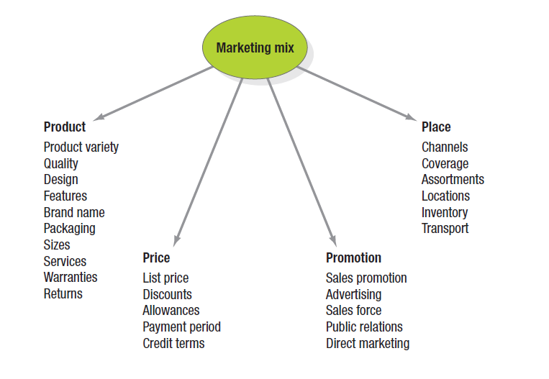
The Marketing Mix
Notes:
McCarthy classified various marketing activities into marketing-mix tools of four broad kinds, which he called the four Ps of marketing: product, price, place, and promotion. The marketing variables under each P are shown in Figure 1.4. Given the breadth, complexity, and richness of marketing, however—as exemplified by holistic marketing—clearly these four Ps are not the whole story anymore.

Slide 20
The New Four Ps
People
Processes
Programs
Performance
Notes:
If we update them to reflect the holistic marketing concept, we arrive at a more representative set that encompasses modern marketing realities: people, processes, programs, and performance, as in Figure 1.5.
People reflects, in part, internal marketing and the fact that employees are critical to marketing success.
Processes reflects all the creativity, discipline, and structure brought to marketing management. Programs reflects all the firm’s consumer-directed activities. It encompasses the old four Ps as well as a range of other marketing activities that might not fit as neatly into the old view of marketing.
We define performance as in holistic marketing, to capture the range of possible outcome measures that have financial and nonfinancial implications (profitability as well as brand and customer equity), and implications beyond the company itself (social responsibility, legal, ethical, and community related).

Slide 21
The New Four Ps
People reflects, in part, internal marketing and the fact that employees are critical to marketing success.
Processes reflects all the
  creativity,
  discipline,
  and structure
  brought to marketing.
Programs reflects all the firm’s consumer-directed activities.
  It encompasses the old four Ps as well as a range of other marketing activities that might not fit as neatly into the old view of marketing.
Performance as in holistic marketing, to capture the range of possible outcome measures that have financial and nonfinancial implications (profitability as well as brand and customer equity), and implications beyond the company itself (social responsibility, legal, ethical, and community related).
Notes:
If we update them to reflect the holistic marketing concept, we arrive at a more representative set that encompasses modern marketing realities: people, processes, programs, and performance, as in Figure 1.5.
People reflects, in part, internal marketing and the fact that employees are critical to marketing success.
Processes reflects all the creativity, discipline, and structure brought to marketing management. Programs reflects all the firm’s consumer-directed activities. It encompasses the old four Ps as well as a range of other marketing activities that might not fit as neatly into the old view of marketing.
We define performance as in holistic marketing, to capture the range of possible outcome measures that have financial and nonfinancial implications (profitability as well as brand and customer equity), and implications beyond the company itself (social responsibility, legal, ethical, and community related).

Slide 22
Marketing Applied Strategy Tasks
Develop market strategies and plans
Capture marketing insights
Connect with customers
Build strong brands
Shape market offerings
Deliver value
Communicate value
Create long-term growth
Notes:
With the holistic marketing philosophy as a backdrop, we can identify a specific set of tasks that make up successful marketing management and marketing leadership.

