Slide 1
Applied Marketing Strategies
MGT 681
Lecture 32

Slide 2
The New Global Paradigm
Part 6

Slide 3
Lecture Agenda
What factors should a company review before deciding to go abroad?
How can companies evaluate and select specific foreign markets to enter?
What are the differences between marketing in a developing and a developed market?
What are the major ways of entering a foreign market?
Notes:
With ever faster communication, transportation, and financial flows, the world is rapidly shrinking. Countries are increasingly multicultural, and products and services developed in one country are finding enthusiastic acceptance in others. A German businessman may wear an Italian suit to meet an English friend at a Japanese restaurant, who later returns home to drink Russian vodka and watch a U.S. movie on a Korean TV. Emerging markets that embrace capitalism and consumerism are especially attractive targets. They are also creating marketing powerhouses all their own. Companies need to be able to cross boundaries within and outside their country.

Slide 4
Lecture Agenda
To what extent must the company adapt its products and marketing program to each foreign country?
How do marketers influence country-of-origin effects?
How should the company manage and organize its international activities?

Slide 5
What is a Global Firm?
A global firm is one that operates in more than one country and captures R&D, production, logistical, marketing, and financial advantages in its costs and reputation that are not available to purely domestic competitors.
Notes:
Pollo Campero (Spanish for “country) has used Latin American immigrants to launch over 50 U.S. stores, blending old favorites such as fried plantains and milky horchata drinks with traditional U.S. fare such as grilled chicken and mashed potatoes. Although some U.S. businesses may want to eliminate foreign competition through protective legislation, the better way to compete is to continuously improve products at home and expand into foreign markets. In a global industry, competitors’ strategic positions in major geographic or national markets are affected by their overall global positions. A global firm operates in more than one country and captures R&D, production, logistical, marketing, and financial advantages not available to purely domestic competitors. Global firms plan, operate, and coordinate their activities on a worldwide basis.

Slide 6
Major Decisions in
International Marketing
Deciding whether to go
Deciding which markets to enter
Deciding how to enter
Deciding on the marketing program
Deciding on the marketing organization
Notes:
For a company of any size or any type to go global, it must make a series of decisions as shown in Figure 21.1 and detailed in the slide.

Slide 7
Reasons for Pursuing
Global Markets
Better profit opportunities
Larger customer base to achieve economies of scale
Less dependence on any one market
Desire to counterattack global competitors in their home markets
Customers require international service
Notes:
Most companies would prefer to remain domestic if their domestic market were large enough. Managers would not need to learn other languages and laws, deal with volatile currencies, face political and legal uncertainties, or redesign their products to suit different customer needs and expectations. Business would be easier and safer. Yet several factors can draw companies into the international arena:
Some international markets present better profit opportunities than the domestic market.
The company needs a larger customer base to achieve economies of scale.
The company wants to reduce its dependence on any one market.
The company decides to counterattack global competitors in their home markets.
Customers are going abroad and require international service.

Slide 8
Risks to Going Abroad
Lack of knowledge of foreign culture
Lack of understanding of foreign needs
Lack of understanding of foreign regulations
Lack of managers with international expertise
Changes in the country environment
Notes:
Before making a decision to go abroad, the company must also weigh several risks:
• The company might not understand foreign preferences and could fail to offer a competitively attractive product.
• The company might not understand the foreign country’s business culture.
• The company might underestimate foreign regulations and incur unexpected costs.
• The company might lack managers with international experience.
• The foreign country might change its commercial laws, devalue its currency, or undergo a political revolution and expropriate foreign property.

Slide 9
Four Stages of Internationalization
Stage 1: No regular export activities
Stage 2: Export via independent agents
Stage 3: Establish sales subsidiaries
Stage 4: Establish production facilities abroad
Notes:
Some companies don’t act until events thrust them into the international arena. The internationalization process typically has four stages. These stages are shown in the slide.
The first task is to move from stage 1 to stage 2.Most firms work with an independent agent and enter a nearby or similar country. Later, the firm establishes an export department to manage its agent relationships. Still later, it replaces agents with its own sales subsidiaries in its larger export markets. This increases investment and risk, but also earning potential. Next, to manage subsidiaries, the company replaces the export department with an international department or division. If markets are large and stable, or the host country requires local production, the company will locate production facilities there. By this time, it’s operating as a multinational and optimizing its sourcing, financing, manufacturing, and marketing as a global organization.

Slide 10
Momentum in Market Entry
Waterfall Approach
Sprinkler Approach
Born Global
Notes:
Companies must decide how many countries to enter and how fast to expand. Typical entry strategies are the waterfall approach, gradually entering countries in sequence, and the sprinkler approach, entering many countries simultaneously. Increasingly, firms—especially technology intensive firms—are born global and market to the entire world from the outset.

Slide 11
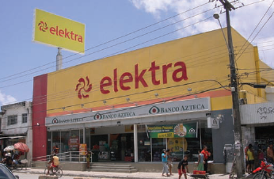
Local Dynamos
Notes:
In Mexico, retailer Grupo Elektra [a Mexican financial and retail corporation owned by Grupo Salinas that is listed on the New York Stock Exchange (EKT), the Bolsa Mexicana de Valores (ELEKTRA), and the Spanish Stock Market Latibex (XEKT)] is selling washing machines, refrigerators, televisions, and other items on credit to people making less than $10 a day. The company’s many stores double as bank branches where people can withdraw, deposit, and transmit cash, as well as get loans. According to BCG, local dynamos often combine in-depth understanding of consumer tastes with cost-effective production techniques to create a locally laser-focused business model.

Slide 12
Regional Free Trade Zones
European Union
NAFTA
MERCOSUL
APEC
ASEAN
Notes:
The European Union. Formed in 1957, the European Union set out to create a single European market by reducing barriers to the free flow of products, services, finances, and labor among member countries, and by developing trade policies with nonmember nations. Today, it’s one of the world’s largest single markets, with 27 member countries, a common currency—the euro—and more than 495 million consumers, accounting for 37 percent of the world’s exports.
NAFTA In January 1994, the North American Free Trade Agreement (NAFTA) unified the United States, Mexico, and Canada in a single market of 440 million people who produce and consume $16 trillion worth of goods and services annually.
MERCOSUR (or MERCOSUL) links Brazil, Argentina, Paraguay, Uruguay, and (soon) Venezuela to promote free trade and the fluid movement of goods, people, and currency.
APEC Twenty-one countries, as well as the NAFTA members and Japan and China, are working to create a pan-Pacific free trade area under the auspices of the Asian Pacific Economic Cooperation (APEC) forum. These countries account for approximately 40.5 percent of the world’s population, approximately 54.2 percent of world GDP, and about 43.7 percent of world trade.
ASEAN Ten countries make up the Association of Southeast Asian Nations: Brunei Darussalam, Cambodia, Indonesia, Lao PDR, Malaysia, Myanmar, Philippines, Singapore, Thailand, and Viet Nam.

Slide 13
Key Emerging Markets
Brazil
Russia
India
China
Indonesia
South Africa
Notes:
One of the sharpest distinctions in global marketing is between developed and developing or emerging markets such as Brazil, Russia, India, and China (often called “BRIC” for short: Brazil, Russia, India, and China). Two other developing markets with much economic and marketing significance are Indonesia and South Africa. The unmet needs of the developing world represent huge potential markets for food, clothing, shelter, consumer electronics, appliances, and many other goods.

Slide 14
Five Modes of Entry into Foreign Markets
Indirect exporting
Direct exporting
Licensing
Joint ventures
Direct investment
Notes:
Once a company decides to target a particular country, it must determine the best mode of entry. Its broad choices are indirect exporting, direct exporting, licensing, joint ventures, and direct investment, shown in Figure 21.2 and listed in the slide. Each succeeding strategy entails more commitment, risk, control, and profit potential.

Slide 15
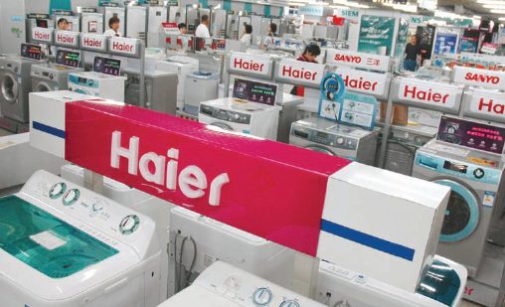
Indirect Exporting Methods
Notes:
Companies typically start with export, specifically indirect exporting—that is, they work through independent intermediaries. Domestic-based export merchants buy the manufacturer’s products and then sell them abroad. Domestic-based export agents, including trading companies, seek and negotiate foreign purchases for a commission. Cooperative organizations conduct exporting activities for several producers—often of primary products such as fruits or nuts—and are partly under their administrative control. Export-management companies agree to manage a company’s export activities for a fee. Indirect export has two advantages. First, there is less investment: The firm doesn’t have to develop an export department, an overseas sales force, or a set of international contacts. Second, there’s less risk: Because international marketing intermediaries bring know-how and services to the relationship, the seller will make fewer mistakes.

Slide 16
Direct Exporting Methods
Domestic-based export department
Overseas sales branch or subsidiary
Traveling export sales representatives
Foreign-based distributors or agents
Notes:
Companies may eventually decide to handle their own exports. The investment and risk are somewhat greater, but so is the potential return. Direct exporting happens in several ways:
• Domestic-based export department or division. A purely service function may evolve into a self-contained export department operating as its own profit center.
• Overseas sales branch or subsidiary. The sales branch handles sales and distribution and perhaps warehousing and promotion as well. It often serves as a display and customer-service center.
• Traveling export sales representatives. Home-based sales representatives travel abroad to find business.
• Foreign-based distributors or agents. These third parties can hold limited or exclusive rights to represent the company in that country.

Slide 17
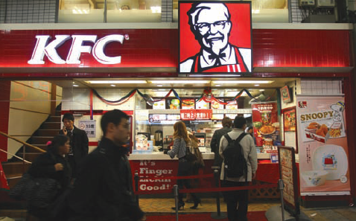
Licensing
Notes:
Licensing is a simple way to engage in international marketing. The licensor issues a license to a foreign company to use a manufacturing process, trademark, patent, trade secret, or other item of value for a fee or royalty. The licensor gains entry at little risk; the licensee gains production expertise or a well-known product or brand name. The licensor, however, has less control over the licensee than over its own production and sales facilities. If the licensee is very successful, the firm has given up profits, and if and when the contract ends, it might find it has created a competitor. To prevent this, the licensor usually supplies some proprietary product ingredients or components (as Coca-Cola does). But the best strategy is to lead in innovation so the licensee will continue to depend on the licensor.
Licensing arrangements vary. Companies such as Hyatt and Marriott sell management contracts to owners of foreign hotels to manage these businesses for a fee. The management firm may have the option to purchase some share in the managed company within a stated period.
In contract manufacturing, the firm hires local manufacturers to produce the product. Contract manufacturing reduces the company’s control over the process and risks loss of potential profits. However, it offers a chance to start faster, with the opportunity to partner with or buy out the local manufacturer later.
Finally, a company can enter a foreign market through franchising, a more complete form of licensing. The franchisor offers a complete brand concept and operating system. In return, the franchisee invests in and pays certain fees to the franchisor.

Slide 18
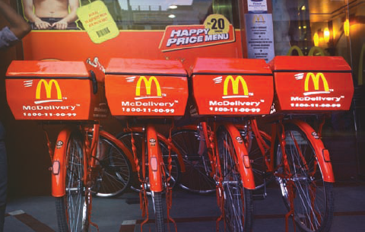
Joint Ventures
Notes:
Historically, foreign investors have often joined local investors in a joint venture company in which they share ownership and control. A joint venture may be necessary or desirable for economic or political reasons. The foreign firm might lack the financial, physical, or managerial resources to undertake the venture alone, or the foreign government might require joint ownership as a condition for entry. Joint ownership has drawbacks. The partners might disagree over investment, marketing, or other policies. One might want to reinvest earnings for growth, the other to declare more dividends. Joint ownership can also prevent a multinational company from carrying out specific manufacturing and marketing policies on a worldwide basis.
McDonald’s handpicks its global partners one by one to find “compulsive achievers” who will put forth the desired effort.

Slide 19

Direct Investment
Notes:
If the market is large enough, direct investment offers distinct advantages. First, the firm secures cost economies through cheaper labor or raw materials, government incentives, and freight savings. Second, the firm strengthens its image in the host country because it creates jobs. Third, the firm deepens its relationship with government, customers, local suppliers, and distributors, enabling it to better adapt its products to the local environment. Fourth, the firm retains full control over its investment and therefore can develop manufacturing and marketing policies that serve its long term international objectives. Fifth, the firm assures itself of access to the market in case the host country insists locally purchased goods have domestic content. The main disadvantage of direct investment is that the firm exposes a large investment to risks such as blocked or devalued currencies, worsening markets, or expropriation. If the host country requires substantial severance for employees, reducing or closing operations can be expensive.

Slide 20
Global Marketing
Advantages
Economies of scale
Lower marketing costs
Power and scope
Consistency in brand image
Ability to leverage
Uniformity of marketing practices
Disadvantages
Differences in consumer needs, wants, usage patterns
Differences in consumer response to marketing mix
Differences in brand development process
Differences in environment
Notes:
International companies must decide how much to adapt their marketing strategy to local conditions. At one extreme is a standardized marketing program worldwide, which promises the lowest costs; Table 21.2 summarizes some pros and cons. At the other extreme is an adapted marketing program in which the company, consistent with the marketing concept, believes consumer needs vary and tailors marketing to each target group.

Slide 21
Cultural Dimensions
Individualism versus collectivism—In collectivist societies, the self-worth of an individual is rooted more in the social system than in individual achievement (high collectivism: Japan; low: United States).
High versus low power distance—High power distance cultures tend to be less egalitarian (high: Russia; low: Nordic).
Masculine versus feminine—This dimension measures how much the culture is dominated by assertive males versus nurturing females (highly masculine: Japan; low: Nordic countries).
Weak versus strong uncertainty avoidance—Uncertainty avoidance indicates how risk-aversive people are (high avoidance: Greece; low: Jamaica). Consumer behavior differences as well as historical market factors lead marketers to position brands differently in different markets.
Notes:
Consumer behavior may reflect cultural differences that can be pronounced across countries. Hofstede identifies four cultural dimensions that differentiate countries:
1. Individualism versus collectivism—In collectivist societies, the self-worth of an individual is rooted more in the social system than in individual achievement (high collectivism: Japan; low: United States).
2. High versus low power distance—High power distance cultures tend to be less egalitarian (high: Russia; low: Nordic).
3. Masculine versus feminine—This dimension measures how much the culture is dominated by assertive males versus nurturing females (highly masculine: Japan; low: Nordic countries).
4. Weak versus strong uncertainty avoidance—Uncertainty avoidance indicates how risk-aversive people are (high avoidance: Greece; low: Jamaica). Consumer behavior differences as well as historical market factors lead marketers to position brands differently in different markets.
Heineken beer is a high-end super-premium offering in the United States but middle-of-the-road in its Dutch home market. Honda automobiles denote speed, youth, and energy in Japan and quality and reliability in the United States.

Slide 22
What Marketing Aspects Might Be Adapted for International Marketing?
Product features
Labeling
Colors
Materials
Sales promotion
Advertising media
Brand name
Packaging
Advertising execution
Prices
Advertising themes
Notes:
Because of all these differences, most products require at least some adaptation. Even Coca-Cola is sweeter or less carbonated in certain countries. Rather than assuming it can introduce its domestic product “as is” in another country, the company should review the elements listed in the slide and determine which add more revenue than cost if adapted. The best global brands are consistent in theme but reflect significant differences in consumer behavior, brand development, competitive forces, and the legal or political environment. Global brand managers are often told to “Think Global, Act Local.”

Slide 23
Commandments of Global Branding
Understand similarities and differences in the global branding landscape
Do not take shortcuts in brand building
Establish a marketing infrastructure
Embrace integrated marketing communications
Establish brand partnerships
Notes:
This slide and the next list the 10 Commandments of Global Branding detailed in the Marketing Memo.

Slide 24
Commandments of Global Branding
Balance standardization and customization
Balance global and local control
Establish operable guidelines
Implement a global brand-equity measurement system
Leverage brand elements

Slide 25
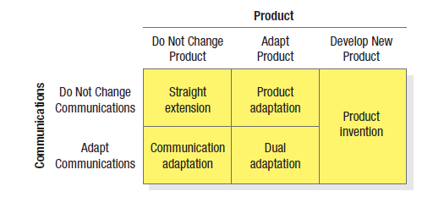
Five International Product and
Communication Strategies
Notes:
There are five communication and product adaptation strategies shown in Figure 21.3. Straight extension introduces the product in the foreign market without any change. Product adaptation alters the product to meet local conditions or preferences. Flexible manufacturing makes it easier to do so on several levels.

Slide 26
Levels of Product Adaptation
Production of regional product versions
Production of country versions
Production of city versions
Production of retailer versions
Notes:
A company can produce a regional version of its product, such as a Western European version. A company can produce a country version. A company can produce a city version. A company can produce different retailer versions.

Slide 27
Price Choices
Set a uniform price everywhere
Set a market-based price in each country
Set a cost-based price in each country
Notes:
A Gucci handbag may sell for $120 in Italy and $240 in the United States. Why? Gucci must add the cost of transportation, tariffs, importer margin, wholesaler margin, and retailer margin to its factory price. Price escalation from these added costs and currency fluctuation risk might make the price two to five times as much in another country to earn the same profit for the manufacturer. Companies have three choices for setting prices in different countries:
Set a uniform price everywhere.
Set a market-based price in each country.
Set a cost-based price in each country.

Slide 28
What is a Gray Market?
A gray market consists of branded products diverted from normal or authorized distributions channels in the country of product origin or cross international borders; dealers in lower priced countries sell products in higher priced countries
Notes:
Gray markets create a free-rider problem, making legitimate distributors’ investments in supporting a manufacturer’s product less productive and selective distribution systems more intensive. They harm distributor relations, tarnish the manufacturer’s brand equity, and undermine the integrity of the distribution channel. They can even pose risks to consumers if the seemingly brand-new product they think they are buying is damaged, remarked, obsolete, without warranty or support, or just counterfeit. Multinationals try to prevent gray markets by policing the distributors, raising their prices to lower-cost distributors, or altering product characteristics or service warranties for different countries.

Slide 29
Country of Origin Effects
Country-of-origin perceptions are the mental associations and beliefs triggered by a country.
People are often ethnocentric and favorably predisposed to their own country’s products
Notes:
Country-of-origin perceptions are the mental associations and beliefs triggered by a country. Although Kazakhstan has a positive story to tell given its huge size, rich natural resources, and rapid modernization, British comedian Sacha Baron Cohen’s mock documentary Borat portrayed the country in a sometimes crude and vulgar light. As one government official noted,“ the only fact of the movie is the geographic location of Kazakhstan.” Fortunately, the tongue-in-cheek film also created awareness and interest in the country and what has been called the “Borat Bounce,” an unanticipated surge in Tourism.
People are often ethnocentric and favorably predisposed to their own country’s products, unless they come from a less developed country. The more favorable a country’s image, the more prominently the “Made in...” label should be displayed. The impact of country of origin varies with the type of product. Consumers want to know where a car was made, but not the lubricating oil. Certain countries enjoy a reputation for certain goods: Japan for automobiles and consumer electronics; the United States for high-tech innovations, soft drinks, toys, cigarettes, and jeans; France for wine, perfume, and luxury goods. Sometimes country of-origin perception can encompass an entire country’s products.

