Slide 1
Applied Marketing Strategies
MGT 681
Lecture 31

Slide 2
Review of Applied Strategy and Controls
Part 5

Slide 3
Lecture Agenda
What are important trends in marketing practices?
What are the keys to effective internal marketing?
How has applied side of marketing evolved?
What tools are available to help companies monitor and improve their marketing activities?
Notes:
Healthy long-term growth for a brand requires that the marketing organization be managed properly. Holistic marketers must engage in a host of carefully planned, interconnected marketing activities and satisfy an increasingly broader set of constituents and objectives. Corporate social responsibility and sustainability have become a priority as organizations grapple with the short-term and long-term effects of their marketing.
Successful holistic marketing requires effective relationship marketing, integrated marketing, internal marketing, and performance marketing. Preceding chapters addressed the first two topics and the strategy and tactics of marketing. This chapter looks at how firms organize, implement, evaluate, and control marketing activities in a context heightened by social responsibility.

Slide 4
Trends in Marketing Practices
Reengineering
Outsourcing
Benchmarking
Supplier partnering
Customer partnering
Merging
Globalizing
Flattening
Focusing
Accelerating
Empowering
Notes:
Table 22.1 explains several important shifts occurring in marketing.
Reengineering refers to appointing teams to manage customer-value-building processes and break down walls between departments. Outsourcing refers to the buying more goods and services from outside domestic or foreign vendors. Benchmarking is the studying of “best practice companies” to improve performance. Supplier partnering refers to partnering with fewer but better value-adding suppliers. Customer partnering refers to the trend of working more closely with customers to add value to their operations.
Merging is the acquiring or merging with firms in the same or complementary industries to gain economies of scale and scope. Globalizing refers to the increasing efforts to “think global” and “act local”. Flattening is the reduction in the number of organizational levels to get closer to the customer. Focusing is determining the most profitable businesses and customers and focusing on them.
Justifying means becoming more accountable by measuring, analyzing, and documenting the effects of marketing actions. Accelerating means designing the organization and setting up processes to respond more quickly to changes in the environment. Empowering is encouraging and empowering personnel to produce more ideas and take more initiative. Broadening is factoring the interests of customers, employees, shareholders, and other stakeholders into the activities of the enterprise. Monitoring is tracking what is said online and elsewhere and studying customers, competitors, and others to improve business practices.

Slide 5
Networked Enterprise
The New Paradigm Internal Marketing
R&D
Purchasing
Manufacturing
Marketing
Sales
Logistics
Accounting
Finance
Public Relations
Other Customer-Contact Personnel
Notes:
Traditionally, marketers played the role of middleman, charged with understanding customers’ needs and transmitting their voice to various functional areas. But in a networked enterprise, every functional area can interact directly with customers. Marketing no longer has sole ownership of customer interactions; rather, it now must integrate all the customer-facing processes so customers see a single face and hear a single voice when they interact with the firm.
Internal marketing requires that everyone in the organization accept the concepts and goals of marketing and engage in choosing, providing, and communicating customer value. Only when all employees realize their job is to create, serve, and satisfy customers does the company become an effective marketer. The “Marketing Memo: Characteristics of Company Departments That Are Truly Customer Driven” presents a scoring card to evaluate which company departments are truly customer driven.

Slide 6
Organizing the
Marketing Department
Functional Organization
Geographic Organization
Product- or Brand-Management Organization
Market-Management Organization
Matrix-Management Organization
Notes:
Modern marketing departments can be organized in a number of different, sometimes overlapping ways: functionally, geographically, by product or brand, by market, or in a matrix.

Slide 7
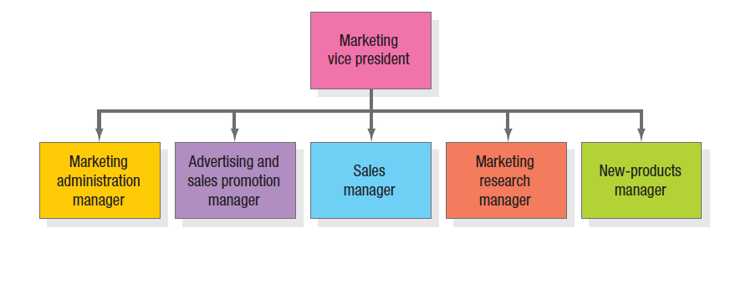
Functional Organization
Notes:
In the most common form of marketing organization, functional specialists report to a marketing vice president who coordinates their activities. Figure 22.1 shows five specialists. a The main advantage of a functional marketing organization is its administrative simplicity. It can be quite a challenge for the department to develop smooth working relationships, however. This form also can result in inadequate planning as the number of products and markets increases and each functional group vies for budget and status.
Other organizations organize along geographic lines.

Slide 8
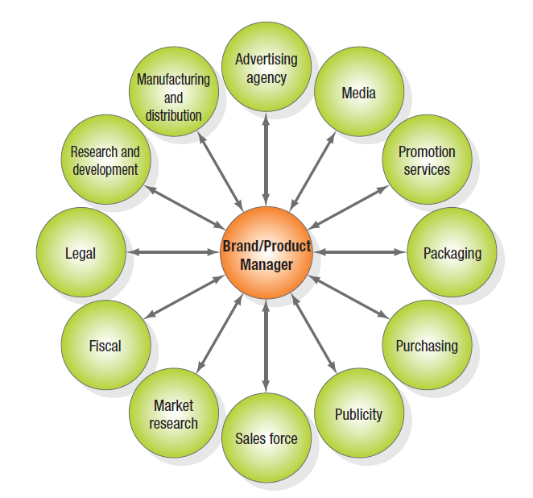
The Product-Management Organization
Notes:
Companies producing a variety of products and brands often establish a product- (or brand-) management organization. This does not replace the functional organization but serves as another layer of management. A product manager supervises product category managers, who in turn supervise specific product and brand managers. A product-management organization makes sense if the company’s products are quite different or there are more than a functional organization can handle. This form is sometimes characterized as a hub-and-spoke system. The brand or product manager is figuratively at the center with spokes leading to various departments representing working relationships. This is shown in Figure 22.2 in the slide.

Slide 9
Tasks Performed by
Brand Managers
Develop long-range and competitive strategy for each product
Prepare annual marketing plan and sales forecast
Work with advertising and merchandising agencies to develop campaigns
Increase support of the product among channel members
Gather continuous intelligence on product performance, customer attitudes
Initiate product improvements
Notes:
The manager in this type of organization performs several tasks listed in the slide. The product-management organization lets the product manager concentrate on developing a cost-effective marketing program and react more quickly to new products in the marketplace; it also gives the company’s smaller brands a product advocate. However, this system has some disadvantages too.
• They become experts in their product area but rarely achieve functional expertise.
• The system often proves costly.
• Brand managers normally manage a brand for only a short time.
• The fragmentation of markets makes it harder to develop a national strategy.
• Product and brand managers focus the company on building market share rather than customer relationships.

Slide 10
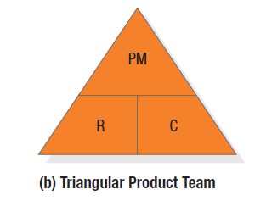
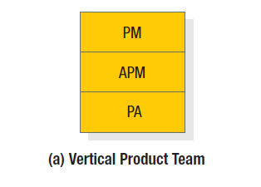
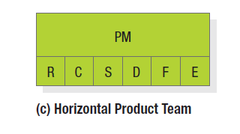
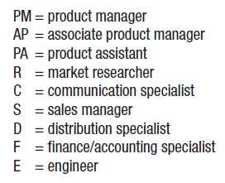
Types of
Product Teams
Notes:
Figure 22.3 shown in the slide presents an alternative in a product-management organization – the use of product teams. There are three types: vertical, triangular, and horizontal. The triangular and horizontal product- team approaches let each major brand be run by a brand-asset management team (BAMT) consisting of key representatives from functions that affect the brand’s performance. The company consists of several BAMTs that periodically report to a BAMT directors committee, which itself reports to a chief branding officer. This is quite different from the way brands have traditionally been handled.

Slide 11
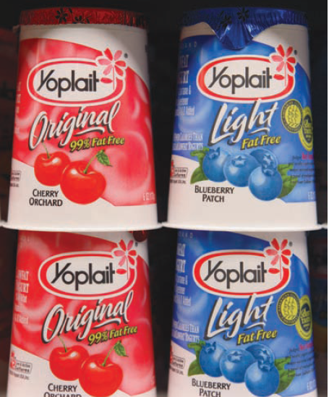
Category Management
Notes:
With category management, a company focuses on product categories to manage its brands. in some packaged-goods firms, category management has evolved into aisle management and encompasses multiple related categories typically found in the same sections of supermarkets and grocery stores. Retailers and regional grocery chains such as Wal-Mart and Dominick’s embrace category management as a means to define a particular product category’s strategic role within the store and address logistics, the role of private-label products, and the trade-offs between product variety and inefficient duplication. General Mills’ Yoplait Yogurt has served as category advisor to the dairy aisle for 24 major retailers, boosting the yogurt base footprint four to eight feet at a time and increasing sales of yogurt by 9 percent and category sales in dairy by 13 percent nationwide.

Slide 12
Market-Management Organization
When customers fall into different user groups with distinct buying preferences and practices, a market-management organization is desirable
Market managers supervise several market-development managers, market specialists, or industry specialists
Market managers are staff people with duties like those of product managers. They develop long-range and annual plans for their markets.
Companies organized this way are called market-centered organizations.
Notes:
When customers fall into different user groups with distinct buying preferences and practices, a market-management organization is desirable. Market managers supervise several market-development managers, market specialists, or industry specialists and draw on functional services as needed. Market managers of important markets might even have functional specialists reporting to them.

Slide 13
Building a Creative
Marketing Organization
Developing a company-wide passion for customers
Organizing around customer segments instead of products
Understanding customers through qualitative and quantitative research
Notes:
Many companies realize they’re not yet really market and customer driven—they are product and sales driven. Transforming into a true market-driven company requires:
1. Developing a company-wide passion for customers
2. Organizing around customer segments instead of products, and
3. Understanding customers through qualitative and quantitative research.
The task is not easy, but the payoffs can be considerable.

Slide 14
How Can CEOs Create a
Marketing-Focused Company?
Convince senior management of the need to become customer focused
Appoint a senior marketing officer and marketing task force
Get outside guidance
Change the company’s reward measurement and system
Hire strong marketing talent
Notes:
In the Marketing Insight, ten steps for a CEO to use in creating a market and customer-focused company are provided. These steps are listed on this slide and the next.

Slide 15
How Can CEOs Create a
Marketing-Focused Company?
Develop strong in-house marketing training programs
Install a modern marketing planning system
Establish an annual marketing excellence recognition program
Shift from a department focus to a process-outcome focus
Empower the employees

Slide 16
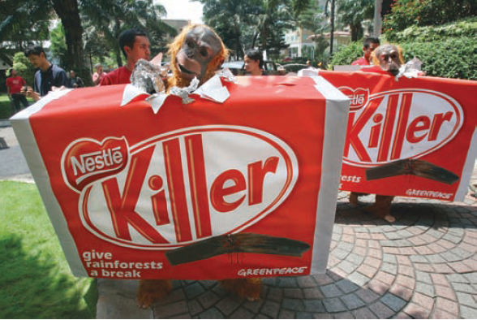
Corporate Social Responsibility
Socially responsible behavior
Ethical behavior
Legal behavior
Notes:
Effective internal marketing must be matched by a strong sense of ethics, values, and social responsibility. A number of forces are driving companies to practice a higher level of corporate social responsibility, such as rising customer expectations, evolving employee goals and ambitions, tighter government legislation and pressure, investor interest in social criteria, media scrutiny, and changing business procurement practices. Palm oil was hailed as a renewable fuel for food companies looking to find a solution to a trans-fat ban, until its use was linked to the destruction of tropical rain forests and the extinction of the orangutan and the sun bear. When Greenpeace released a report criticizing Nestlé for purchasing palm oil for its KitKat candy bars from an Indonesian firm linked to rain forest destruction there, a social media war ensued. Protestors posted a negative video on YouTube, bombarded Twitter and Nestlé’s Facebook page, and took to the streets outside Nestlé’s Jakarta offices.

Slide 17
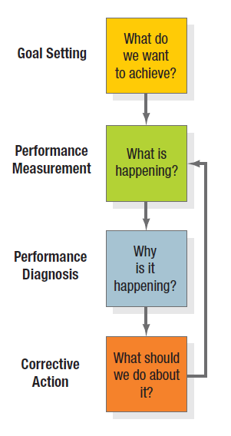
The Control Process
Notes:
Figure 22.4 illustrates the control process.

Slide 18
Types of Marketing Control
Annual Plan Control
Profitability Control
Efficiency Control
Strategic Control
Notes:
Marketing implementation is the process that turns marketing plans into action assignments and ensures they accomplish the plan’s stated objectives. A brilliant strategic marketing plan counts for little if not implemented properly. Strategy addresses the what and why of marketing activities; implementation addresses the who, where, when, and how. Marketing control is the process by which firms assess the effects of their marketing activities and programs and make necessary changes and adjustments.
Table 22.8 lists four types of needed marketing control: annual-plan control, profitability control, efficiency control, and strategic control.

Slide 19
Approaches to Annual Plan Control
Sales analysis
Market share analysis
Sales-to-expense ratios
Financial analysis
Market-based scorecard analysis
Notes:
Annual-plan control ensures the company achieves the sales, profits, and other goals established in its annual plan. First, management sets monthly or quarterly goals. Second, it monitors performance in the marketplace. Third, management determines the causes of serious performance deviations. Fourth, it takes corrective action to close gaps between goals and performance. This control model applies to all levels of the organization. Four tools for the purpose are: sales analysis, market share analysis, marketing expense-to-sales analysis, and financial analysis.

Slide 20
Approaches to
Profitability Control
Product
Territory
Customer
Segment
Trade channel
Order size
Notes:
Companies should measure the profitability of their products, territories, customer groups, segments, trade channels, and order sizes to help determine whether to expand, reduce, or eliminate any products or marketing activities. The chapter appendix shows how to conduct and interpret a marketing profitability analysis.

Slide 21
Efficiency Control Approaches
Sales force
Advertising
Sales promotion
Distribution
Notes:
Some companies have established a marketing controller position to work out of the controller’s office but specialize in improving marketing efficiency. Marketing controllers examine adherence to profit plans, help prepare brand managers’ budgets, measure the efficiency of promotions, analyze media production costs, evaluate customer and geographic profitability, and educate marketing staff on the financial implications of marketing decisions.

Slide 22
Strategic Control Approaches
Marketing effectiveness rating instrument
Marketing audit
Marketing excellence review
Company ethical and social responsibility review
Notes:
Each company should periodically reassess its strategic approach to the marketplace with a good marketing audit. Companies can also perform marketing excellence reviews and ethical/social responsibility reviews.

Slide 23
What is a Marketing Audit?
A marketing audit is a comprehensive, systematic, independent, periodic examination of a company’s or business unit’s marketing environment, objectives, strategies, and activities with a view to determining problem areas and opportunities, and recommending a plan of action to improve the company’s marketing performance.
Notes:
A marketing audit is a comprehensive, systematic, independent, and periodic examination of a company’s or business unit’s marketing environment, objectives, strategies, and activities, with a view to determining problem areas and opportunities and recommending a plan of action to improve the company’s marketing performance.

Slide 24
Characteristics of
Marketing Audits
Comprehensive
Systematic
Independent
Periodic
Notes:
Marketing audits have four characteristics:
Comprehensive—The marketing audit covers all the major marketing activities of a business, not just a few trouble spots as in a functional audit.
Systematic—The marketing audit is an orderly examination of the organization’s macro- and micromarketing environments, marketing objectives and strategies, marketing systems, and specific activities.
Independent— Self-audits, in which managers rate their own operations, lack objectivity and independence.
Periodic—Firms typically initiate marketing audits only after failing to review their marketing operations during good times, with resulting problems. A periodic marketing audit can benefit companies in good health as well as those in trouble.
A full description of the components of a marketing audit are explained in Table 22.10.

