Slide 1
Applied Marketing Strategies
MGT 681
Lecture 30

Slide 2
Strategy Formulation & Implementation
Part 3 & 4

Slide 3
Promotion Strategies

Slide 4
Lecture Agenda
What steps are required in developing an advertising program?
How should sales promotion decisions be made?
What are the guidelines for effective brand-building events and experiences?
How can companies exploit the potential of public relations and publicity?
Notes:
Although there has been an enormous increase in the use of personal communications by marketers in recent years, due to the rapid penetration of the Internet and other factors, the fact remains that mass media, if used correctly, is still an important component of a modern marketing communications program. The old days of “if you build a great ad, they will come,” however, are long gone. To generate consumer interest and sales, mass media must often be supplemented and carefully integrated with other communications.

Slide 5
Lecture Agenda
How can companies conduct direct marketing for competitive advantage?
How can companies carry out effective interactive marketing?
How does word of mouth affect marketing success?
What decisions do companies face in designing and managing a sales force?
Notes:
In the face of the Internet revolution, marketing communications today increasingly occur as a kind of personal dialogue between the company and its customers. Companies must ask not only “How should we reach our customers?” but also “How should our customers reach us?” and “How can our customers reach each other?” New technologies have encouraged companies to move from mass communication to more targeted, two-way communications.
Consumers now play a much more participatory role in the marketing process. Marketers are trying to figure out the right way to be part of the consumer conversation. Personalizing communications and creating dialogues by saying and doing the right thing to the right person at the right time is critical for marketing effectiveness. In this chapter, we consider how companies personalize their marketing communications to have more impact. We begin by evaluating direct and interactive marketing, then move to word-of-mouth marketing, and finish by considering personal selling and the sales force.

Slide 6
Advertising
Advertising is any paid form of nonpersonal presentation and promotion of ideas, goods, or services by an identified sponsor.
Notes:
Advertising is any paid form of nonpersonal presentation and promotion of ideas, goods, or services by an identified sponsor. Among the more successful of the 30-second ads estimated to cost over $2.5 million to run during the broadcast of the 2010 Super Bowl was one for Old Spice body wash. Turning a potential negative of being an old brand into a positive of being experienced, Old Spice has made a remarkable transformation in recent years from “your father’s aftershave” to a contemporary men’s fragrance brand. In a new strategic move, given their important role in the purchase process, the Super Bowl spot targeted women as well as men. The tongue-in-cheek ad featured rugged ex-NFL football player Isaiah Mustafa as “The Man Your Man Could Smell Like.” In one seamless take, Mustafa confidently strikes a variety of romantic poses while passing from a shower in a bathroom to standing on a boat to riding a white horse. Uploaded onto YouTube and other social networking sites, the ad was viewed over 10 million additional times. Old Spice’s Facebook page included a Web application called “My Perpetual Love,” which featured Mustafa offering men the opportunity to be “more like him” by e-mailing and tweeting their sweethearts virtual love notes. For its efforts, the ad agency behind the campaign, Wieden+Kennedy, received a Grand Prix at the Cannes International Ad festival. A follow-up ad in June 2010 showed Mustafa in a new series of “perfect man” activities including baking birthday cakes, building a home with his own hands, swan-diving into a hot tub, and, yes, walking on water.

Slide 7
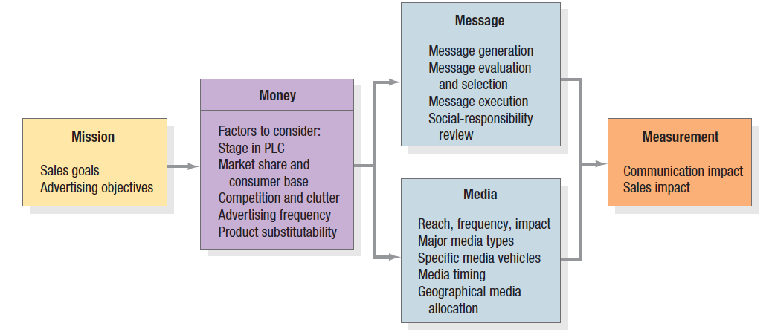
The Five M’s of Advertising
Notes:
In developing an advertising program, marketing managers must always start by identifying the target market and buyer motives. Then they can make the five major decisions, known as “the five Ms”.
Mission: What are our advertising objectives?
Money: How much can we spend and how do we allocate our spending across media types?
Message: What message should we send?
Media: What media should we use?
Measurement: How should we evaluate the results?
These decisions are summarized in Figure 18.1 and described in the following sections.

Slide 8
Developing an
Advertising Program
Setting Objectives
Deciding on the Budget
Developing the Campaign
Deciding on Media
Making Measurement Plans
Notes:
These are the steps in setting an advertising program.

Slide 9
Advertising Objectives
Informative
Persuasive
Reminder
Reinforcement
Notes:
An advertising objective (or goal) is a specific communications task and achievement level to be accomplished with a specific audience in a specific period of time.
Here’s an example: To increase among 30 million homemakers who own automatic washers the number who identify brand X as a low-sudsing detergent, and who are persuaded that it gets clothes cleaner, from 10 percent to 40 percent in one year.
We can classify advertising objectives according to whether their aim is to inform, persuade, remind, or reinforce. Informative advertising aims to create brand awareness and knowledge of new products or new features of existing products. Persuasive advertising aims to create liking, preference, conviction, and purchase of a product or service. Reminder advertising aims to stimulate repeat purchase of products and services. Reinforcement advertising aims to convince current purchasers that they made the right choice.

Slide 10
Factors to Consider in Setting an Advertising Budget
Stage in the product life cycle
Market share and consumer base
Competition and clutter
Advertising frequency
Product substitutability
Notes:
Here are five specific factors to consider when setting the advertising budget:
1. Stage in the product life cycle. New products typically merit large advertising budgets to build awareness and to gain consumer trial. Established brands usually are supported with lower advertising budgets, measured as a ratio to sales.
2. Market share and consumer base. High-market-share brands usually require less advertising expenditure as a percentage of sales to maintain share. To build share by increasing market size requires larger expenditures.
3. Competition and clutter. In a market with a large number of competitors and high advertising spending, a brand must advertise more heavily to be heard. Even simple clutter from advertisements not directly competitive to the brand creates a need for heavier advertising.
4. Advertising frequency. The number of repetitions needed to put the brand’s message across to consumers has an obvious impact on the advertising budget.
5. Product substitutability. Brands in less-differentiated or commodity-like product classes (beer, soft drinks, banks, and airlines) require heavy advertising to establish a unique image.

Slide 11
Developing the
Advertising Campaign
In designing and evaluating an ad campaign, marketers employ both art and science to develop
  The message strategy or positioning of an ad—what the ad attempts to convey about the brand—
  Its creative strategy—how the ad expresses the brand claims.
Advertisers go through three steps:
  Message generation and evaluation
  Creative development and execution
  Social responsibility review.
Notes:
In designing and evaluating an ad campaign, marketers employ both art and science to develop the message strategy or positioning of an ad—what the ad attempts to convey about the brand—and its creative strategy—how the ad expresses the brand claims. Advertisers go through three steps: message generation and evaluation, creative development and execution, and social responsibility review.

Slide 12
Television
Advantages
Reaches broad spectrum of consumers
Low cost per exposure
Ability to demonstrate product use
Ability to portray image and brand personality
Disadvantages
Brief
Clutter
High cost of production
High cost of placement
Lack of attention by viewers
Notes:
Television is generally acknowledged as the most powerful advertising medium and reaches a broad spectrum of consumers at low cost per exposure. TV advertising has two particularly important strengths. First, it can vividly demonstrate product attributes and persuasively explain their corresponding consumer benefits. Second, it can dramatically portray user and usage imagery, brand personality, and other intangibles. Because of the fleeting nature of the ad, however, and the distracting creative elements often found in it, product-related messages and the brand itself can be overlooked. Moreover, the high volume of nonprogramming material on television creates clutter that makes it easy for consumers to ignore or forget ads.

Slide 13
Print Ads
Advantages
Detailed product information
Ability to communicate user imagery
Flexibility
Ability to segment
Disadvantages
Passive medium
Clutter
Unable to demonstrate product use
Notes:
Print media offer a stark contrast to broadcast media. Because readers consume them at their own pace, magazines and newspapers can provide detailed product information and effectively communicate user and usage imagery. At the same time, the static nature of the visual images in print media makes dynamic presentations or demonstrations difficult, and print media can be fairly passive. The two main print media—magazines and newspapers—share many advantages and disadvantages. Although newspapers are timely and pervasive, magazines are typically more effective at building user and usage imagery. Newspapers are popular for local—especially retailer—advertising. On an average day, roughly one-half to three-quarters of U.S. adults read a newspaper, although increasingly that is an online version. Print newspaper circulation fell almost 9 percent in 2009. Although advertisers have some flexibility in designing and placing newspaper ads, poor reproduction quality and short shelf life can diminish the ads’ impact.

Slide 14

Print Ad Components
picture, headline, and copy
Notes:
Researchers studying print advertisements report that the picture, headline, and copy matter in that order. The picture must be strong enough to draw attention. The headline must reinforce the picture and lead the person to read the copy. The copy must be engaging and the brand’s name sufficiently prominent.

Slide 15
Print Ad Evaluation Criteria
Is the message clear at a glance?
Is the benefit in the headline?
Does the illustration support the headline?
Does the first line of the copy support or explain the headline and illustration?
Is the ad easy to read and follow?
Is the product easily identified?
Is the brand or sponsor clearly identified?
Notes:
In judging the effectiveness of a print ad, in addition to considering the communication strategy (target market, communications objectives, and message and creative strategy), marketers should be able to answer yes to the questions presented in the slide about the ad’s execution.

Slide 16
Variables in Media Selection
Reach
Frequency
Impact
Exposure
Notes:
Media selection is finding the most cost-effective media to deliver the desired number and type of exposures to the target audience. What do we mean by the desired number of exposures? The advertiser seeks a specified advertising objective and response from the target audience—for example, a target level of product trial. This level depends on, among other things, level of brand awareness.
Reach (R) is the number of different persons or households exposed to a particular media schedule at least once during a specified time period
Frequency (F) is the number of times within the specified time period that an average person or household is exposed to the message
Impact (I) is the qualitative value of an exposure through a given medium.
Exposure (E) is the exposure to the ad message. Exposure depends upon Reach, Frequency, and Impact.

Slide 17
Choosing Among Major Media Types
Target audience and media habits
Product characteristics
Message characteristics
Cost
Notes:
The media planner must know the capacity of the major advertising media types to deliver reach, frequency, and impact. The major advertising media along with their costs, advantages, and limitations are profiled in Table 18.1. Media planners make their choices by considering factors such as target audience media habits, product characteristics, message requirements, and cost.

Slide 18
Major Media Types
Newspapers
Television
Direct mail
Radio
Magazines
Outdoor
Yellow Pages
Newsletters
Brochures
Telephone
Internet
Notes:
There are several major media types. Each one has its own advantages and disadvantages.

Slide 19
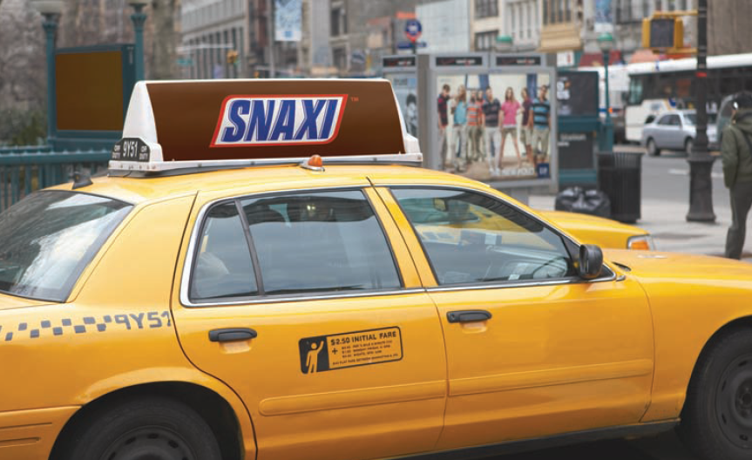
Place Advertising
Notes:
In recent years, reduced effectiveness of traditional mass media has led advertisers to increase their emphasis on alternate advertising media. Place advertising, or out-of-home advertising, is a broad category including many creative and unexpected forms to grab consumers’ attention. The rationale is that marketers are better off reaching people where they work, play, and, of course, shop. Popular options include billboards, public spaces, product placement, and point of purchase. Billboards have been transformed and now use colorful, digitally produced graphics, backlighting, sounds, movement, and unusual—even 3D—images. Advertisers have been increasingly placing ads in unconventional places such as on movie screens, on airplanes, and in fitness clubs, as well as in classrooms, sports arenas, office and hotel elevators, and other public places. Billboard-type poster ads are showing up everywhere. Transit ads on buses, subways, and commuter trains—around for years—have become a valuable way to reach working women.“Street furniture”—bus shelters, kiosks, and public areas—is another fast-growing option. Marketers pay product placement fees of $100,000 to as much as $500,000 so their products will make cameo appearances in movies and on television.

Slide 20
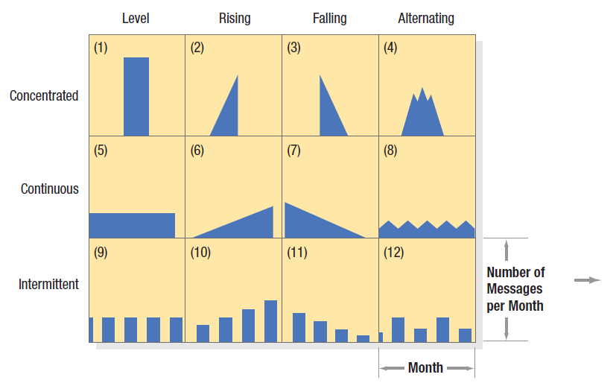
Advertising
Timing Patterns
Notes:
In choosing media, the advertiser has both a macroscheduling and a microscheduling decision. The macroscheduling decision relates to seasons and the business cycle. Suppose 70 percent of a product’s sales occur between June and September. The firm can vary its advertising expenditures to follow the seasonal pattern, to oppose the seasonal pattern, or to be constant throughout the year. The microscheduling decision calls for allocating advertising expenditures within a short period to obtain maximum impact. Suppose the firm decides to buy 30 radio spots in the month of September. Figure 18.3 shows several possible patterns. The left side shows that advertising messages for the month can be concentrated (“burst” advertising), dispersed continuously throughout the month, or dispersed intermittently. The top side shows that the advertising messages can be beamed with a level, rising, falling, or alternating frequency. The chosen pattern should meet the communications objectives set in relationship to the nature of the product, target customers, distribution channels, and other marketing factors. The timing pattern should consider three factors. Buyer turnover expresses the rate at which new buyers enter the market; the higher this rate, the more continuous the advertising should be. Purchase frequency is the number of times the average buyer buys the product during the period; the higher the purchase frequency, the more continuous the advertising should be. The forgetting rate is the rate at which the buyer forgets the brand; the higher the forgetting rate, the more continuous the advertising should be.

Slide 21
Media Schedule Patterns
Continuity
Concentrated
Flighting
Pulsing
Notes:
In launching a new product, the advertiser must choose among continuity, concentration, flighting, and pulsing.
Continuity means exposures appear evenly throughout a given period. Generally, advertisers use continuous advertising in expanding market situations, with frequently purchased items, and in tightly defined buyer categories.
Concentration calls for spending all the advertising dollars in a single period. This makes sense for products with one selling season or related holiday.
Flighting calls for advertising during a period, followed by a period with no advertising, followed by a second period of advertising activity. It is useful when funding is limited, the purchase cycle is relatively infrequent, or items are seasonal.
Pulsing is continuous advertising at low-weight levels, reinforced periodically by waves of heavier activity. It draws on the strength of continuous advertising and flights to create a compromise scheduling strategy.

Slide 22
Measuring Sales Impact of Advertising
Share of Expenditures
Share of Voice
Share of Mind and Heart
Share of Market
Notes:
Companies are generally interested in finding out whether they are overspending or underspending on advertising. One way to answer this question is to work with the formulation shown in Figure 18.4. A company’s share of advertising expenditures produces a share of voice (proportion of company advertising of that product to all advertising of that product) that earns a share of consumers’ minds and hearts and, ultimately, a share of market.

Slide 23
What is Sales Promotion?
Sales promotion consists of a collection of incentive tools, mostly short term, designed to stimulate quicker or greater purchase of particular products or services by consumers or the trade.
Notes:
Sales promotion, a key ingredient in marketing campaigns, consists of a collection of incentive tools, mostly short term, designed to stimulate quicker or greater purchase of particular products or services by consumers or the trade. Whereas advertising offers a reason to buy, sales promotion offers an incentive. Sales promotion includes tools for consumer promotion (samples, coupons, cash refund offers, prices off, premiums, prizes, patronage rewards, free trials, warranties, tie-in promotions, cross-promotions, point-of-purchase displays, and demonstrations); trade promotion (prices off, advertising and display allowances, and free goods); and business and sales force promotion (trade shows and conventions, contests for sales reps, and specialty advertising).

Slide 24
Consumer-Directed Sales Promotion Tactics
Samples
Coupons
Cash refund offers
Price offs
Premiums
Prizes
Patronage rewards
Free trials
Tie-in promotions
Notes:
The promotion planner should take into account the type of market, sales promotion objectives, competitive conditions, and each tool’s cost-effectiveness. The main consumer promotion tools are summarized in Table 18.3.
Samples offer of a free amount of a product or service delivered door-to-door, sent in the mail, picked up in a store, attached to another product, or featured in an advertising offer. Coupons are certificates entitling the bearer to a stated saving on the purchase of a specific product. Cash Refund Offers (rebates) provide a price reduction after purchase rather than at the retail shop. Price Packs (cents-off deals) offer to consumers of savings off the regular price of a product, flagged on the label or package. Premiums (gifts) are merchandise offered at a relatively low cost or free as an incentive to purchase a particular product. Frequency Programs are programs providing rewards related to the consumer’s frequency and intensity in purchasing the company’s products or services. Prizes (contests, sweepstakes, games) are offers of the chance to win cash, trips, or merchandise as a result of purchasing something. Patronage Awards offer values in cash or in other forms that are proportional to patronage of a certain vendor or group of vendors. Free Trials invite prospective purchasers to try the product without cost in the hope that they will buy.
Tie-in Promotions are two or more brands or companies team up on coupons, refunds, and contests to increase pulling power.

Slide 25
Trade-Directed
Sales Promotion Tactics
Price offs
Allowances
Free goods
Sales contests
Spiffs
Trade shows
Specialty advertising
Notes:
Manufacturers use a number of trade promotion tools (see Table 18.4). Manufacturers award money to the trade (1) to persuade the retailer or wholesaler to carry the brand; (2) to persuade the retailer or wholesaler to carry more units than the normal amount; (3) to induce retailers to promote the brand by featuring, display, and price reductions; and (4) to stimulate retailers and their sales clerks to push the product. Price-Off (off-invoice or off-list) is a straight discount off the list price on each case purchased during a stated time period. An allowance is an amount offered in return for the retailer’s agreeing to feature the manufacturer’s products in some way. An advertising allowance compensates retailers for advertising the manufacturer’s product. A display allowance compensates them for carrying a special product display. Free Goods offers includes extra cases of merchandise to intermediaries who buy a certain quantity or who feature a certain flavor or size. Trade Shows and Conventions are industry associations organize annual trade shows and conventions. A sales contest aims at inducing the sales force or dealers to increase their sales results over a stated period, with prizes (money, trips, gifts, or points) going to those who succeed. Specialty advertising consists of useful, low-cost items bearing the company’s name and address, and sometimes an advertising message that salespeople give to prospects and customers.

Slide 26

Events and Experiences
Notes:
Daily encounters with brands may also affect consumers’ brand attitudes and beliefs. Atmospheres are “packaged environments” that create or reinforce leanings toward product purchase. Law offices decorated with Oriental rugs and oak furniture communicate “stability” and “success.” A five-star hotel will use elegant chandeliers, marble columns, and other tangible signs of luxury.
Many firms are creating their own events and experiences to create consumer and media interest and involvement. To promote its new GE Profile Frontload Washer and Dryer with SmartDispense Technology—designed to optimize the amount of detergent used in any one wash—GE used traditional online and mass media. To create even more buzz, the firm hung 800 feet of jeans and shirts on a massive clothesline in Times Square to represent the six months’ worth of washing the new machines could typically handle before needing more detergent. On one of the traffic islands were 20-foot-high inflatable versions of the new washer/dryer.

Slide 27
Why Sponsor Events?
To identify with a particular target market or life style
To increase brand awareness
To create or reinforce consumer perceptions of key brand image associations
To enhance corporate image
To create experiences and evoke feelings
To express commitment to community
To entertain key clients or reward employees
To permit merchandising or promotional opportunities
Notes:
This slide lists some of the many reasons to sponsor events as a promotional tool.

Slide 28
Public Relations Functions
Press relations
Product publicity
Corporate communications
Lobbying
Counseling
Notes:
A public is any group that has an actual or potential interest in or impact on a company’s ability to achieve its objectives. Public relations (PR) includes a variety of programs to promote or protect a company’s image or individual products. The best PR departments counsel top management to adopt positive programs and eliminate questionable practices so negative publicity doesn’t arise in the first place. They perform the following five functions:
1. Press relations—Presenting news and information about the organization in the most positive light.
2. Product publicity—Sponsoring efforts to publicize specific products.
3. Corporate communications—Promoting understanding of the organization through internal and external communications.
4. Lobbying—Dealing with legislators and government officials to promote or defeat legislation and regulation.
5. Counseling—Advising management about public issues, and company positions and image during good times and bad.

Slide 29
Tasks Aided by Public Relations
Launching new products
Repositioning a mature product
Building interest in a product category
Influencing specific target groups
Defending products that have encountered public problems
Building the corporate image in a way that reflects favorable on products
Notes:
Many companies are turning to marketing public relations (MPR) to support corporate or product promotion and image making. MPR, like financial PR and community PR, serves a special constituency, the marketing department.
The old name for MPR was publicity, the task of securing editorial space—as opposed to paid space—in print and broadcast media to promote or “hype” a product, service, idea, place, person, or organization. MPR goes beyond simple publicity and plays an important role in the following tasks:
• Launching new products.
• Repositioning a mature product.
• Building interest in a product category.
• Influencing specific target groups.
• Building the corporate image in a way that reflects favorably on its products.

Slide 30
Major Tools in Marketing PR
Publications
Events
Sponsorships
News
Speeches
Public Service Activities
Identity Media
Notes:
These are the major tools used by public relations.
Companies rely extensively on published materials to reach and influence their target markets. These include annual reports, brochures, articles, company newsletters and magazines, and audiovisual materials. Companies can draw attention to new products or other company activities by arranging and publicizing special events such as news conferences, seminars, outings, trade shows, exhibits, contests and competitions, and anniversaries that will reach the target publics. Companies can promote their brands and corporate name by sponsoring and publicizing sports and cultural events and highly regarded causes. One of the major tasks of PR professionals is to find or create favorable news about the company, its products, and its people and to get the media to accept press releases and attend press conferences. Increasingly, company executives must field questions from the media or give talks at trade associations or sales meetings, and these appearances can build the company’s image. Companies can build goodwill by contributing money and time to good causes. Companies need a visual identity that the public immediately recognizes. The visual identity is carried by company logos, stationery, brochures, signs, business forms, business cards, buildings, uniforms, and dress codes.

Slide 31
What is Direct Marketing?
Direct marketing is the use of consumer-direct channels to reach and deliver goods and services to customers without using market middlemen.
Notes:
Direct marketing is the use of consumer-direct (CD) channels to reach and deliver goods and services to customers without using marketing middlemen.

Slide 32
Direct Marketing Channels
Direct mail
Catalogs
Telemarketing
Other direct response
Notes:
Direct marketers can use a number of channels to reach individual prospects and customers: direct mail, catalog marketing, telemarketing, interactive TV, kiosks, Web sites, and mobile devices. They often seek a measurable response, typically a customer order, through direct-order marketing. Direct marketing has been a fast-growing avenue for serving customers, partly in response to the high and increasing costs of reaching business markets through a sales force. Sales produced through traditional direct marketing channels (catalogs, direct mail, and telemarketing) have been growing rapidly, along with direct-mail sales, which include sales to the consumer market, B2B, and fund-raising by charitable institutions. Direct marketing has been outpacing U.S. retail sales.

Slide 33
Constructing a Direct-Mail Campaign
Establish objectives
Select target prospects
Develop offer elements
Test elements
Execute
Measure success
Notes:
Direct-mail marketing means sending an offer, announcement, reminder, or other item to an individual consumer. Using highly selective mailing lists, direct marketers send out millions of mail pieces each year—letters, flyers, foldouts, and other “salespeople with wings.” Some direct marketers mail multimedia DVDs to prospects and customers.
Direct mail is a popular medium because it permits target market selectivity, can be personalized, is flexible, and allows early testing and response measurement. Although the cost per thousand is higher than for mass media, the people reached are much better prospects.
In constructing an effective direct-mail campaign, direct marketers must choose their objectives, target markets and prospects, offer elements, means of testing the campaign, and measures of campaign success.

Slide 34
RFM Formula for
Selecting Prospects
Recency
Frequency
Monetary value
Notes:
Most direct marketers apply the RFM (recency, frequency, monetary amount) formula to select customers according to how much time has passed since their last purchase, how many times they have purchased, and how much they have spent since becoming a customer. Suppose L.L. Bean is offering a jacket. It might make this offer to the most attractive customers—those who made their last purchase between 30 and 60 days ago, who make three to six purchases a year, and who have spent at least $100 since becoming customers. Points are established for varying RFM levels; the more points, the more attractive the customer.

Slide 35
Elements of the Offer Strategy
Product
Offer
Medium
Distribution Method
Creative Strategy
Notes:
The offer strategy has five elements—the product, the offer, the medium, the
distribution method, and the creative strategy. The strategy will answer these questions.
What is being offered?
At what price?
Through what medium?
Distributed in what manner?
With what creative appeal?

Slide 36

Components of the Mailing
Outside envelope
Sales letter
Circular
Reply form
Reply envelope
Notes:
The direct mail marketer must also determine the components of the mailing itself. Experiments of direct mail pieces show that response to the offers can vary based on things like the look and size of the envelope, the wording of the letter, and the type of reply envelope.

Slide 37
Catalogs
In catalog marketing, companies may send
  Full-line merchandise catalogs,
  Specialty consumer catalogs,
Usually in print form but also as DVDs or online
Many direct marketers find combining catalogs and Web sites an effective way to sell
Notes:
In catalog marketing, companies may send full-line merchandise catalogs, specialty consumer catalogs, and business catalogs, usually in print form but also as DVDs or online. Many direct marketers find combining catalogs and Web sites an effective way to sell. Catalogs are a huge business—the Internet and catalog retailing industry includes 16,000 companies with combined annual revenue of $235 billion. The success of a catalog business depends on managing customer lists carefully to avoid duplication or bad debts, controlling inventory, offering good-quality merchandise so returns are low, and projecting a distinctive image. Some companies add literary or information features, send swatches of materials, operate a special online or telephone hotline to answer questions, send gifts to their best customers, and donate a percentage of profits to good causes. Putting their entire catalog online also provides business marketers with better access to global consumers than ever before, saving printing and mailing costs.

Slide 38
Types of Telemarketing
Telesales
Telecoverage
Teleprospecting
Customer service and technical support
Notes:
Telemarketing is the use of the telephone and call centers to attract prospects, sell to existing customers, and provide service by taking orders and answering questions. It helps companies increase revenue, reduce selling costs, and improve customer satisfaction. Companies use call centers for inbound telemarketing—receiving calls from customers—and outbound telemarketing—initiating calls to prospects and customers. It is increasing for business uses but has been met with opposition in consumer markets.

Slide 39
Other Media for Direct Response
Television
Radio
Kiosks
Newspapers
Magazines
Internet
Notes:
Direct marketers use all the major media. Newspapers and magazines carry ads offering books, clothing, appliances, vacations, and other goods and services that individuals can order via toll-free numbers. Radio ads present offers 24 hours a day. Some companies prepare 30- and 60-minute infomercials to combine the sell of television commercials with the draw of information and entertainment. Infomercials promote products that are complicated or technologically advanced, or that require a great deal of explanation. At-home shopping channels are dedicated to selling goods and services on a toll-free number or via the Web for delivery within 48 hours.

Slide 40
Public Issues in Direct Marketing
Irritation
Unfairness
Deception/fraud
Invasion of privacy
Notes:
Direct marketers and their customers usually enjoy mutually rewarding relationships. But there is a dark side too. Many people don’t like hard-sell, direct marketing solicitations. Some direct marketers take advantage of impulsive or less sophisticated buyers or prey on the vulnerable, especially the elderly. Some direct marketers design mailers and write copy intended to mislead or exaggerate product size, performance claims, or the “retail price.”The Federal Trade Commission receives thousands of complaints each year about fraudulent investment scams and phony charities. It seems that almost every time consumers order products by mail or telephone, apply for a credit card, or take out a magazine subscription, their names, addresses, and purchasing behavior may be added to several company databases. Critics worry that marketers may know too much about consumers’ lives, and that they may use this knowledge to take unfair advantage.

Slide 41
Interactive Marketing
Tailored messages possible
Easy to track responsiveness
Contextual ad placement possible
Search engine advertising possible
Subject to click fraud
Consumers develop selective attention
Notes:
The variety of online communication options means companies can send tailored messages that engage consumers by reflecting their special interests and behavior. The Internet is also highly accountable and its effects can be easily traced by noting how many unique visitors or “UVs” click on a page or ad, how long they spend with it, and where they go afterward. Marketers can build or tap into online communities, inviting participation from consumers and creating a long-term marketing asset in the process. The Web offers the advantage of contextual placement, buying ads on sites related to the marketer’s offerings. Marketers can also place advertising based on keywords from search engines, to reach people when they’ve actually started the buying process. Using the Web also has disadvantages. Consumers can effectively screen out most messages. Marketers may think their ads are more effective than they are if bogus clicks are generated by software- powered Web sites. Advertisers also lose some control over their online messages, which can be hacked or vandalized. But many feel the pros outweigh the cons, and the Web is attracting marketers of all kinds.

Slide 42
Word of Mouth
Earned
media
Paid
media
Notes:
Consumers use word of mouth to talk about dozens of brands each day, from media and entertainment products such as movies, TV shows, and publications to food products, travel services, and retail stores. With the growth of social media, as Chapter 17 noted, marketers sometimes distinguish paid media from earned or free media. Although different points of view prevail, paid media results from press coverage of company-generated advertising, publicity, or other promotional efforts. Earned media—sometimes called free media—is all the PR benefits a firm receives without having directly paid for anything—all the news stories, blogs, social network conversations that deal with a brand. Earned media isn’t literally free—the company has to invest in products, services, and their marketing to some degree to get people to pay attention and write and talk about them, but the expenses are not devoted to eliciting a media response.

Slide 43
Platforms of Social Media
Online Communities and Forums
Blogs
Social Networks
Notes:
Online communities and forums come in all shapes and sizes. Many are created by consumers or groups of consumers with no commercial interests or company affiliations. Others are sponsored by companies whose members communicate with the company and with each other through postings, instant messaging, and chat discussions about special interests related to the company’s products and brands. These online communities and forums can be a valuable resource for companies and provide multiple functions by both collecting and conveying key information. Blogs, regularly updated online journals or diaries, have become an important outlet for word of mouth. There are millions in existence and they vary widely, some personal for close friends and families, others designed to reach and influence a vast audience. One obvious appeal of blogs is bringing together people with common interests. Social networks have become an important force in both business-to-consumer and business-to-business marketing.

Slide 44
How to Start Buzz
Identify influential individuals and companies and devote extra effort to them
Supply key people with product samples
Work through community influentials
Develop word-of-mouth referral channels to build business
Provide compelling information that customers want to pass along
Notes:
Some marketers highlight two particular forms of word of mouth—buzz and viral marketing. Buzz marketing generates excitement, creates publicity, and conveys new relevant brand-related information through unexpected or even outrageous means. Viral marketing is another form of word of mouth, or “word of mouse,” that encourages consumers to pass along company-developed products and services or audio, video, or written information to others online.

Slide 45

Types of Sales Representatives
1. Deliverer
2. Order taker
3. Missionary
4. Technician
5. Demand creator
6. Solution vendor
Notes:
The term sales representative covers six positions, ranging from the least to the most creative types of selling:
1. Deliverer—A salesperson whose major task is the delivery of a product (water, fuel, oil).
2. Order taker—An inside order taker (standing behind the counter) or outside order taker (calling on the supermarket manager).
3. Missionary—A salesperson not permitted to take an order but expected rather to build goodwill or educate the actual or potential user.
4. Technician—A salesperson with a high level of technical knowledge (the engineering salesperson who is primarily a consultant to client companies).
5. Demand creator—A salesperson who relies on creative methods for selling tangible products or intangibles.
6. Solution vendor—A salesperson whose expertise is solving a customer’s problem, often with a system of the company’s products and services.

Slide 46
Sales Tasks
Prospecting
Targeting
Communicating
Selling
Servicing
Information gathering
Allocating
Notes:
Regardless of the selling context, salespeople perform one or more specific tasks:
• Prospecting. Searching for prospects, or leads
• Targeting. Deciding how to allocate their time among prospects and customers
• Communicating. Communicating information about the company’s products and services
• Selling. Approaching, presenting, answering questions, overcoming objections, and closing sales
• Servicing. Providing various services to the customers—consulting on problems, rendering technical assistance, arranging financing, expediting delivery
• Information gathering. Conducting market research and doing intelligence work
• Allocating. Deciding which customers will get scarce products during product shortages

Slide 47
Components of Sales Force Compensation
Fixed amount
Variable amount
Expense allowance
Benefits
Notes:
The company must quantify four components of sales force compensation. The fixed amount, a salary, satisfies the need for income stability. The variable amount, whether commissions, bonus, or profit sharing, serves to stimulate and reward effort. Expense allowances enable sales reps to meet the expenses of travel and entertaining. Benefits, such as paid vacations, sickness or accident benefits, pensions, and life insurance, provide security and job satisfaction. Fixed compensation is common in jobs with a high ratio of nonselling to selling duties, and jobs where the selling task is technically complex and requires teamwork. Variable compensation works best where sales are cyclical or depend on individual initiative. Fixed and variable compensation give rise to three basic types of compensation plans—straight salary, straight commission, and combination salary and commission.

Slide 48
Managing the Sales Force
Recruiting
Selecting
Training
Supervising
Motivating
Evaluating
Notes:
Various policies and procedures guide the firm in recruiting, selecting, training, supervising, motivating, and evaluating sales representatives to manage its sales force as shown in Figure 19.5.
After management develops its selection criteria, it must recruit. The human resources department solicits names from current sales representatives, uses employment agencies, places job ads, and contacts college students. Selection procedures can vary from a single informal interview to prolonged testing and interviewing. New hires are trained and supervised. They may be intrinsically or extrinsically motivated. Most marketers believe that the higher the salesperson’s motivation, the greater the effort and the resulting performance, rewards, and satisfaction— all of which increase motivation. Lastly, their performance must be evaluated.

