Slide 1
Applied Marketing Strategies
MGT 681
Lecture 29

Slide 2
Strategy Formulation & Implementation
Part 3 & 4

Slide 3
Promotion Strategies

Slide 4
Lecture Agenda
What is the role of marketing communications?
How do marketing communications work?
What are the major steps in developing effective communications?
What is the communications mix and how should it be set?
What is an integrated marketing communications program?
Notes:
Modern marketing calls for more than developing a good product, pricing it attractively, and making it accessible. Companies must also communicate with their present and potential stakeholders and the general public. For most marketers, therefore, the question is not whether to communicate but rather what to say, how and when to say it, to whom, and how often. Consumers can turn to hundreds of cable and satellite TV channels, thousands of magazines and newspapers, and millions of Internet pages. They are taking a more active role in deciding what communications they want to receive as well as how they want to communicate to others about the products and services they use. To effectively reach and influence target markets, holistic marketers are creatively employing multiple forms of communications.

Slide 5
Marketing Communications
Marketing communications are the means by which firms attempt to inform, persuade, and remind consumers—directly or indirectly—about the products and brands they sell.
Notes:
Marketing communications are the means by which firms attempt to inform, persuade, and remind consumers—directly or indirectly—about the products and brands they sell. In a sense, marketing communications represent the voice of the company and its brands; they are a means by which the firm can establish a dialogue and build relationships with consumers. Ocean Spray—an agricultural cooperative of cranberry growers—has used a variety of communication vehicles to turn its sales fortunes around.
Facing stiff competition, a number of adverse consumer trends, and nearly a decade of declining sales, Ocean Spray COO Ken Romanzi and Arnold Worldwide decided to “reintroduce the cranberry to America” as the “surprisingly versatile little fruit that supplies modern-day benefits,” through a true 360-degree campaign that used all facets of marketing communications to reach consumers in a variety of settings. The intent was to support the full range of products—cranberry sauce, fruit juices, and dried cranberries in different forms—and leverage the fact that the brand was born in the cranberry bogs and remained there still.

Slide 6
Modes of Marketing Communications
Advertising
Sales promotion
Events and experiences
Public relations and publicity
Direct marketing
Interactive marketing
Word-of-mouth marketing
Personal selling
Notes:
The marketing communications mix consists of eight major modes of communication.
1. Advertising is any paid form of nonpersonal presentation and promotion of ideas, goods, or services by an identified sponsor.
2. Sales promotion is any variety of short-term incentives to encourage trial or purchase of a product or service.
3. Events and experiences are company-sponsored activities and programs designed to create daily or special brand-related interactions with consumers.
4. Public relations and publicity are a variety of programs directed internally to employees of the company or externally to consumers, other firms, the government, and media
5. Direct marketing is the use of mail, telephone, fax, e-mail, or Internet to communicate directly with or solicit response or dialogue from specific customers and prospects.
6. Interactive marketing is online activities and programs designed to engage customers or prospects.
7. Word-of-mouth marketing refers to people-to-people oral, written, or electronic communications.
8. Personal selling is face-to-face interaction with one or more prospective purchasers for the purpose of making presentations, answering questions, and procuring orders.

Slide 7
Communication Platforms
Advertising
Print and broadcast ads
Packaging inserts
Motion pictures
Brochures and booklets
Posters
Billboards
POP displays
Logos
Videotapes
Sales Promotion
Contests, games, sweepstakes
Premiums
Sampling
Trade shows, exhibits
Coupons
Rebates
Entertainment
Continuity programs
Notes:
Table 17.1 lists numerous communication platforms.

Slide 8
Communication Platforms
Events/ Experiences
Sports
Entertainment
Festivals
Art
Causes
Factory tours
Company museums
Street activities
Public Relations
Press kits
Speeches
Seminars
Annual reports
Charitable donations
Publications
Community relations
Lobbying
Identity media
Notes:
Table 17.1 lists numerous communication platforms.

Slide 9
Communication Platforms
Personal Selling
Sales presentations
Sales meetings
Incentive programs
Samples
Fairs and trade shows
Direct Marketing
Catalogs
Mailings
Telemarketing
Electronic shopping
TV shopping
Fax mail
E-mail
Voice mail
Websites
Notes:
Table 17.1 lists numerous communication platforms.

Slide 10
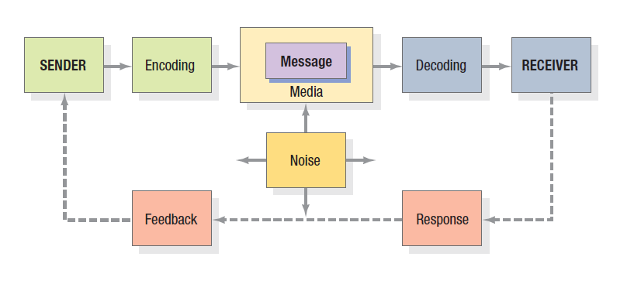
Elements in the Communications Process
Notes:
Marketers should understand the fundamental elements of effective communications. Two models are useful: a macromodel and a micromodel. Figure 17.1 shows a macromodel with nine key factors in effective communication. Two represent the major parties— sender and receiver. Two represent the major tools—message and media. Four represent major communication functions—encoding, decoding, response, and feedback. The last element in the system is noise, random and competing messages that may interfere with the intended communication.
Senders must know what audiences they want to reach and what responses they want to get. They must encode their messages so the target audience can decode them. They must transmit the message through media that reach the target audience and develop feedback channels to monitor the responses. The more the sender’s field of experience overlaps that of the receiver, the more effective the message is likely to be.

Slide 11
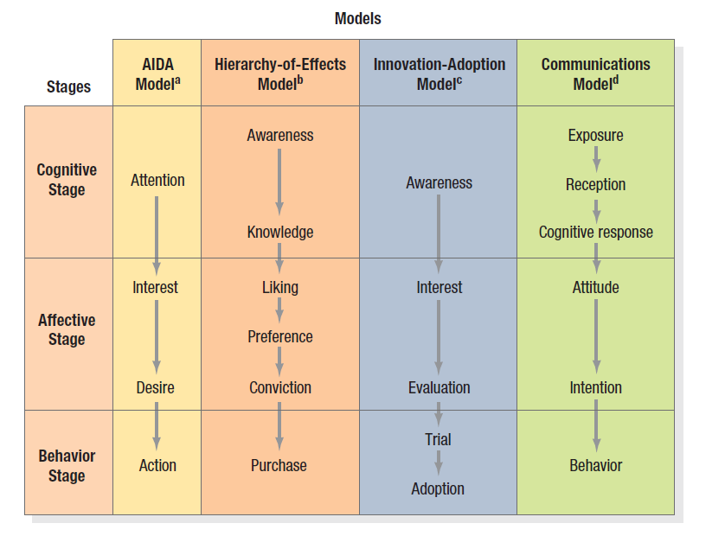
Micromodels of Communications
Notes:
Micromodels of marketing communications concentrate on consumers’ specific responses to communications. Figure 17.2 summarizes four classic response hierarchy models. All these models assume the buyer passes through cognitive, affective, and behavioral stages, in that order. This “learn-feel-do” sequence is appropriate when the audience has high involvement with a product category perceived to have high differentiation, such as an automobile or house. An alternative sequence, “do-feel-learn,” is relevant when the audience has high involvement but perceives little or no differentiation within the product category, such as an airline ticket or personal computer. A third sequence, “learn-do-feel,” is relevant when the audience has low involvement and perceives little differentiation, such as with salt or batteries. By choosing the right sequence, the marketer can do a better job of planning communications.

Slide 12
An Ideal Ad Campaign
The right consumer is exposed to the message at the right time and place
The ad causes consumer to pay attention
The ad reflects consumer’s level of understanding and behaviors with product
The ad correctly positions brand in terms of points-of-difference and points-of-parity
The ad motivates consumer to consider purchase of the brand
The ad creates strong brand associations
Notes:
To increase the odds for a successful marketing communications campaign, marketers must attempt to increase the likelihood that each step occurs. For example, the ideal ad campaign would ensure that:
1. The right consumer is exposed to the right message at the right place and at the right time.
2. The ad causes the consumer to pay attention but does not distract from the intended message.
3. The ad properly reflects the consumer’s level of understanding of and behaviors with the product and the brand.
4. The ad correctly positions the brand in terms of desirable and deliverable points-of-difference and points-of-parity.
5. The ad motivates consumers to consider purchase of the brand, and
6. The ad creates strong brand associations with all these stored communications effects so they can have an impact when consumers are considering making a purchase.

Slide 13
Steps in Developing Effective Communications
Identify target audience
Determine objectives
Design communications
Select channels
Establish budget
Decide on media mix
Measure results/manage IMC
Notes:
Figure 17.3 shows the eight steps in developing effective communications. We begin with the basics: identifying the target audience, determining the objectives, designing the communications, selecting the channels, and establishing the budget.

Slide 14
Communications Objectives
Category need means establishing a product or service category as necessary to remove or satisfy a perceived discrepancy between a current motivational state and a desired emotional state.
Brand awareness is the consumer’s ability to recognize or recall the brand within the category, in sufficient detail to make a purchase.
Brand attitude help consumers evaluate the brand’s perceived ability to meet a currently relevant need.
Brand purchase intention focuses to move consumers to decide to purchase the brand or take purchase-related action.
Notes:
There are four key communications objectives identified in this slide. We may try to establish a category need which means establishing a product or service category as necessary to remove or satisfy a perceived discrepancy between a current motivational state and a desired emotional state.
We may try to build brand awareness such that the consumer’s ability to recognize or recall the brand within the category, in sufficient detail to make a purchase. We may focus on brand attitude to help consumers evaluate the brand’s perceived ability to meet a currently relevant need. We may focus on brand purchase intention to move consumers to decide to purchase the brand or take purchase-related action.

Slide 15
Designing the Communications
Message strategy
Creative strategy
Message source
Notes:
Formulating the communications to achieve the desired response requires solving three problems: what to say (message strategy), how to say it (creative strategy), and who should say it (message source).The vision of GE’s Smart Grid program is to fundamentally overhaul the United States’ power grid, making it more efficient and sustainable and able also to deliver renewable-source energy such as wind and solar. An integrated campaign of print, TV, and online ads and an online augmented-reality demo was designed to increase understanding and support of the Smart Grid and GE’s leadership in solving technological problems. In its 2009 Super Bowl launch TV spot, the famous scarecrow character from The Wizard of Oz was shown bouncing along the top of a transmission tower singing, “If I Only Had a Brain.” A narrator voiced over the key communication message, “Smart Grid makes the way we distribute electricity more efficient simply by making it more intelligent.” One online ad used a flock of birds on electrical wires chirping and flapping their wings in synchronized rhythm to Rossini’s “Barber of Seville.” Another showed power lines becoming banjo strings for electrical pylons to play “O Susannah.” After drawing the audience in, the ads lay out the basic intent of the Smart Grid with links to more information. The augmented-reality GE microsite PlugIntoTheSmartGrid.com allowed users to create a digital hologram of Smart Grid technology using computer peripherals and 3D graphics.

Slide 16
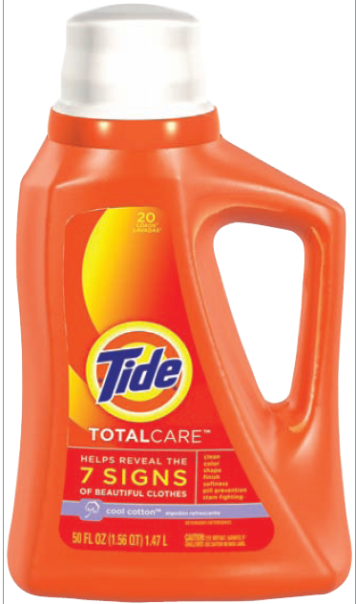
Message Strategy
Notes:
In determining message strategy, management searches for appeals, themes, or ideas that will tie in to the brand positioning and help establish points-of-parity or points-of-difference. Some of these may be related directly to product or service performance (the quality, economy, or value of the brand), whereas others may relate to more extrinsic considerations (the brand as being contemporary, popular, or traditional). Buyers are thought to expect four types of reward from a product: rational, sensory, social, or ego satisfaction. Buyers might visualize these rewards from results -of -use experience, product-in-use experience, or incidental-to-use experience. Crossing the four types of rewards with the three types of experience generates 12 types of messages. For example, the appeal “gets clothes cleaner” is a rational-reward promise following results-of-use experience. The phrase “real beer taste in a great light beer” is a sensory-reward promise connected with product-in-use experience.

Slide 17
Creative Strategy
Informational and transformational appeals
An informational (rational) appeal elaborates on product or service attributes or benefits.
    problem solution ads
    product demonstration ads
    product comparison ads
    testimonials from unknown or celebrity endorsers
A transformational (emotional) appeal elaborates on a nonproduct-related benefit or image.
    what kind of person uses a brand
    what kind of experience results from use
Notes:
Communications effectiveness depends on how a message is being expressed, as well as on its content. If a communication is ineffective, it may mean the wrong message was used, or the right one was poorly expressed. Creative strategies are the way marketers translate their messages into a specific communication. We can broadly classify them as either informational or transformational appeals. An informational appeal elaborates on product or service attributes or benefits. Examples in advertising are problem solution ads (Excedrin stops the toughest headache pain), product demonstration ads (Thompson Water Seal can withstand intense rain, snow, and heat), product comparison ads (DIRECTV offers better HD options than cable or other satellite operators), and testimonials from unknown or celebrity endorsers (NBA phenomenon LeBron James pitching Nike, Sprite, and McDonald’s). Informational appeals assume strictly rational processing of the communication on the consumer’s part. A transformational appeal elaborates on a nonproduct-related benefit or image. It might depict what kind of person uses a brand (VW advertised to active, youthful people with its famed “Drivers Wanted” campaign) or what kind of experience results from use (Pringles advertised “Once You Pop, the Fun Don’t Stop” for years). Transformational appeals often attempt to stir up emotions that will motivate purchase.

Slide 18
Positive and Negative Appeals
Communicators use negative appeals such as fear, guilt, and shame to get people to do things (brush their teeth, have an annual health checkup) or stop doing things (smoking).
Communicators also use positive emotional appeals such as humor, love, pride, and joy.
Notes:
Communicators use negative appeals such as fear, guilt, and shame to get people to do things (brush their teeth, have an annual health checkup) or stop doing things (smoking, abusing alcohol, overeating). Fear appeals work best when they are not too strong, when source credibility is high, and when the communication promises, in a believable and efficient way, to relieve the fear it arouses. Messages are most persuasive when moderately discrepant with audience beliefs. Communicators also use positive emotional appeals such as humor, love, pride, and joy. Motivational or “borrowed interest” devices—such as the presence of cute babies, frisky puppies, popular music, or provocative sex appeals—are often employed to attract attention and raise involvement with an ad. These techniques are thought necessary in the tough new media environment characterized by low-involvement consumer processing and competing ad and programming clutter.
Burger King told people that the Whopper was no longer on the menu as a scarcity appeal.

Slide 19
Message Source
Messages delivered by attractive or popular sources can achieve higher attention and recall
Advertisers often use celebrities as spokespeople
Celebrities are likely to be effective when they are credible or personify a key product attribute
The three most often identified sources of credibility are expertise, trustworthiness, and likability
  Expertise is the specialized knowledge the communicator possesses to back the claim
  Trustworthiness describes how objective and honest the source is perceived to be
  Likability describes the source’s attractiveness
Notes:
Messages delivered by attractive or popular sources can achieve higher attention and recall, which is why advertisers often use celebrities as spokespeople. Celebrities are likely to be effective when they are credible or personify a key product attribute. William Shatner is the spokesperson for Priceline.com.
What is important is the spokesperson’s credibility. The three most often identified sources of credibility are expertise, trustworthiness, and likability. Expertise is the specialized knowledge the communicator possesses to back the claim. Trustworthiness describes how objective and honest the source is perceived to be. Friends are trusted more than strangers or salespeople, and people who are not paid to endorse a product are viewed as more trustworthy than people who are paid. Likability describes the source’s attractiveness. Qualities such as candor, humor, and naturalness make a source more likable. The most highly credible source would score high on all three dimensions expertise, trustworthiness, and likability.

Slide 20
Select Communication Channels
Personal
Nonpersonal
Notes:
Selecting an efficient means to carry the message becomes more difficult as channels of communication become more fragmented and cluttered. Communications channels may be personal and nonpersonal. Within each are many subchannels. Personal communications channels let two or more persons communicate face-to-face or person-to-audience through a phone, surface mail, or e-mail. They derive their effectiveness from individualized presentation and feedback and include direct and interactive marketing, word-of-mouth marketing, and personal selling.
We can draw a further distinction between advocate, expert, and social communications channels. Advocate channels consist of company salespeople contacting buyers in the target market. Expert channels consist of independent experts making statements to target buyers. Social channels consist of neighbors, friends, family members, and associates talking to target buyers. Nonpersonal channels are communications directed to more than one person and include advertising, sales promotions, events and experiences, and public relations.

Slide 21
Select Communication Channels
Personal communications channels let two or more persons communicate face-to-face or person-to-audience through a phone, surface mail, or e-mail.
Derive its effectiveness from individualized presentation and feedback
    Direct and interactive marketing
    Word-of-mouth marketing
    Personal selling
Further distinction of Personal Communication
    Advocate channels consist of company salespeople contacting buyers in the target market.
    Expert channels consist of independent experts making statements to target buyers.
    Social channels consist of neighbors, friends, family members, and associates talking to target buyers
Notes:
Selecting an efficient means to carry the message becomes more difficult as channels of communication become more fragmented and cluttered. Communications channels may be personal and nonpersonal. Within each are many subchannels. Personal communications channels let two or more persons communicate face-to-face or person-to-audience through a phone, surface mail, or e-mail. They derive their effectiveness from individualized presentation and feedback and include direct and interactive marketing, word-of-mouth marketing, and personal selling.
We can draw a further distinction between advocate, expert, and social communications channels. Advocate channels consist of company salespeople contacting buyers in the target market. Expert channels consist of independent experts making statements to target buyers. Social channels consist of neighbors, friends, family members, and associates talking to target buyers. Nonpersonal channels are communications directed to more than one person and include advertising, sales promotions, events and experiences, and public relations.

Slide 22
Select Communication Channels
Nonpersonal channels are communications directed to more than one person and include:
  Advertising
  Sales promotions
  Events and experiences
  Public relations
Notes:
Selecting an efficient means to carry the message becomes more difficult as channels of communication become more fragmented and cluttered. Communications channels may be personal and nonpersonal. Within each are many subchannels. Personal communications channels let two or more persons communicate face-to-face or person-to-audience through a phone, surface mail, or e-mail. They derive their effectiveness from individualized presentation and feedback and include direct and interactive marketing, word-of-mouth marketing, and personal selling.
We can draw a further distinction between advocate, expert, and social communications channels. Advocate channels consist of company salespeople contacting buyers in the target market. Expert channels consist of independent experts making statements to target buyers. Social channels consist of neighbors, friends, family members, and associates talking to target buyers. Nonpersonal channels are communications directed to more than one person and include advertising, sales promotions, events and experiences, and public relations.

Slide 23
Establish the Budget
Affordable
Percentage-of-sales
Competitive parity
Objective-and-task
Notes:
One of the most difficult marketing decisions is determining how much to spend on marketing communications. John Wanamaker, the department store magnate, once said, “I know that half of my advertising is wasted, but I don’t know which half.” There are four common methods for setting budgets: the affordable method, the percentage-of-sales method, the competitive- parity method, and the objective-and-task method.
Some companies set the communication budget at what they think the company can afford. The affordable method completely ignores the role of promotion as an investment and the immediate impact of promotion on sales volume. Some companies set communication expenditures at a specified percentage of current or anticipated sales or of the sales price. Some companies set their communication budget to achieve share-of-voice parity with competitors. The objective-and-task method calls upon marketers to develop communication budgets by defining specific objectives, determining the tasks that must be performed to achieve these objectives, and estimating the costs of performing them. The sum of these costs is the proposed communication budget.

Slide 24
Objective-and-Task Method
Establish the market share goal.
Determine the percentage that should be reached.
Determine the percentage of aware prospects that should be persuaded to try the brand.
Determine the number of advertising impressions per 1% trial rate.
Determine the number of gross rating points that would have to be purchased.
Determine the necessary advertising budget on the basis of the average cost of buying a GRP.
Notes:
Here’s an example of using the Objective and Task Method. Suppose Dr. Pepper Snapple Group wants to introduce a new natural energy drink, called Sunburst, for the casual athlete. Its objectives might be as follows:
The company estimates 50 million potential users and sets a target of attracting 8 percent of the market—that is, 4 million users.
The advertiser hopes to reach 80 percent (40 million prospects) with its advertising message.
The advertiser would be pleased if 25 percent of aware prospects (10 million) tried Sunburst. It estimates that 40 percent of all triers, or 4 million people, will become loyal users.
The advertiser estimates that 40 advertising impressions (exposures) for every 1 percent of the population will bring about a 25 percent trial rate.
A gross rating point is one exposure to 1 percent of the target population. Because the company wants to achieve 40 exposures to 80 percent of the population, it will want to buy 3,200 gross rating points.
To expose 1 percent of the target population to one impression costs an
average of $3,277. Therefore, 3,200 gross rating points will cost $10,486,400 (= $3,277 × 3,200) in the introductory year.

Slide 25
Characteristics of the Mix
Advertising
Pervasiveness
Amplified expressiveness
Impersonality
Sales Promotion
Communication
Incentive
Invitation
Notes:
This slide explains the characteristics of advertising and sales promotion. Advertising permits the seller to repeat a message many times. It also allows the buyer to receive and compare the messages of various competitors. Large-scale advertising says something positive about the seller’s size, power, and success. Advertising provides opportunities for dramatizing the company and its products through the artful use of print, sound, and color. The advertiser can choose the aspects of the brand and product on which to focus communications.
Companies use sales promotion tools—coupons, contests, premiums, and the like—to draw a stronger and quicker buyer response, including short-run effects such as highlighting product offers and boosting sagging sales. Sales promotion tools offer three distinctive benefits: They draw attention and may lead the product. They incorporate some concession, inducement, or contribution that gives value to the consumer. They include a distinct invitation to engage in the transaction now.

Slide 26
Characteristics of the Mix
Public Relations and Publicity
High credibility
Ability to catch buyers off guard
Dramatization
Events and Experiences
Relevant
Involving
Implicit
Notes:
This slide explains the characteristics of public relations and events. Marketers tend to underuse public relations, yet a well-thought-out program coordinated with the other communications-mix elements can be extremely effective, especially if a company needs to challenge consumers’ misconceptions. The appeal of public relations and publicity is based on three distinctive qualities: high credibility, ability to reach hard-to-find buyers, and dramatization.
There are many advantages to events and experiences as long as they have the following characteristics. The events should be relevant, engaging, and include a soft implicit sell rather than a direct one.

Slide 27
Characteristics of the Mix
Direct Marketing
Customized
Up-to-date
Interactive
Word of Mouth Marketing
Credible
Personal
Timely
Personal Selling
Personal interaction
Cultivation
Response
Notes:
This slide explains the characteristics of direct marketing, personal selling, and word of mouth marketing. Direct and interactive marketing messages share three characteristics. They can be customized, current, and interactive.
Word of mouth also takes many forms both online or offline. Three noteworthy characteristics are the level of influence, personalization, and timeliness.
Personal selling is the most effective tool at later stages of the buying process, particularly in building up buyer preference, conviction, and action. Personal selling has three notable qualities. It includes personal interactions. It enables relationship cultivation. The buyer is given personal choices and encouraged to respond.

