Slide 1
Applied Marketing Strategies
MGT 681
Lecture 27

Slide 2
Distribution Strategies

Slide 3
Lecture Agenda
What is a marketing channel system and value network?
What work do marketing channels perform?
How should channels be designed?
What decisions do companies face in managing their channels?
How should companies integrate channels and manage channel conflict?
What are the key issues with e-commerce and m-commerce?
Notes:
Successful value creation needs successful value delivery. Holistic marketers are increasingly taking a value network view of their businesses. Instead of limiting their focus to their immediate suppliers, distributors, and customers, they are examining the whole supply chain that links raw materials, components, and manufactured goods and shows how they move toward the final consumers. Companies are looking at their suppliers’ suppliers upstream and at their distributors’ customers downstream. They are looking at customer segments and considering a wide range of new and different means to sell, distribute, and service their offerings. Companies today must build and manage a continuously evolving and increasingly complex channel system and value network. In this chapter, we consider strategic and tactical issues with integrating marketing channels and developing value networks.

Slide 4
Designing a
Marketing Channel System
Analyze customer needs
Establish channel objectives
Identify major channel alternatives
Evaluate major channel alternatives
Notes:
To design a marketing channel system, marketers analyze customer needs and wants, establish channel objectives and constraints, and identify and evaluate major channel alternatives.

Slide 5
Analyze customer needs
Lot size
Waiting and delivery time
Spatial convenience
Product variety
Service backup
Notes:
Channels produce five service outputs:
1. Lot size is the number of units the channel permits a typical customer to purchase on one occasion. In buying cars for its fleet, Hertz prefers a channel from which it can buy a large lot size; a household wants a channel that permits a lot size of one.
2. Waiting and delivery time is the average time customers wait for receipt of goods. Customers increasingly prefer faster delivery channels.
3. Spatial convenience is the degree to which the marketing channel makes it easy for customers to purchase the product.
4. Product variety is the assortment provided by the marketing channel. Normally, customers prefer a greater assortment because more choices increase the chance of finding what they need, although too many choices can sometimes create a negative effect.
5. Service backup is the add-on services (credit, delivery, installation, repairs) provided by the channel. The greater the service backup, the greater the work provided by the channel.

Slide 6
Service Outputs of Channels
Lot size is the number of units the channel permits a typical customer to purchase on one occasion.
Waiting and delivery time is the average time customers wait for receipt of goods. Customers increasingly prefer faster delivery channels.
Spatial convenience is the degree to which the marketing channel makes it easy for customers to purchase the product.
Product variety is the assortment provided by the marketing channel.
Service backup is the add-on services (credit, delivery, installation, repairs) provided by the channel. The greater the service backup, the greater the work provided by the channel.
Notes:
Channels produce five service outputs:
1. Lot size is the number of units the channel permits a typical customer to purchase on one occasion. In buying cars for its fleet, Hertz prefers a channel from which it can buy a large lot size; a household wants a channel that permits a lot size of one.
2. Waiting and delivery time is the average time customers wait for receipt of goods. Customers increasingly prefer faster delivery channels.
3. Spatial convenience is the degree to which the marketing channel makes it easy for customers to purchase the product.
4. Product variety is the assortment provided by the marketing channel. Normally, customers prefer a greater assortment because more choices increase the chance of finding what they need, although too many choices can sometimes create a negative effect.
5. Service backup is the add-on services (credit, delivery, installation, repairs) provided by the channel. The greater the service backup, the greater the work provided by the channel.

Slide 7
Establish Channel Objectives

Slide 8
Identifying Channel Alternatives
Types of intermediaries
Number of intermediaries
Terms and responsibilities
Notes:
Channel alternatives differ in three ways: the types of intermediaries, the number needed, and the terms and responsibilities of each. Consider the channel alternatives identified by a consumer electronics company that produces satellite radios. It could sell its players directly to automobile manufacturers to be installed as original equipment, auto dealers, rental car companies, or satellite radio specialist dealers through a direct sales force or through distributors. It could also sell its players through company stores, online retailers, mail-order catalogs, or mass merchandisers such as Best Buy. It will need to decide on the number of ntermediaries (discussed further on the next slide) and on what each channel member will be responsible for (also discussed further).

Slide 9
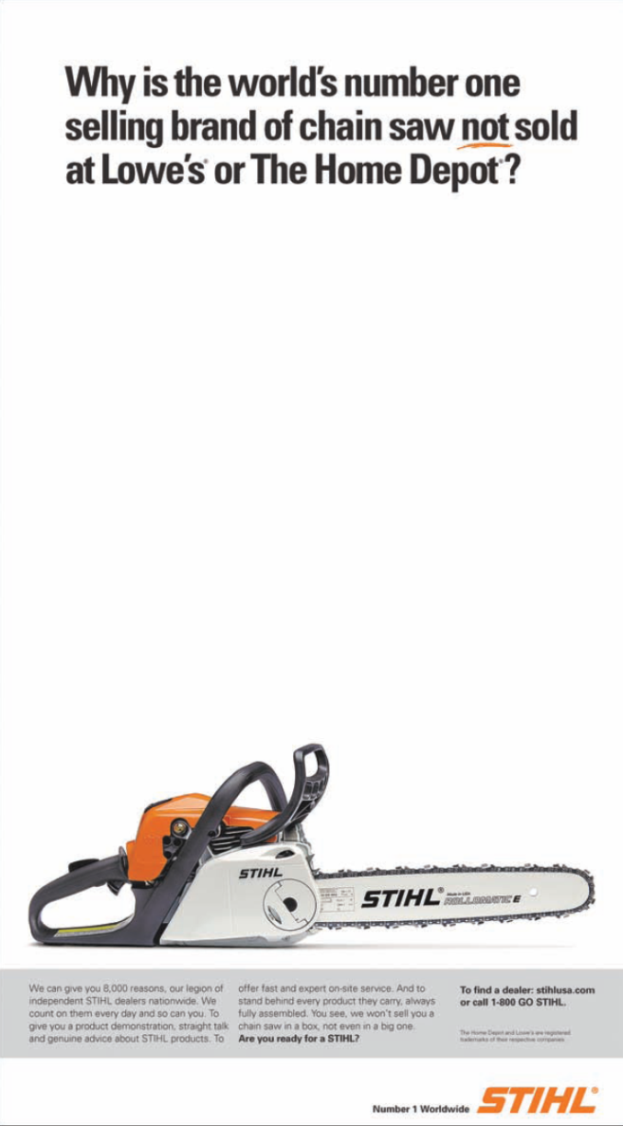
Number of Intermediaries
Exclusive
Selective
Intensive
Notes:
Three strategies based on the number of intermediaries are exclusive distribution, selective distribution, and intensive distribution. Exclusive distribution means severely limiting the number of intermediaries. It’s appropriate when the producer wants to maintain control over the service level and outputs offered by the resellers, and it often includes exclusive dealing arrangements. By granting exclusive distribution, the producer hopes to obtain more dedicated and knowledgeable selling. Selective distribution relies on only some of the intermediaries willing to carry a particular product. Intensive distribution places the goods or services in as many outlets as possible. This strategy serves well for snack foods, soft drinks, newspapers, candies, and gum—products consumers buy frequently or in a variety of locations.

Slide 10
Terms and Responsibilities of Channel Members
Price policy
Condition of sale
Distributors’ territorial rights
Mutual services and responsibilities
Notes:
Each channel member must be treated respectfully and given the opportunity to be profitable. The main elements in the “trade-relations mix” are price policies, conditions of sale, territorial rights, and specific services to be performed by each party. Price policy calls for the producer to establish a price list and schedule of discounts and allowances that intermediaries see as equitable and sufficient. Conditions of sale refers to payment terms and producer guarantees. Most producers grant cash discounts to distributors for early payment. They might also offer a guarantee against defective merchandise or price declines, creating an incentive to buy larger quantities. Distributors’ territorial rights define the distributors’ territories and the terms under which the producer will enfranchise other distributors. Distributors normally expect to receive full credit for all sales in their territory, whether or not they did the selling. Mutual services and responsibilities must be carefully spelled out, especially in franchised and exclusive- agency channels.

Slide 11
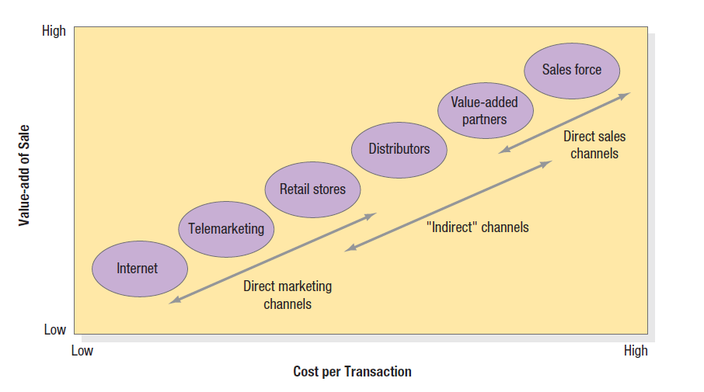
The Value-Adds versus
Costs of Different Channels
Notes:
Each channel alternative needs to be evaluated against economic, control, and adaptive criteria. Each channel alternative will produce a different level of sales and costs. Figure 15.4 shows how six different sales channels stack up in terms of the value added per sale and the cost per transaction. For example, in the sale of industrial products costing between $2,000 and $5,000, the cost per transaction has been estimated at $500 (field sales), $200 (distributors), $50 (telesales), and $10 (Internet). A Booz Allen Hamilton study showed that the average transaction at a full-service branch costs the bank $4.07, a phone transaction costs $.54, and an ATM transaction costs $.27, but a typical Web-based transaction costs only $.01.

Slide 12
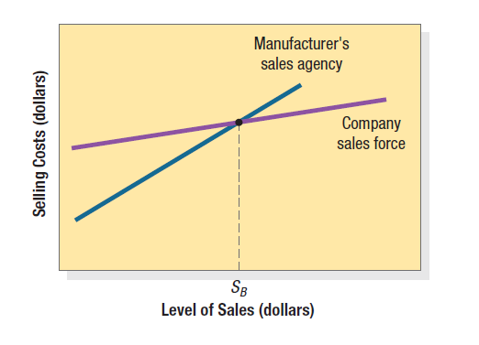
Break-Even Cost Chart
Notes:
Firms will try to align customers and channels to maximize demand at the lowest overall cost. Clearly, sellers try to replace high-cost channels with low-cost channels as long as the value added per sale is sufficient. A North Carolina furniture manufacturer wants to sell its line to retailers on the West Coast. One alternative is to hire 10 new sales representatives to receive a base salary plus commissions. The other alternative is to use a manufacturer’s sales agency that has extensive contacts with retailers. Its 30 sales representatives would receive a commission based on their sales. The first step is to estimate how many sales each alternative will likely generate. The next step is to estimate the costs of selling different volumes through each channel. The cost schedules are shown in Figure 15.5. Engaging a sales agency is less expensive than establishing a new company sales office, but costs rise faster through an agency because sales agents get larger commissions. The final step is comparing sales and costs.
As Figure 15.5 shows, there is one sales level (SB) at which selling costs are the same for the two channels. The sales agency is thus the better channel for any sales volume below SB, and the company sales branch is better at any volume above SB. Given this information, it is not surprising that sales agents tend to be used by smaller firms, or by large firms in smaller territories where the volume is low.

Slide 13
Channel-Management Decisions
Selecting channel members
Training channel members
Motivating channel members
Evaluating channel members
Modifying channel members
Notes:
After a company has chosen a channel system, it must select, train, motivate, and evaluate individual intermediaries for each channel. It must also modify channel design and arrangements over time. As the company grows, it can also consider channel expansion into international markets.

Slide 14
Channel Power
Coercive
Reward
Legitimate
Expert
Referent
Notes:
Channel power is the ability to alter channel members’ behavior so they take actions they would not have taken otherwise. Manufacturers can draw on the following types of power to elicit cooperation:
Coercive power means that the manufacturer threatens to withdraw a resource or terminate a relationship if intermediaries fail to cooperate. Reward power includes when the manufacturer offers intermediaries an extra benefit for performing specific acts or functions. Legitimate power includes the manufacturer requesting a behavior that is warranted under the contract. Expert power means the manufacturer has special knowledge the intermediaries value. Once the intermediaries acquire this expertise, however, expert power weakens. Referent power means the manufacturer is so highly respected that intermediaries are proud to be associated with it.

Slide 15
Channel Power
Coercive power means that the manufacturer threatens to withdraw a resource or terminate a relationship if intermediaries fail to cooperate.
Reward power includes when the manufacturer offers intermediaries an extra benefit for performing specific acts or functions.
Legitimate power includes the manufacturer requesting a behavior that is warranted under the contract.
Expert power means the manufacturer has special knowledge the intermediaries value. Once the intermediaries acquire this expertise, however, expert power weakens.
Referent power means the manufacturer is so highly respected that intermediaries are proud to be associated with it.
Notes:
Channel power is the ability to alter channel members’ behavior so they take actions they would not have taken otherwise. Manufacturers can draw on the following types of power to elicit cooperation:
Coercive power means that the manufacturer threatens to withdraw a resource or terminate a relationship if intermediaries fail to cooperate. Reward power includes when the manufacturer offers intermediaries an extra benefit for performing specific acts or functions. Legitimate power includes the manufacturer requesting a behavior that is warranted under the contract. Expert power means the manufacturer has special knowledge the intermediaries value. Once the intermediaries acquire this expertise, however, expert power weakens. Referent power means the manufacturer is so highly respected that intermediaries are proud to be associated with it.

Slide 16
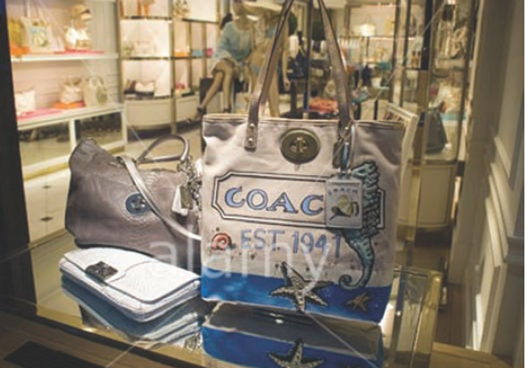
Integrated Marketing Channel System
Notes:
An integrated marketing channel system is one in which the strategies and tactics of selling through one channel reflect the strategies and tactics of selling through one or more other channels. Adding more channels gives companies three important benefits. The first is increased market coverage. Not only are more customers able to shop for the company’s products in more places, but those who buy in more than one channel are often more profitable than single-channel customers. The second benefit is lower channel cost—selling by phone is cheaper than personal selling to small customers. The third is more customized selling— such as by adding a technical sales force to sell complex equipment. There is a trade-off, however. New channels typically introduce conflict and problems with control and cooperation. Two or more may end up competing for the same customers.

Slide 17
Channel Integration and Systems
Vertical marketing systems
  Corporate VMS
  Administered VMS
  Contractual VMS
Horizontal marketing systems
Multichannel systems
Notes:
A conventional marketing channel consists of an independent producer, wholesaler(s), and retailer(s). Each is a separate business seeking to maximize its own profits, even if this goal reduces profit for the system as a whole. No channel member has complete or substantial control over other members.
A vertical marketing system (VMS), by contrast, includes the producer, wholesaler(s), and retailer(s) acting as a unified system. One channel member, the channel captain, owns or franchises the others or has so much power that they all cooperate. An administered VMS coordinates successive stages of production and distribution through the size and power of one of the members. Manufacturers of dominant brands can secure strong trade cooperation and support from resellers. A contractual VMS consists of independent firms at different levels of production and distribution, integrating their programs on a contractual basis to obtain more economies or sales impact than they could achieve alone. Sometimes thought of as “value-adding partnerships” (VAPs), contractual VMSs come in three types: wholesaler-sponsored voluntary chains, retailer cooperatives, and franchise organizations.

Slide 18
Channel Integration and Systems
A conventional marketing channel consists of an independent producer, wholesaler(s), and retailer(s).
  Each is a separate business seeking to maximize its own profits, even if this goal reduces profit for the system as a whole.
  No channel member has complete or substantial control over other members.
A vertical marketing system (VMS), by contrast, includes the producer, wholesaler(s), and retailer(s) acting as a unified system.
One channel member, the channel captain, owns or franchises the others or has so much power that they all cooperate.
Notes:
A conventional marketing channel consists of an independent producer, wholesaler(s), and retailer(s). Each is a separate business seeking to maximize its own profits, even if this goal reduces profit for the system as a whole. No channel member has complete or substantial control over other members.
A vertical marketing system (VMS), by contrast, includes the producer, wholesaler(s), and retailer(s) acting as a unified system. One channel member, the channel captain, owns or franchises the others or has so much power that they all cooperate. An administered VMS coordinates successive stages of production and distribution through the size and power of one of the members. Manufacturers of dominant brands can secure strong trade cooperation and support from resellers. A contractual VMS consists of independent firms at different levels of production and distribution, integrating their programs on a contractual basis to obtain more economies or sales impact than they could achieve alone. Sometimes thought of as “value-adding partnerships” (VAPs), contractual VMSs come in three types: wholesaler-sponsored voluntary chains, retailer cooperatives, and franchise organizations.

Slide 19
Vertical Marketing System
Corporate VMS coordinates successive stages of production and distribution under single ownership.
Administered VMS coordinates successive stages of production and distribution through the size and power of one of the members.
  Manufacturers of dominant brands can secure strong trade cooperation and support from resellers.
A contractual VMS consists of independent firms at different levels of production and distribution, integrating their programs on a contractual basis to obtain more economies or sales impact than they could achieve alone.
  Sometimes thought of as “value-adding partnerships” (VAPs), contractual VMSs come in three types:
    wholesaler-sponsored voluntary chains
    retailer cooperatives
    franchise organizations.

Slide 20
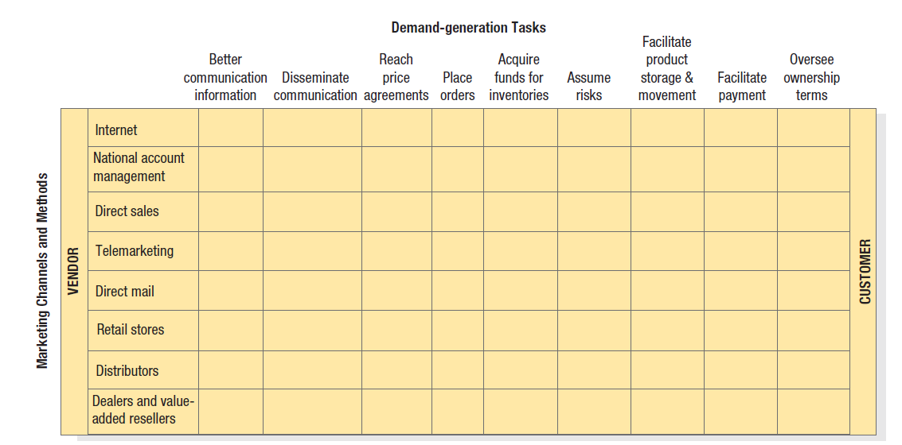
The Hybrid Grid
Notes:
Clearly, companies need to think through their channel architecture and determine which channels should perform which functions. Figure 15.6 shows a simple grid to help make channel architecture decisions. The grid consists of major marketing channels (as rows) and the major channel tasks to be completed (as columns). The grid illustrates why using only one channel is not efficient.

Slide 21
Channel Conflict
What types of conflict arise in channels?
What causes conflict?
What can marketers do to resolve it?
Notes:
No matter how well channels are designed and managed, there will be some conflict, if only because the interests of independent business entities do not always coincide. Channel conflict is generated when one channel member’s actions prevent another channel from achieving its goal. Channel coordination occurs when channel members are brought together to advance the goals of the channel, as opposed to their own potentially incompatible goals. Horizontal channel conflict occurs between channel members at the same level. • Vertical channel conflict occurs between different levels of the channel. Multichannel conflict exists when the manufacturer has established two or more channels that sell to the same market. It’s likely to be especially intense when the members of one channel get a lower price (based on larger-volume purchases) or work with a lower margin.

Slide 22
Causes of Channel Conflict
Goal incompatibility
Unclear roles and rights
Differences in perception
Intermediaries’ dependence on manufacturer
Notes:
Some causes of channel conflict are easy to resolve, others are not. Several causes are listed in the slide. For instance, the manufacturer may want to achieve rapid market penetration through a low-price policy. Dealers, in contrast, may prefer to work with high margins and pursue short-run profitability. HP may sell personal computers to large accounts through its own sales force, but its licensed dealers may also be trying to sell to large accounts. Territory boundaries and credit for sales often produce conflict. The manufacturer may be optimistic about the short-term economic outlook and want dealers to carry higher inventory. Dealers may be pessimistic. In the beverage category, it is not uncommon for disputes to arise between manufacturers and their distributors about the optimal advertising strategy. The fortunes of exclusive dealers, such as auto dealers, are profoundly affected by the manufacturer’s product and pricing decisions. This situation creates a high potential for conflict.

Slide 23
Strategies for Managing Channel Conflict
Strategic justification
Dual compensation
Superordinate goals
Employee exchange
Joint memberships
Cooptation
Diplomacy
Mediation
Arbitration
Legal recourse
Notes:
There are a number of mechanisms for effective conflict management.
In some cases, a convincing strategic justification that they serve distinctive segments and do not compete as much as they might think can reduce potential for conflict among channel members. Dual compensation pays existing channels for sales made through new channels. Channel members can come to an agreement on the fundamental or superordinate goal they are jointly seeking, whether it is survival, market share, high quality, or customer satisfaction. They usually do this when the channel faces an outside threat, such as a more efficient competing channel, an adverse piece of legislation, or a shift in consumer desires. A useful step is to exchange persons between two or more channel levels. Similarly, marketers can encourage joint memberships in trade associations. Co-optation is an effort by one organization to win the support of the leaders of another by including them in advisory councils, boards of directors, and the like. When conflict is chronic or acute, the parties may resort to diplomacy, mediation, or arbitration. Diplomacy takes place when each side sends a person or group to meet with its counterpart to resolve the conflict. Mediation relies on a neutral third party skilled in conciliating the two parties’ interests. In arbitration two parties agree to present their arguments to one or more arbitrators and accept their decision. If nothing else proves effective, a channel partner may choose to file a lawsuit.

Slide 24
E-Commerce
Pure-click
Brick-and-click
Notes:
E-commerce uses a Web site to transact or facilitate the sale of products and services online. Online retailers compete in three key aspects of a transaction: (1) customer interaction with the Web site, (2) delivery, and (3) ability to address problems when they occur. We can distinguish between pure-click companies, those that have launched a Web site without any previous existence as a firm, and brick-and-click companies, existing companies that have added an online site for information or e-commerce.

Slide 25

M-Commerce
Notes:
The widespread penetration of cell phones and smart phones—there are currently more mobile phones than personal computers in the world—allows people to connect to the Internet and place online orders on the move. Many see a big future in what is now called m-commerce (m for mobile). The existence of mobile channels and media can keep consumers connected and interacting with a brand throughout their day-to-day lives. GPS-type features can help identify shopping or purchase opportunities for consumers for their favorite brands.

