Slide 1
Applied Marketing Strategies
MGT 681
Lecture 23

Slide 2
Strategy Formulation & Implementation
Part 3 & 4

Slide 3
Pricing Strategies

Slide 4
Lecture Agenda
How do consumers process and evaluate prices?
How should a company set prices initially for products or services?
How should a company adapt prices to meet varying circumstances and opportunities?
When should a company initiate a price change?
How should a company respond to a competitor’s price challenge?
Notes:
Price is the one element of the marketing mix that produces revenue; the other elements produce costs. Prices are perhaps the easiest element of the marketing program to adjust; product features, channels, and even communications take more time. Price also communicates to the market the company’s intended value positioning of its product or brand. A well-designed and marketed product can command a price premium and reap big profits. But new economic realities have caused many consumers to pinch pennies, and many companies have had to carefully review their pricing strategies as a result. Pricing decisions are clearly complex and difficult, and many marketers neglect their pricing strategies.
Holistic marketers must take into account many factors in making pricing decisions—the company, the customers, the competition, and the marketing environment. Pricing decisions must be consistent with the firm’s marketing strategy and its target markets and brand positioning. In this chapter, we cover the concepts and tools to facilitate the setting of initial prices and adjusting prices over time and markets.

Slide 5
Synonyms for Price
Rent
Tuition
Fee
Fare
Rate
Toll
Premium
Honorarium
Special assessment
Bribe
Dues
Salary
Commission
Wage
Tax
Notes:
Price is not just a number on a tag. It comes in many forms and performs many functions. Rent, tuition, fares, fees, rates, tolls, retainers, wages, and commissions are all the price you pay for some good or service.

Slide 6
The Internet Changes the
Pricing Environment –
By Providing Information
Notes:
A combination of environmentalism, renewed frugality, and concern about jobs and home values forced many U.S. consumers to rethink how they spent their money. Here is a short list of how the Internet allows sellers to discriminate between buyers, and buyers to discriminate between sellers.
Buyers can get instant price comparisons from thousands of vendors, name their price and have it met, and get products free.
Sellers can monitor customer behavior and tailor offers to individuals and give certain customers access to special prices.
Both buyers and sellers can negotiate prices in online auctions and exchanges or even in person.

Slide 7
Common Pricing Mistakes
Determine costs and take traditional industry margins
Failure to revise price to capitalize on market changes
Setting price independently of the rest of the marketing mix
Failure to vary price by product item, market segment, distribution channels, and purchase occasion
Notes:
Executives complain that pricing is a big headache—and getting worse by the day. Many companies do not handle pricing well and fall back on “strategies” such as: “We determine our costs and take our industry’s traditional margins.” Other common mistakes are not revising price often enough to capitalize on market changes; setting price independently of the rest of the marketing program rather than as an intrinsic element of market-positioning strategy; and not varying price enough for different product items, market segments, distribution channels, and purchase occasions.

Slide 8
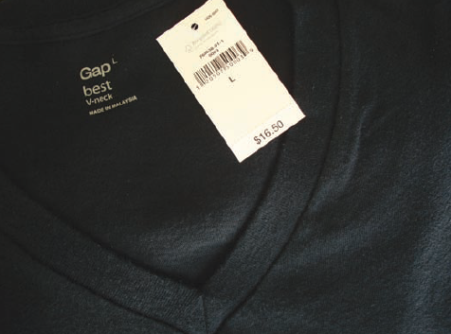
Consumer Psychology and Pricing
Reference prices
Price-quality inferences
Price endings
Price cues
Notes:
Purchase decisions are based on how consumers perceive prices and what they consider the current actual price to be—not on the marketer’s stated price. Customers may have a lower price threshold below which prices signal inferior or unacceptable quality, as well as an upper price threshold above which prices are prohibitive and the product appears not worth the money. Although consumers may have fairly good knowledge of price ranges, surprisingly few can accurately recall specific prices. When examining products, however, they often employ reference prices, comparing an observed price to an internal reference price they remember or an external frame of reference such as a posted “regular retail price. Many consumers use price as an indicator of quality. Image pricing is especially effective with ego-sensitive products such as perfumes, expensive cars, and designer clothing. Many sellers believe prices should end in an odd number. Customers see an item priced at $299 as being in the $200 rather than the $300 range; they tend to process prices “left-to-right” rather than by rounding. Price encoding in this fashion is important if there is a mental price break at the higher, rounded price.

Slide 9
Possible Consumer Reference Prices
“Fair price”
Typical price
Last price paid
Upper-bound price
Lower-bound price
Competitor prices
Expected future price
Usual discounted price
Notes:
All types of reference prices are possible as you can see in Table 14.1, and sellers often attempt to manipulate them. For example, a seller can situate its product among expensive competitors to imply that it belongs in the same class. Department stores will display women’s apparel in separate departments differentiated by price; dresses in the more expensive department are assumed to be of better quality. Marketers also encourage reference-price thinking by stating a high manufacturer’s suggested price, indicating that the price was much higher originally, or pointing to a competitor’s high price.

Slide 10

Tiers in Pricing
Notes:
Most markets have three to five price points or tiers. Marriott Hotels is good at developing different brands or variations of brands for different price points: Marriott Vacation Club—Vacation Villas (highest price), Marriott Marquis (high price), Marriott (high-medium price), Renaissance (medium-high price), Courtyard (medium price), TownePlace Suites (medium-low price), and Fairfield Inn (low price). Firms devise their branding strategies to help convey the price-quality tiers of their products or services to consumers

Slide 11
Steps in Setting Price
Select the price objective
Determine demand
Estimate costs
Analyze competitor price mix
Select pricing method
Select final price
Notes:
The firm must consider many factors in setting its pricing policy. Table 14.2 summarizes the six steps in the process.

Slide 12
Step 1: Selecting the Pricing Objective
Survival
Maximum current profit
Maximum market share
Maximum market skimming
Product-quality leadership
Notes:
The company first decides where it wants to position its market offering. The clearer a firm’s objectives, the easier it is to set price. Five major objectives are: survival, maximum current profit, maximum market share, maximum market skimming, and product-quality leadership. Companies pursue survival as their major objective if they are plagued with overcapacity, intense competition, or changing consumer wants. As long as prices cover variable costs and some fixed costs, the company stays in business. Survival is a short-run objective; in the long run, the firm must learn how to add value or face extinction. Many companies try to set a price that will maximize current profits. Some companies want to maximize their market share. They believe a higher sales volume will lead to lower unit costs and higher long-run profit. Companies unveiling a new technology favor setting high prices to maximize market skimming. Market skimming makes sense under the following conditions: (1) A sufficient number of buyers have a high current demand; (2) the unit costs of producing a small volume are high enough to cancel the advantage of charging what the traffic will bear; (3) the high initial price does not attract more competitors to the market; (4) the high price communicates the image of a superior product. A company might aim to be the product-quality leader in the market.

Slide 13
Step 2: Determining Demand
Price sensitivity
Estimate demand curves
Price elasticity of demand
Notes:
Each price will lead to a different level of demand and have a different impact on a company’s marketing objectives. The normally inverse relationship between price and demand is captured in a demand curve as shown in Figure 14.1 on the next slide. The higher the price, the lower the demand. For prestige goods, the demand curve sometimes slopes upward.
Most companies attempt to measure their demand curves using several different methods. For example, surveys can explore how many units consumers would buy at different proposed prices. Price experiments can vary the prices of different products in a store or charge different prices for the same product in similar territories to see how the change affects sales. Statistical analysis of past prices, quantities sold, and other factors can reveal their relationships.

Slide 14
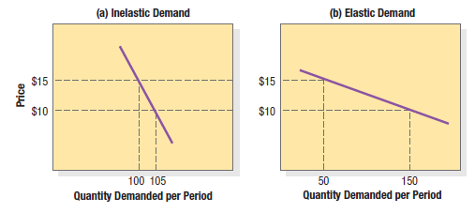
Inelastic and
Elastic Demand
Notes:
The demand curve shows the market’s probable purchase quantity at alternative prices. It sums the reactions of many individuals with different price sensitivities. The first step in estimating demand is to understand what affects price sensitivity. Generally speaking, customers are less price sensitive to low-cost items or items they buy infrequently. They are also less price sensitive when (1) there are few or no substitutes or competitors; (2) they do not readily notice the higher price; (3) they are slow to change their buying habits; (4) they think the higher prices are justified; and (5) price is only a small part of the total cost of obtaining, operating, and servicing the product over its lifetime.

Slide 15
Factors Leading to Less Price Sensitivity
The product is more distinctive
Buyers are less aware of substitutes
Buyers cannot easily compare the quality of substitutes
Expenditure is a smaller part of buyer’s total income
Expenditure is small compared to the total cost
Part of the cost is paid by another party
Product is used with previously purchased assets
Product is assumed to have high quality and prestige
Buyers cannot store the product
Notes:
Companies prefer customers who are less price-sensitive. Table 14.3 lists some characteristics associated with decreased price sensitivity.

Slide 16
Step 3: Estimating Costs
Types of costs
Accumulated production
Activity-based cost accounting
Target costing
Notes:
Demand sets a ceiling on the price the company can charge for its product. Costs set the floor. The company wants to charge a price that covers its cost of producing, distributing, and selling the product, including a fair return for its effort and risk. Yet when companies price products to cover their full costs, profitability isn’t always the net result.

Slide 17
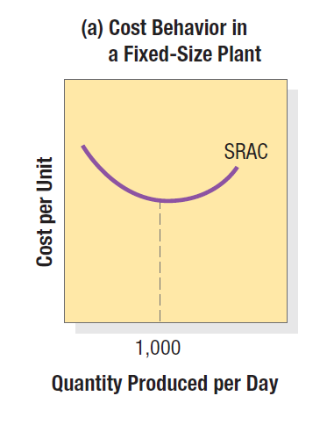
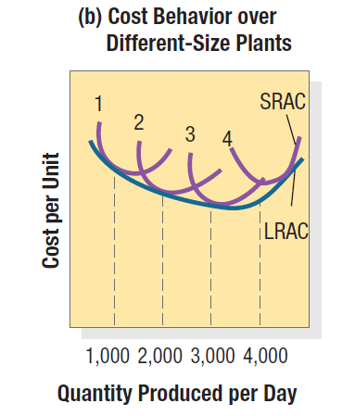
Cost Per Unit at Different Levels of Production
Notes:
To price intelligently, management needs to know how its costs vary with different levels of production. Take the case in which a company such as TI has built a fixed-size plant to produce 1,000 hand calculators a day. The cost per unit is high if few units are produced per day. As production approaches 1,000 units per day, the average cost falls because the fixed costs are spread over more units. Short-run average cost increases after 1,000 units, however, because the plant becomes inefficient. Workers must line up for machines, getting in each other’s way, and machines break down more often. This is shown in Figure 14.2a. If TI believes it can sell 2,000 units per day, it should consider building a larger plant. The plant will use more efficient machinery and work arrangements, and the unit cost of producing 2,000 calculators per day will be lower than the unit cost of producing 1,000 per day. This is shown in the long-run average cost curve (LRAC) in Figure 14.2b. In fact, a 3,000-capacity plant would be even more efficient according to Figure 14.2b, but a 4,000-daily production plant would be less so because of increasing diseconomies of scale: There are too many workers to manage, and paperwork slows things down. Figure 14.2b indicates that a 3,000-daily production plant is the optimal size if demand is strong enough to support this level of production.

Slide 18
Cost Terms and Production
Fixed costs
Variable costs
Total costs
Average cost
Cost at different levels of production
Notes:
A company’s costs take two forms, fixed and variable. Fixed costs, also known as overhead, are costs that do not vary with production level or sales revenue. A company must pay bills each month for rent, heat, interest, salaries, and so on regardless of output. Variable costs vary directly with the level of production. For example, each hand calculator produced by Texas Instruments incurs the cost of plastic, microprocessor chips, and packaging. These costs tend to be constant per unit produced, but they’re called variable because their total varies with the number of units produced. Total costs consist of the sum of the fixed and variable costs for any given level of production. Average cost is the cost per unit at that level of production; it equals total costs divided by production. Management wants to charge a price that will at least cover the total production costs at a given level of production. To price intelligently, management needs to know how its costs vary with different levels of production.

Slide 19
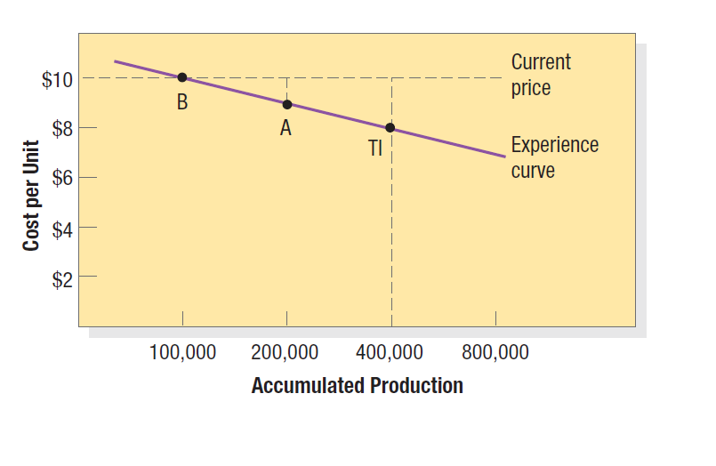
Cost per Unit as a Function of Accumulated Production
Notes:
Figure 14.3 shows, is that average cost falls with accumulated production experience. Thus the average cost of producing the first 100,000 hand calculators is $10 per calculator. When the company has produced the first 200,000 calculators, the average cost has fallen to $9. After its accumulated production experience doubles again to 400,000, the average cost is $8. This decline in the average cost with accumulated production experience is called the experience curve or learning curve. Now suppose three firms compete in this industry, TI, A, and B. TI is the lowest-cost producer at $8, having produced 400,000 units in the past. If all three firms sell the calculator for $10, TI makes $2 profit per unit, A makes $1 per unit, and B breaks even. The smart move for TI would be to lower its price to $9. This will drive B out of the market, and even A may consider leaving. TI will pick up the business that would have gone to B (and possibly A). Furthermore, price-sensitive customers will enter the market at the lower price. As production increases beyond 400,000 units, TI’s costs will drop still further and faster and will more than restore its profits, even at a price of $9. TI has used this aggressive pricing strategy repeatedly to gain market share and drive others out of the industry. Experience-curve pricing nevertheless carries major risks. Aggressive pricing might give the product a cheap image. It also assumes competitors are weak followers. The strategy leads the company to build more plants to meet demand, but a competitor may choose to innovate with a lower cost technology. The market leader is now stuck with the old technology.

Slide 20
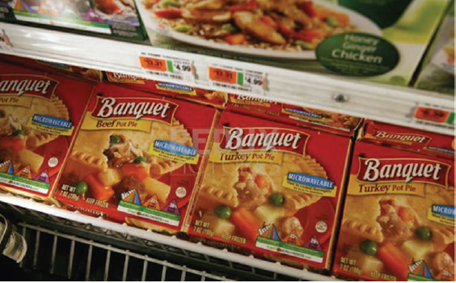
Target Costing
Notes:
Costs change with production scale and experience. They can also change as a result of a concentrated effort by designers, engineers, and purchasing agents to reduce them through target costing. Market research establishes a new product’s desired functions and the price at which it will sell, given its appeal and competitors’ prices. This price less desired profit margin leaves the target cost the marketer must achieve. The firm must examine each cost element—design, engineering, manufacturing, sales—and bring down costs so the final cost projections are in the target range. When ConAgra Foods decided to increase the list prices of its Banquet frozen dinners to cover higher commodity costs, the average retail price of the meals increased from $1 to $1.25.When sales dropped significantly, management vowed to return to a $1 price, which necessitated cutting $250 million in other costs through a variety of methods, such as centralized purchasing and shipping, less expensive ingredients, and smaller portions.

Slide 21

Analyzing Competitor’s Costs
Notes:
Although the natural cleaner market was pioneered by Seventh Generation and method cleaning products, Clorox Green Works now commands 42 percent market share. The Green Works product line consists of 10 natural cleaners using biodegradable ingredients, packaged in recyclable materials, and not tested on animals The first major new Clorox brand in more than 20 years, it doubled the size of the natural cleaning category with its strategy of “delivering a line of affordable products that are good for consumers, good for retailers, and good for the environment.” The company charges only a 10 percent to 20 percent premium over conventional cleaners, versus the premium of 40 percent or more charged by other natural cleaners.

Slide 22
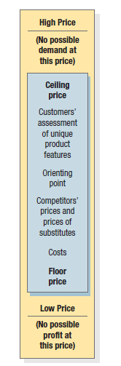
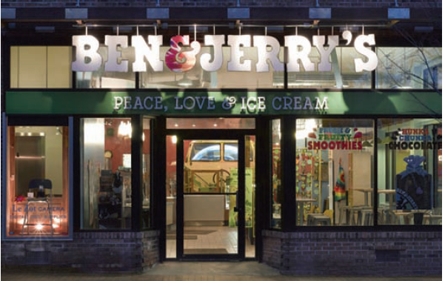
The Three Cs Model for Price-Setting
Notes:
Given the customers’ demand schedule, the cost function, and competitors’ prices, the company is now ready to select a price. Figure 14.4 summarizes the three major considerations in price setting: Costs set a floor to the price. Competitors’ prices and the price of substitutes provide an orienting point. Customers’ assessment of unique features establishes the price ceiling.

Slide 23
Step 5: Selecting a Pricing Method
Markup pricing
Target-return pricing
Perceived-value pricing
Value pricing
Going-rate pricing
Auction-type pricing
Notes:
The most elementary pricing method is to add a standard markup to the product’s cost. In target-return pricing, the firm determines the price that yields its target rate of return on investment. Public utilities, which need to make a fair return on investment, often use this method. An increasing number of companies now base their price on the customer’s perceived value. Perceived value is made up of a host of inputs, such as the buyer’s image of the product performance, the channel deliverables, the warranty quality, customer support, and softer attributes such as the supplier’s reputation, trustworthiness, and esteem. Companies must deliver the value promised by their value proposition, and the customer must perceive this value. In recent years, several companies have adopted value pricing: They win loyal customers by charging a fairly low price for a high-quality offering. In going-rate pricing, the firm bases its price largely on competitors’ prices. In oligopolistic industries that sell a commodity such as steel, paper, or fertilizer, all firms normally charge the same price. Auction-type pricing is growing more popular, especially with scores of electronic marketplaces selling everything from pigs to used cars as firms dispose of excess inventories or used goods.

Slide 24
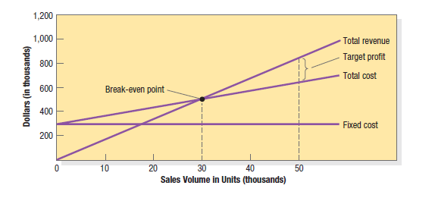
Break-Even Chart for Determining Target-Return Price and Break-Even Volume
Notes:
The manufacturer will realize this 20 percent ROI provided its costs and estimated sales turn out to be accurate. But what if sales don’t reach 50,000 units? The manufacturer can prepare a break-even chart to learn what would happen at other sales levels (see Figure 14.5). Fixed costs are $300,000 regardless of sales volume. Variable costs, not shown in the figure, rise with volume. Total costs equal the sum of fixed and variable costs. The total revenue curve starts at zero and rises with each unit sold. The total revenue and total cost curves cross at 30,000 units. This is the break-even volume. We can verify it by the following formula:
Break-even volume = fixed cost (price - variable cost) = $300,000
$20 - $10 = 30,000
The manufacturer, of course, is hoping the market will buy 50,000 units at $20, in which case it earns $200,000 on its $1 million investment, but much depends on price elasticity and competitors’ prices.

Slide 25
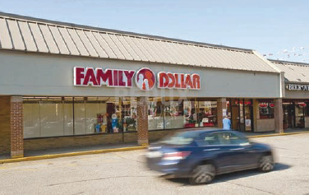
Dollar Store Pricing
Notes:
Once-unfashionable “dollar stores” such as Dollar General, Family Dollar Stores, Big Lots, and Dollar Tree are gaining popularity, partly fueled by an economic downturn. In 2008, these four biggest players in the category generated $26 billion in sales with 20,000 stores and gross margins of 35 percent to -40 percent. These ultra discounters are not dollar stores in a strict sense of the word—they sell many items over $1, although most are under $10. They have, however, developed a simple, successful formula for drawing shoppers from Target and even Wal-Mart. Their answer is to build small, easy-to-navigate stores in expensive real estate locations with parking handy; keep overhead low by limiting inventory to mostly inexpensive overstocks, odd lots, and buyouts; and spend sparingly on store décor and get free word-of-mouth publicity.

Slide 26
Auction-Type Pricing
English
Dutch
Sealed-Bid
Notes:
These are the three major types of auctions and their separate pricing procedures. English auctions (ascending bids) have one seller and many buyers. On sites such as eBay and Amazon.com, the seller puts up an item and bidders raise the offer price until the top price is reached. The highest bidder gets the item. English auctions are used today for selling antiques, cattle, real estate, and used equipment and vehicles. Dutch auctions (descending bids) feature one seller and many buyers, or one buyer and many sellers. In the first kind, an auctioneer announces a high price for a product and then slowly decreases the price until a bidder accepts. In the other, the buyer announces something he or she wants to buy, and potential sellers compete to offer the lowest price. Sealed-bid auctions let would-be suppliers submit only one bid; they cannot know the other bids. The U.S. government often uses this method to procure supplies.

Slide 27
Step 6: Selecting the Final Price
Impact of other marketing activities
Company pricing policies
Gain-and-risk sharing pricing
Impact of price on other parties
Notes:
Pricing methods narrow the range from which the company must select its final price. In selecting that price, the company must consider additional factors, including the impact of other marketing activities, company pricing policies, gain-and-risk-sharing pricing, and the impact of price on other parties. Here we will examine several price-adaptation strategies: geographical pricing, price discounts and allowances, promotional pricing, and differentiated pricing.

Slide 28
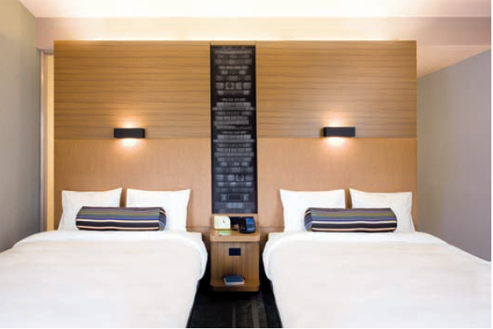
Geographical Pricing
Pricing varies by location
Notes:
In geographical pricing, the company decides how to price its products to different customers in different locations and countries. Should the company charge higher prices to distant customers to cover the higher shipping costs, or a lower price to win additional business? How should it account for exchange rates and the strength of different currencies? Another question is how to get paid. This issue is critical when buyers lack sufficient hard currency to pay for their purchases. Many buyers want to offer other items in payment, a practice known as countertrade. U.S. companies are often forced to engage in countertrade if they want the business. Countertrade may account for 15 percent to 20 percent of world trade and takes several forms.
Barter means the buyer and seller directly exchange goods, with no money and no third party involved.
A compensation deal involves the seller receives some percentage of the payment in cash and the rest in products. A British aircraft manufacturer sold planes to Brazil for 70 percent cash and the rest in coffee.
A buyback arrangement means that the seller sells a plant, equipment, or technology to another country and agrees to accept as partial payment products manufactured with the supplied equipment.
Offset means the seller receives full payment in cash but agrees to spend a substantial amount of the money in that country within a stated time period.

Slide 29

Price Discounts and Allowances
Discount
Quantity discount
Functional discount
Seasonal discount
Allowance
Notes:
This slide lists many types of discounts. A discount is a price reduction to buyers who pay bills promptly. A typical example is “2/10, net 30,” which means that payment is due within 30 days and that the buyer can deduct 2 percent by paying the bill within 10 days.
A quantity discount is a price reduction to those who buy large volumes. A functional or trade discount is offered by a manufacturer to trade channel members if they will perform certain functions, such as selling, storing, and record keeping. Manufacturers must offer the same functional discounts within each channel. A seasonal discount is a price reduction to those who buy merchandise or services out of season.
An allowance is an extra payment designed to gain reseller participation in special programs. Trade-in allowances are granted for turning in an old item when buying a new one. Promotional allowances reward dealers for participating in advertising and sales support programs.

Slide 30
Promotional Pricing Tactics
Loss-leader pricing
Special-event pricing
Cash rebates
Low-interest financing
Longer payment terms
Warranties and service contracts
Psychological discounting
Notes:
Companies can use several pricing techniques to stimulate early purchase.
Loss-leader pricing means that supermarkets and department stores often drop the price on well-known brands to stimulate additional store traffic. This pays if the revenue on the additional sales compensates for the lower margins on the loss-leader items.
Special event pricing means that sellers will establish special prices in certain seasons to draw in more customers. Special customer pricing means sellers will offer special prices exclusively to certain customers. Cash rebates mean that auto companies and other consumer-goods companies offer cash rebates to encourage purchase of the manufacturers’ products within a specified time period. Low-interest financing means that instead of cutting its price, the company can offer customers low interest financing. Sellers, especially mortgage banks and auto companies, stretch loans over longer periods and thus lower the monthly payments. Companies can promote sales by adding a free or low-cost warranty or service contract. Using psychological discounting is a strategy that sets an artificially high price and then offers the product at substantial savings; for example, “Was $359, now $299.”

Slide 31
Differentiated Pricing
Customer-segment pricing
Product-form pricing
Image pricing
Channel pricing
Location pricing
Time pricing
Yield pricing
Notes:
In third-degree price discrimination, the seller charges different amounts to different classes of buyers, as in the following situations.
Customer segment pricing means that different customer groups pay different prices for the same product or service. Product form pricing means that different versions of the product are priced differently, but not proportionately to their costs. Evian prices a 48 ounce bottle of its mineral water at $2.00 and 1.7 ounces of the same water in a moisturizer spray at $6.00. Some companies price the same product at two different levels based on image differences. Channel pricing means charging a different price depending on where the consumer buys the product. Location pricing means the same product is priced differently at different locations even though the cost of offering it at each location is the same. Time pricing means that prices are varied by season, day, or hour.

Slide 32
Traps in Price Cutting Strategies
Low-quality trap
Fragile-market-share trap
Shallow-pockets trap
Price-war trap
Notes:
There are several consequences of cutting prices. Consumers may assume quality is low. They may be fickle due to lower price. Competitors may match prices to encourage customers to switch.

Slide 33
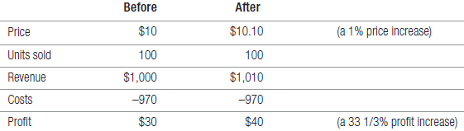
Should We Raise Prices?
Notes:
It can be worthwhile to raise prices. A successful price increase can raise profits considerably. If the company’s profit margin is 3 percent of sales, a 1 percent price increase will increase profits by 33 percent if sales volume is unaffected. This situation is illustrated in Table 14.6. The assumption is that a company charged $10 and sold 100 units and had costs of $970, leaving a profit of $30, or 3 percent on sales. By raising its price by 10 cents (a 1 percent price increase), it boosted its profits by 33 percent, assuming the same sales volume.
A major circumstance provoking price increases is cost inflation. Rising costs unmatched by productivity gains squeeze profit margins and lead companies to regular rounds of price increases. Companies often raise their prices by more than the cost increase, in anticipation of further inflation or government price controls, in a practice called anticipatory pricing.

Slide 34
Methods for Increasing Prices
Delayed quotation pricing
Escalator clauses
Unbundling
Reduction of discounts
Notes:
Another factor leading to price increases is overdemand. When a company cannot supply all its customers, it can raise its prices, ration supplies, or both. It can increase price in the following ways, each of which has a different impact on buyers. Delayed quotation pricing means that the company does not set a final price until the product is finished or delivered. This pricing is prevalent in industries with long production lead times, such as industrial construction and heavy equipment.
Escalator clauses are used when the company requires the customer to pay today’s price and all or part of any inflation increase that takes place before delivery. An escalator clause bases price increases on some specified price index. Unbundling means the company maintains its price but removes or prices separately one or more elements that were part of the former offer, such as free delivery or installation. Car companies sometimes add higher-end audio entertainment systems or GPS navigation systems as extras to their vehicles.
Reduction of discounts means that the company instructs its sales force not to offer its normal cash and quantity discounts.

Slide 35
Brand Leader Responses to Competitive Price Cuts
Maintain price
Maintain price and add value
Reduce price
Increase price and improve quality
Launch a low-price fighter line
Notes:
This slide explains the choices the brand leader can make if a competing firm makes price cuts.

