Slide 1
Applied Marketing Strategies
MGT 681
Lecture 22

Slide 2
Strategy Formulation & Implementation
Part 3 & 4

Slide 3
Designing and Managing Services

Slide 4
Lecture Agenda
How do we define and classify services and how do they differ from goods?
What are the new services realities?
How can we achieve excellence in services marketing?
How can we improve service quality?
How can goods marketers improve customer support services?
Notes:
As product companies find it harder and harder to differentiate their physical products, they turn to service differentiation. Many in fact find significant profitability in delivering superior service, whether that means on-time delivery, better and faster answering of inquiries, or quicker resolution of complaints. Top service providers know these advantages well and also how to create memorable customer experiences. Because it is critical to understand the special nature of services and what that means to marketers, in this chapter we systematically analyze services and how to market them most effectively.

Slide 5
What is a Service?
A service is any act of performance that one party can offer another that is essentially intangible and does not result in the ownership of anything; its production may or may not be tied to a physical product.
Notes:
Services are an important part of the economy. The Bureau of Labor Statistics reports that the service-producing sector will continue to be the dominant employment generator in the economy, adding about 14.6 million jobs through 2018, or 96 percent of the expected increase in total employment. By 2018, the goods-producing sector is expected to account for 12.9 percent of total jobs, down from 17.3 percent in 1998 and 14.2 percent in 2008. Manufacturing lost 4.1 million jobs from 1998 through 2008 and expected to lose another 1.2 million jobs between 2008 and 2018.3 These numbers and others have led to a growing interest in the special problems of marketing services.

Slide 6
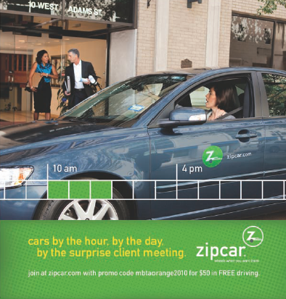
Services are Everywhere
Notes:
The government sector, with its courts, employment services, hospitals, loan agencies, military services, police and fire departments, postal service, regulatory agencies, and schools, is in the service business. The private nonprofit sector—museums, charities, churches, colleges, foundations, and hospitals—is in the service business. A good part of the business sector, with its airlines, banks, hotels, insurance companies, law firms, management consulting firms, medical practices, motion picture companies, plumbing repair companies, and real estate firms, is in the service business. Many workers in the manufacturing sector, such as computer operators, accountants, and legal staff, are really service providers. In fact, they make up a “service factory” providing services to the “goods factory.”And those in the retail sector, such as cashiers, clerks, salespeople, and customer service representatives, are also providing a service.

Slide 7
Categories of Service Mix
Pure tangible good
Good with accompanying services
Hybrid
Service with accompany goods
Pure service
Notes:
The service component can be a minor or a major part of the total offering. We distinguish five categories of offerings.
A pure tangible good is a tangible good such as soap, toothpaste, or salt with no accompanying services.
A tangible good with accompanying services is a tangible good, like a car, computer, or cell phone, accompanied by one or more services.
A hybrid is an offering, like a restaurant meal, of equal parts goods and services.
A major service with accompanying minor goods and services refers to a major service, like air travel, with additional services or supporting goods such as snacks and drinks. This offering requires a capital-intensive good—an airplane—for its realization, but the primary item is a service.
A pure service is primarily an intangible service, such as babysitting, psychotherapy, or massage.

Slide 8
Service Distinctions
Equipment-based or people-based
Service processes
Client’s presence required or not
Personal needs or business needs
Objectives and ownership
Notes:
The range of service offerings makes it difficult to generalize without a few further distinctions. Services vary as to whether they are equipment based (automated car washes, vending machines) or people based (window washing, accounting services). People-based services vary by whether unskilled, skilled, or professional workers provide them. Service companies can choose among different processes to deliver their service. Some services need the client’s presence. Brain surgery requires the client’s presence, a car repair does not. If the client must be present, the service provider must be considerate of his or her needs. Services may meet a personal need (personal services) or a business need (business services). Service providers differ in their objectives (profit or nonprofit) and ownership (private or public). These two characteristics, when crossed, produce four quite different types of organizations.

Slide 9
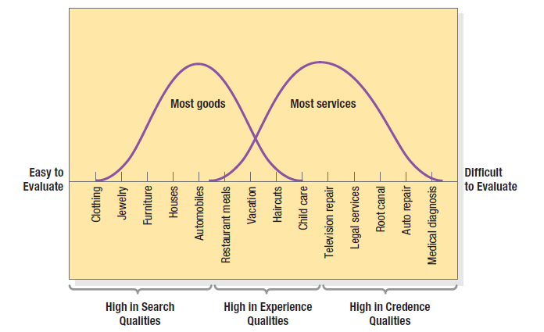
Continuum of Evaluation for Different Types of Products
Notes:
Customers cannot judge the technical quality of some services even after they have received them. Figure 13.1 shows various products and services according to difficulty of evaluation. At the left are goods high in search qualities—that is, characteristics the buyer can evaluate before purchase. In the middle are goods and services high in experience qualities characteristics the buyer can evaluate after purchase. At the right are goods and services high in credence qualities—characteristics the buyer normally finds hard to evaluate even after consumption. Because services are generally high in experience and credence qualities, there is more risk in their purchase, with several consequences. First, service consumers generally rely on word of mouth rather than advertising. Second, they rely heavily on price, provider, and physical cues to judge quality. Third, they are highly loyal to service providers who satisfy them. Fourth, because switching costs are high, consumer inertia can make it challenging to entice business away from a competitor.

Slide 10
Distinctive Characteristics of Services
Intangibility
Inseparability
Variability
Perishability
Notes:
Four distinctive service characteristics greatly affect the design of marketing programs: intangibility, inseparability, variability, and perishability. Intangibility means that it is difficult to evaluate services unless we have tangible cues and physical evidence to use. Inseparability means that we cannot separate the service from the experience of the customer. Variability means that services tend to vary from experience to experience. Perishability means that we cannot inventory services.

Slide 11
Physical Evidence and Presentation
Place
People
Equipment
Communication material
Symbols
Price
Notes:
Service companies can try to demonstrate their service quality through physical evidence and presentation. Suppose a bank wants to position itself as the “fast” bank. It could make this positioning strategy tangible through any number of marketing tools.
1. Place—The exterior and interior should have clean lines. The layout of the desks and the traffic flow should be planned carefully. Waiting lines should not get overly long.
2. People—Employees should be busy, but there should be a sufficient number to manage the workload.
3. Equipment—Computers, copy machines, desks and ATMs should look like, and be, state of the art.
4. Communication material—Printed materials—text and photos—should suggest efficiency and speed.
5. Symbols—The bank’s name and symbol could suggest fast service.
6. Price—The bank could advertise that it will deposit $5 in the account of any customer who waits in line more than five minutes.

Slide 12
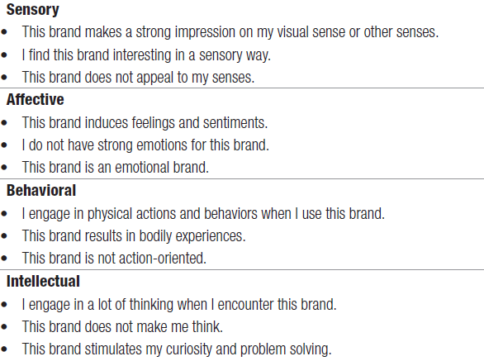
Dimensions of Brand Experience
Notes:
Table 13.1 measures brand experiences in general along sensory,
affective, behavioral, and intellectual dimensions. Applications to services are clear.

Slide 13

Inseparability
Notes:
Whereas physical goods are manufactured, then inventoried, then distributed, and later consumed, services are typically produced and consumed simultaneously. A haircut can’t be stored—or produced without the barber. The provider is part of the service. Because the client is also often present, provider–client interaction is a special feature of services marketing. Buyers of entertainment and professional services are very interested in the specific provider. Several strategies exist for getting around the limitations of inseparability. The service provider can work with larger groups. The service provider can work faster and see more clients. The service organization can train more service providers and build up client confidence, as H&R Block has done with its national network of trained tax consultants. Such a tactic could be a good approach for Chapman-Kelly, as shown in the slide.

Slide 14

Variability
Notes:
Because the quality of services depends on who provides them, when and where, and to whom, services are highly variable. Some doctors have an excellent bedside manner; others are less empathic.

Slide 15
Variability
1. Invest in good hiring and training procedures.
  Recruiting the right employees
  Training
2. Standardize the service-performance process throughout the organization.
  Service Blue Print
3. Monitor customer satisfaction.
  Employ suggestion and complaint systems, customer surveys, and comparison shopping.
  Customer needs may vary in different areas, allowing firms to develop region-specific customer satisfaction programs.

Slide 16
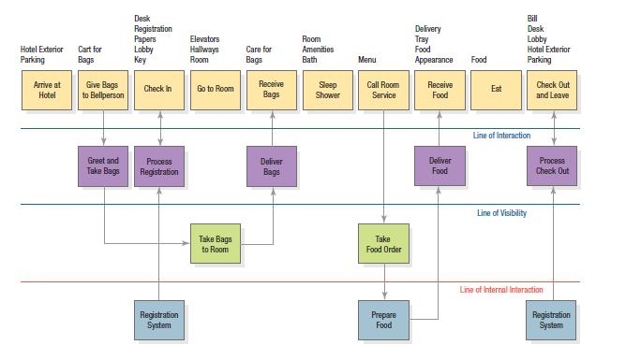
Increasing Quality Control
Notes:
To reassure customers, some firms offer service guarantees that may reduce consumer perceptions of risk. Here are three steps service firms can take to increase quality control.
1. Invest in good hiring and training procedures. Recruiting the right employees and providing them with excellent training is crucial, regardless of whether employees are highly skilled professionals or low-skilled workers.
2. Standardize the service-performance process throughout the organization. A service blueprint can map out the service process, the points of customer contact, and the evidence of service from the customer’s point of view. Figure 13.2 shows a service blueprint for a guest spending a night at a hotel.
3. Monitor customer satisfaction. Employ suggestion and complaint systems, customer surveys, and comparison shopping. Customer needs may vary in different areas, allowing firms to develop region-specific customer satisfaction programs.

Slide 17
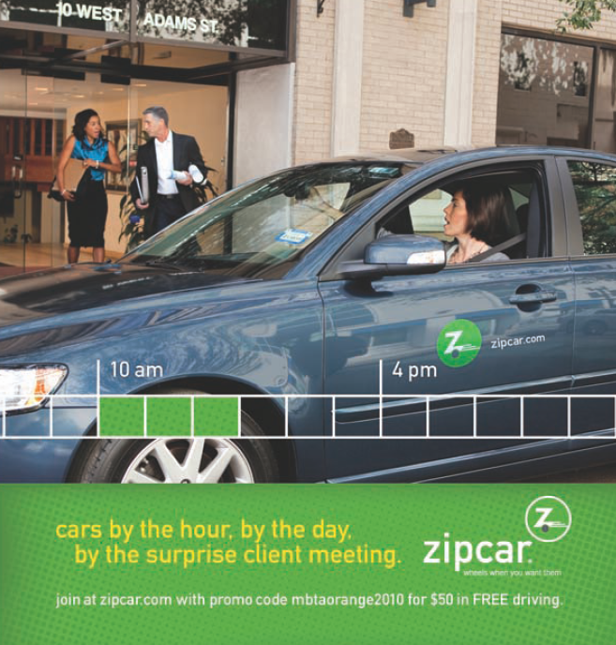
Perishability
Notes:
Services cannot be stored, so their perishability can be a problem when demand fluctuates.

Slide 18
Matching Demand and Supply
Demand side
Differential pricing
Nonpeak demand
Complementary services
Reservation systems
Supply side
Part-time employees
Peak-time efficiency
Increased consumer participation
Shared services
Facilities for future expansion
Notes:
Demand or yield management is critical—the right services must be available to the right customers at the right places at the right times and right prices to maximize profitability. Several strategies can produce a better match between service demand and supply.
On the demand side:
• Differential pricing will shift some demand from peak to off-peak periods.
• Nonpeak demand can be cultivated.
• Complementary services can provide alternatives to waiting customers.
• Reservation systems are a way to manage the demand level.
On the supply side:
• Part-time employees can serve peak demand.
• Peak-time efficiency routines can allow employees to perform only essential tasks during peak periods.
• Increased consumer participation frees service providers’ time.
• Shared services can improve offerings.
• Facilities for future expansion can be a good investment.

Slide 19


New Service Realities
Notes:
Many firms like Singapore Airlines and Jet Blue are leveraging the new realities of services marketing. These include a shift in the relationship brands have with customers, more empowered customers, and customer coproduction. Customer coproduction refers to the joint fulfillment of a service by customer and company.

Slide 20
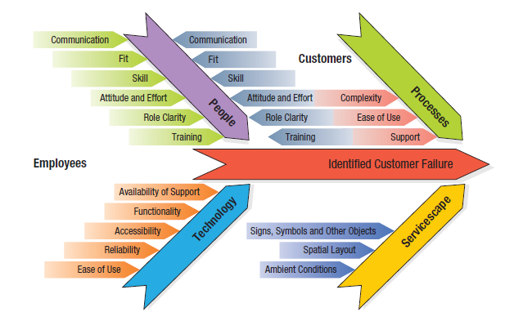
Root Causes of Customer Failure
Notes:
Figure 13.3 displays the four broad causes of customer failures. Solutions come in all forms, as these examples show:
1. Redesign processes and redefine customer roles to simplify service encounters. One of the keys to Netflix’s success is that it charges a flat fee and allows customers to return DVDs by mail at their leisure, giving customers greater control and flexibility.
2. Incorporate the right technology to aid employees and customers. Comcast, the largest cable operator by subscribers in the United States, introduced software to identify network glitches before they affected service and to better inform call-center operators about customer problems. Repeat service calls dropped 30 percent as a result.
3. Create high-performance customers by enhancing their role clarity, motivation, and ability. USAA reminds enlisted policyholders to suspend their car insurance when they are stationed overseas.
4. Encourage “customer citizenship” so customers help customers. At golf courses, players can not only follow the rules by playing and behaving appropriately, they can encourage others to do so.

Slide 21
Solutions to Customer Failures
Redesign processes and redefine customer roles to simplify service encounters
Incorporate the right technology to aid employees and customers
Create high-performance customers by enhancing their role clarity, motivation, and ability
Encourage customer citizenship where customers help customers
Notes:
This slide identifies some ways to recover from service failures.

Slide 22
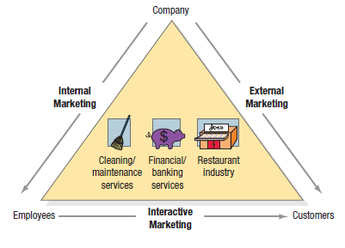
Types of Marketing in Service Industries
Notes:
Marketing excellence with services requires excellence in three broad areas: external, internal, and interactive marketing as shown in Figure 13.4.
• External marketing describes the normal work of preparing, pricing, distributing, and promoting the service to customers.
• Internal marketing describes training and motivating employees to serve customers well. The most important contribution the marketing department can make is arguably to be “exceptionally clever in getting everyone else in the organization to practice marketing.”
• Interactive marketing describes the employees’ skill in serving the client. Clients judge service not only by its technical quality (Was the surgery successful?), but also by its functional quality.

Slide 23
Best Practices
Strategic Concept
Top-Management Commitment
High Standards
Self-Service Technologies
Monitoring Systems
Satisfying Customer Complaints
Satisfying Employees
Notes:
In achieving marketing excellence with their customers, well-managed service companies share a strategic concept, a history of top-management commitment to quality, high standards, profit tiers, and systems for monitoring service performance and customer complaints.

Slide 24
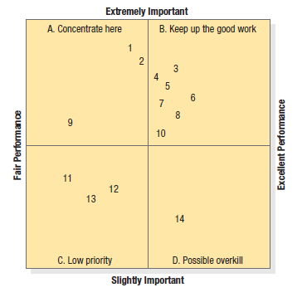
Importance-Performance Analysis
Notes:
We can judge services on customer importance and company performance. Importance-performance analysis rates the various elements of the service bundle and identifies required actions. Table 13.2 shows how customers rated 14 service elements or attributes of an automobile dealer’s service department on importance and performance. For example, “Job done right the first time” (attribute 1) received a mean importance rating of 3.83 and a mean performance rating of 2.63, indicating that customers felt it was highly important but not performed well. The ratings of the 14 elements are divided into four sections in Figure 13.5.
Quadrant A in the figure shows important service elements that are not being performed at the desired levels; they include elements 1, 2, and 9. The dealer should concentrate on improving the service department’s performance on these elements.
Quadrant B shows important service elements that are being performed well; the company needs to maintain the high performance.
Quadrant C shows minor service elements that are being delivered in a mediocre way but do not need any attention.
Quadrant D shows that a minor service element, “Send out maintenance notices,” is being performed in an excellent manner.

Slide 25
Factors Leading to Customer Switching Behavior
Pricing
Inconvenience
Core Service Failure
Service Encounter Failures
Response to Service Failure
Competition
Ethical Problems
Involuntary Switching
Notes:
Service outcome and customer loyalty are influenced by a host of variables. One study identified more than 800 critical behaviors that cause customers to switch services. These behaviors fall into eight categories explained further in Table 13.3 in the book.

Slide 26
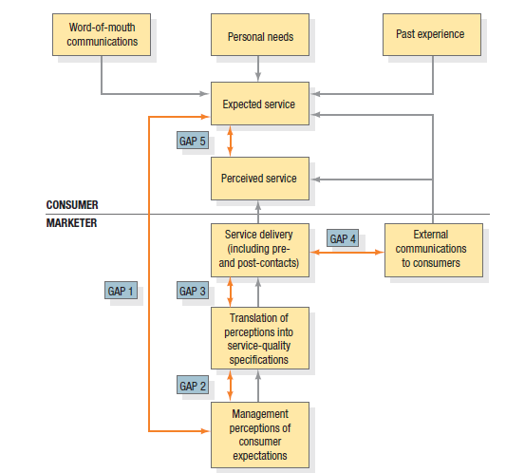
Service-Quality Model
Notes:
The service-quality model in Figure 13.6 highlights the main requirements for delivering high service quality. It identifies five gaps that cause unsuccessful delivery:
1. Gap between consumer expectation and management perception—Management does not always correctly perceive what customers want. Hospital administrators may think patients want better food, but patients may be more concerned with nurse responsiveness.
2. Gap between management perception and service-quality specification Management might correctly perceive customers’ wants but not set a performance standard. Hospital administrators may tell the nurses to give “fast” service without specifying it in minutes.
3. Gap between service-quality specifications and service delivery—Employees might be poorly trained, or incapable of or unwilling to meet the standard; they may be held to conflicting standards, such as taking time to listen to customers and serving them fast.
4. Gap between service delivery and external communications—Consumer expectations are affected by statements made by company representatives and ads. If a hospital brochure shows a beautiful room but the patient finds it to be cheap and tacky looking, external communications have distorted the customer’s expectations.
5. Gap between perceived service and expected service—This gap occurs when the consumer misperceives the service quality.

Slide 27
Determinants of Service Quality
1. Reliability—The ability to perform the promised service dependably and accurately.
2. Responsiveness—Willingness to help customers and provide prompt service.
3. Assurance—The knowledge and courtesy of employees and their ability to convey trust and confidence.
4. Empathy—The provision of caring, individualized attention to customers.
5. Tangibles—The appearance of physical facilities, equipment, personnel, and communication materials.
Notes:
Based on this service-quality model, researchers identified five determinants of service quality, in this order of importance.
1. Reliability—The ability to perform the promised service dependably and accurately.
2. Responsiveness—Willingness to help customers and provide prompt service.
3. Assurance—The knowledge and courtesy of employees and their ability to convey trust and confidence.
4. Empathy—The provision of caring, individualized attention to customers.
5. Tangibles—The appearance of physical facilities, equipment, personnel, and communication materials.

