Slide 1
Applied Marketing Strategies
MGT 681
Lecture 21

Slide 2
Strategy Formulation & Implementation
Part 3 & 4

Slide 3
Product Strategy

Slide 4
Lecture Agenda
What are the characteristics of products and how do marketers classify products?
How can companies differentiate products?
Why is product design important and what factors affect a good design?
Notes:
At the heart of a great brand is a great product. Product is a key element in the market offering. To achieve market leadership, firms must offer products and services of superior quality that provide unsurpassed customer value.

Slide 5
Lecture Agenda
How can a company build and manage its product mix and product lines?
How can companies combine products to create strong co-brands or ingredient brands?
How can companies use packaging, labeling, warranties, and guarantees as marketing tools?

Slide 6
Service Differentiation
Ordering ease
Delivery
Installation
Customer training
Customer consulting
Maintenance and repair
Returns
Notes:
The main service differentiators are ordering ease, delivery, installation, customer training, customer consulting, and maintenance and repair. Ordering ease refers to how easy it is for the customer to place an order with the company. Delivery refers to how well the product or service is brought to the customer. It includes speed, accuracy, and care throughout the process. Installation refers to the work done to make a product operational in its planned location. Customer consulting includes data, information systems, and advice services the seller offers to buyers. Maintenance and repair programs help customers keep purchased products in good working order.
We can think of product returns in two ways:
• Controllable returns result from problems or errors by the seller or customer and can mostly be eliminated with improved handling or storage, better packaging, and improved transportation and forward logistics by the seller or its supply chain partners.
• Uncontrollable returns result from the need for customers to actually see, try, or experience products in person to determine suitability and can’t be eliminated by the company in the short run through any of these means.

Slide 7

Design
Notes:
As competition intensifies, design offers a potent way to differentiate and position a company’s products and services. Design is the totality of features that affect how a product looks, feels, and functions to a consumer. Design offers functional and aesthetic benefits and appeals to both our rational and emotional sides.

Slide 8
The Product Hierarchy
Item
Product type
Product line
Product class
Product family
Need family
Notes:
The product hierarchy stretches from basic needs to particular items that satisfy those needs. The text describes the six levels of the product hierarchy, using life insurance as an example.
The need family is the core need that underlies the existence of a product family. Security is an example.
The product family refers to all the product classes that can satisfy a core need with reasonable effectiveness. Examples are savings and income.
The product class is the group of products within the product family recognized as having a certain functional coherence, also known as a product category. Financial instruments are an example.
The product line is a group of products within a product class that are closely related because they perform a similar function, are sold to the same customer groups, are marketed through the same outlets or channels, or fall within given price ranges. Life insurance is an example.
The product type is a group of items within a product line that share one of several possible forms of the product. Term life insurance is an example.
An item (also called stock-keeping unit or product variant) is a distinct unit within a brand or product line distinguishable by size, price, appearance, or some other attribute.

Slide 9
The Product Hierarchy
The need family is the core need that underlies the existence of a product family. Security is an example.
The product family refers to all the product classes that can satisfy a core need with reasonable effectiveness. Examples are savings and income.
The product class is the group of products within the product family recognized as having a certain functional coherence, also known as a product category. Financial instruments are an example.
The product line is a group of products within a product class that are closely related because they perform a similar function, are sold to the same customer groups, are marketed through the same outlets or channels, or fall within given price ranges. Life insurance is an example.
The product type is a group of items within a product line that share one of several possible forms of the product. Term life insurance is an example.
An item (also called stock-keeping unit or product variant) is a distinct unit within a brand or product line distinguishable by size, price, appearance, or some other attribute.
Notes:
The product hierarchy stretches from basic needs to particular items that satisfy those needs. The text describes the six levels of the product hierarchy, using life insurance as an example.
The need family is the core need that underlies the existence of a product family. Security is an example.
The product family refers to all the product classes that can satisfy a core need with reasonable effectiveness. Examples are savings and income.
The product class is the group of products within the product family recognized as having a certain functional coherence, also known as a product category. Financial instruments are an example.
The product line is a group of products within a product class that are closely related because they perform a similar function, are sold to the same customer groups, are marketed through the same outlets or channels, or fall within given price ranges. Life insurance is an example.
The product type is a group of items within a product line that share one of several possible forms of the product. Term life insurance is an example.
An item (also called stock-keeping unit or product variant) is a distinct unit within a brand or product line distinguishable by size, price, appearance, or some other attribute.

Slide 10
Product Systems and Mixes
Notes:
A product system is a group of diverse but related items that function in a compatible manner. For example, the extensive iPod product system includes headphones and headsets, cables and docks, armbands, cases, power and car accessories, and speakers. A product mix (also called a product assortment) is the set of all products and items a particular seller offers for sale.
A product mix consists of various product lines. NEC’s (Japan) product mix consists of communication products and computer products. Michelin has three product lines: tires, maps, and restaurant- rating services.

Slide 11
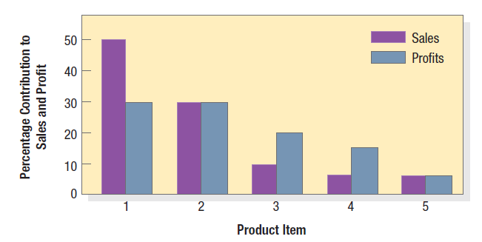
Product-Item Contributions to a Product Line’s Total Sales and Profits
Notes:
In offering a product line, companies normally develop a basic platform and modules that can be added to meet different customer requirements and lower production costs. Product-line managers need to know the sales and profits of each item in their line to determine which items to build, maintain, harvest, or divest. They also need to understand each product line’s market profile. Figure 12.3 shows a sales and profit report for a five-item product line. The first item accounts for 50 percent of total sales and 30 percent of total profits. The first two items account for 80 percent of total sales and 60 percent of total profits. If these two items were suddenly hurt by a competitor, the line’s sales and profitability could collapse. These items must be carefully monitored and protected. At the other end, the last item delivers only 5 percent of the product line’s sales and profits. The product-line manager may consider dropping this item unless it has strong growth potential.

Slide 12
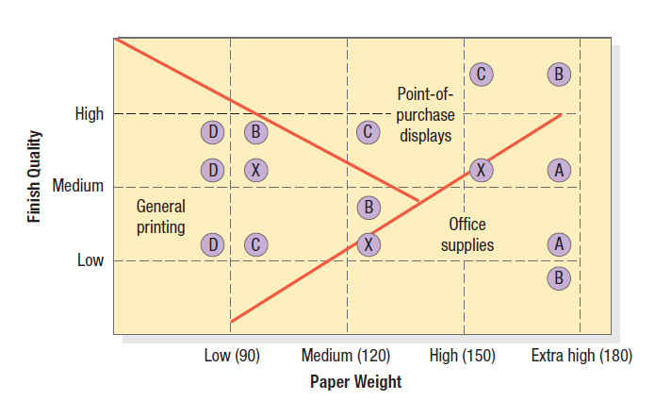
Product Map for a Paper-Product Line
Notes:
The product-line manager must review how the line is positioned against competitors’ lines. Consider paper company X with a paperboard product line. Two paperboard attributes are weight and finish quality. Paper is usually offered at standard levels of 90, 120, 150, and 180 weights. Finish quality is offered at low, medium, and high levels. Figure 12.4 shows the location of the various product-line items of company X and four competitors, A, B, C, and D. The product map shows which competitors’ items are competing against company X’s items. For example, company X’s low-weight, medium quality paper competes against competitor D’s and B’s papers, but its high weight, medium-quality paper has no direct competitor. The map also reveals possible locations for new items. No manufacturer offers a high-weight, low-quality paper. If company X estimates a strong unmet demand and can produce and price this paper at low cost, it could consider adding this item to its line. Another benefit of product mapping is that it identifies market segments. Figure 12.4 shows the types of paper, by weight and quality, preferred by the general printing industry, the point-of-purchase display industry, and the office supply industry. The map shows that company X is well positioned to serve the needs of the general printing industry but less effective in serving the other two industries.

Slide 13
Line Stretching
Down-Market Stretch
Up-Market Stretch
Two-Way Stretch
Notes:
Company objectives influence product-line length. One objective is to create a product line to induce up-selling. A different objective is to create a product line that facilitates cross-selling. Every company’s product line covers a certain part of the total possible range. Line stretching occurs when a company lengthens its product line beyond its current range, whether down-market, up-market, or both ways.

Slide 14
Product-Mix Pricing
Product-line pricing
Optional-feature pricing
Captive-product pricing
Two-part pricing
By-product pricing
Product-bundling pricing
Notes:
Marketers must modify their price-setting logic when the product is part of a product mix. In product-mix pricing, the firm searches for a set of prices that maximizes profits on the total mix. Pricing is difficult because the various products have demand and cost interrelationships and are subject to different degrees of competition. We can distinguish six situations calling for product mix pricing: product-line pricing, optional-feature pricing, captive-product pricing, two-part pricing, by-product pricing, and product-bundling pricing. Companies normally develop product lines rather than single products and introduce price steps. Many companies offer optional products, features, and services with their main product. Some products require the use of ancillary or captive products. Service firms engage in two-part pricing, consisting of a fixed fee plus a variable usage fee. The production of certain goods—meats, petroleum products, and other chemicals—often results in by-products that should be priced on their value. Sellers often bundle products and features. Pure bundling occurs when a firm offers its products only as a bundle.

Slide 15
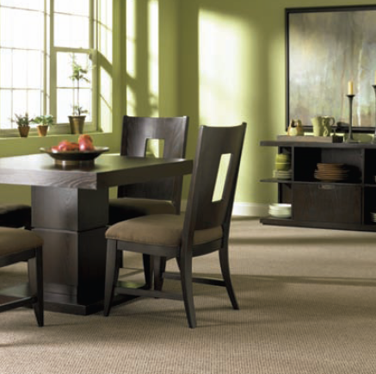
Ingredient Branding
Notes:
Marketers often combine their products with products from other companies. In co-branding, two or more well known brands are combined into a joint product or marketed together in some fashion. One form of co-branding is same-company co-branding, as when General Mills advertises Trix cereal and Yoplait yogurt. Another form is joint-venture co-branding, such as General Electric and Hitachi lightbulbs in Japan. There is multiple-sponsor co-branding. Finally, there is retail co-branding, such as jointly owned Pizza Hut, KFC, and Taco Bell restaurants.
Ingredient branding is a special case of co-branding. It creates brand equity for materials, components, or parts that are necessarily contained within other branded products.
DuPont has introduced d ingredient. a number of innovative products such as Corian® solid-surface material, for use in markets ranging from apparel to aerospace. Many, such as Lycra® and Stainmaster® fabrics, Teflon® coating, and Kevlar® fiber, became household names as ingredient brands in consumer products manufactured by other companies.

Slide 16
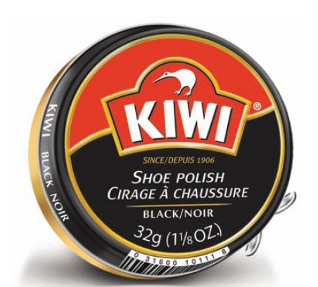
What is the Fifth P?
Packaging, sometimes called the 5th P, is all the activities of designing and producing the container for a product.
Notes:
Many marketers have called packaging a fifth P, along with price, product, place, and promotion. Most, however, treat packaging and labeling as an element of product strategy. Warranties and guarantees can also be an important part of the product strategy and often appear on the package.

Slide 17
Factors Contributing to the
Emphasis on Packaging
Self-service
Consumer affluence
Company/brand image
Innovation opportunity
Notes:
Various factors contribute to the growing use of packaging as a marketing tool.
An increasing number of products are sold on a self-serve basis. In an average supermarket, which may stock 15,000 items, the typical shopper passes some 300 products per minute. Given that 50 percent to 70 percent of all purchases are made in the store, the effective package must perform many sales tasks: attract attention, describe the product’s features, create consumer confidence, and make a favorable overall impression.
Rising affluence means consumers are willing to pay a little more for the convenience, appearance, dependability, and prestige of better packages.
Packages contribute to instant recognition of the company or brand. In the store, they can create a billboard effect, such as Garnier Fructis with its bright green packaging in the hair care aisle.
Unique or innovative packaging such as resealable spouts can bring big benefits to consumers and profits to producers.

Slide 18
Packaging Objectives
Identify the brand
Convey descriptive and persuasive information
Facilitate product transportation and protection
Assist at-home storage
Aid product consumption
Notes:
Packaging must achieve a number of objectives:
1. Identify the brand.
2. Convey descriptive and persuasive information.
3. Facilitate product transportation and protection.
4. Assist at-home storage.
5. Aid product consumption.
To achieve these objectives and satisfy consumers’ desires, marketers must choose the aesthetic and functional components of packaging correctly. Aesthetic considerations relate to a package’s size and shape, material, color, text, and graphics.

Slide 19
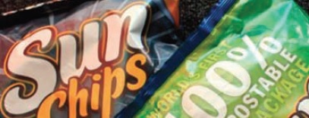
Functions of Labels
Notes:
A label performs several functions. First, it identifies the product or brand—for instance, the name Sunkist stamped on oranges. It might also grade the product; canned peaches are grade-labeled A, B, and C. The label might describe the product: who made it, where and when, what it contains, how it is to be used, and how to use it safely. Finally, the label might promote the product through attractive graphics.

