Slide 1
Applied Marketing Strategies
MGT 681
Lecture 2

Slide 2
Review of Concepts
Part 1

Slide 3
Lecture Agenda
Why is marketing important?
What is the scope of marketing?
What are some fundamental marketing concepts?
How has marketing changed?
What are the tasks necessary for successful marketing?
Notes:
Good marketing is no accident, but a result of careful planning and execution using state-of-the-art tools and techniques. It becomes both an art and a science as marketers strive to find creative new solutions to challenges in a complex marketing environment.
In this book, the authors describe how top marketers balance discipline and imagination to address these new marketing realities. In the first chapter, they set the stage by reviewing important marketing concepts, tools, frameworks, and issues.
The questions identified in the slide will be our focus.

Slide 4
What is Marketing?
Meeting human and social needs
Meeting needs profitably (Shortest Definition)
Turning Private or social needs into profitable business opportunity
Societal vs. managerial Definition
  Delivering higher standards of living
  The art of selling product

Slide 5
What is Marketing?
Marketing is an organizational function and a set of processes for creating, communicating, and delivering value to customers and for managing customer relationships in ways that benefit the organization and its stakeholders.
Notes:
Marketing is about identifying and meeting human and social needs. One of the shortest good definitions of marketing is “meeting needs profitably.”
The American Marketing Association offers the following formal definition: Marketing is the activity, set of institutions, and processes for creating, communicating, delivering, and exchanging offerings that have value for customers, clients, partners, and society at large.

Slide 6
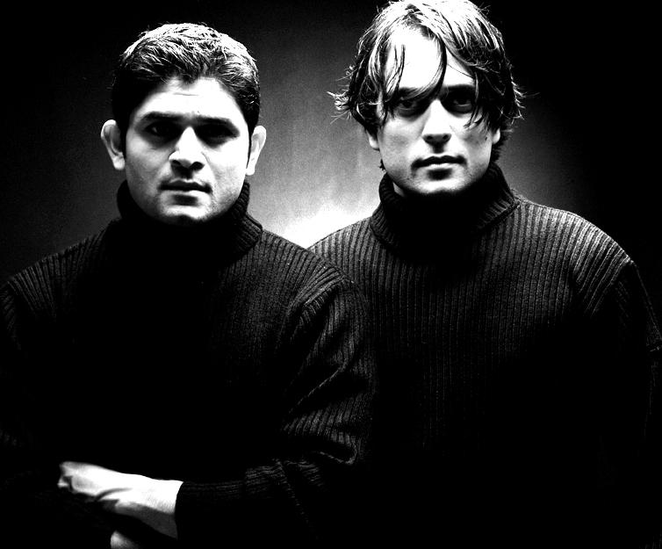
What is Marketed?
Goods
Services
Events
Experiences
Persons
Notes:
Marketers market 10 main types of entities as shown on slides 1-5 and 1-6.

Slide 7
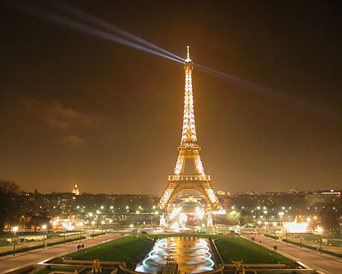
What is Marketed?
Places
Properties
Organizations
Information
Ideas

Slide 8
Demand
A want backed by purchasing power
Marketer and Prospect
Demand Management
  Level
  Timing
  Composition

Slide 9
Demand States
Negative
Nonexistent
Latent
Declining
Irregular
Unwholesome
Full
Overfull
Notes:
Eight demand states are possible:
1. Negative demand—Consumers dislike the product and may even pay to avoid it.
2. Nonexistent demand—Consumers may be unaware of or uninterested in the product.
3. Latent demand—Consumers may share a strong need that cannot be satisfied by an existing product.
4. Declining demand—Consumers begin to buy the product less frequently or not at all.
5. Irregular demand—Consumer purchases vary on a seasonal, monthly, weekly, daily, or even hourly basis.
6. Full demand—Consumers are adequately buying all products put into the marketplace.
7. Overfull demand—More consumers would like to buy the product than can be satisfied.
8. Unwholesome demand—Consumers may be attracted to products that have undesirable social consequences.
In each case, marketers must identify the underlying cause(s) of the demand state and determine a plan of action to shift demand to a more desired state.

Slide 10
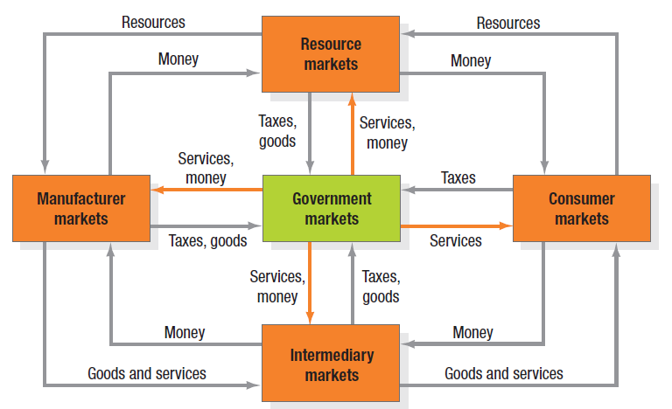
Figure 1.1 Structure of Flows in Modern Exchange Economy
Notes:
Traditionally, a “market” was a physical place where buyers and sellers gathered to buy and sell goods. Economists describe a market as a collection of buyers and sellers who transact over a particular product or product class (such as the housing market or the grain market).
Five basic markets and their connecting flows are shown in Figure 1.1.
Manufacturers go to resource markets (raw material markets, labor markets, money markets), buy resources and turn them into goods and services, and sell finished products to intermediaries, who sell them to consumers. Consumers sell their labor and receive money with which they pay for goods and services. The government collects tax revenues to buy goods from resource, manufacturer, and intermediary markets and uses these goods and services to provide public services. Each nation’s economy, and the global economy, consists of interacting sets of markets linked through exchange processes. Marketers use the term market to cover various groupings of customers. They view sellers as constituting the industry and buyers as constituting the market.

Slide 11
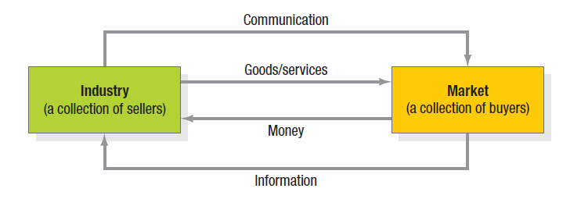
Figure 1.2
A Simple Marketing System
Notes:
Figure 1.2 shows the relationship between the industry and the market. Sellers and buyers are connected by four flows. Sellers send goods and services and communications such as ads and direct mail to the market; in return they receive money and information such as customer attitudes and sales data. The inner loop shows an exchange of money for goods and services; the outer loop shows an exchange of information.

Slide 12
Key Customer Markets
Consumer markets
Business markets
Global markets
Nonprofit/Government markets
Notes:
Consumer Markets: Companies selling mass consumer goods and services spend a great deal of time establishing a strong brand image by developing a superior product and packaging, ensuring its availability, and backing it with engaging communications and reliable service.
Business Markets: Companies selling business goods and services often face well-informed professional buyers skilled at evaluating competitive offerings. Global Markets: Companies in the global marketplace must decide which countries to enter; how to enter each (as an exporter, licenser, joint venture partner, contract manufacturer, or solo manufacturer); how to adapt product and service features to each country; how to price products in different countries; and how to design communications for different cultures. They face different requirements for buying and disposing of property; cultural, language, legal and political differences; and currency fluctuations.
Nonprofit and Governmental Markets: Companies selling to nonprofit organizations with limited purchasing power such as churches, universities, charitable organizations, and government agencies need to price carefully.

Slide 13
Core Concepts
Needs, wants, and demands
Target markets, positioning, segmentation
Offerings and brands
Value and satisfaction
Marketing channels
Supply chain
Competition
Marketing environment
Marketing planning
Notes:
This is a list of core marketing concepts. They will be discussed further on the coming slides.

Slide 14
Marketspaces
Marketplaces
Metamarkets

Slide 15
Types of Needs
Stated
Real
Unstated
Delight
Secret
Notes:
We can distinguish five types of needs:
1. Stated needs (The customer wants an inexpensive car.)
2. Real needs (The customer wants a car whose operating cost, not initial price, is low.)
3. Unstated needs (The customer expects good service from the dealer.)
4. Delight needs (The customer would like the dealer to include an onboard GPS navigation
system.)
5. Secret needs (The customer wants friends to see him or her as a savvy consumer.)

Slide 16

Target Markets,
Positioning & Segmentation
Notes:
Not everyone likes the same cereal, restaurant, college, or movie. Therefore, marketers start by dividing the market into segments. They identify and profile distinct groups of buyers who might prefer or require varying product and service mixes by examining demographic, psychographic, and behavioral differences among buyers.
After identifying market segments, the marketer decides which present the greatest opportunities— which are its target markets. For each, the firm develops a market offering that it positions in the minds of the target buyers as delivering some central benefit(s).

Slide 17

Offerings and Brands
Notes:
Companies address customer needs by putting forth a value proposition, a set of benefits that satisfy those needs. The intangible value proposition is made physical by an offering, which can be a combination of products, services, information, and experiences.
A brand is an offering from a known source. A brand name such as McDonald’s carries many associations in people’s minds that make up its image: hamburgers, cleanliness, convenience, courteous service, and golden arches. All companies strive to build a brand image with as many strong, favorable, and unique brand associations as possible.

Slide 18
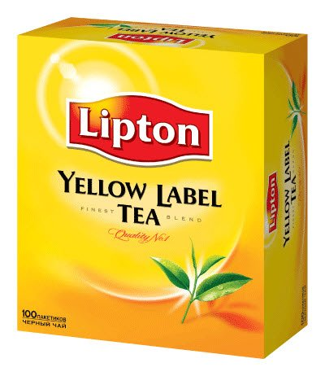
Value and Satisfaction
Notes:
The buyer chooses the offerings he or she perceives to deliver the most value, the sum of the tangible and intangible benefits and costs to her. Value, a central marketing concept, is primarily a combination of quality, service, and price (qsp), called the customer value triad. Value perceptions increase with quality and service but decrease with price. We can think of marketing as the identification, creation, communication, delivery, and monitoring of customer value. Satisfaction reflects a person’s judgment of a product’s perceived performance in relationship to expectations. If the performance falls short of expectations, the customer is disappointed. If it matches expectations, the customer is satisfied. If it exceeds them, the customer is delighted. LL Bean consistently has high satisfaction ratings.

Slide 19
Marketing Channels
Communication
Distribution
Service
Notes:
To reach a target market, the marketer uses three kinds of marketing channels. Communication channels deliver and receive messages from target buyers and include newspapers, magazines, radio, television, mail, telephone, billboards, posters, fliers, CDs, audiotapes, and the Internet. Beyond these, firms communicate through the look of their retail stores and Web sites and other media. Marketers are increasingly adding dialogue channels such as e-mail, blogs, and toll-free numbers to familiar monologue channels such as ads.
The marketer uses distribution channels to display, sell, or deliver the physical product or service(s) to the buyer or user. These channels may be direct via the Internet, mail, or mobile phone or telephone, or indirect with distributors, wholesalers, retailers, and agents as intermediaries.
To carry out transactions with potential buyers, the marketer also uses service channels that include warehouses, transportation companies, banks, and insurance companies. Marketers clearly face a design challenge in choosing the best mix of communication, distribution, and service channels for their offerings.

Slide 20
Marketing Environment
Demographic
Economic
Socio-cultural
Political-legal
Technological
Natural
Notes:
The marketing environment consists of the task environment and the broad environment. The task environment includes the actors engaged in producing, distributing, and promoting the offering.
These are the company, suppliers, distributors, dealers, and target customers. In the supplier group are material suppliers and service suppliers, such as marketing research agencies, advertising agencies, banking and insurance companies, transportation companies, and telecommunications companies.
Distributors and dealers include agents, brokers, manufacturer representatives, and others who facilitate finding and selling to customers.
The broad environment consists of six components: demographic environment, economic environment, social-cultural environment, natural environment, technological environment, and political- legal environment. Marketers must pay close attention to the trends and developments in these and adjust their marketing strategies as needed.

Slide 21
Major Societal Forces
Network information technology
Globalization
Deregulation
Privatization
Heightened competition
Industry convergence
Retail transformation
Disintermediation
Consumer buying power
Consumer participation
Consumer resistance
Notes:
Today, major, and sometimes interlinking, societal forces have created new marketing behaviors, opportunities, and challenges. Here are 12 key ones.

Slide 22
Company Orientations
Production
Product
Selling
Marketing
Notes:
The production concept is one of the oldest concepts in business. It holds that consumers prefer products that are widely available and inexpensive. Managers of production-oriented businesses concentrate on achieving high production efficiency, low costs, and mass distribution.
The product concept proposes that consumers favor products offering the most quality, performance, or innovative features.
The selling concept holds that consumers and businesses, if left alone, won’t buy enough of the organization’s products. It is practiced most aggressively with unsought goods—goods buyers don’t normally think of buying such as insurance and cemetery plots—and when firms with overcapacity aim to sell what they make, rather than make what the market wants. The marketing concept emerged in the mid-1950s41 as a customer-centered, sense-and respond philosophy. The job is to find not the right customers for your products, but the right products for your customers.

Slide 23
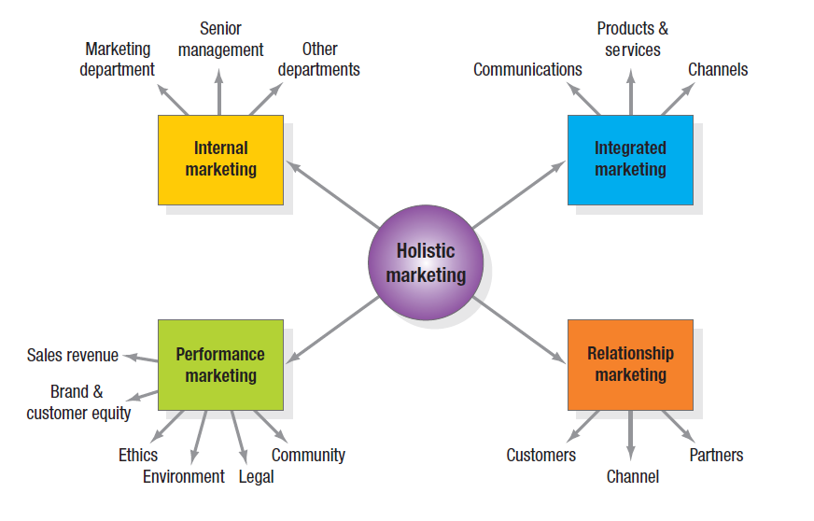
Holistic Marketing
Notes:
The holistic marketing concept is based on the development, design, and implementation of marketing programs, processes, and activities that recognize their breadth and interdependencies.
Holistic marketing acknowledges that everything matters in marketing—and that a broad, integrated perspective is often necessary. Figure 1.3 provides a schematic overview of four broad components characterizing holistic marketing: relationship marketing, integrated marketing, internal marketing, and performance marketing.

Slide 24
Relationship Marketing
Customers
Employees
Marketing Partners
Financial Community
Notes:
Relationship marketing aims to build mutually satisfying long-term relationships with key constituents in order to earn and retain their business.
Four key constituents for relationship marketing are customers, employees, marketing partners (channels, suppliers, distributors, dealers, agencies), and members of the financial community (shareholders, investors, analysts). Marketers must create prosperity among all these constituents and balance the returns to all key stakeholders. To develop strong relationships with them requires understanding their capabilities and resources, needs, goals, and desires. The ultimate outcome of relationship marketing is a unique company asset called a marketing network, consisting of the company and its supporting stakeholders—customers, employees, suppliers, distributors, retailers, and others—with whom it has built mutually profitable business relationships. The operating principle is simple: build an effective network of relationships with key stakeholders, and profits will follow.

Slide 25

Integrated Marketing
Notes:
Integrated marketing occurs when the marketer devises marketing activities and assembles marketing programs to create, communicate, and deliver value for consumers such that “the whole is greater than the sum of its parts.” Two key themes are that (1) many different marketing activities can create, communicate, and deliver value and (2) marketers should design and implement any one marketing activity with all other activities in mind.

Slide 26

Internal Marketing
Internal marketing is the task of
hiring, training, and motivating able employees
who want to serve customers well.
Notes:
Snowshoe Mountain in Snowshoe, West Virginia, embarked on a marketing program based on internal marketing to better brand the ski resort with a promise of an “authentic, rustic and engaging wilderness experience.” In launching a branding initiative to define their goals and articulate what they wanted the Snowshoe Mountain brand to represent to visitors, the resort’s marketers started inside. They incorporated the new brand promise in a 40-page brand book that contained the history of the resort and a list of seven attitude words that characterized how employees should interact with guests. On-mountain messaging and signs also reminded employees to deliver on the brand promise. All new hires received a brand presentation from the director of marketing to help them better understand the brand and become effective advocates.

Slide 27
Performance Marketing
Financial
Accountability
Social Responsibility Marketing
Notes:
Performance marketing requires understanding the financial and nonfinancial returns to business and society from marketing activities and programs. Top marketers are increasingly going beyond sales revenue to examine the marketing scorecard and interpret what is happening to market share, customer loss rate, customer satisfaction, product quality, and other measures. They are also considering the legal, ethical, social, and environmental effects of marketing activities and programs.

Slide 28
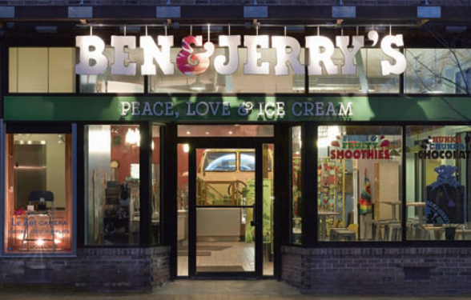
Types of
Corporate Social Initiatives
Corporate social marketing
Cause marketing
Cause-related marketing
Corporate philanthropy
Corporate community involvement
Socially responsible business practices
Notes:
In Table 1.2 these forms of social activity are defined and examples from McDonald’s are provided.

Slide 29
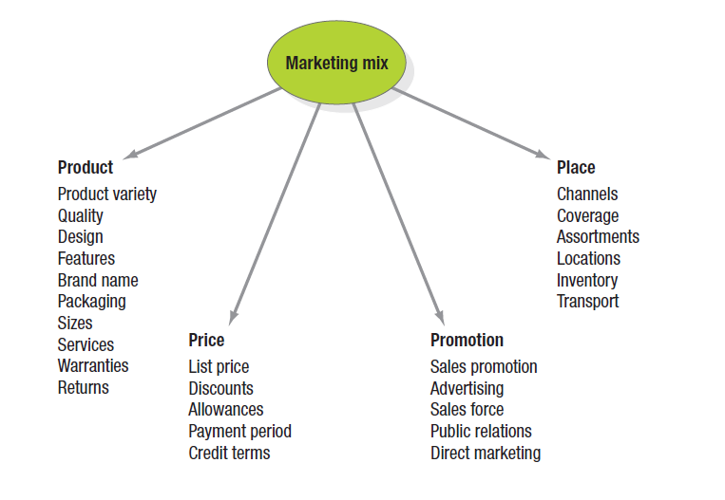
The Marketing Mix
Notes:
McCarthy classified various marketing activities into marketing-mix tools of four broad kinds, which he called the four Ps of marketing: product, price, place, and promotion. The marketing variables under each P are shown in Figure 1.4. Given the breadth, complexity, and richness of marketing, however—as exemplified by holistic marketing—clearly these four Ps are not the whole story anymore.

Slide 30
The New Four Ps
People
Processes
Programs
Performance
Notes:
If we update them to reflect the holistic marketing concept, we arrive at a more representative set that encompasses modern marketing realities: people, processes, programs, and performance, as in Figure 1.5.
People reflects, in part, internal marketing and the fact that employees are critical to marketing success.
Processes reflects all the creativity, discipline, and structure brought to marketing management. Programs reflects all the firm’s consumer-directed activities. It encompasses the old four Ps as well as a range of other marketing activities that might not fit as neatly into the old view of marketing.
We define performance as in holistic marketing, to capture the range of possible outcome measures that have financial and nonfinancial implications (profitability as well as brand and customer equity), and implications beyond the company itself (social responsibility, legal, ethical, and community related).

Slide 31
For Review
Why is marketing important?
What is the scope of marketing?
What are some fundamental marketing concepts?
How has marketing changed?
What are the tasks necessary for successful marketing?
Notes:
This chapter has covered the content needed to answer the chapter questions. Use this slide to review and identify problem areas.

Slide 32
Marketing Applied Strategy Tasks
Develop market strategies and plans
Capture marketing insights
Connect with customers
Build strong brands
Shape market offerings
Deliver value
Communicate value
Create long-term growth
Notes:
With the holistic marketing philosophy as a backdrop, we can identify a specific set of tasks that make up successful marketing management and marketing leadership.

