Slide 1
Applied Marketing Strategies
MGT 681
Lecture 19

Slide 2
Marketing Ecology
Part 2

Slide 3
Analyzing
Business Markets

Slide 4
Lecture Agenda
What is the business market, and how does it differ from the consumer market?
What buying situations do organizational buyers face?
Who participates in the business-to-business buying process?
Notes:
Some of the world’s most valuable brands belong to business marketers: ABB, Caterpillar, DuPont, FedEx, GE, Hewlett-Packard, IBM, Intel, and Siemens, to name a few. Many principles of basic marketing also apply to business marketers. They need to embrace holistic marketing principles, such as building strong relationships with their customers, just like any marketer. But they also face some unique considerations in selling to other businesses. In this chapter, we will highlight some of the crucial similarities and differences for marketing in business markets. The next slide includes additional questions to be addressed in this chapter.

Slide 5
Lecture Agenda
How do business buyers make their decisions?
How can companies build strong relationships with business customers?
How do institutional buyers and government agencies do their buying?

Slide 6
Stages in the Buying Process: Buyphases
Problem recognition
General need description
Product specification
Supplier search
Proposal solicitation
Supplier selection
Order-routine specification
Performance review
Notes:
These are the stages in the buying process. Notice that the buying process is similar to that for consumers.

Slide 7
Problem Recognition

Slide 8
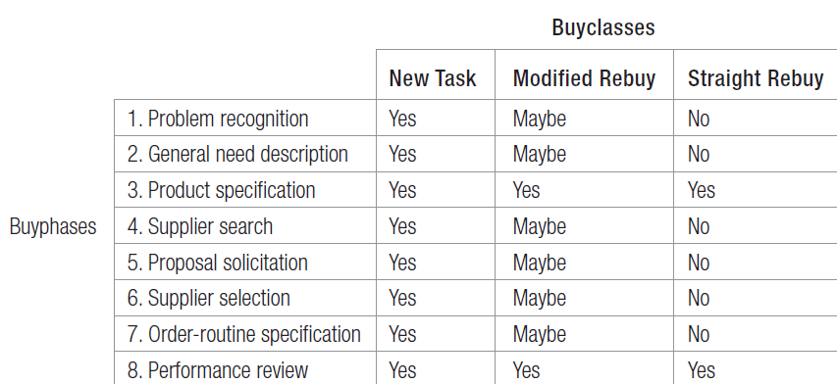
Buygrid Framework
Notes:
Table 7.1 is the buygrid framework. In modified-rebuy or straight-rebuy situations, some stages are compressed or bypassed. For example, the buyer normally has a favorite supplier or a ranked list of suppliers and can skip the search and proposal solicitation stages.

Slide 9
General Need Description and Product Specification

Slide 10
Supplier Search

Slide 11

Forms of Electronic Marketplaces
Catalog sites
Vertical markets
Pure play auction sites
Spot markets
Private exchanges
Barter markets
Buying alliances
Notes:
Companies that purchase over the Internet are utilizing electronic marketplaces in several forms as listed in the slide.

Slide 12
Proposal Solicitation

Slide 13
Supplier Selection

Slide 14
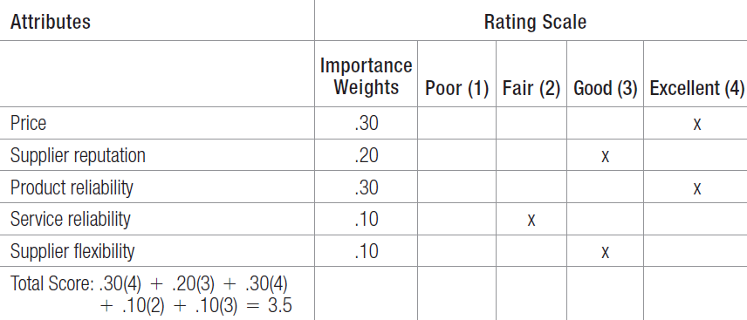
An Example of
Vendor Analysis
Notes:
Before selecting a supplier, the buying center will specify and rank desired supplier attributes, often using a supplier-evaluation model such as the one in Table 7.2.

Slide 15
Order Routine Specification
Stockless purchase plans
Vendor-managed inventory
Continuous replenishment
Notes:
Orders can be made routine at times. Some techniques for managing ordering needs includes the use of purchase plans, vendor-managed inventory, and shifting to a system of continuous replenishment.

Slide 16
Performance Review

Slide 17
Categories of Buyer-Seller Relationships
Basic buying and selling
Bare bones
Contractual transaction
Customer supply
Cooperative systems
Collaborative
Mutually adaptive
Customer is king
Notes:
A number of forces influence the development of a relationship between business partners. Four relevant factors are availability of alternatives, importance of supply, complexity of supply, and supply market dynamism. Based on these we can classify buyer–supplier relationships into eight categories. 1. Basic buying and selling—These are simple, routine exchanges with moderate levels of cooperation and information exchange. 2. Bare bones—These relationships require more adaptation by the seller and less cooperation and information exchange. 3. Contractual transaction—These exchanges are defined by formal contract and generally have low levels of trust, cooperation, and interaction. 4. Customer supply—In this traditional custom supply situation, competition rather than cooperation is the dominant form of governance. 5. Cooperative systems—The partners in cooperative systems are united in operational ways, but neither demonstrates structural commitment through legal means or adaptation. 6. Collaborative—In collaborative exchanges, much trust and commitment lead to true partnership. 7. Mutually adaptive—Buyers and sellers make many relationship-specific adaptations, but without necessarily achieving strong trust or cooperation. 8. Customer is king—In this close, cooperative relationship, the seller adapts to meet the customer’s needs without expecting much adaptation or change in exchange.

Slide 18
Categories of Buyer-Seller Relationships
1. Basic buying and selling—These are simple, routine exchanges with moderate levels of cooperation and information exchange.
2. Bare bones—These relationships require more adaptation by the seller and less cooperation and information exchange.
3. Contractual transaction—These exchanges are defined by formal contract and generally have low levels of trust, cooperation, and interaction.
4. Customer supply—In this traditional custom supply situation, competition rather than cooperation is the dominant form of governance.
5. Cooperative systems—The partners in cooperative systems are united in operational ways, but neither demonstrates structural commitment through legal means or adaptation.
6. Collaborative—In collaborative exchanges, much trust and commitment lead to true partnership.
7. Mutually adaptive—Buyers and sellers make many relationship-specific adaptations, but without necessarily achieving strong trust or cooperation.
8. Customer is king—In this close, cooperative relationship, the seller adapts to meet the customer’s needs without expecting much adaptation or change in exchange.
Notes:
A number of forces influence the development of a relationship between business partners. Four relevant factors are availability of alternatives, importance of supply, complexity of supply, and supply market dynamism. Based on these we can classify buyer–supplier relationships into eight categories. 1. Basic buying and selling—These are simple, routine exchanges with moderate levels of cooperation and information exchange. 2. Bare bones—These relationships require more adaptation by the seller and less cooperation and information exchange. 3. Contractual transaction—These exchanges are defined by formal contract and generally have low levels of trust, cooperation, and interaction. 4. Customer supply—In this traditional custom supply situation, competition rather than cooperation is the dominant form of governance. 5. Cooperative systems—The partners in cooperative systems are united in operational ways, but neither demonstrates structural commitment through legal means or adaptation. 6. Collaborative—In collaborative exchanges, much trust and commitment lead to true partnership. 7. Mutually adaptive—Buyers and sellers make many relationship-specific adaptations, but without necessarily achieving strong trust or cooperation. 8. Customer is king—In this close, cooperative relationship, the seller adapts to meet the customer’s needs without expecting much adaptation or change in exchange.

Slide 19

Institutional Markets
Notes:
Much of what we have said also applies to the buying practices of institutional and government organizations. However, we want to highlight certain special features of these markets. The institutional market consists of schools, hospitals, nursing homes, prisons, and other institutions that must provide goods and services to people in their care. In most countries, government organizations are a major buyer of goods and services. They typically require suppliers to submit bids and often award the contract to the lowest bidder. In some cases, they will make allowance for superior quality or a reputation for completing contracts on time. Governments will also buy on a negotiated contract basis, primarily in complex projects with major R&D costs and risks and those where there is little competition.

