Slide 1
Applied Marketing Strategies
MGT 681
Lecture 18

Slide 2
Marketing Ecology
Part 2

Slide 3
Analyzing
Business Markets

Slide 4
Lecture Agenda
What is the business market, and how does it differ from the consumer market?
What buying situations do organizational buyers face?
Who participates in the business-to-business buying process?
Notes:
Some of the world’s most valuable brands belong to business marketers: ABB, Caterpillar, DuPont, FedEx, GE, Hewlett-Packard, IBM, Intel, and Siemens, to name a few. Many principles of basic marketing also apply to business marketers. They need to embrace holistic marketing principles, such as building strong relationships with their customers, just like any marketer. But they also face some unique considerations in selling to other businesses. In this chapter, we will highlight some of the crucial similarities and differences for marketing in business markets. The next slide includes additional questions to be addressed in this chapter.

Slide 5
Lecture Agenda
How do business buyers make their decisions?
How can companies build strong relationships with business customers?
How do institutional buyers and government agencies do their buying?

Slide 6
What is Organizational Buying?
Organizational buying refers to the decision-making process by which formal organizations establish the need for purchased products and services, and identify, evaluate, and choose among alternative brands and suppliers.
Notes:
Organizational buying is the decision-making process by which formal organizations establish the need for purchased products and services and identify, evaluate, and choose among alternative brands and suppliers. The business market consists of all the organizations that acquire goods and services used in the production of other products or services that are sold, rented, or supplied to others. The major industries making up the business market are agriculture, forestry, and fisheries; mining; manufacturing; construction; transportation; communication; public utilities; banking, finance, and insurance; distribution; and services

Slide 7
Top Marketing Challenges
Understanding customer needs in new ways;
Identifying new opportunities for growth;
Improving value management techniques
Competing and growing in global markets
Countering the threat of product and service commoditization
Convincing C-level executives to embrace the marketing concept
Notes:
Business marketers face many of the same challenges as consumer marketers. In particular, understanding their customers and what they value is of paramount importance to both. A survey of top business-to-business firms identified the challenges listed in the slide as key issues they faced.

Slide 8
Characteristics of
Business Markets
Fewer buyers
Close supplier-customer relationships
Professional purchasing
Many buying influences
Multiple sales calls
Derived demand
Inelastic demand
Fluctuating demand
Geographically concentrated buyers
Direct purchasing
Notes:
Business marketers contrast sharply with consumer markets in some ways. The business marketer normally deals with far fewer, much larger buyers than the consumer marketer does, particularly in such industries as aircraft engines and defense weapons. Because of the smaller customer base and the importance and power of the larger customers, suppliers are frequently expected to customize their offerings to individual business customer needs. Business goods are often purchased by trained purchasing agents, who must follow their organizations’ purchasing policies, constraints, and requirements. More people typically influence business buying decisions. Buying committees consisting of technical experts and even senior management are common in the purchase of major goods. The demand for business goods is ultimately derived from the demand for consumer goods. The total demand for many business goods and services is inelastic—that is, not much affected by price changes. The demand for business goods and services tends to be more volatile than the demand for consumer goods and services. The geographical concentration of producers helps to reduce selling costs. Business buyers often buy directly from manufacturers rather than through intermediaries, especially items that are technically complex or expensive such as mainframes or aircraft.

Slide 9
Buying Situation
Straight Rebuy
Modified Rebuy
New Task
Notes:
The business buyer faces many decisions in making a purchase. How many depends on the complexity of the problem being solved, newness of the buying requirement, number of people involved, and time required. Three types of buying situations are the straight rebuy, modified rebuy, and new task. In a straight rebuy, the purchasing department reorders supplies such as office supplies and bulk chemicals on a routine basis and chooses from suppliers on an approved list. The buyer in a modified rebuy wants to change product specifications, prices, delivery requirements, or other terms. A new-task purchaser buys a product or service for the first time (an office building, a new security system). The greater the cost or risk, the larger the number of participants, and the greater their information gathering—the longer the time to a decision.

Slide 10
Systems Buying And Selling
Many business buyers prefer to buy a total problem solution from one seller called systems buying
The practice originated with government purchases of major weapons and communications systems.
The government solicited bids from prime contractors that, if awarded the contract, would be responsible for bidding out and assembling the system’s subcomponents from second-tier contractors.
The prime contractor thus provided a turnkey solution, so-called because the buyer simply had to turn one key to get the job done.
Sellers have increasingly recognized that buyers like to purchase in this way, and many have adopted systems selling as a marketing tool.
One variant of systems selling is systems contracting, in which a single supplier provides the buyer with its entire requirement of supplies.
  Manage the customer’s inventory
  Dams, steel factories, irrigation systems, sanitation systems, pipelines, utilities, and even new towns.
Notes:
NetApp is a Fortune 1000 company providing data management and storage solutions to medium- and large-sized clients Many business buyers prefer to buy a total problem solution from one seller. Called systems buying, this practice originated with government purchases of major weapons and communications systems. The government solicited bids from prime contractors that, if awarded the contract, would be responsible for bidding out and assembling the system’s subcomponents from second-tier contractors. The prime contractor thus provided a turnkey solution, so-called because the buyer simply had to turn one key to get the job done. Sellers have increasingly recognized that buyers like to purchase in this way, and many have adopted systems selling as a marketing tool. One variant of systems selling is systems contracting, in which a single supplier provides the buyer with its entire requirement of MRO supplies. During the contract period, the supplier also manages the customer’s inventory. Systems selling is a key industrial marketing strategy in bidding to build large-scale industrial projects such as dams, steel factories, irrigation systems, sanitation systems, pipelines, utilities, and even new towns.

Slide 11
The Buying Center
Initiators
Users
Influencers
Deciders
Approvers
Buyers
Gatekeepers
Notes:
The buying center consists of all those individuals and groups who participate in the purchasing decision-making process, who share some common goals and the risks arising from the decisions. The buying center includes all members of the organization who play any of the following seven roles in the purchase decision process. These roles are listed in the slide.
Initiators are users or others in the organization who request that something be purchased.
Users are those who will use the product or service. In many cases, the users initiate the buying proposal and help define the product requirements.
Influencers are people who influence the buying decision, often by helping define specifications and providing information for evaluating alternatives.
Deciders are people who decide on product requirements or on suppliers.
Approvers are people who authorize the proposed actions of deciders or buyers.
Buyers are people who have formal authority to select the supplier and arrange the purchase terms. Buyers may help shape product specifications, but they play their major role in selecting vendors and negotiating.
Gatekeepers are people who have the power to prevent sellers or information from reaching members of the buying center.

Slide 12
The Buying Center
The buying center consists of all those individuals and groups who participate in the purchasing decision-making process, who share some common goals and the risks arising from the decisions.
Initiators are users or others in the organization who request that something be purchased.
Users are those who will use the product or service. In many cases, the users initiate the buying proposal and help define the product requirements.
Influencers are people who influence the buying decision, often by helping define specifications and providing information for evaluating alternatives.
Deciders are people who decide on product requirements or on suppliers.
Approvers are people who authorize the proposed actions of deciders or buyers.
Buyers are people who have formal authority to select the supplier and arrange the purchase terms. Buyers may help shape product specifications, but they play their major role in selecting vendors and negotiating.
Gatekeepers are people who have the power to prevent sellers or information from reaching members of the buying center.
Notes:
The buying center consists of all those individuals and groups who participate in the purchasing decision-making process, who share some common goals and the risks arising from the decisions. The buying center includes all members of the organization who play any of the following seven roles in the purchase decision process. These roles are listed in the slide.
Initiators are users or others in the organization who request that something be purchased.
Users are those who will use the product or service. In many cases, the users initiate the buying proposal and help define the product requirements.
Influencers are people who influence the buying decision, often by helping define specifications and providing information for evaluating alternatives.
Deciders are people who decide on product requirements or on suppliers.
Approvers are people who authorize the proposed actions of deciders or buyers.
Buyers are people who have formal authority to select the supplier and arrange the purchase terms. Buyers may help shape product specifications, but they play their major role in selecting vendors and negotiating.
Gatekeepers are people who have the power to prevent sellers or information from reaching members of the buying center.

Slide 13
Of Concern to Marketers
Who are the major decision participants?
What decisions do they influence?
What is their level of influence?
What evaluation criteria do they use?
Notes:
This slide lists specific questions that concern business marketers as they make buying decisions.

Slide 14
Stages in the Buying Process: Buyphases
Problem recognition
General need description
Product specification
Supplier search
Proposal solicitation
Supplier selection
Order-routine specification
Performance review
Notes:
These are the stages in the buying process. Notice that the buying process is similar to that for consumers.

Slide 15
Problem Recognition

Slide 16
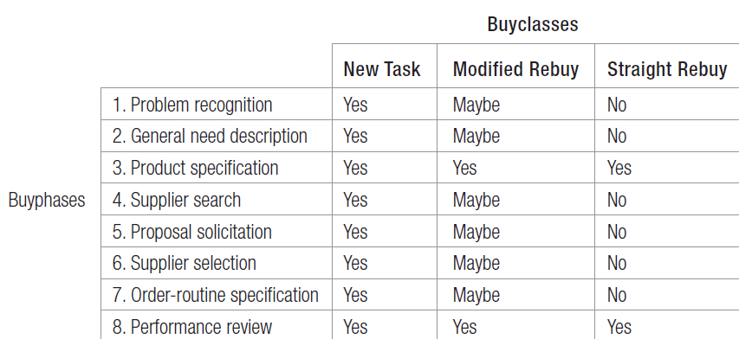
Buygrid Framework
Notes:
Table 7.1 is the buygrid framework. In modified-rebuy or straight-rebuy situations, some stages are compressed or bypassed. For example, the buyer normally has a favorite supplier or a ranked list of suppliers and can skip the search and proposal solicitation stages.

Slide 17
General Need Description and Product Specification

Slide 18
Supplier Search

Slide 19

Forms of Electronic Marketplaces
Catalog sites
Vertical markets
Pure play auction sites
Spot markets
Private exchanges
Barter markets
Buying alliances
Notes:
Companies that purchase over the Internet are utilizing electronic marketplaces in several forms as listed in the slide.

Slide 20
Proposal Solicitation

Slide 21
Supplier Selection

Slide 22
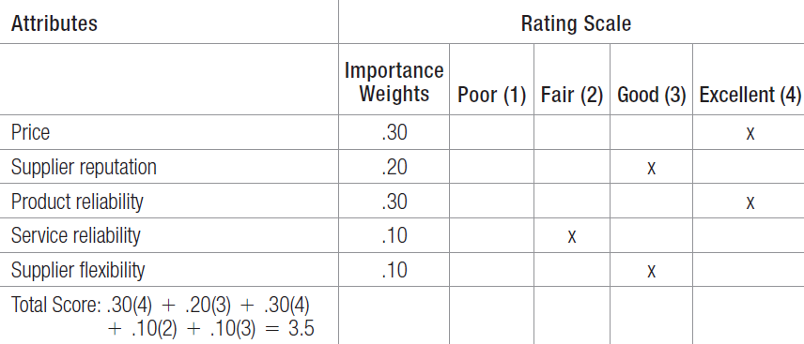
An Example of
Vendor Analysis
Notes:
Before selecting a supplier, the buying center will specify and rank desired supplier attributes, often using a supplier-evaluation model such as the one in Table 7.2.

Slide 23
Order Routine Specification
Stockless purchase plans
Vendor-managed inventory
Continuous replenishment
Notes:
Orders can be made routine at times. Some techniques for managing ordering needs includes the use of purchase plans, vendor-managed inventory, and shifting to a system of continuous replenishment.

Slide 24
Performance Review

Slide 25
Categories of Buyer-Seller Relationships
Basic buying and selling
Bare bones
Contractual transaction
Customer supply
Cooperative systems
Collaborative
Mutually adaptive
Customer is king
Notes:
A number of forces influence the development of a relationship between business partners. Four relevant factors are availability of alternatives, importance of supply, complexity of supply, and supply market dynamism. Based on these we can classify buyer–supplier relationships into eight categories. 1. Basic buying and selling—These are simple, routine exchanges with moderate levels of cooperation and information exchange. 2. Bare bones—These relationships require more adaptation by the seller and less cooperation and information exchange. 3. Contractual transaction—These exchanges are defined by formal contract and generally have low levels of trust, cooperation, and interaction. 4. Customer supply—In this traditional custom supply situation, competition rather than cooperation is the dominant form of governance. 5. Cooperative systems—The partners in cooperative systems are united in operational ways, but neither demonstrates structural commitment through legal means or adaptation. 6. Collaborative—In collaborative exchanges, much trust and commitment lead to true partnership. 7. Mutually adaptive—Buyers and sellers make many relationship-specific adaptations, but without necessarily achieving strong trust or cooperation. 8. Customer is king—In this close, cooperative relationship, the seller adapts to meet the customer’s needs without expecting much adaptation or change in exchange.

Slide 26
Categories of Buyer-Seller Relationships
1. Basic buying and selling—These are simple, routine exchanges with moderate levels of cooperation and information exchange.
2. Bare bones—These relationships require more adaptation by the seller and less cooperation and information exchange.
3. Contractual transaction—These exchanges are defined by formal contract and generally have low levels of trust, cooperation, and interaction.
4. Customer supply—In this traditional custom supply situation, competition rather than cooperation is the dominant form of governance.
5. Cooperative systems—The partners in cooperative systems are united in operational ways, but neither demonstrates structural commitment through legal means or adaptation.
6. Collaborative—In collaborative exchanges, much trust and commitment lead to true partnership.
7. Mutually adaptive—Buyers and sellers make many relationship-specific adaptations, but without necessarily achieving strong trust or cooperation.
8. Customer is king—In this close, cooperative relationship, the seller adapts to meet the customer’s needs without expecting much adaptation or change in exchange.
Notes:
A number of forces influence the development of a relationship between business partners. Four relevant factors are availability of alternatives, importance of supply, complexity of supply, and supply market dynamism. Based on these we can classify buyer–supplier relationships into eight categories. 1. Basic buying and selling—These are simple, routine exchanges with moderate levels of cooperation and information exchange. 2. Bare bones—These relationships require more adaptation by the seller and less cooperation and information exchange. 3. Contractual transaction—These exchanges are defined by formal contract and generally have low levels of trust, cooperation, and interaction. 4. Customer supply—In this traditional custom supply situation, competition rather than cooperation is the dominant form of governance. 5. Cooperative systems—The partners in cooperative systems are united in operational ways, but neither demonstrates structural commitment through legal means or adaptation. 6. Collaborative—In collaborative exchanges, much trust and commitment lead to true partnership. 7. Mutually adaptive—Buyers and sellers make many relationship-specific adaptations, but without necessarily achieving strong trust or cooperation. 8. Customer is king—In this close, cooperative relationship, the seller adapts to meet the customer’s needs without expecting much adaptation or change in exchange.

Slide 27

Institutional Markets
Notes:
Much of what we have said also applies to the buying practices of institutional and government organizations. However, we want to highlight certain special features of these markets. The institutional market consists of schools, hospitals, nursing homes, prisons, and other institutions that must provide goods and services to people in their care. In most countries, government organizations are a major buyer of goods and services. They typically require suppliers to submit bids and often award the contract to the lowest bidder. In some cases, they will make allowance for superior quality or a reputation for completing contracts on time. Governments will also buy on a negotiated contract basis, primarily in complex projects with major R&D costs and risks and those where there is little competition.

