Slide 1
Applied Marketing Strategies
MGT 681
Lecture 16

Slide 2
Marketing Ecology
Part 2

Slide 3
Analyzing
Consumer Markets

Slide 4
Lecture Agenda
How do consumer characteristics influence buying behavior?
What major psychological processes influence consumer responses to the marketing program?
How do consumers make purchasing decisions?
In what ways do consumers stray from a deliberate rational decision process?
Notes:
The aim of marketing is to meet and satisfy target customers’ needs and wants better than competitors. Marketers must have a thorough understanding of how consumers think, feel, and act and offer clear value to each and every target consumer.

Slide 5
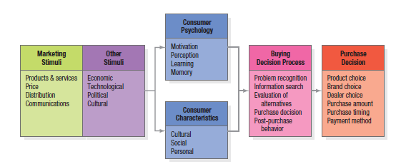
Model of Consumer Behavior
Notes:
The starting point for understanding consumer behavior is the stimulus-response model shown in Figure 6.1.Marketing and environmental stimuli enter the consumer’s consciousness, and a set of psychological processes combine with certain consumer characteristics to result in decision processes and purchase decisions. The marketer’s task is to understand what happens in the consumer’s consciousness between the arrival of the outside marketing stimuli and the ultimate purchase decisions. Four key psychological processes—motivation, perception, learning, and memory—fundamentally influence consumer responses.

Slide 6
Motivation
Freud’s
Theory
Behavior
is guided by
subconscious
motivations
Maslow’s
Hierarchy
of Needs
Behavior
is driven by
lowest,
unmet need
Herzberg’s
Two-Factor
Theory
Behavior is
guided by
motivating
and hygiene
factors
Notes:
Three of the best-known theories of human motivation—those of Sigmund Freud, Abraham Maslow, and Frederick Herzberg—carry quite different implications for consumer analysis and marketing strategy. Sigmund Freud assumed the psychological forces shaping people’s behavior are largely unconscious, and that a person cannot fully understand his or her own motivations. Someone who examines specific brands will react not only to their stated capabilities, but also to other, less conscious cues such as shape, size, weight, material, color, and brand name. Abraham Maslow sought to explain why people are driven by particular needs at particular times. His answer is that human needs are arranged in a hierarchy from most to least pressing—physiological needs, safety needs, social needs, esteem needs, and self-actualization. We discuss Maslow’s theory on the next slide. Frederick Herzberg developed a two-factor theory that distinguishes dissatisfiers (factors that cause dissatisfaction) from satisfiers (factors that cause satisfaction). The absence of dissatisfiers is not enough to motivate a purchase; satisfiers must be present.

Slide 7
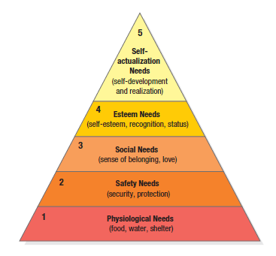
Maslow’s Hierarchy
Notes:
The slide illustrates Maslow’s Need Hierarchy. The theory suggests that people will try to satisfy their most important need first and then try to satisfy the next most important. For example, a starving man (need 1) will not take an interest in the latest happenings in the art world (need 5), nor in how he is viewed by others (need 3 or 4), nor even in whether he is breathing clean air (need 2), but when he has enough food and water, the next most important need will become salient.

Slide 8
Perception
Perception is the process by which we select, organize, and interpret information inputs to create a meaningful picture of the world.
Selective attention
Selective retention
Selective distortion
Subliminal perception
Notes:
A motivated person is ready to act—how is influenced by his or her perception of the situation. In marketing, perceptions are more important than reality, because perceptions affect consumers’ actual behavior. Perception is the process by which we select, organize, and interpret information inputs to create a meaningful picture of the world. It depends not only on physical stimuli, but also on the stimuli’s relationship to the surrounding environment and on conditions within each of us. Because we cannot possibly attend to all these, we screen most stimuli out—a process called selective attention. Selective attention means that marketers must work hard to attract consumers’ notice. Even noticed stimuli don’t always come across in the way the senders intended. Selective distortion is the tendency to interpret information in a way that fits our preconceptions. Consumers will often distort information to be consistent with prior brand and product beliefs and expectations. Because of selective retention, we’re likely to remember good points about a product we like and forget good points about competing products.

Slide 9
Perception
Perceptions are more important than reality, because perceptions affect consumers’ actual behavior.
It depends not only on physical stimuli, but also on the stimuli’s relationship to the surrounding environment and on conditions within each of us.
Because we cannot possibly attend to all these, we screen most stimuli out—a process called selective attention. Selective attention means that marketers must work hard to attract consumers’ notice.
Even noticed stimuli don’t always come across in the way the senders intended. Selective distortion is the tendency to interpret information in a way that fits our preconceptions.
Consumers will often distort information to be consistent with prior brand and product beliefs and expectations.
Because of selective retention, we’re likely to remember good points about a product we like and forget good points about competing products.
Notes:
A motivated person is ready to act—how is influenced by his or her perception of the situation. In marketing, perceptions are more important than reality, because perceptions affect consumers’ actual behavior. Perception is the process by which we select, organize, and interpret information inputs to create a meaningful picture of the world. It depends not only on physical stimuli, but also on the stimuli’s relationship to the surrounding environment and on conditions within each of us. Because we cannot possibly attend to all these, we screen most stimuli out—a process called selective attention. Selective attention means that marketers must work hard to attract consumers’ notice. Even noticed stimuli don’t always come across in the way the senders intended. Selective distortion is the tendency to interpret information in a way that fits our preconceptions. Consumers will often distort information to be consistent with prior brand and product beliefs and expectations. Because of selective retention, we’re likely to remember good points about a product we like and forget good points about competing products.

Slide 10
Learning
Learning induces changes in our behavior arising from experience.
Most human behavior is learned, although much learning is incidental.
Learning theorists believe learning is produced through the interplay of drives, stimuli, cues, responses, and reinforcement.
Two popular approaches to learning are classical conditioning and operant (instrumental) conditioning.
A drive is a strong internal stimulus impelling action.
Cues are minor stimuli that determine when, where, and how a person responds.
Notes:
When we act, we learn. Learning induces changes in our behavior arising from experience. Most human behavior is learned, although much learning is incidental. Learning theorists believe learning is produced through the interplay of drives, stimuli, cues, responses, and reinforcement. Two popular approaches to learning are classical conditioning and operant (instrumental) conditioning. A drive is a strong internal stimulus impelling action. Cues are minor stimuli that determine when, where, and how a person responds. Suppose you buy an HP computer. If your experience is rewarding, your response to computers and HP will be positively reinforced. Later, when you want to buy a printer, you may assume that because it makes good computers, HP also makes good printers. In other words, you generalize your response to similar stimuli. A countertendency to generalization is discrimination. Discrimination means we have learned to recognize differences in sets of similar stimuli and can adjust our responses accordingly.

Slide 11
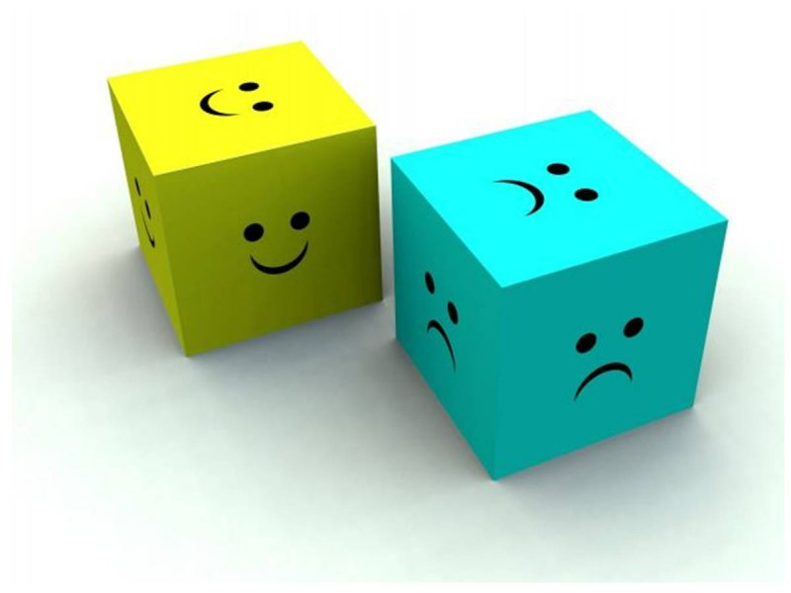
Emotions
Notes:
A brand or product may make a consumer feel emotions like pride and confidence . An ad may create feelings of amusement, disgust, or wonder. Emotions are connected to the choices we make as consumers.

Slide 12
Memory
Cognitive psychologists distinguish between
  short-term memory (STM)—a temporary and limited repository of information
  long-term memory (LTM)—a more permanent, essentially unlimited repository.
All the information and experiences we encounter as we go through life can end up in our long-term memory.
Most widely accepted views of long-term memory structure assume we form some kind of associative model.
The associative network memory model views LTM as a set of nodes and links.
  Nodes are stored information connected by links that vary in strength.
  Any type of information can be stored in the memory network, including verbal, visual, abstract, and contextual.
  A spreading activation process from node to node determines how much we retrieve and what information we can actually recall in any given situation.
  When encoding external information or retrieving internal information from LTM (other nodes are also activated if they’re strongly enough associated with that node.
Brand associations consist of all brand-related thoughts, feelings, perceptions, images, experiences, beliefs, attitudes, and so on that become linked to the brand node.
Notes:
Cognitive psychologists distinguish between short-term memory (STM)—a temporary and limited repository of information—and long-term memory (LTM)—a more permanent, essentially unlimited repository. All the information and experiences we encounter as we go through life can end up in our long-term memory. Most widely accepted views of long-term memory structure assume we form some kind of associative model. For example, the associative network memory model views LTM as a set of nodes and links. Nodes are stored information connected by links that vary in strength. Any type of information can be stored in the memory network, including verbal, visual, abstract, and contextual. A spreading activation process from node to node determines how much we retrieve and what information we can actually recall in any given situation. When a node becomes activated because we’re encoding external information (when we read or hear a word or phrase) or retrieving internal information from LTM (when we think about some concept), other nodes are also activated if they’re strongly enough associated with that node. In this model, we can think of consumer brand knowledge as a node in memory with a variety of linked associations. The strength and organization of these associations will be important determinants of the information we can recall about the brand. Brand associations consist of all brand-related thoughts, feelings, perceptions, images, experiences, beliefs, attitudes, and so on that become linked to the brand node.

Slide 13
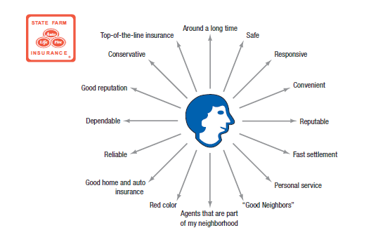
State Farm Mental Map
Notes:
We can think of marketing as a way of making sure consumers have product and service experiences to create the right brand knowledge structures and maintain them in memory. Companies such as Procter & Gamble like to create mental maps of consumers that depict their knowledge of a particular brand in terms of the key associations likely to be triggered in a marketing setting, and their relative strength, favorability, and uniqueness to consumers. Figure 6.3 displays a very simple mental map highlighting brand beliefs for a hypothetical consumer for State Farm insurance.

Slide 14
Consumer Buying Process
Problem Recognition
Information Search
Evaluation of alternatives
Purchase Decision
Postpurchase Behavior
Notes:
Marketing scholars have developed a “stage model” of the process (see Figure 6.4). The consumer typically passes through five stages: problem recognition, information search, evaluation of alternatives, purchase decision, and postpurchase behavior. Clearly, the buying process starts long before the actual purchase and has consequences long afterward. Consumers don’t always pass through all five stages—they may skip or reverse some. When you buy your regular brand of toothpaste, you go directly from the need to the purchase decision, skipping information search and evaluation. The model in Figure 6.4 provides a good frame of reference, however, because it captures the full range of considerations that arise when a consumer faces a highly involving new purchase.

Slide 15
Sources of Information
Personal
Commercial
Public
Experiential
Notes:
Major information sources to which consumers will turn fall into four groups:
The personal sources include family, friends, neighbors, acquaintances.
Commercial sources include advertising, Web sites, salespersons, dealers, packaging, and displays.
Public sources refer to mass media and consumer-rating organizations.
Experiential sources refer to the consumers’ experiences handling, examining, and using the product.
The relative amount and influence of these sources vary with the product category and the buyer’s characteristics. Generally speaking, although consumers receive the greatest amount of information about a product from commercial—that is, marketer-dominated—sources, the most effective information often comes from personal or experiential sources, or public sources that are independent authorities.

Slide 16
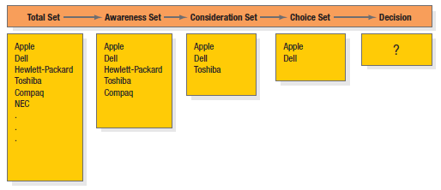
Successive Sets in Decision Making
Notes:
Figure 6.5 illustrates how consumers move through from developing an initial set of brands to consider to making a final decision. By gathering information, the consumer learns about competing brands and their features. The first box in Figure 6.5 shows the total set of brands available. The individual consumer will come to know a subset of these, the awareness set. Only some, the consideration set, will meet initial buying criteria. As the consumer gathers more information, just a few, the choice set, will remain strong contenders. The consumer makes a final choice from these.

Slide 17
Consumer Buying Process
Problem Recognition
Information Search
Evaluation of alternatives
Purchase Decision
Postpurchase Behavior
Notes:
Marketing scholars have developed a “stage model” of the process (see Figure 6.4). The consumer typically passes through five stages: problem recognition, information search, evaluation of alternatives, purchase decision, and postpurchase behavior. Clearly, the buying process starts long before the actual purchase and has consequences long afterward. Consumers don’t always pass through all five stages—they may skip or reverse some. When you buy your regular brand of toothpaste, you go directly from the need to the purchase decision, skipping information search and evaluation. The model in Figure 6.4 provides a good frame of reference, however, because it captures the full range of considerations that arise when a consumer faces a highly involving new purchase.

Slide 18
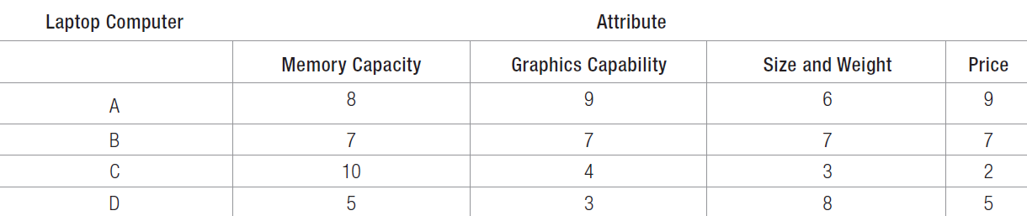
A Consumer’s Brand Beliefs about Laptop Computers
Notes:
Table 6.4 illustrates the use of the expectancy-value model of attitude formation in decision making. The expectancy-value model of attitude formation posits that consumers evaluate products and services by combining their brand beliefs—the positives and negatives—according to importance. Suppose Linda has narrowed her choice set to four laptop computers (A, B, C, and D). Assume she’s interested in four attributes: memory capacity, graphics capability, size and weight, and price. Table 6.4 shows her beliefs about how each brand rates on the four attributes. If one computer dominated the others on all the criteria, we could predict that Linda would choose it. But, as is often the case, her choice set consists of brands that vary in their appeal. If Linda wants the best memory capacity, she should buy C; if she wants the best graphics capability, she should buy A; and so on. If we knew the weights Linda attaches to the four attributes, we could more reliably predict her laptop choice. Suppose she assigned 40 percent of the importance to the laptop’s memory capacity, 30 percent to graphics capability, 20 percent to size and weight, and 10 percent to price. To find Linda’s perceived value for each laptop according to the expectancy-value model, we multiply her weights by her beliefs about each computer’s attributes.

Slide 19
Consumer Buying Process
Problem Recognition
Information Search
Evaluation of alternatives
Purchase Decision
Postpurchase Behavior
Notes:
Marketing scholars have developed a “stage model” of the process (see Figure 6.4). The consumer typically passes through five stages: problem recognition, information search, evaluation of alternatives, purchase decision, and postpurchase behavior. Clearly, the buying process starts long before the actual purchase and has consequences long afterward. Consumers don’t always pass through all five stages—they may skip or reverse some. When you buy your regular brand of toothpaste, you go directly from the need to the purchase decision, skipping information search and evaluation. The model in Figure 6.4 provides a good frame of reference, however, because it captures the full range of considerations that arise when a consumer faces a highly involving new purchase.

Slide 20
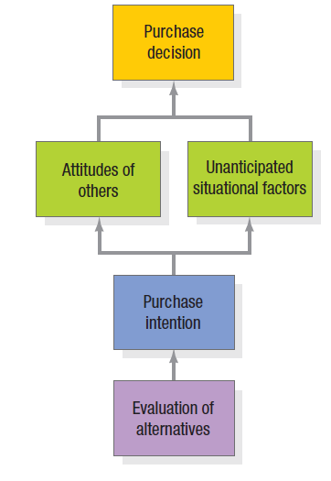
Steps Between Alternative Evaluation and Purchase
Notes:
Even if consumers form brand evaluations, two general factors can intervene between the purchase intention and the purchase decision (see Figure 6.6). The first factor is the attitudes of others. The influence of another person’s attitude depends on two things: (1) the intensity of the other person’s negative attitude toward our preferred alternative and (2) our motivation to comply with the other person’s wishes. The more intense the other person’s negativism and the closer he or she is to us, the more we will adjust our purchase intention. The converse is also true.

Slide 21
Non-Compensatory Models of Choice
Conjunctive
Lexicographic
Elimination-by-aspects
Notes:
The expectancy-value model is a compensatory model, in that perceived good things about a product can help to overcome perceived bad things. But consumers often take “mental shortcuts” called heuristics or rules of thumb in the decision process. With noncompensatory models of consumer choice, positive and negative attribute considerations don’t necessarily net out. Evaluating attributes in isolation makes decision making easier for a consumer, but it also increases the likelihood that she would have made a different choice if she had deliberated in greater detail. We highlight three choice heuristics here.
1. Using the conjunctive heuristic, the consumer sets a minimum acceptable cutoff level for each attribute and chooses the first alternative that meets the minimum standard for all attributes. For example, if Linda decided all attributes had to rate at least 5, she would choose laptop computer B.
2. With the lexicographic heuristic, the consumer chooses the best brand on the basis of its perceived most important attribute. With this decision rule, Linda would choose laptop computer C.
3. Using the elimination-by-aspects heuristic, the consumer compares brands on an attribute selected probabilistically—where the probability of choosing an attribute is positively related to its importance—and eliminates brands that do not meet minimum acceptable cutoffs.

Slide 22
Consumer Buying Process
Problem Recognition
Information Search
Evaluation of alternatives
Purchase Decision
Postpurchase Behavior
Notes:
Marketing scholars have developed a “stage model” of the process (see Figure 6.4). The consumer typically passes through five stages: problem recognition, information search, evaluation of alternatives, purchase decision, and postpurchase behavior. Clearly, the buying process starts long before the actual purchase and has consequences long afterward. Consumers don’t always pass through all five stages—they may skip or reverse some. When you buy your regular brand of toothpaste, you go directly from the need to the purchase decision, skipping information search and evaluation. The model in Figure 6.4 provides a good frame of reference, however, because it captures the full range of considerations that arise when a consumer faces a highly involving new purchase.

Slide 23

Perceived Risk
Functional
Physical
Financial
Social
Psychological
Time
Notes:
A consumer’s decision to modify, postpone, or avoid a purchase decision is heavily influenced by one or more types of perceived risk:
1. Functional risk—The product does not perform to expectations.
2. Physical risk—The product poses a threat to the physical well-being or health of the user or others.
3. Financial risk—The product is not worth the price paid.
4. Social risk—The product results in embarrassment in front of others.
5. Psychological risk—The product affects the mental well-being of the user.
6. Time risk—The failure of the product results in an opportunity cost of finding another satisfactory product.
In this promotional message for QuickBooks, the money-back guarantee seeks to lower perceived risk.

Slide 24
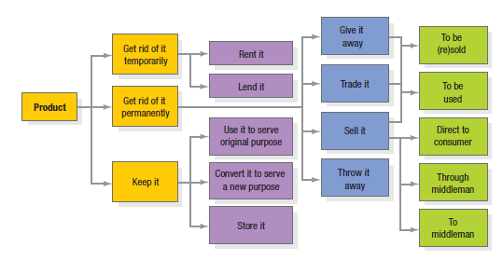
How Customers
Use or Dispose of Products
Notes:
Marketers should also monitor how buyers use and dispose of the product (Figure 6.7). A key driver of sales frequency is product consumption rate—the more quickly buyers consume a product, the sooner they may be back in the market to repurchase it. Consumers may fail to replace some products soon enough because they overestimate product life. One strategy to speed replacement is to tie the act of replacing the product to a certain holiday, event, or time of year.

Slide 25
Decision Heuristics
Availability
Representativeness
Anchoring and adjustment
Notes:
The availability heuristic—Consumers base their predictions on the quickness and ease with which a particular example of an outcome comes to mind. If an example comes to mind too easily, consumers might overestimate the likelihood of its happening. The representativeness heuristic—Consumers base their predictions on how representative or similar the outcome is to other examples. The anchoring and adjustment heuristic—Consumers arrive at an initial judgment and then adjust it based on additional information.

Slide 26

Framing
Notes:
Decision framing is the manner in which choices are presented to and seen by a decision maker. A $200 cell phone may not seem that expensive in the context of a set of $400 phones but may seem very expensive if those phones cost $50. Framing effects are pervasive and can be powerful. Marketers can influence consumer decision making through what they call the choice architecture—the environment in which decisions are structured and buying choices are made. According to these researchers, in the right environment, consumers can be given a “nudge” via some small feature in the environment that attracts attention and alters behavior.

Slide 27
Mental Accounting
Consumers tend to…
  Segregate gains
  Integrate losses
  Integrate smaller losses with larger gains
  Segregate small gains from large losses
Notes:
Mental accounting is based on a set of core principles:
1. Consumers tend to segregate gains. When a seller has a product with more than one positive dimension, it’s desirable to have the consumer evaluate each dimension separately. Listing multiple benefits of a large industrial product, for example, can make the sum of the parts seem greater than the whole.
2. Consumers tend to integrate losses. Marketers have a distinct advantage in selling something if its cost can be added to another large purchase. House buyers are more inclined to view additional expenditures favorably given the high price of buying a house.
3. Consumers tend to integrate smaller losses with larger gains. The “cancellation” principle might explain why withholding taxes from monthly paychecks is less aversive than large, lump-sum tax payments—the smaller withholdings are more likely to be absorbed by the larger pay amount.
4. Consumers tend to segregate small gains from large losses. The “silver lining” principle might explain the popularity of rebates on big-ticket purchases such as cars. The principles of mental accounting are derived in part from prospect theory. Prospect theory maintains that consumers frame their decision alternatives in terms of gains and losses according to a value function. Consumers are generally loss-averse. They tend to overweight very low probabilities and undersweight very high probabilities.

