Slide 1
Applied Marketing Strategies
MGT 681
Lecture 16

Slide 2
Marketing Ecology
Part 2

Slide 3
Analyzing
Consumer Markets

Slide 4
Lecture Agenda
How do consumer characteristics influence buying behavior?
What major psychological processes influence consumer responses to the marketing program?
How do consumers make purchasing decisions?
In what ways do consumers stray from a deliberate rational decision process?
Notes:
The aim of marketing is to meet and satisfy target customers’ needs and wants better than competitors. Marketers must have a thorough understanding of how consumers think, feel, and act and offer clear value to each and every target consumer.

Slide 5

Consumer Behavior
Consumer behavior is the study of how individuals, groups, and organizations select, buy, use, and dispose of goods, services, ideas, or experiences to satisfy their needs and wants.
Notes:
Consumer behavior is the study of how individuals, groups, and organizations select, buy, use, and dispose of goods, services, ideas, or experiences to satisfy their needs and wants. Marketers must fully understand both the theory and reality of consumer behavior. Table 6.1 provides a snapshot profile of U.S. consumers.

Slide 6
What Influences
Consumer Behavior?
Cultural Factors
Social Factors
Personal Factors
Notes:
A consumer’s buying behavior is influenced by cultural, social, and personal factors. Of these, cultural factors exert the broadest and deepest influence.

Slide 7
What is Culture?
Culture is the fundamental determinant of a person’s wants and behaviors acquired through socialization processes with family and other key institutions.
Notes:
Culture, subculture, and social class are particularly important influences on consumer buying behavior. Culture is the fundamental determinant of a person’s wants and behavior. Through family and other key institutions, a child growing up in the United States is exposed to values such as achievement and success, activity, efficiency and practicality, progress, material comfort, individualism, freedom, external comfort, humanitarianism, and youthfulness. A child growing up in another country might have a different view of self, relationship to others, and rituals

Slide 8
Subcultures
Nationalities
Religions
Racial groups
Geographic regions
Notes:
Each culture consists of smaller subcultures that provide more specific identification and socialization for their members. Subcultures include nationalities, religions, racial groups, and geographic regions. When subcultures grow large and affluent enough, companies often design specialized marketing programs to serve them.

Slide 9
Social Classes
Upper uppers
Lower uppers
Upper middles
Middle
Working
Upper lowers
Lower lowers
Notes:
Virtually all human societies exhibit social stratification, most often in the form of social classes, relatively homogeneous and enduring divisions in a society, hierarchically ordered and with members who share similar values, interests, and behavior. One classic depiction of social classes in the United States defined seven ascending levels: (1) lower lowers, (2) upper lowers, (3) working class, (4) middle class, (5) upper middles, (6) lower uppers, and (7) upper uppers. Social class members show distinct product and brand preferences in many areas, including clothing, home furnishings, leisure activities, and automobiles. They also differ in media preferences; upper-class consumers often prefer magazines and books, and lower-class consumers often prefer television.

Slide 10
Social Factors
Reference groups
Family
Social roles
Statuses
Notes:
In addition to cultural factors, social factors such as reference groups, family, and social roles and statuses affect our buying behavior.

Slide 11
Reference Groups
Membership groups
Primary groups
Secondary groups
Aspirational groups
Disassociative groups
Notes:
A person’s reference groups are all the groups that have a direct (face-to-face) or indirect influence on their attitudes or behavior. Groups having a direct influence are called membership groups. Some of these are primary groups with whom the person interacts fairly continuously and informally, such as family, friends, neighbors, and coworkers. People also belong to secondary groups, such as religious, professional, and trade-union groups, which tend to be more formal and require less continuous interaction. Reference groups influence members in at least three ways. They expose an individual to new behaviors and lifestyles, they influence attitudes and self-concept, and they create pressures for conformity that may affect product and brand choices. People are also influenced by groups to which they do not belong. Aspirational groups are those a person hopes to join; disassociative groups are those whose values or behavior an individual rejects. Where reference group influence is strong, marketers must determine how to reach and influence the group’s opinion leaders. An opinion leader is the person who offers informal advice or information about a specific product or product category, such as which of several brands is best or how a particular product may be used. Opinion leaders are often highly confident, socially active, and frequent users of the category.

Slide 12
Reference Groups
Reference groups are all the groups that have a direct (face-to-face) or indirect influence on their attitudes or behavior.
Groups having a direct influence are called membership groups.
Some of these are primary groups with whom the person interacts fairly continuously and informally, such as family, friends, neighbors, and coworkers.
People also belong to secondary groups, such as religious, professional, and trade-union groups, which tend to be more formal and require less continuous interaction.
  Reference groups influence members in at least three ways.
  Expose an individual to new behaviors and lifestyles
  Influence attitudes and self-concept
  Create pressures for conformity that may affect product and brand choices.
Aspirational groups are those a person hopes to join
Disassociative groups are those whose values or behavior an individual rejects.
An opinion leader is the person who offers informal advice or information about a specific product or product category,
Notes:
A person’s reference groups are all the groups that have a direct (face-to-face) or indirect influence on their attitudes or behavior. Groups having a direct influence are called membership groups. Some of these are primary groups with whom the person interacts fairly continuously and informally, such as family, friends, neighbors, and coworkers. People also belong to secondary groups, such as religious, professional, and trade-union groups, which tend to be more formal and require less continuous interaction. Reference groups influence members in at least three ways. They expose an individual to new behaviors and lifestyles, they influence attitudes and self-concept, and they create pressures for conformity that may affect product and brand choices. People are also influenced by groups to which they do not belong. Aspirational groups are those a person hopes to join; disassociative groups are those whose values or behavior an individual rejects. Where reference group influence is strong, marketers must determine how to reach and influence the group’s opinion leaders. An opinion leader is the person who offers informal advice or information about a specific product or product category, such as which of several brands is best or how a particular product may be used. Opinion leaders are often highly confident, socially active, and frequent users of the category.

Slide 13
Family Distinctions
Affecting Buying Decisions
Family members constitute the most influential primary reference group. There are two families in the buyer’s life.
The family of orientation consists of parents and siblings.
  From parents a person acquires an orientation toward
    Religion,
    Politics, and economics
    Sense of personal ambition,
    Self-worth
    Love
A more direct influence on everyday buying behavior is the family of procreation—namely, the person’s spouse and children. In the United States, husband–wife engagement in purchases has traditionally varied widely by product category
Notes:
The family is the most important consumer buying organization in society, and family members constitute the most influential primary reference group. There are two families in the buyer’s life. The family of orientation consists of parents and siblings. From parents a person acquires an orientation toward religion, politics, and economics and a sense of personal ambition, self-worth, and love. Even if the buyer no longer interacts very much with his or her parents, parental influence on behavior can be significant. Almost 40 percent of families have auto insurance with the same company as the husband’s parents.
A more direct influence on everyday buying behavior is the family of procreation—namely, the person’s spouse and children. In the United States, husband–wife engagement in purchases has traditionally varied widely by product category. The wife has usually acted as the family’s main purchasing agent, especially for food, sundries, and staple clothing items. Now traditional purchasing roles are changing, and marketers would be wise to see both men and women as possible targets.

Slide 14
Personal Factors
Age
Life cycle stage
Occupation
Wealth
Personality
Values
Lifestyle
Self-concept
Notes:
Personal factors that affect consumer decisions include age, life cycle stage, occupation, wealth, personality, values, lifestyle, and self-concept. We’ll take a closer look at a few of these in the coming slides.

Slide 15

Age and Stage of Lifecycle
Notes:
Our taste in food, clothes, furniture, and recreation is often related to our age. Consumption is also shaped by the family life cycle and the number, age, and gender of people in the household at any point in time. U.S. households are increasingly fragmented—the traditional family of four with a husband, wife, and two kids makes up a much smaller percentage of total households than it once did. The average U.S. household size in 2008 was 2.6 persons. In addition, psychological life-cycle stages may matter. Adults experience certain “passages” or “transformations” as they go through life. Their behavior as they go through these passages, such as becoming a parent, is not necessarily fixed but changes with the times. Marketers should also consider critical life events or transitions—marriage, childbirth, illness, relocation, divorce, first job, career change, retirement, death of a spouse—as giving rise to new needs.

Slide 16

Occupation and Economic Circumstances
Notes:
Occupation also influences consumption patterns. Marketers try to identify the occupational groups that have above-average interest in their products and services and even tailor products for certain occupational groups: Computer software companies, for example, design different products for brand managers, engineers, lawyers, and physicians.
As the recent recession clearly indicated, both product and brand choice are greatly affected by economic circumstances: spendable income (level, stability, and time pattern), savings and assets (including the percentage that is liquid), debts, borrowing power, and attitudes toward spending and saving. Luxury-goods makers such as Gucci, Prada, and Burberry are vulnerable to an economic downturn. If economic indicators point to a recession, marketers can take steps to redesign, reposition, and reprice their products or introduce or increase the emphasis on discount brands so they can continue to offer value to target customers. Some firms—such as Snap Fitness—are well-positioned to take advantage of good and bad economic times to begin with. twice—24 hour Snap Fitness actually expanded the number of its clubs, and its revenue doubled. The franchise chain did all this despite charging members only $35 per month with easy cancellation fees. Its secret? A no-frills approach reinforced by the motto, “Fast, Convenient, Affordable.”

Slide 17
Personality
A set of distinguishing human psychological traits that lead to relatively consistent and enduring responses to environmental stimuli (including buying behavior).
Personality is described in terms of traits such as
  Self-confidence
  Dominance,
  Autonomy,
  Deference, sociability,
  Defensiveness
  Adaptability.
A lifestyle is a person’s pattern of living in the world as expressed in activities, interests, and opinions.
Notes:
Each person has personality characteristics that influence his or her buying behavior. By personality, we mean a set of distinguishing human psychological traits that lead to relatively consistent and enduring responses to environmental stimuli (including buying behavior).We often describe personality in terms of such traits as self-confidence dominance, autonomy, deference, sociability, defensiveness, and adaptability. Personality can be a useful variable in analyzing consumer brand choices. People from the same subculture, social class, and occupation may lead quite different lifestyles. A lifestyle is a person’s pattern of living in the world as expressed in activities, interests, and opinions. It portrays the “whole person” interacting with his or her environment. Marketers search for relationships between their products and lifestyle groups. In this content from Joie de Vivre we see a focus on the consumers’ personality.

Slide 18
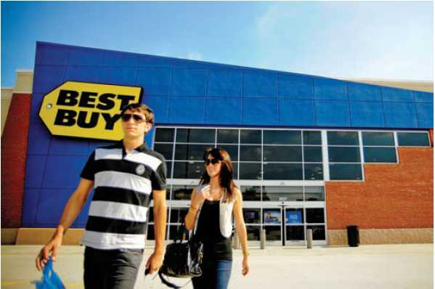
Brand Personality
Sincerity
Excitement
Competence
Sophistication
Ruggedness
Notes:
Brands also have personalities, and consumers are likely to choose brands whose personalities match their own. We define brand personality as the specific mix of human traits that we can attribute to a particular brand. Research on brand personalities identified the following traits:
1. Sincerity (down-to-earth, honest, wholesome, and cheerful)
2. Excitement (daring, spirited, imaginative, and up-to-date)
3. Competence (reliable, intelligent, and successful)
4. Sophistication (upper-class and charming)
5. Ruggedness (outdoorsy and tough)
Brands tend to be strong on one particular trait. For instance, Levi’s on “ruggedness”; MTV on “excitement”; CNN on “competence”; and Campbell’s on “sincerity.” These brands will, in theory, attract users high on the same traits.
Best Buy has developed a personality image of sincerity using its Twelp Force on Twitter.

Slide 19
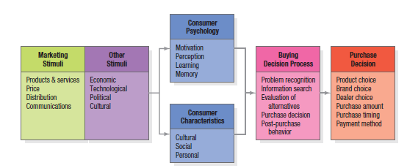
Model of Consumer Behavior
Notes:
The starting point for understanding consumer behavior is the stimulus-response model shown in Figure 6.1.Marketing and environmental stimuli enter the consumer’s consciousness, and a set of psychological processes combine with certain consumer characteristics to result in decision processes and purchase decisions. The marketer’s task is to understand what happens in the consumer’s consciousness between the arrival of the outside marketing stimuli and the ultimate purchase decisions. Four key psychological processes—motivation, perception, learning, and memory—fundamentally influence consumer responses.

Slide 20
Motivation
Freud’s
Theory
Behavior
is guided by
subconscious
motivations
Maslow’s
Hierarchy
of Needs
Behavior
is driven by
lowest,
unmet need
Herzberg’s
Two-Factor
Theory
Behavior is
guided by
motivating
and hygiene
factors
Notes:
Three of the best-known theories of human motivation—those of Sigmund Freud, Abraham Maslow, and Frederick Herzberg—carry quite different implications for consumer analysis and marketing strategy. Sigmund Freud assumed the psychological forces shaping people’s behavior are largely unconscious, and that a person cannot fully understand his or her own motivations. Someone who examines specific brands will react not only to their stated capabilities, but also to other, less conscious cues such as shape, size, weight, material, color, and brand name. Abraham Maslow sought to explain why people are driven by particular needs at particular times. His answer is that human needs are arranged in a hierarchy from most to least pressing—physiological needs, safety needs, social needs, esteem needs, and self-actualization. We discuss Maslow’s theory on the next slide. Frederick Herzberg developed a two-factor theory that distinguishes dissatisfiers (factors that cause dissatisfaction) from satisfiers (factors that cause satisfaction). The absence of dissatisfiers is not enough to motivate a purchase; satisfiers must be present.

Slide 21
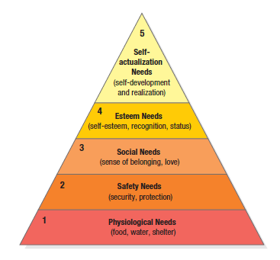
Maslow’s Hierarchy
Notes:
The slide illustrates Maslow’s Need Hierarchy. The theory suggests that people will try to satisfy their most important need first and then try to satisfy the next most important. For example, a starving man (need 1) will not take an interest in the latest happenings in the art world (need 5), nor in how he is viewed by others (need 3 or 4), nor even in whether he is breathing clean air (need 2), but when he has enough food and water, the next most important need will become salient.

Slide 22
Perception
Selective attention
Selective retention
Selective distortion
Subliminal perception
Notes:
A motivated person is ready to act—how is influenced by his or her perception of the situation. In marketing, perceptions are more important than reality, because perceptions affect consumers’ actual behavior. Perception is the process by which we select, organize, and interpret information inputs to create a meaningful picture of the world. It depends not only on physical stimuli, but also on the stimuli’s relationship to the surrounding environment and on conditions within each of us. Because we cannot possibly attend to all these, we screen most stimuli out—a process called selective attention. Selective attention means that marketers must work hard to attract consumers’ notice. Even noticed stimuli don’t always come across in the way the senders intended. Selective distortion is the tendency to interpret information in a way that fits our preconceptions. Consumers will often distort information to be consistent with prior brand and product beliefs and expectations. Because of selective retention, we’re likely to remember good points about a product we like and forget good points about competing products.

Slide 23

Learning
Notes:
When we act, we learn. Learning induces changes in our behavior arising from experience. Most human behavior is learned, although much learning is incidental. Learning theorists believe learning is produced through the interplay of drives, stimuli, cues, responses, and reinforcement. Two popular approaches to learning are classical conditioning and operant (instrumental) conditioning. A drive is a strong internal stimulus impelling action. Cues are minor stimuli that determine when, where, and how a person responds. Suppose you buy an HP computer. If your experience is rewarding, your response to computers and HP will be positively reinforced. Later, when you want to buy a printer, you may assume that because it makes good computers, HP also makes good printers. In other words, you generalize your response to similar stimuli. A countertendency to generalization is discrimination. Discrimination means we have learned to recognize differences in sets of similar stimuli and can adjust our responses accordingly.

Slide 24
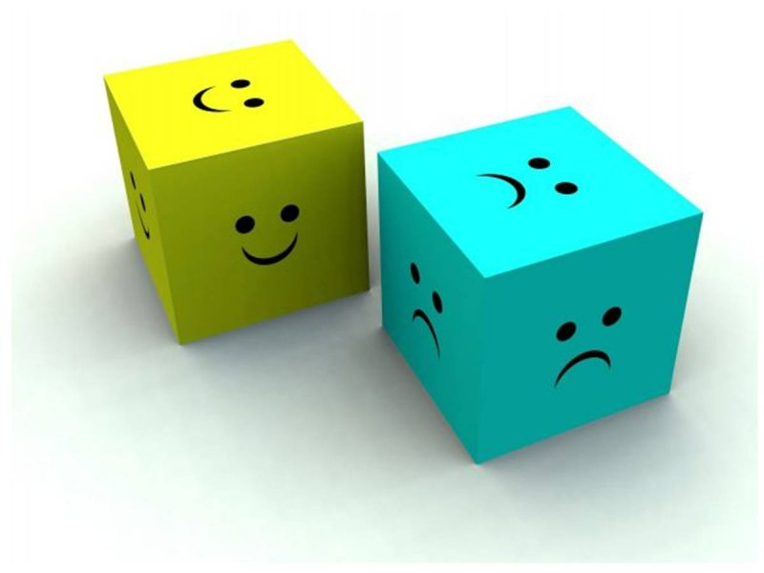
Emotions
Notes:
A brand or product may make a consumer feel emotions like pride and confidence . An ad may create feelings of amusement, disgust, or wonder. Emotions are connected to the choices we make as consumers.

Slide 25

Memory
Notes:
Cognitive psychologists distinguish between short-term memory (STM)—a temporary and limited repository of information—and long-term memory (LTM)—a more permanent, essentially unlimited repository. All the information and experiences we encounter as we go through life can end up in our long-term memory. Most widely accepted views of long-term memory structure assume we form some kind of associative model. For example, the associative network memory model views LTM as a set of nodes and links. Nodes are stored information connected by links that vary in strength. Any type of information can be stored in the memory network, including verbal, visual, abstract, and contextual. A spreading activation process from node to node determines how much we retrieve and what information we can actually recall in any given situation. When a node becomes activated because we’re encoding external information (when we read or hear a word or phrase) or retrieving internal information from LTM (when we think about some concept), other nodes are also activated if they’re strongly enough associated with that node. In this model, we can think of consumer brand knowledge as a node in memory with a variety of linked associations. The strength and organization of these associations will be important determinants of the information we can recall about the brand. Brand associations consist of all brand-related thoughts, feelings, perceptions, images, experiences, beliefs, attitudes, and so on that become linked to the brand node.

Slide 26
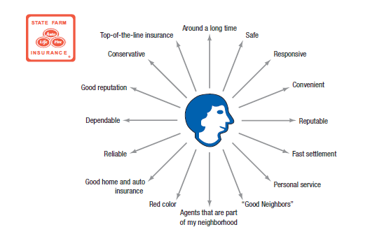
Figure 6.3 State Farm Mental Map
Notes:
We can think of marketing as a way of making sure consumers have product and service experiences to create the right brand knowledge structures and maintain them in memory. Companies such as Procter & Gamble like to create mental maps of consumers that depict their knowledge of a particular brand in terms of the key associations likely to be triggered in a marketing setting, and their relative strength, favorability, and uniqueness to consumers. Figure 6.3 displays a very simple mental map highlighting brand beliefs for a hypothetical consumer for State Farm insurance.

Slide 27
Figure 6.4 Consumer Buying Process
Problem Recognition
Information Search
Evaluation of alternatives
Purchase Decision
Postpurchase Behavior
Notes:
Marketing scholars have developed a “stage model” of the process (see Figure 6.4). The consumer typically passes through five stages: problem recognition, information search, evaluation of alternatives, purchase decision, and postpurchase behavior. Clearly, the buying process starts long before the actual purchase and has consequences long afterward. Consumers don’t always pass through all five stages—they may skip or reverse some. When you buy your regular brand of toothpaste, you go directly from the need to the purchase decision, skipping information search and evaluation. The model in Figure 6.4 provides a good frame of reference, however, because it captures the full range of considerations that arise when a consumer faces a highly involving new purchase.

Slide 28
Sources of Information
Personal
Commercial
Public
Experiential
Notes:
Major information sources to which consumers will turn fall into four groups:
The personal sources include family, friends, neighbors, acquaintances.
Commercial sources include advertising, Web sites, salespersons, dealers, packaging, and displays.
Public sources refer to mass media and consumer-rating organizations.
Experiential sources refer to the consumers’ experiences handling, examining, and using the product.
The relative amount and influence of these sources vary with the product category and the buyer’s characteristics. Generally speaking, although consumers receive the greatest amount of information about a product from commercial—that is, marketer-dominated—sources, the most effective information often comes from personal or experiential sources, or public sources that are independent authorities.

Slide 29
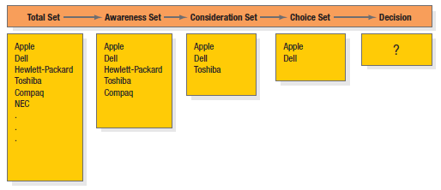
Figure 6.5 Successive Sets in Decision Making
Notes:
Figure 6.5 illustrates how consumers move through from developing an initial set of brands to consider to making a final decision. By gathering information, the consumer learns about competing brands and their features. The first box in Figure 6.5 shows the total set of brands available. The individual consumer will come to know a subset of these, the awareness set. Only some, the consideration set, will meet initial buying criteria. As the consumer gathers more information, just a few, the choice set, will remain strong contenders. The consumer makes a final choice from these.

Slide 30
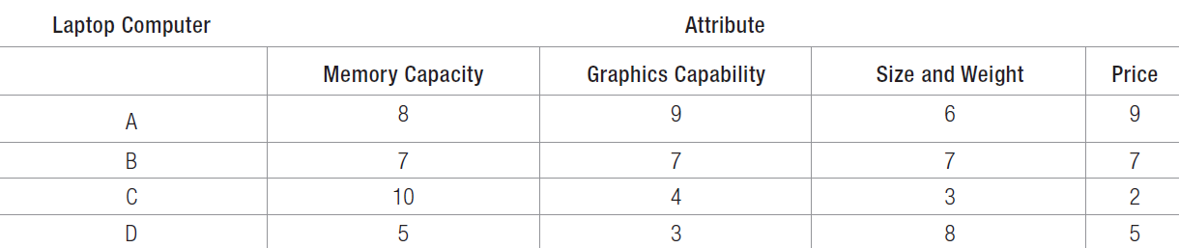
Table 6.4 A Consumer’s Brand Beliefs about Laptop Computers
Notes:
Table 6.4 illustrates the use of the expectancy-value model of attitude formation in decision making. The expectancy-value model of attitude formation posits that consumers evaluate products and services by combining their brand beliefs—the positives and negatives—according to importance. Suppose Linda has narrowed her choice set to four laptop computers (A, B, C, and D). Assume she’s interested in four attributes: memory capacity, graphics capability, size and weight, and price. Table 6.4 shows her beliefs about how each brand rates on the four attributes. If one computer dominated the others on all the criteria, we could predict that Linda would choose it. But, as is often the case, her choice set consists of brands that vary in their appeal. If Linda wants the best memory capacity, she should buy C; if she wants the best graphics capability, she should buy A; and so on. If we knew the weights Linda attaches to the four attributes, we could more reliably predict her laptop choice. Suppose she assigned 40 percent of the importance to the laptop’s memory capacity, 30 percent to graphics capability, 20 percent to size and weight, and 10 percent to price. To find Linda’s perceived value for each laptop according to the expectancy-value model, we multiply her weights by her beliefs about each computer’s attributes.

Slide 31
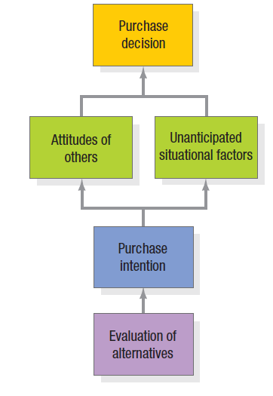
Figure 6.6 Steps Between Alternative Evaluation and Purchase
Notes:
Even if consumers form brand evaluations, two general factors can intervene between the purchase intention and the purchase decision (see Figure 6.6). The first factor is the attitudes of others. The influence of another person’s attitude depends on two things: (1) the intensity of the other person’s negative attitude toward our preferred alternative and (2) our motivation to comply with the other person’s wishes. The more intense the other person’s negativism and the closer he or she is to us, the more we will adjust our purchase intention. The converse is also true.

Slide 32
Non-Compensatory Models of Choice
Conjunctive
Lexicographic
Elimination-by-aspects
Notes:
The expectancy-value model is a compensatory model, in that perceived good things about a product can help to overcome perceived bad things. But consumers often take “mental shortcuts” called heuristics or rules of thumb in the decision process. With noncompensatory models of consumer choice, positive and negative attribute considerations don’t necessarily net out. Evaluating attributes in isolation makes decision making easier for a consumer, but it also increases the likelihood that she would have made a different choice if she had deliberated in greater detail. We highlight three choice heuristics here.
1. Using the conjunctive heuristic, the consumer sets a minimum acceptable cutoff level for each attribute and chooses the first alternative that meets the minimum standard for all attributes. For example, if Linda decided all attributes had to rate at least 5, she would choose laptop computer B.
2. With the lexicographic heuristic, the consumer chooses the best brand on the basis of its perceived most important attribute. With this decision rule, Linda would choose laptop computer C.
3. Using the elimination-by-aspects heuristic, the consumer compares brands on an attribute selected probabilistically—where the probability of choosing an attribute is positively related to its importance—and eliminates brands that do not meet minimum acceptable cutoffs.

Slide 33

Perceived Risk
Functional
Physical
Financial
Social
Psychological
Time
Notes:
A consumer’s decision to modify, postpone, or avoid a purchase decision is heavily influenced by one or more types of perceived risk:
1. Functional risk—The product does not perform to expectations.
2. Physical risk—The product poses a threat to the physical well-being or health of the user or others.
3. Financial risk—The product is not worth the price paid.
4. Social risk—The product results in embarrassment in front of others.
5. Psychological risk—The product affects the mental well-being of the user.
6. Time risk—The failure of the product results in an opportunity cost of finding another satisfactory product.
In this promotional message for QuickBooks, the money-back guarantee seeks to lower perceived risk.

Slide 34
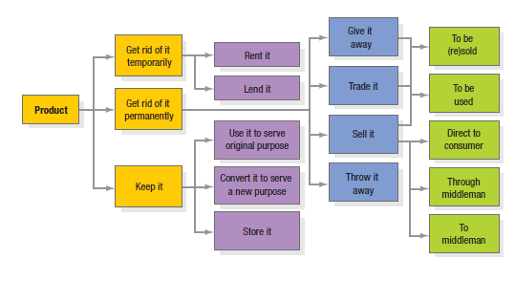
Figure 6.7 How Customers
Use or Dispose of Products
Notes:
Marketers should also monitor how buyers use and dispose of the product (Figure 6.7). A key driver of sales frequency is product consumption rate—the more quickly buyers consume a product, the sooner they may be back in the market to repurchase it. Consumers may fail to replace some products soon enough because they overestimate product life. One strategy to speed replacement is to tie the act of replacing the product to a certain holiday, event, or time of year.

Slide 35

Low-Involvement Decision Making
Notes:
The elaboration likelihood model, an influential model of attitude formation and change, describes how consumers make evaluations in both low- and high-involvement circumstances. There are two means of persuasion in their model: the central route, in which attitude formation or change stimulates much thought and is based on the consumer’s diligent, rational consideration of the most important product information; and the peripheral route, in which attitude formation or change provokes much less thought and results from the consumer’s association of a brand with either positive or negative peripheral cues. Peripheral cues for consumers include a celebrity endorsement, a credible source, or any object that generates positive feelings. Consumers follow the central route only if they possess sufficient motivation, ability, and opportunity. We buy many products under conditions of low involvement and without significant brand differences.

Slide 36
Decision Heuristics
Availability
Representativeness
Anchoring and adjustment
Notes:
The availability heuristic—Consumers base their predictions on the quickness and ease with which a particular example of an outcome comes to mind. If an example comes to mind too easily, consumers might overestimate the likelihood of its happening. The representativeness heuristic—Consumers base their predictions on how representative or similar the outcome is to other examples. The anchoring and adjustment heuristic—Consumers arrive at an initial judgment and then adjust it based on additional information.

Slide 37
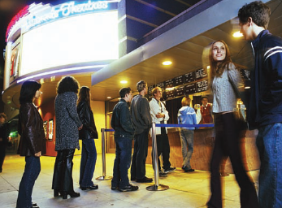
Framing
Notes:
Decision framing is the manner in which choices are presented to and seen by a decision maker. A $200 cell phone may not seem that expensive in the context of a set of $400 phones but may seem very expensive if those phones cost $50. Framing effects are pervasive and can be powerful. Marketers can influence consumer decision making through what they call the choice architecture—the environment in which decisions are structured and buying choices are made. According to these researchers, in the right environment, consumers can be given a “nudge” via some small feature in the environment that attracts attention and alters behavior.

Slide 38
Mental Accounting
Consumers tend to…
  Segregate gains
  Integrate losses
  Integrate smaller losses with larger gains
  Segregate small gains from large losses
Notes:
Mental accounting is based on a set of core principles:
1. Consumers tend to segregate gains. When a seller has a product with more than one positive dimension, it’s desirable to have the consumer evaluate each dimension separately. Listing multiple benefits of a large industrial product, for example, can make the sum of the parts seem greater than the whole.
2. Consumers tend to integrate losses. Marketers have a distinct advantage in selling something if its cost can be added to another large purchase. House buyers are more inclined to view additional expenditures favorably given the high price of buying a house.
3. Consumers tend to integrate smaller losses with larger gains. The “cancellation” principle might explain why withholding taxes from monthly paychecks is less aversive than large, lump-sum tax payments—the smaller withholdings are more likely to be absorbed by the larger pay amount.
4. Consumers tend to segregate small gains from large losses. The “silver lining” principle might explain the popularity of rebates on big-ticket purchases such as cars. The principles of mental accounting are derived in part from prospect theory. Prospect theory maintains that consumers frame their decision alternatives in terms of gains and losses according to a value function. Consumers are generally loss-averse. They tend to overweight very low probabilities and underweight very high probabilities.

Slide 39
For Review
How do consumer characteristics influence buying behavior?
What major psychological processes influence consumer responses to the marketing program?
How do consumers make purchasing decisions?
In what ways do consumers stray from a deliberate rational decision process?
Notes:
This chapter addressed four key questions, shown in the slide.

